Slide 1
ADS336 Design Thinking
UNIT-4a
Academic Year: 2026-2027[ODD]

Slide 2
UNIT-4: Prototype & Test – Iterative Design
Syllabus
Creating prototypes to visualize and communicate solutions.
Iterative design process: Testing, feedback, and refinement.
Rapid prototyping techniques: Paper prototypes, digital mock-ups, and wireframes.
Conducting user testing and incorporating feedback for design improvement.

Slide 3
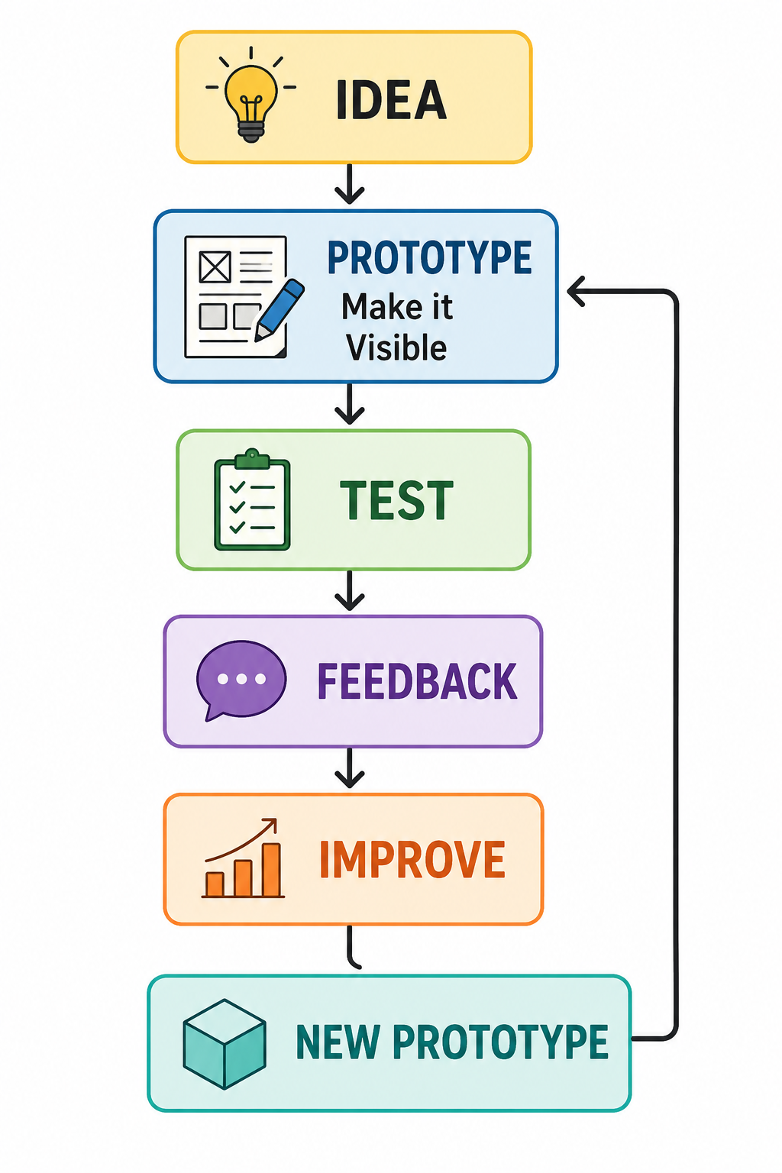
I. Creating prototypes to visualize and communicate solutions
Basic Idea
A prototype is an early representation of a solution that helps designers visualize ideas, test assumptions, communicate concepts, and collect feedback before developing the final product.
In Design Thinking, prototyping transforms an abstract idea into something that people can see, touch, experience, or interact with.

Slide 4
In Design Thinking, prototyping is the process of creating a simple representation of an idea or solution so that it can be visualized, communicated, explored, and tested.
A prototype does not have to be a finished product. It is created to answer questions such as:
  How will the solution work?
  How will the user interact with it?
  Is the idea easy to understand?
  What problems might users face?
  What improvements are required?
Basic Concept
Problem → Idea → Prototype → Feedback → Improvement → Solution

Slide 5
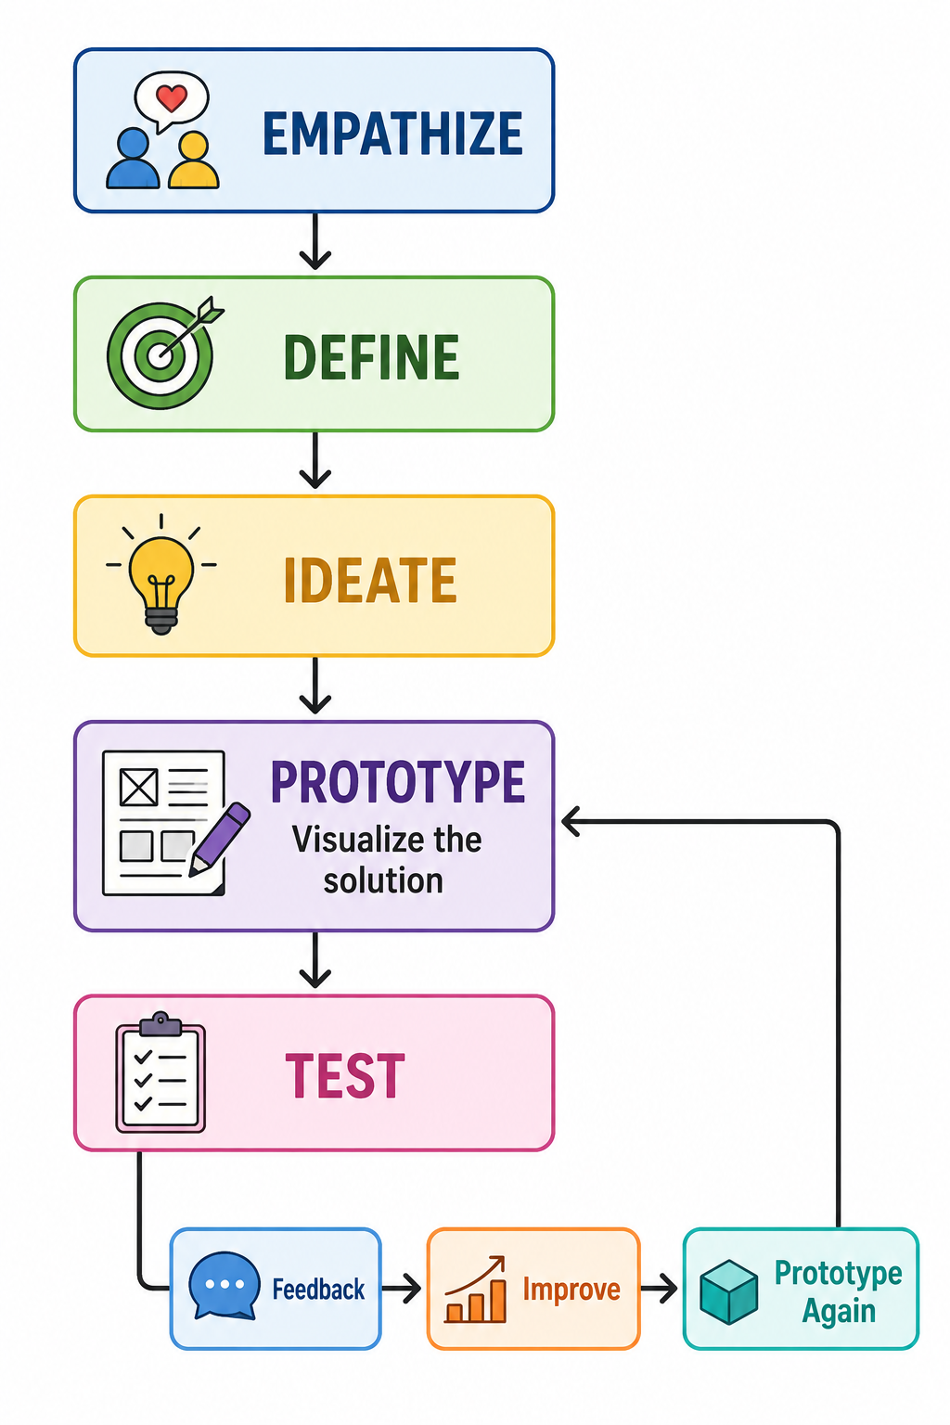
Position of Prototyping in Design Thinking
Prototyping is an important stage in the Design Thinking process.
(refer previous unit)

Slide 6
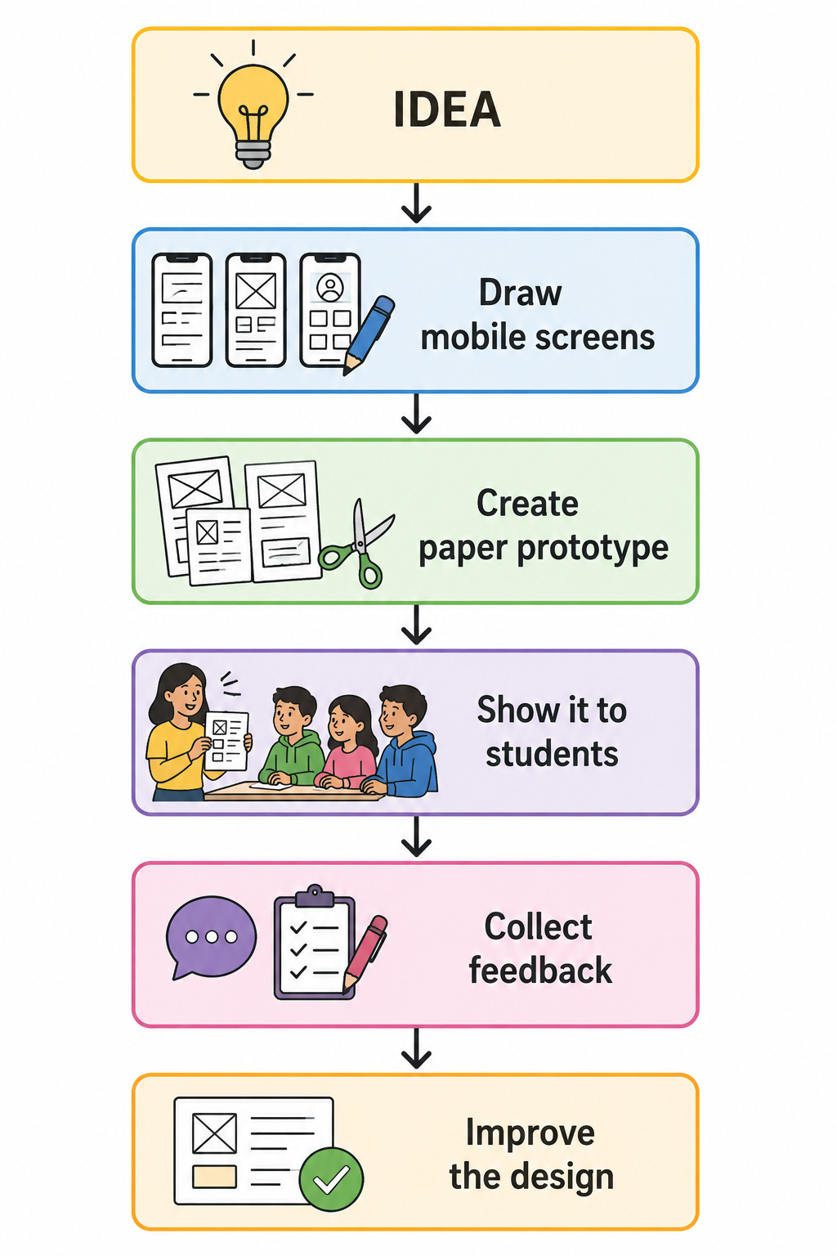
Example
Problem: Students often forget assignment deadlines.
Idea: Develop a mobile application that reminds students about upcoming deadlines.
Instead of immediately developing the complete app:

Slide 7
Why Do We Create Prototypes?
Prototypes help designers answer important questions early.
A prototype can help us:
  Visualize an idea.
  Communicate the solution to others.
  Identify design problems.
  Test assumptions.
  Understand user interaction.
  Gather feedback.
  Improve the solution.
  Reduce the risk of developing an unsuitable final product.

Slide 8
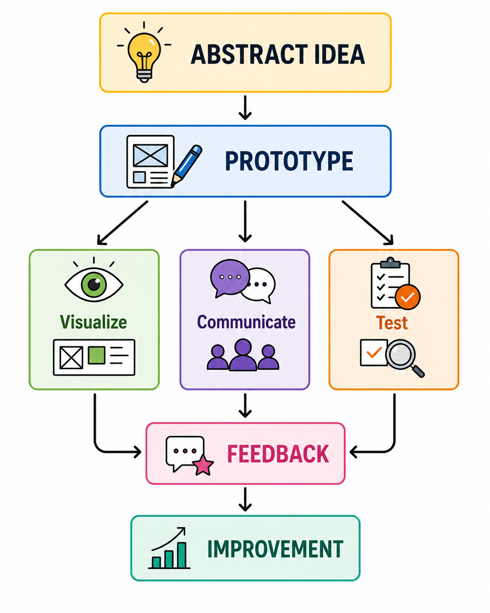
Diagram: From Idea to Understanding

Slide 9
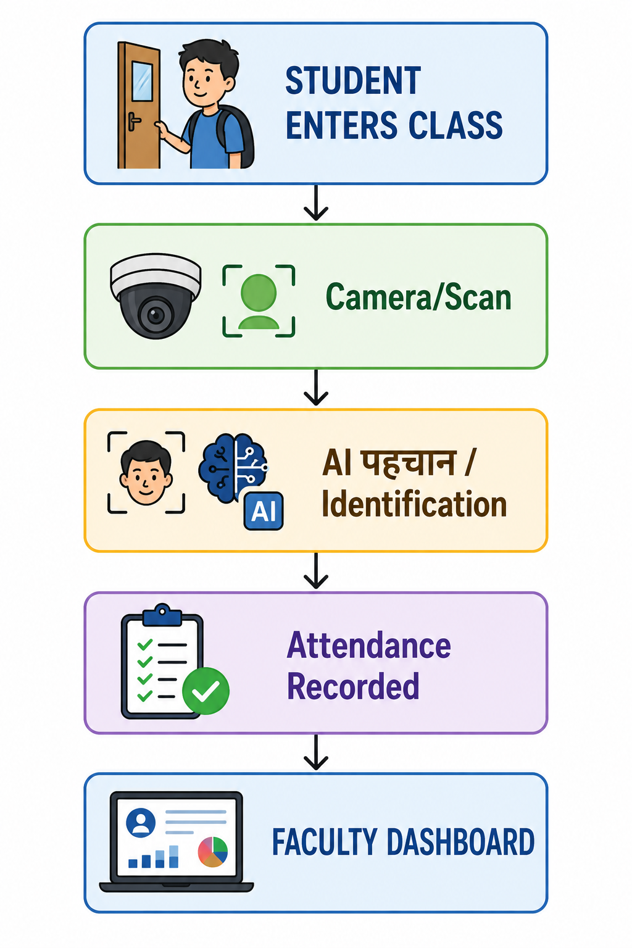
Prototyping to Visualize Solutions
Sometimes an idea exists only in the designer's mind. Different people may imagine the idea differently.
A prototype makes the idea visible and concrete.
Example: Smart Classroom Attendance System
Suppose a team proposes:
"We will create an AI-based smart attendance system."
This statement alone does not clearly explain how the system works.
A prototype can visualize the process.
Now the idea becomes easier to understand and discuss.

Slide 10
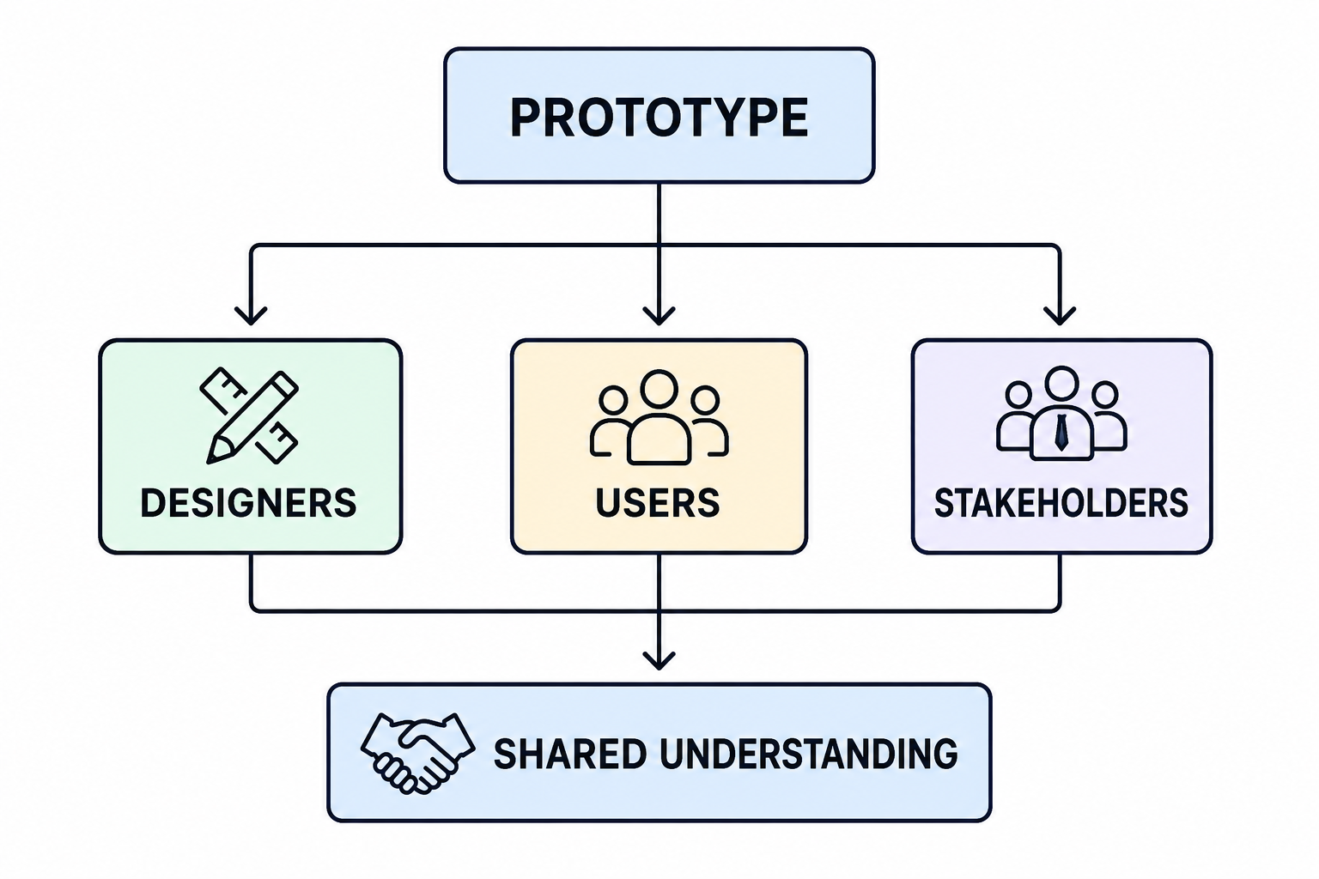
Prototyping to Communicate Solutions
A prototype acts as a common language between:
Instead of explaining:
"Imagine a dashboard with three sections, notifications, progress indicators, and recommendation features..."
The designer can simply show the prototype.
This makes communication:
Faster
Clearer
More interactive
Easier to evaluate

Slide 11
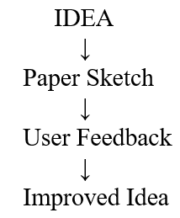
Levels of Prototypes
Prototypes can be developed at different levels of detail and functionality, depending on what the designer wants to communicate or test.
1. Low-Fidelity Prototype
A simple and quick representation of an idea.
Examples:
Paper sketches
Hand-drawn screens
Storyboards
Simple wireframes
Paper models
Purpose:
To explore ideas, structure, and basic user flow.

Slide 12
2. Medium-Fidelity Prototype
A more structured representation with greater detail, but without complete functionality.
Examples:
Digital wireframes
Detailed screen layouts
Basic clickable interfaces
More realistic mockups
Purpose:
To test navigation, layout, interaction, and user flow.
Example:
Login → Home → Search → Results → Details

Slide 13
3. High-Fidelity Prototype
A detailed and realistic representation that closely resembles the final product.
Examples:
Interactive application prototype
Fully designed website prototype
Functional product model
Advanced digital prototype
Purpose:
To test usability, interactions, visual design, and near-real functionality.
Key Point
Low fidelity → "What should we build?"
Medium fidelity → "How should it work?"
High fidelity → "Does it work well for the user?"

Slide 14
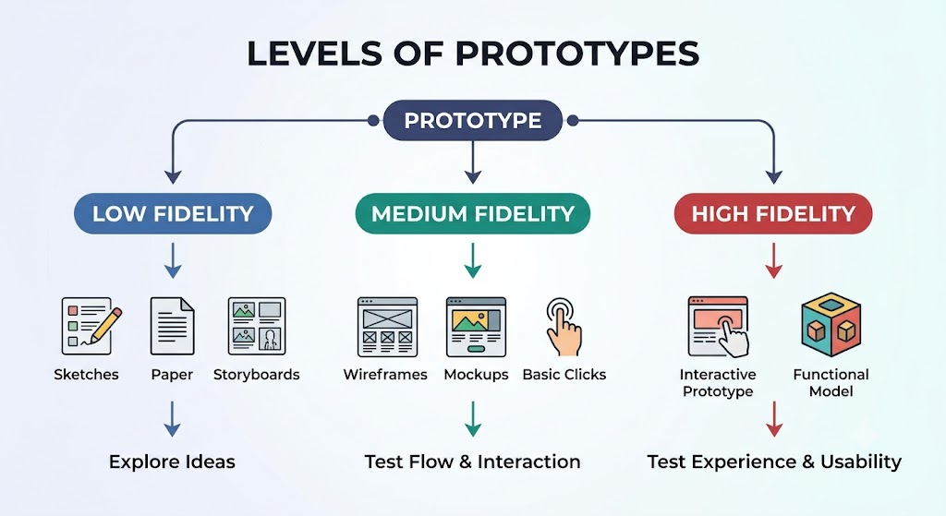

Slide 15
Examples
Prototype Type | Example
Sketch | Hand-drawn mobile screen
Paper Prototype | Paper buttons and screens
Storyboard | Sequence showing user interaction
Wireframe | Basic digital screen layout
Mockup | Detailed visual representation
Clickable Prototype | Interactive screens
Functional Prototype | Working version of selected features

Slide 16
Comparison
Level | Detail | Cost | Time | Main Purpose
Low-Fidelity | Low | Low | Short | Explore ideas
Medium-Fidelity | Moderate | Moderate | Moderate | Test structure & interaction
High-Fidelity | High | Higher | Longer | Test realistic experience

Slide 17
Prototype Fidelity Should Match the Learning Goal
A common mistake is assuming that every prototype must be highly detailed.
Instead, ask: “What do we want to learn?”
Build only enough of the prototype to answer the question you are trying to investigate.
Learning Goal | Suitable Prototype
Explore an idea | Sketch
Understand user journey | Storyboard
Test layout | Wireframe
Evaluate appearance | Mockup
Test navigation | Clickable prototype
Test physical size | Physical model
Test functionality | Functional prototype

Slide 18
Classroom Activity: Low-Fidelity Prototype Challenge
Problem Statement:
Students often waste time searching for available classrooms, laboratories, or study spaces on campus. Design a solution that helps students quickly identify and locate an available space.
Task: Form teams of 4–5 students.
Each team should:
  Understand the problem.
  Identify the user's needs.
  Generate possible solutions.
  Select one solution.
  Create a low-fidelity prototype.
  Explain how the user interacts with it.
  Present it to another team.
  Collect feedback.
  Improve the prototype.
Materials
A4 sheets
Chart paper
Sticky notes
Pens
Markers
Scissors
Tape/glue

Slide 19
II. Iterative design process: Testing, feedback, and refinement
In Design Thinking, designing a product, service, system, or solution is not a one-time activity. A designer rarely develops the perfect solution on the first attempt. Instead, the solution is tested, evaluated, improved, and tested again. This continuous cycle is called the iterative design process.
Iterative design is a systematic process of repeatedly testing a design, collecting feedback, identifying problems, making improvements, and testing the improved design until it better satisfies the needs of users.
The three major activities are:
Testing – checking how well a proposed solution works with users.
Feedback – collecting observations, opinions, difficulties, and suggestions from users and stakeholders.
Refinement – modifying and improving the solution based on the feedback.

Slide 20
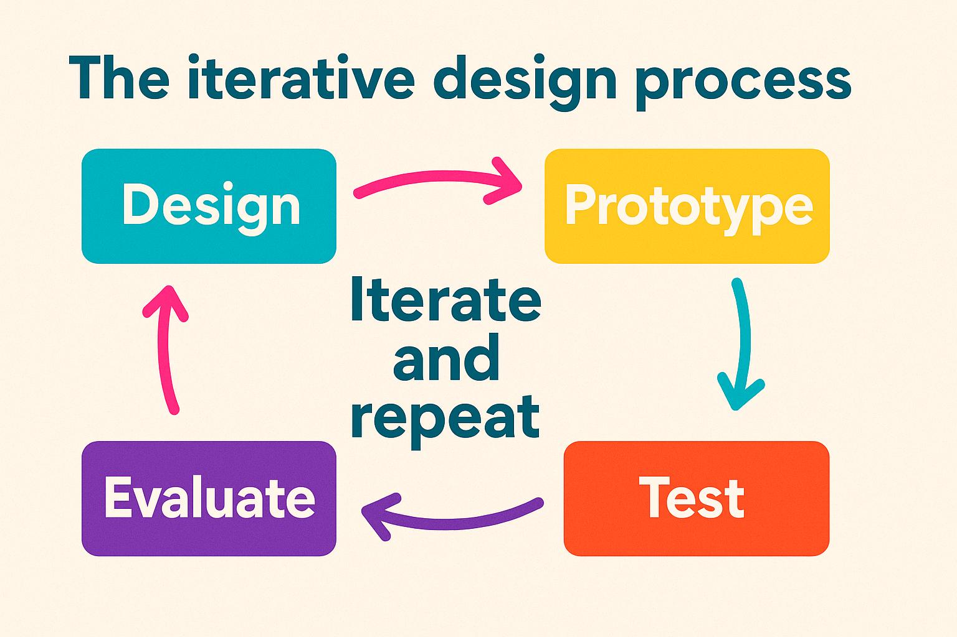
Basic idea:
Design → Prototype → Test → Feedback → Refine → Retest → Improved Solution

Slide 21
Meaning of Iterative Design
The word iteration means repeating a process to achieve improvement.
In design thinking, an initial idea is treated as a starting point rather than a final answer. Designers create a prototype, expose it to users, learn from the users' experiences, make changes, and repeat the process.
Definition:
Iterative design is an approach in which a design is repeatedly developed, tested, evaluated, and modified based on user feedback.
The purpose is not simply to find errors. It is to develop a solution that is:
  Useful
  Usable
  Desirable
  Feasible
  Effective
  Suitable for the target users

Slide 22
Why Is Iteration Important in Design Thinking?
Iteration is important because designers often make assumptions about what users need. Some of these assumptions may be incorrect.
For example, a designer may think:
"Users need more features."
After testing, users may actually say:
"There are too many features. The product is confusing."
The testing process reveals the difference between what designers assume and what users actually experience.

Slide 23
Importance of iteration
1. Identifies problems early
Testing a prototype can reveal usability problems before the final product is developed.
2. Reduces the risk of failure
Instead of investing heavily in an untested idea, designers experiment with small prototypes.
3. Improves user satisfaction
Users directly influence the improvement of the solution.
4. Encourages learning
Every test provides new information about the problem and the proposed solution.
5. Challenges assumptions
Testing helps determine whether the designer's assumptions are correct.
6. Produces better solutions
Repeated improvement generally results in a solution that is more closely aligned with user needs.
7. Supports innovation
Designers can experiment with different alternatives instead of becoming attached to the first idea.

Slide 24
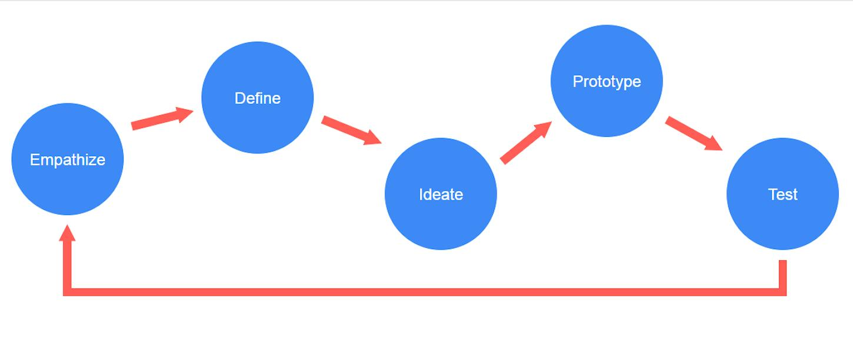
Iterative Design in the Design Thinking Process
A commonly used Design Thinking process consists of:
Empathize → Define → Ideate → Prototype → Test
Iteration is particularly visible between the Prototype and Test stages, but it can actually occur throughout the entire process.

Slide 25
For example:
Empathize
↓
Understand users
Define
↓
Identify the problem
Ideate
↓
Generate possible solutions
Prototype
↓
Create an initial version
Test
↓
Observe users
Feedback
↓
Identify problems and opportunities
Refine
↓
Improve the prototype
Retest
↓
Check whether the changes worked
The process can then move backward to an earlier stage if testing reveals that the problem itself was incorrectly defined.

Slide 26
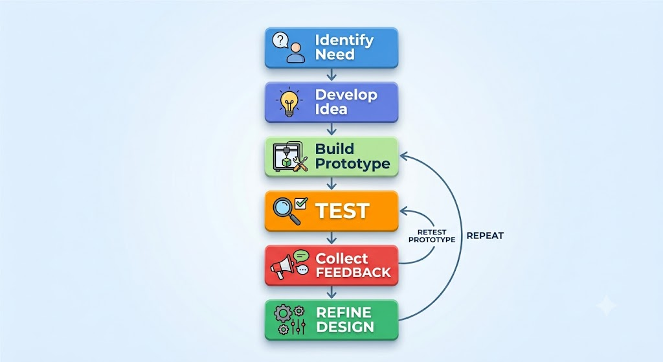
The Iterative Design Cycle
A simple iterative design cycle can be represented as:
The output of one iteration becomes
the input for the next iteration.

Slide 27
Stage 1: Testing
Testing is the process of exposing a prototype or proposed solution to real or representative users to determine how well it meets their needs.
Testing helps answer questions such as:
  Can users understand the solution?
  Can users use it without difficulty?
  Does it solve the intended problem?
  Where do users experience confusion?
  What features work well?
  What needs improvement?
  Does the solution meet user expectations?
Testing should be performed as early as possible because discovering a problem early is usually less costly than discovering it after the final product is developed.

Slide 28
Objectives of Testing
The major objectives of testing are:
1. Validate the design
Determine whether the proposed solution actually addresses the identified problem.
2. Identify usability problems
Find areas where users struggle, become confused, or make mistakes.
3. Understand user behaviour
Observe what users actually do, rather than relying only on what they say.
4. Evaluate assumptions
Determine whether assumptions made during ideation and prototyping are correct.
5. Compare alternatives
Test different versions of a solution and determine which performs better.
6. Discover unexpected needs
Users may reveal requirements that designers did not initially consider.

Slide 29
Types of Testing
A. Usability Testing
Users are asked to perform specific tasks using the prototype.
Example
For a mobile banking application:
"Transfer ₹1,000 to another account."
The designer observes:
How quickly the user completes the task
Where the user hesitates
Whether the user makes errors
Whether instructions are clear

Slide 30
B. User Interviews
Users are asked questions about their experience with the prototype.
Example questions:
  What did you like?
  What was difficult?
  What was confusing?
  What would you change?
  What feature was most useful?
C. Observation
The designer observes users interacting with the product or service.
Observation is important because users may not always be able to explain why they experience a problem.
D. A/B Testing
Two versions of a design are presented to different groups of users.
For example:
  Version A: "Buy Now"
  Version B: "Purchase"
The designer compares user responses or behaviour.

Slide 31
E. Prototype Testing
A low-fidelity or high-fidelity prototype is tested before full development.
Examples include:
  Paper prototypes
  Wireframes
  Clickable interfaces
  Physical models
  Role-playing
  Storyboards
F. Field Testing
The solution is tested in the environment where it will actually be used.
For example, a public transportation application could be tested by passengers during actual travel.

Slide 32
Principles of Effective Testing
Good testing should be:
User-centred
Test with actual or representative users rather than only designers.
Objective
Designers should avoid influencing users toward a particular answer.
Task-oriented
Users should be given realistic tasks.
Observational
Designers should observe behaviour, not just collect opinions.
Repeated
One test is rarely sufficient.
Evidence-based
Design decisions should be based on evidence collected during testing.

Slide 33
Stage 2: Feedback
Feedback is information obtained from users, stakeholders, observations, measurements, and testing results about the strengths and weaknesses of a design.
Feedback answers:
What is working, what is not working, and what should change?
Feedback can be:
  Positive
  Negative
  Neutral
  Quantitative
  Qualitative

Slide 34
Sources of Feedback
Feedback can come from many sources.
Source | Example
Users | Comments about difficulty using a product
Customers | Satisfaction or complaints
Designers | Design observations
Developers | Technical limitations
Stakeholders | Business requirements
Experts | Professional evaluation
Support teams | Frequently reported problems
Analytics | Usage and drop-off data

Slide 35
Qualitative and Quantitative Feedback
a) Qualitative Feedback
Qualitative feedback describes experiences, opinions, emotions, and reasons.
Example:
"I don't understand what this button does."
It explains why a problem occurs.
Methods
  Interviews
  Open-ended questions
  Observation
  Focus groups
  User comments
b) Quantitative Feedback
Quantitative feedback is expressed using numbers and measurable data.
Examples:
80% of users completed the task.
Average task completion time = 45 seconds.
6 out of 10 users made an error.
Customer satisfaction score = 4.2/5.
Quantitative data helps measure how much or how often something happens.

Slide 36
Good Feedback vs. Poor Feedback
Poor feedback
"The app is bad."
This is too general.
Useful feedback
"Seven out of ten users could not find the payment-history option within one minute."
This identifies:
  The problem
  The frequency
  The affected users
  A measurable situation
Therefore, good feedback should be:
Specific + Relevant + Evidence-based + Actionable

Slide 37
Stage 3: Refinement
Refinement is the process of modifying and improving a design based on evidence obtained through testing and feedback.
Refinement may involve:
  Removing unnecessary features
  Adding missing features
  Changing the interface
  Simplifying instructions
  Improving accessibility
  Changing the physical form
  Improving functionality
  Changing the sequence of tasks
  Correcting errors
  Improving visual design

Slide 38
Example of Refinement
Suppose a designer develops an online food-ordering application.
Initial design
The home screen contains:
15 categories
10 promotional banners
Multiple navigation buttons
Several pop-up messages
Testing result
Users report: "There is too much information and I don't know where to start."
Feedback
The main problem is information overload.

Slide 39
Refinement
The designer:
Reduces the number of categories
Removes unnecessary banners
Highlights search
Simplifies navigation
Places frequently ordered items prominently
Retesting
Users now find restaurants more quickly.
This demonstrates:
Test → Feedback → Refine → Retest

Slide 40
The Complete Iterative Process
Step 5: Collect evidence
Record:
  Errors
  Completion time
  User comments
  Behaviour
  Satisfaction
  Confusion
  Suggestions
Step 6: Analyse feedback
Identify patterns and major problems.
Step 7: Prioritize problems
Not every problem needs to be fixed immediately.
Step 8: Refine the design
Modify the prototype based on important findings.
Step 9: Retest
Test the improved version with users.
Step 10: Repeat
Continue until the solution meets the required goals.
The process can be divided into the following steps.
Step 1: Establish the design goal
Clearly identify what the solution is expected to accomplish.
Step 2: Develop a prototype
Create a representation of the proposed solution.
Step 3: Select users
Choose users who represent the target audience.
Step 4: Conduct testing
Ask users to interact with the prototype or perform realistic tasks.

Slide 41
Prioritizing Feedback
Designers may receive hundreds of comments. They cannot necessarily implement all of them.
Feedback can therefore be classified according to:
Impact
How seriously does the problem affect the user?
Frequency
How many users experience it?
Severity
Does it cause inconvenience, confusion, or complete task failure?
Feasibility
How difficult or expensive is it to fix?
Importance
Does fixing it contribute significantly to the main design objective?

Slide 42
A useful prioritization approach is:
Priority | Description | Action
High | Prevents users from completing important tasks | Fix immediately
Medium | Causes difficulty but users can continue | Improve
Low | Minor inconvenience | Consider later

Slide 43
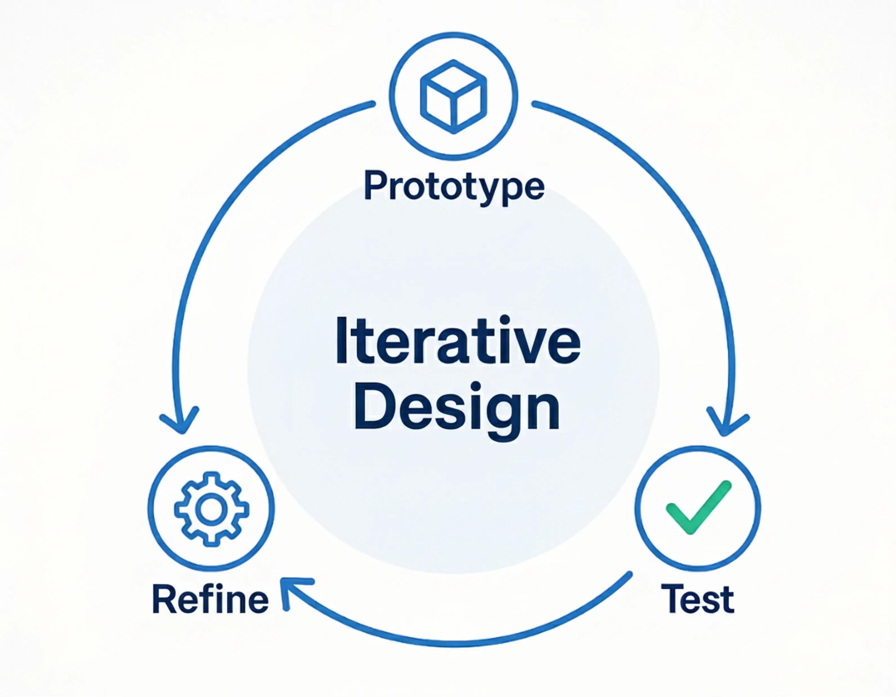
Iteration and Prototyping
Prototyping and iteration are closely connected.
A prototype provides something that users can interact with.
Without a prototype, designers often discuss ideas theoretically.
With a prototype, designers can ask:
"Show me what happens when you use it."
This generates stronger evidence.
Prototype → Test → Learn → Improve

Slide 44
Example: Designing a College Student App
Consider a design team developing an app for college students.
Problem
Students have difficulty finding information about classes, events, and assignments.
First prototype
The team creates a simple mobile interface.
Testing
Students attempt to:
Find today's timetable.
Locate an assignment deadline.
Find a college event.

Slide 45
Findings
Students successfully find events but struggle to locate assignments.
Feedback
Students say: "Assignments should be visible directly on the home screen."
Refinement
The designers add an Upcoming Assignments section to the home screen.
Second test
Students locate assignments more quickly.
Further feedback
Students request notifications for approaching deadlines.
Second refinement
The team introduces deadline notifications.
This creates another iteration.
Iteration 1:
Prototype → Test → Feedback → Improve
Iteration 2:
Improved prototype → Test → Feedback → Improve

Slide 46
Activity
Physical Product Design
Suppose a company is designing a reusable water bottle.
Website Design
Initial assumption
Users want many navigation options.

Slide 47
UNIT-4: Prototype & Test – Iterative Design
Syllabus
Creating prototypes to visualize and communicate solutions.
Iterative design process: Testing, feedback, and refinement.
Rapid prototyping techniques: Paper prototypes, digital mock-ups, and wireframes.
Conducting user testing and incorporating feedback for design improvement.

Slide 48
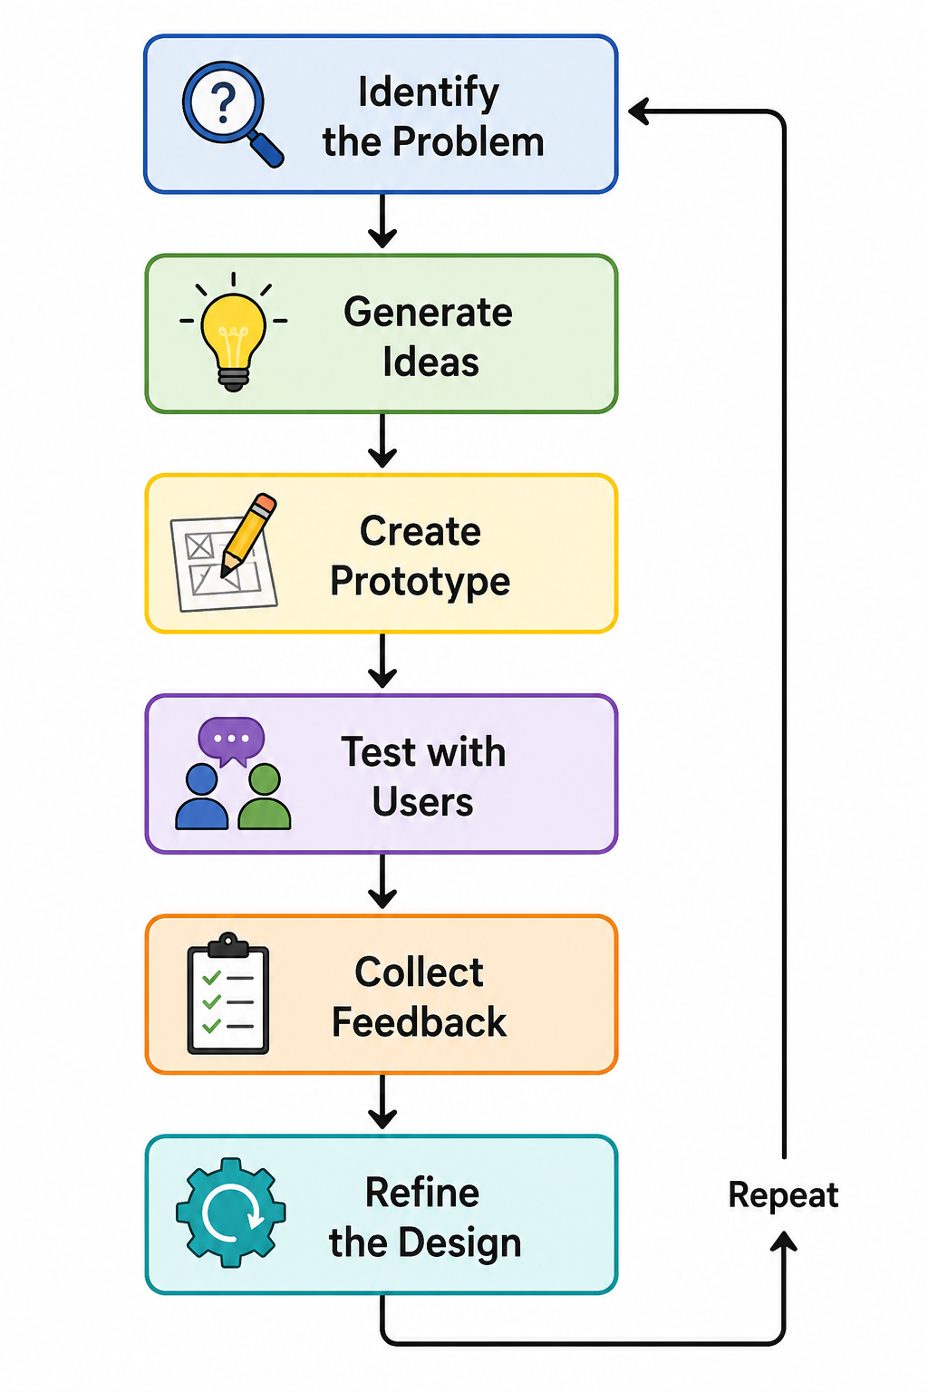
I. Rapid Prototyping techniques
Rapid prototyping is a design technique used to quickly create a simplified version of a product, service, website, or application so that ideas can be visualized, tested, evaluated, and improved before developing the final product.
The main objective is not to build the final product, but to learn quickly from users and identify problems early.
Key idea:
Build → Test → Learn → Improve.

Slide 49
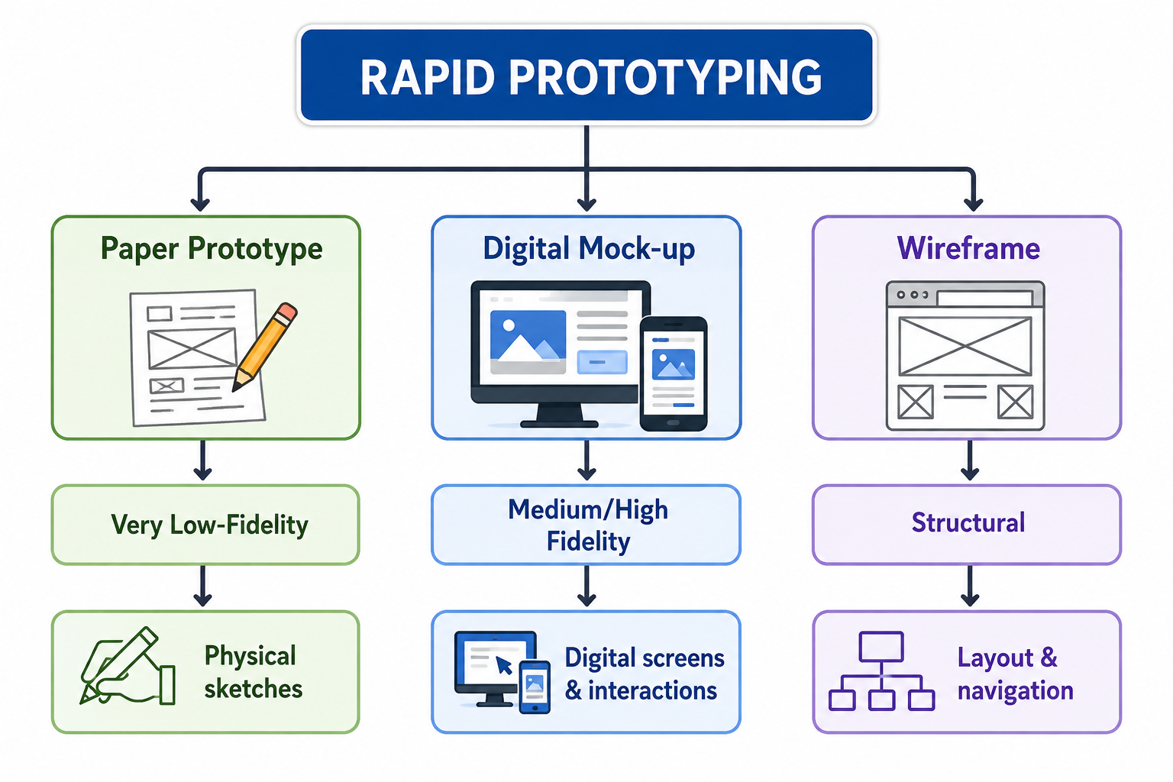
Types of Rapid Prototyping
Three commonly used rapid prototyping techniques are:
Paper Prototype
Digital Mock-up
Wireframe

Slide 50
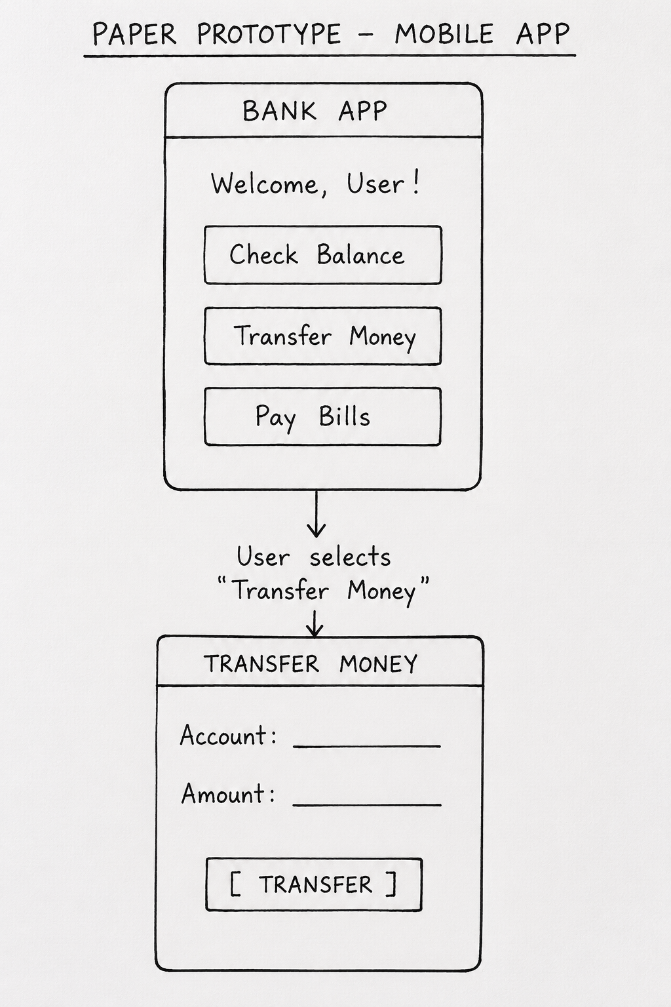
a)Paper Prototypes
A paper prototype is a simple representation of a product or interface created using paper, pencil, sticky notes, cards, or sketches.
It is one of the fastest and least expensive prototyping techniques.
For example, when designing a mobile banking application, each paper sheet can represent a different screen.
The designer can manually replace one paper screen with another when the user "clicks" a button.

Slide 51
Characteristics
Very low cost
Very quick to create
Easy to modify
Does not require programming
Suitable for early-stage ideas
Focuses on functionality and user flow, rather than appearance
Advantages
Low cost – Only paper and stationery are required.
Fast creation – A prototype can be created within minutes.
Easy modification – Elements can be erased, moved, or redrawn.
Encourages creativity – Designers can experiment freely.
Useful for user testing – Users can interact with the prototype.
Reduces development risk – Problems can be identified before coding.

Slide 52
Limitations
Cannot accurately represent complex interactions.
Visual appearance is limited.
Difficult to demonstrate animations.
Not suitable for testing actual software performance.
May appear less realistic to some users.

Slide 53
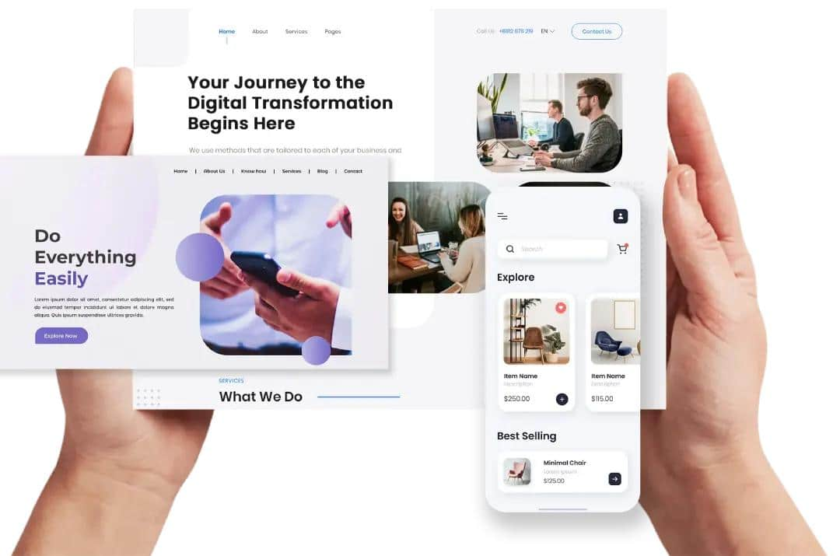
b) Digital Mock-ups
A digital mock-up is a computer-based representation of a product or user interface.
It provides a more realistic representation of how the final product may look.
Digital mock-ups can be created using design and prototyping tools such as Figma, Adobe XD, Sketch, or similar software.

Slide 54
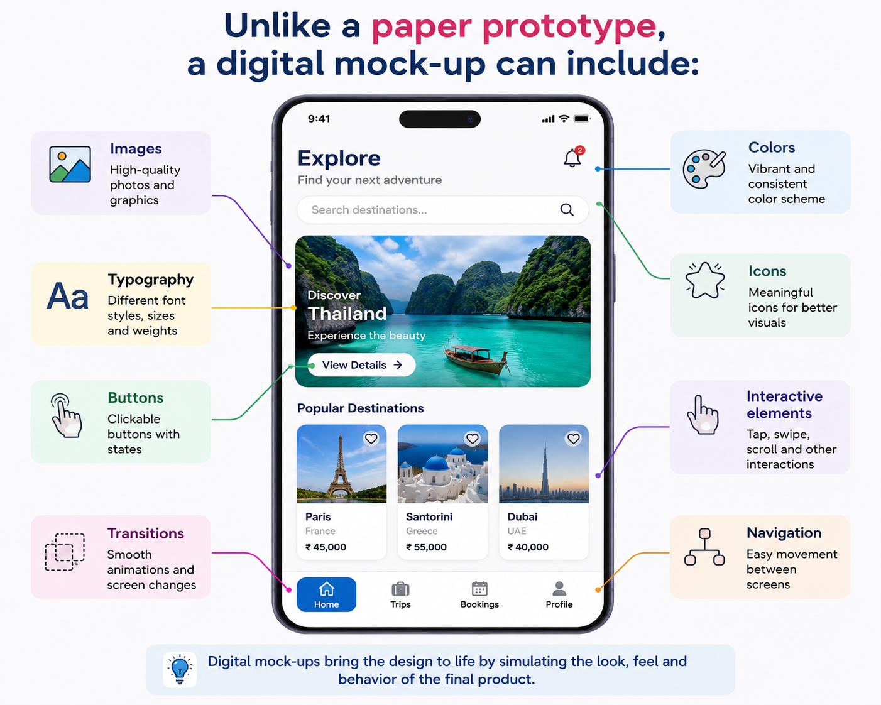
Unlike a paper prototype, a digital mock-up can include:
Images
Colors
Typography
Icons
Buttons
Navigation
Interactive elements
Transitions

Slide 55
Advantages
More realistic than paper prototypes.
Provides better visual representation.
Can demonstrate user interaction.
Easy to share with stakeholders.
Useful for usability testing.
Changes can be made without recreating the entire prototype.
Limitations
Requires software/tools.
Takes more time than paper prototyping.
May require design skills.
Users may focus too much on visual appearance instead of functionality.
High-fidelity mock-ups can create the impression that development is almost complete.

Slide 56
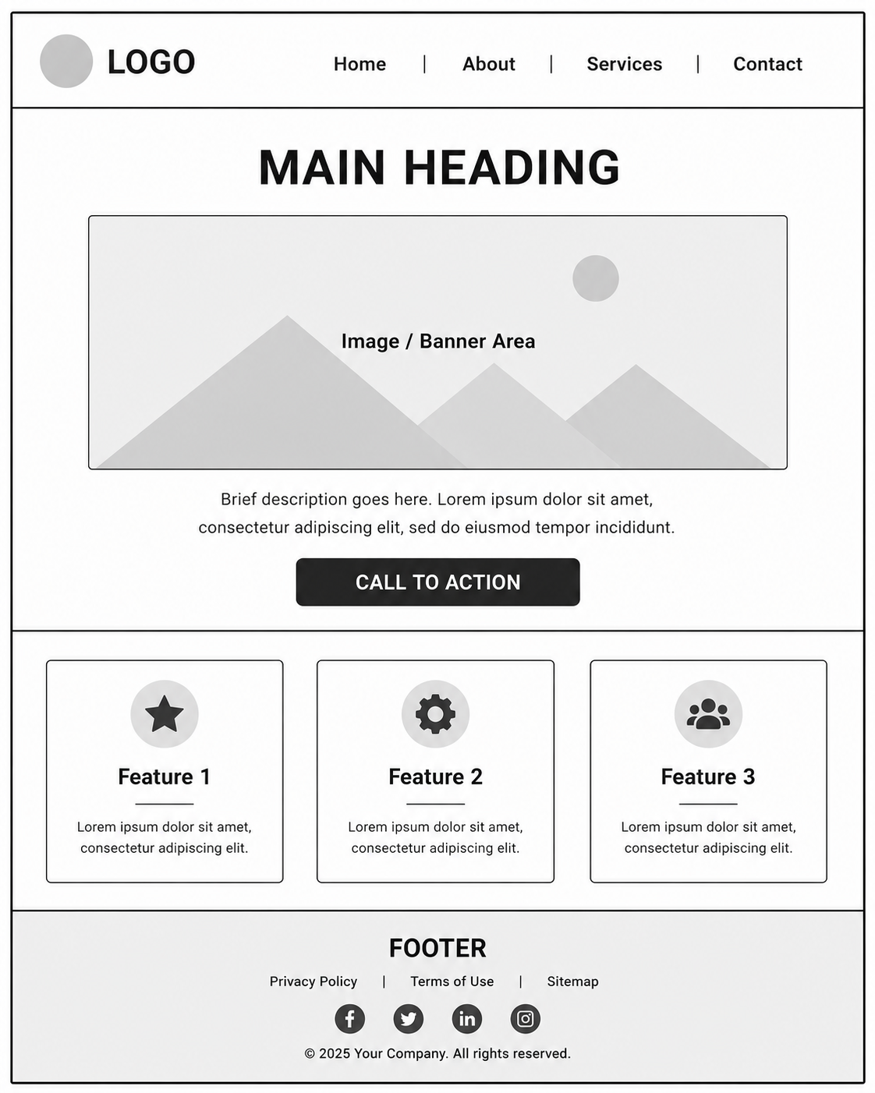
c) Wireframes
A wireframe is a simplified visual representation of the structure, layout, content, and navigation of a website or application.
Wireframes primarily answer:
"Where should each element be placed?"
They generally do not focus on detailed colors, images, animations, or visual styling.
Example: Website Wireframe

Slide 57
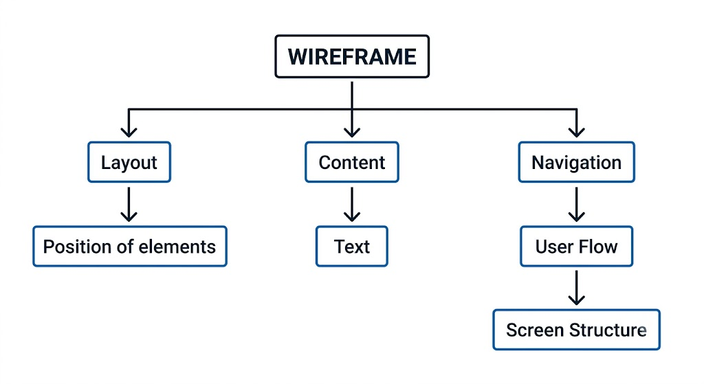
Wireframe Focus

Slide 58
Low-Fidelity vs High-Fidelity Prototypes
Prototypes can be classified according to their level of detail and realism
Feature | Low-Fidelity | High-Fidelity
Detail | Low | High
Cost | Very low | Higher
Creation time | Very short | Longer
Example | Paper sketch | Interactive digital prototype
Colors | Usually limited | Realistic
Interaction | Basic | Advanced
Purpose | Explore ideas | Validate final design
Changes | Very easy | Comparatively harder

Slide 59
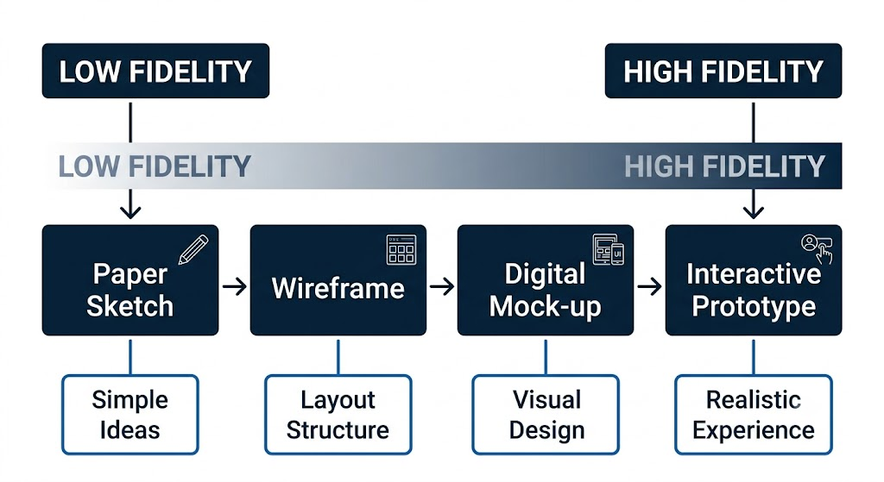
Fidelity spectrum

Slide 60
Comparison of the Three Techniques
Aspect | Paper Prototype | Wireframe | Digital Mock-up
Medium | Paper | Digital/Paper | Digital
Cost | Very Low | Low | Medium
Speed | Very Fast | Fast | Moderate
Detail | Low | Low–Medium | Medium–High
Visual Design | Minimal | Minimal | Detailed
Interaction | Limited | Basic | Can be interactive
Best Used For | Idea exploration | Layout & navigation | Visual & interaction testing
Programming Required | No | No | Usually no
Modification | Very Easy | Easy | Easy
User Testing | Yes | Yes | Yes

Slide 61
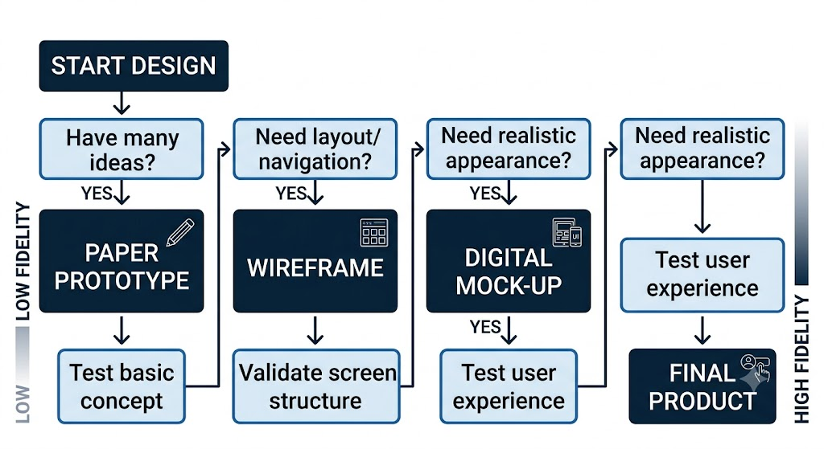
When to Use Each Technique

Slide 62
Benefits of Rapid Prototyping
1. Early Problem Detection
Design problems can be identified before significant development effort is spent.
2. Faster Iteration
Designers can quickly create several alternatives.
3. User Involvement
Users can provide feedback at an early stage.
4. Better Communication
A prototype helps designers explain ideas to developers, clients, and stakeholders.
5. Reduced Cost
Fixing a problem during the design stage is generally less expensive than fixing it after implementation.
6. Improved User Experience
Continuous testing and refinement can produce a product that better satisfies user needs.

Slide 63
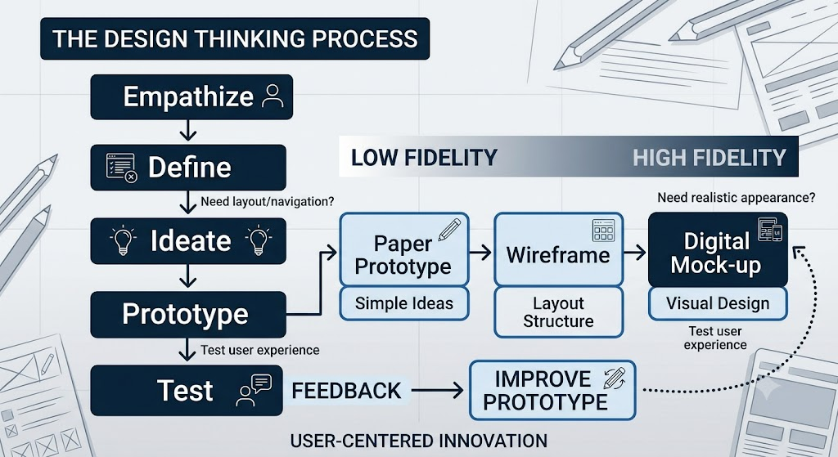
Rapid Prototyping in Design Thinking
Rapid prototyping is strongly connected to the Prototype and Test stages of Design Thinking.

Slide 64
Recap
Rapid Prototyping
A technique for quickly creating an early version of a product or interface.
Used to visualize, test, and refine ideas.
Reduces the risk and cost of developing unsuitable solutions.
Paper Prototype
Created using paper, pencil, cards, or sticky notes.
Very fast and inexpensive.
Best for exploring early concepts and user flows.
Wireframe
Represents the basic structure and layout of an interface.
Focuses on placement, content hierarchy, and navigation.
Usually has minimal visual styling.

Slide 65
Digital Mock-up
Computer-based representation of the proposed interface.
Provides a more realistic visual representation.
Can include colors, images, typography, icons, and interactions.
Paper prototype = What could the idea look like?
Wireframe = Where should everything go?
Digital mock-up = What could the final interface look and behave like?

Slide 66
IV. Conducting user testing and incorporating feedback for design improvement
User testing is a method of evaluating a product, prototype, website, mobile application, or service by observing real or representative users interacting with it.
The purpose is to understand:
  Whether users can complete their tasks.
  Where users face difficulties.
  What users like or dislike.
  Whether the design satisfies user needs.
  What changes are required to improve the design.
User testing means putting a prototype in front of users, observing how they use it, collecting their feedback, and using that feedback to improve the design.

Slide 67
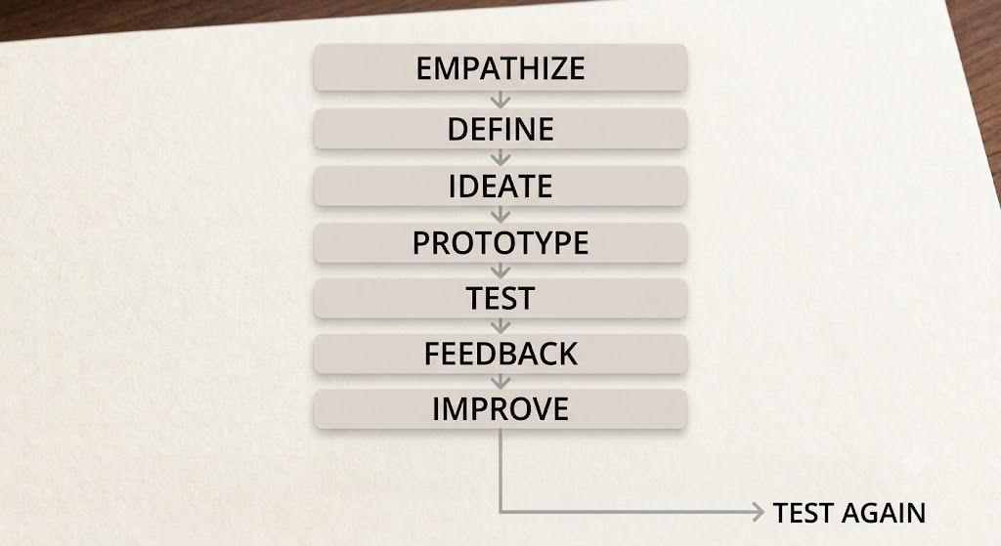
User Testing in the Design Thinking Process
User testing is closely associated with the Test stage of Design Thinking.
User testing is not necessarily the final step.
The results may reveal a new problem, causing the designer to:
Test → Learn → Modify → Prototype → Test again
This makes the design process iterative.

Slide 68
Objectives of User Testing
The major objectives are:
1. Identify usability problems
Find out where users struggle while using the product.
2. Evaluate task completion
Determine whether users can successfully complete important tasks.
3. Understand user behaviour
Observe how users naturally interact with the design.
4. Collect user opinions
Understand what users like, dislike, expect, or find confusing.
5. Validate design assumptions
Check whether the designer's assumptions about users are correct.
6. Improve user experience
Use evidence from testing to make the product easier, clearer, and more useful.

Slide 69
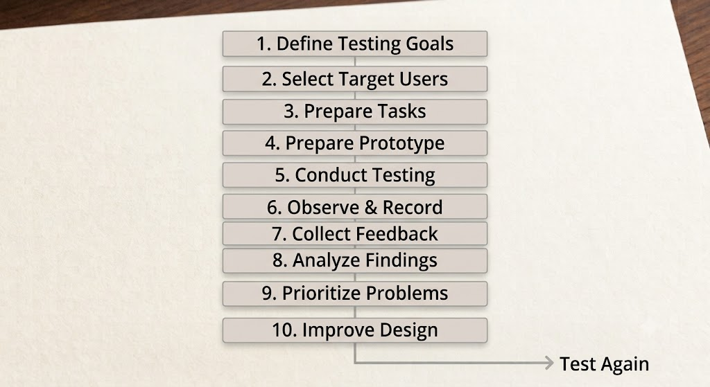
Steps in Conducting User Testing

Slide 70
Step 1 – Define Testing Goals
Before testing, the designer must decide what needs to be evaluated.
Example
For a food-delivery application, testing goals could be:
  Can users search for a restaurant?
  Can users find a particular food item?
  Can users add an item to the cart?
  Can users complete checkout?
  Can users understand the delivery information?
Good Testing Goal
"Determine whether first-time users can successfully place a food order without assistance."
This is better than a vague goal such as: "Test the application."

Slide 71
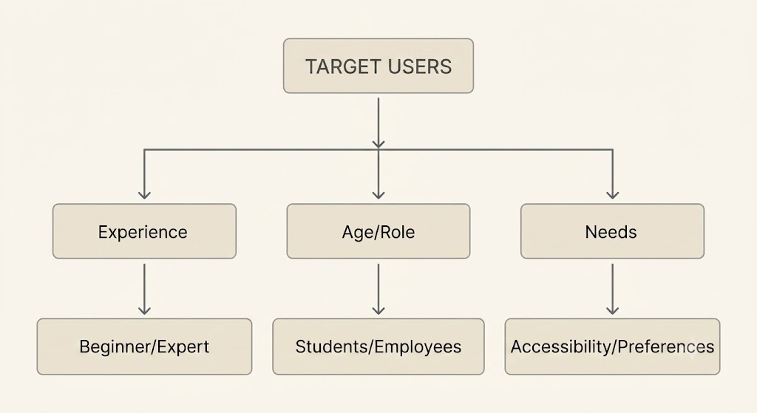
Step 2 – Select Target Users
Users selected for testing should represent the intended target audience.

Slide 72
Example
For a university student-learning application, participants could include:
Undergraduate students
Postgraduate students
Students with different levels of technical experience
Important
Testing with the wrong users can produce misleading feedback.

Slide 73
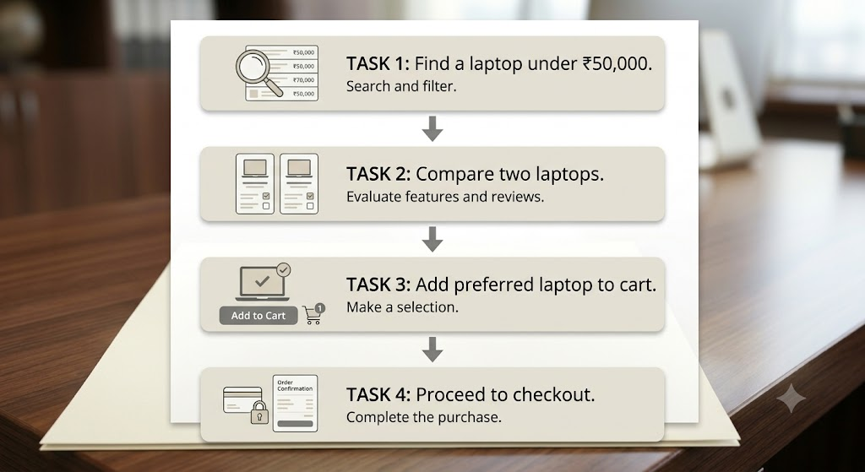
Step 3 – Prepare Testing Tasks
Users should be given specific tasks rather than simply being told to explore the product.
Example: Online Shopping Application

Slide 74
The designer observes whether users can complete these tasks.
Good Task
"You need a laptop for programming. Find a suitable laptop under ₹50,000 and add it to your cart."
Poor Task
"Click around the application."
The first task represents a real-world user goal.

Slide 75
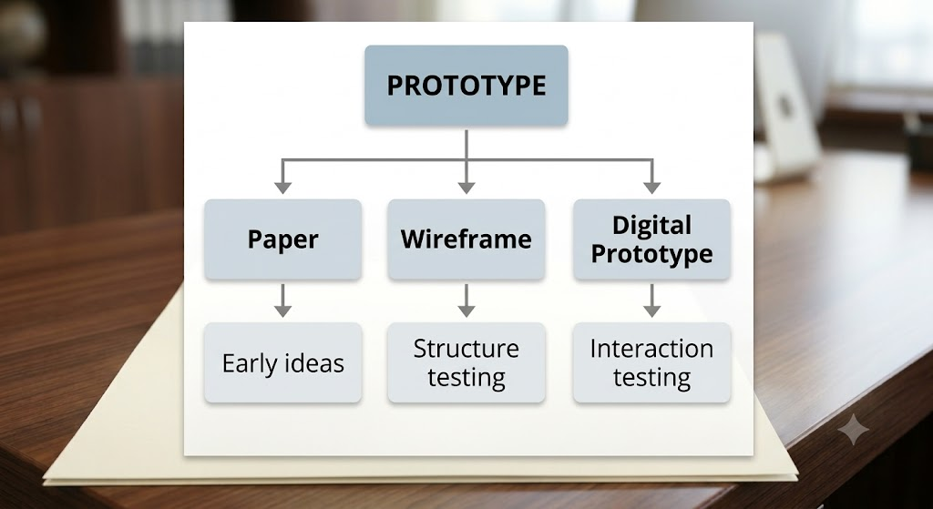
Step 4 – Prepare the Prototype
The prototype used for testing can be:
Paper prototype
Wireframe
Digital mock-up
Interactive prototype
Working application
The prototype should be sufficiently developed to answer the testing questions.

Slide 76
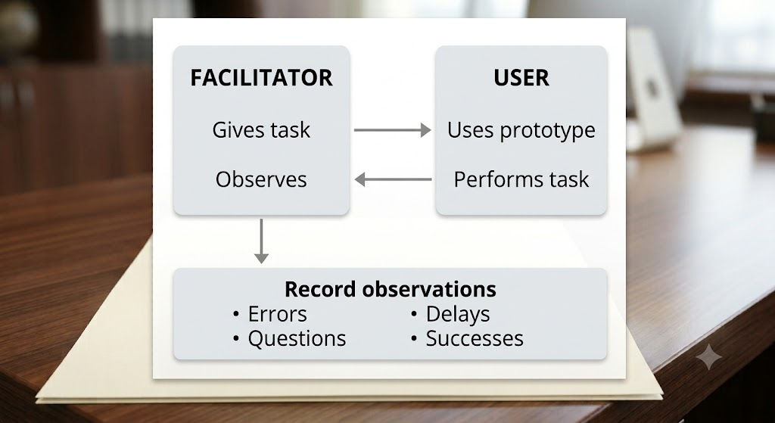
Step 5 – Conduct the Test
Typical Testing Setup
During the test, the facilitator gives the user a task and observes their behaviour.
The facilitator should generally avoid leading the user toward the expected answer.

Slide 77
Step 6 - Observe and Record
What Should Be Observed?
During testing, designers should observe both what users say and what users do.
Important observations:
Observation | Example
Task completion | User successfully completes checkout
Errors | User clicks the wrong button
Time | User takes 3 minutes to find an option
Confusion | User asks where to proceed
Navigation | User repeatedly goes back
Behaviour | User ignores an important button
Emotion | User appears frustrated
Questions | User asks what an icon means

Slide 78
What users do can be more informative than what users say.
For example, a user may say:
"The interface is easy."
But if they repeatedly fail to find the checkout button, there is a usability problem.
Watch carefully how users interact with the prototype.
Record:
  Where they struggle
  Mistakes they make
  Time taken
  Confusing screens
  Questions they ask
  Successful actions
Important: Don't just listen to what users say; also observe what they actually do.

Slide 79
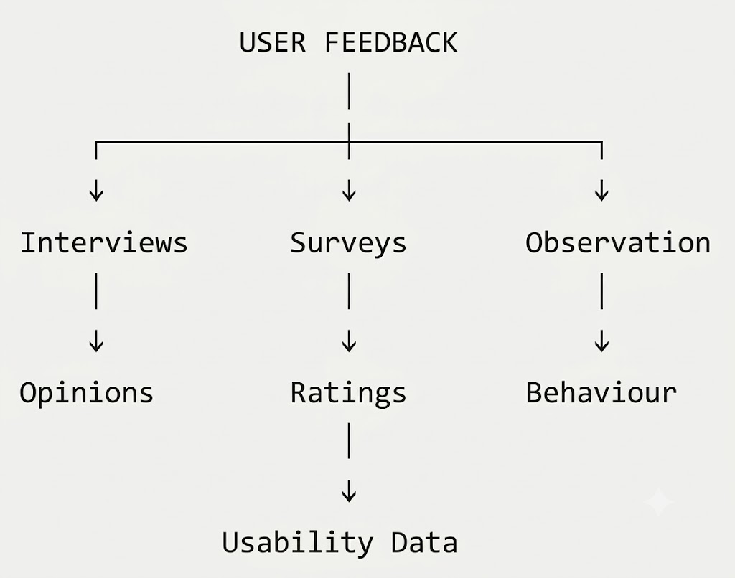
Step 7 – Collect User Feedback
Feedback can be collected using several methods.

Slide 80
Common Methods
A. Interviews
Users are asked questions after completing tasks.
Example:
What did you find difficult?
What did you like?
What would you change?
Was anything confusing?
B. Questionnaires
Users provide ratings and written comments.
Example:
How easy was it to place an order?
Very Difficult 1 2 3 4 5 Very Easy
C. Observation
The designer watches users interact with the product.
D. Think-Aloud Method
Users explain their thoughts while performing a task.
Example: "I am looking for the checkout button, but I don't see it."
This can reveal the user's reasoning and expectations.

Slide 81
Step 8 – Analyze Findings
Raw feedback should be organized into meaningful findings.
Example
Suppose five users test a food-delivery application.
USER TEST RESULTS
User 1 → Could not find Cart
User 2 → Could not find Cart
User 3 → Found Cart easily
User 4 → Could not find Cart
User 5 → Asked where Cart was

Slide 82
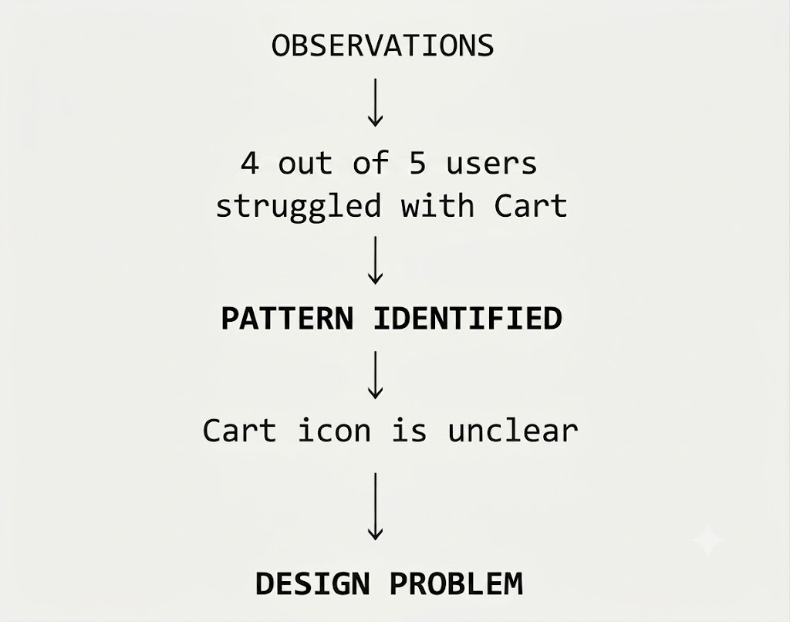
The designer identifies:

Slide 83
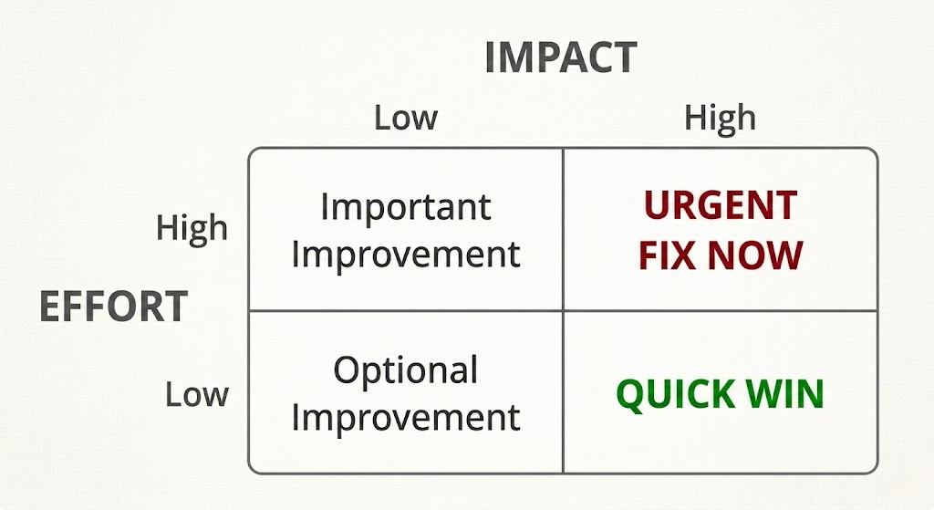
Step 9 –Prioritize Problems
Not every piece of feedback should immediately result in a design change.
Problems should be prioritized.
Priority Matrix

Slide 84
Example
Critical usability problems should be addressed before minor aesthetic preferences.
Problem | Impact | Priority
Checkout button unclear | High | Very High
Font slightly small | Medium | Medium
Background image preference | Low | Low
Payment process fails | Very High | Critical

Slide 85
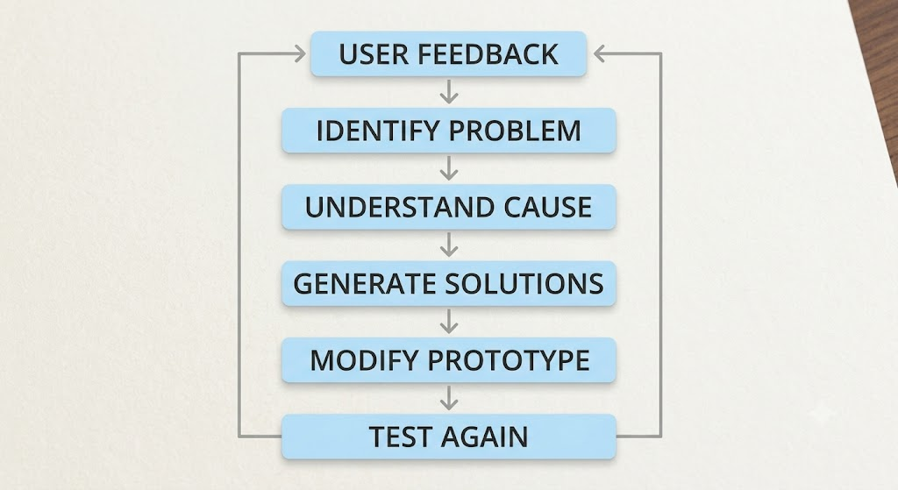
Step 10 – Improve Design: Incorporating Feedback
Feedback should be converted into specific design improvements.

Slide 86
Example
Feedback:
"I couldn't understand what this icon does."
Analysis
The icon does not communicate its function clearly.
Improvement
Replace the unfamiliar icon.
Add a text label.
Improve visual hierarchy.
Test the revised version.

Slide 87
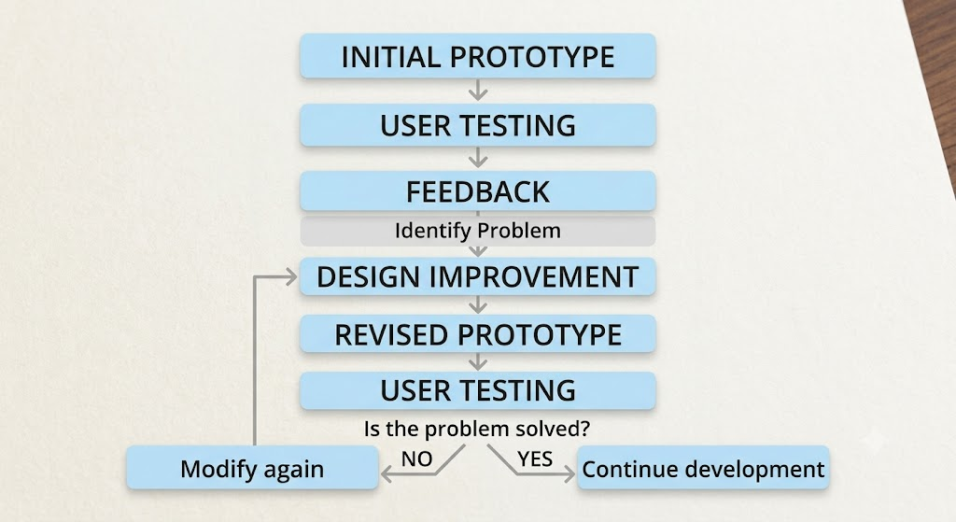
Before-and-After Improvement Cycle

Slide 88
Types of Feedback
Feedback can generally be divided into different categories.
1. Positive Feedback
Indicates what works well.
Example:
"The search feature is very easy to use."
2. Negative Feedback
Identifies problems.
Example:
"I cannot understand the payment process."
3. Suggestive Feedback
Provides an idea for improvement.
Example:
"It would be useful to have a filter for price."
4. Behavioural Feedback
Comes from observing what users actually do.
Example:
Users repeatedly click the logo expecting it to take them to the home page.

Slide 89
Qualitative and Quantitative Feedback
a) Qualitative Feedback
Provides descriptions, opinions, emotions, and explanations.
Examples:
Interviews
Observations
User comments
Open-ended questions
User:
"The checkout page is confusing
because I don't know what to do next."

Slide 90
b) Quantitative Feedback
Provides measurable numerical information.
Examples:
  Task completion rate
  Error rate
  Time taken
  User ratings
  Number of clicks
5 users tested
↓
4 completed task
↓
80% completion rate

Slide 91
Comparison
Qualitative | Quantitative
Descriptive | Numerical
Explains why | Shows how much/how many
Interviews | Surveys
Observations | Completion rate
User comments | Task time
Feelings/opinions | Error count

Slide 92
Principles for Effective User Testing
Principle 1 – Test early
Do not wait until the product is completely developed.
Principle 2 – Test real tasks
Give users tasks that resemble actual usage.
Principle 3 – Observe rather than interfere
Allow users to interact naturally.
Principle 4 – Focus on the user, not the designer
The objective is to discover whether the design works for users.
Principle 5 – Look for patterns
Repeated problems across participants are particularly valuable.
Principle 6 – Prioritize feedback
Focus first on problems with high impact.
Principle 7 – Iterate
Test the revised design again.

Slide 93
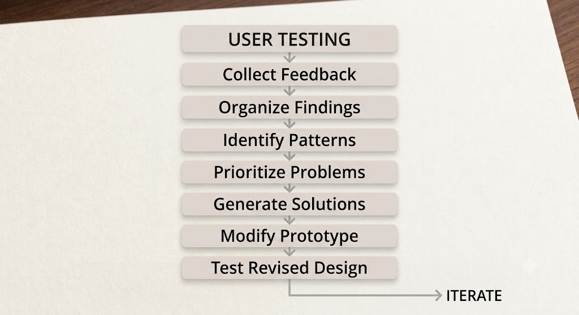
Complete Feedback Incorporation Framework

Slide 94
Recap
Conducting User Testing and Incorporating Feedback
User testing is the process of evaluating a product or prototype by observing representative users performing predefined tasks. The process begins by defining testing objectives, selecting suitable users, preparing realistic tasks, and conducting the test. During testing, designers observe user behaviour, task completion, errors, confusion, and interaction patterns. Feedback can be collected through interviews, questionnaires, observations, and think-aloud sessions.
The collected feedback is then analyzed to identify common usability problems and patterns. Problems are prioritized according to their impact and importance. Appropriate design modifications are made based on the findings, and the revised prototype is tested again. This iterative process of testing, feedback, and refinement helps create a product that is more usable, effective, and aligned with user needs.
Prepare → Test → Observe → Collect Feedback → Analyze → Prioritize → Improve → Test Again

Slide 95
Classroom Activity
“Test It, Fix It!” – Rapid User Testing Challenge
Topic: Conducting User Testing and Incorporating Feedback
Duration: 30–40 minutes
Group size: 4–5 students per group
Objective: Students experience the complete cycle of prototype → user testing → feedback → improvement.
Scenario
Ask each group to choose one everyday problem:
College canteen ordering
Library book search
Student attendance tracking
Campus navigation
Online assignment submission
College bus tracking

