Slide 1
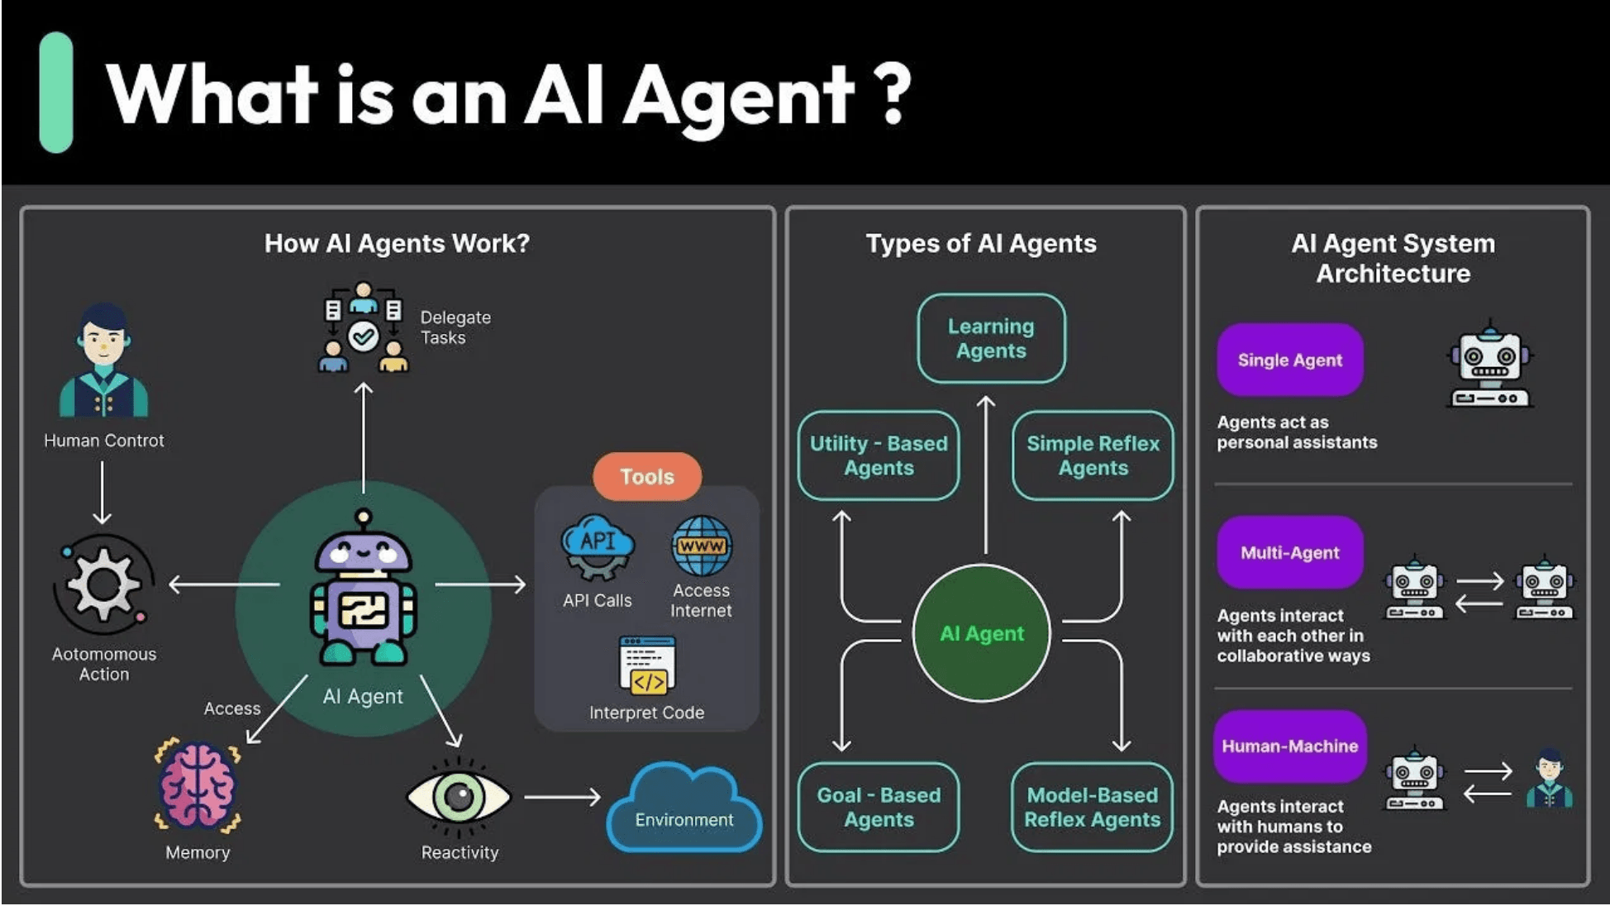
NEXUS.LAB
The Future of Autonomous AI Cognitive Environments

Slide 2

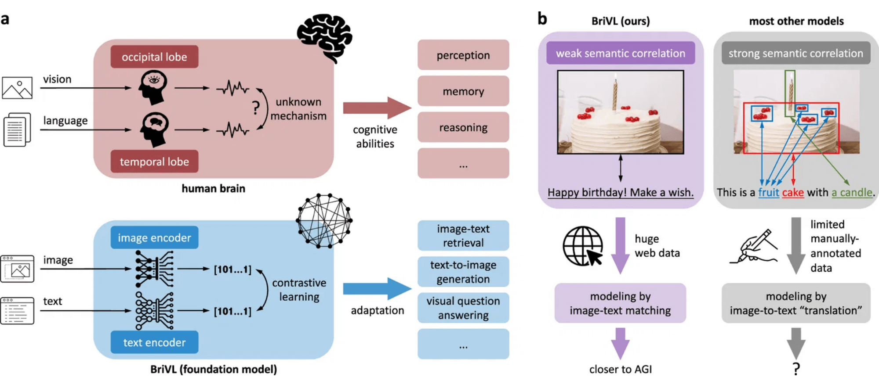
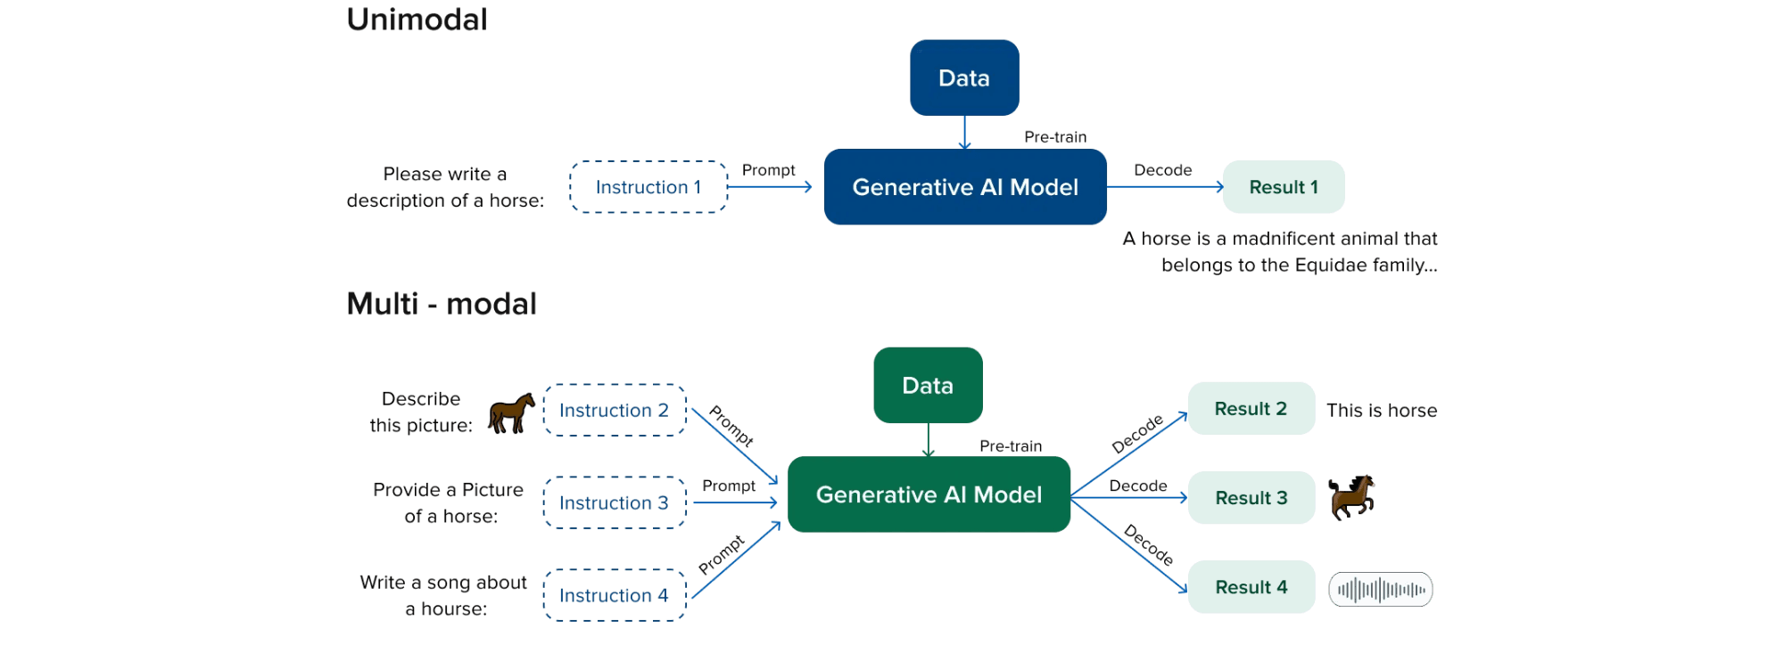
Multimodal Fusion & Context
Diverse Inputs
Supports source code, error screenshots, UI mockups, system diagrams, and logs.
Context State
Fuses all inputs into a single state representing the project and learning level.
Deep Understanding
Goes beyond text to interpret handwritten notes and whiteboard images.

Slide 3

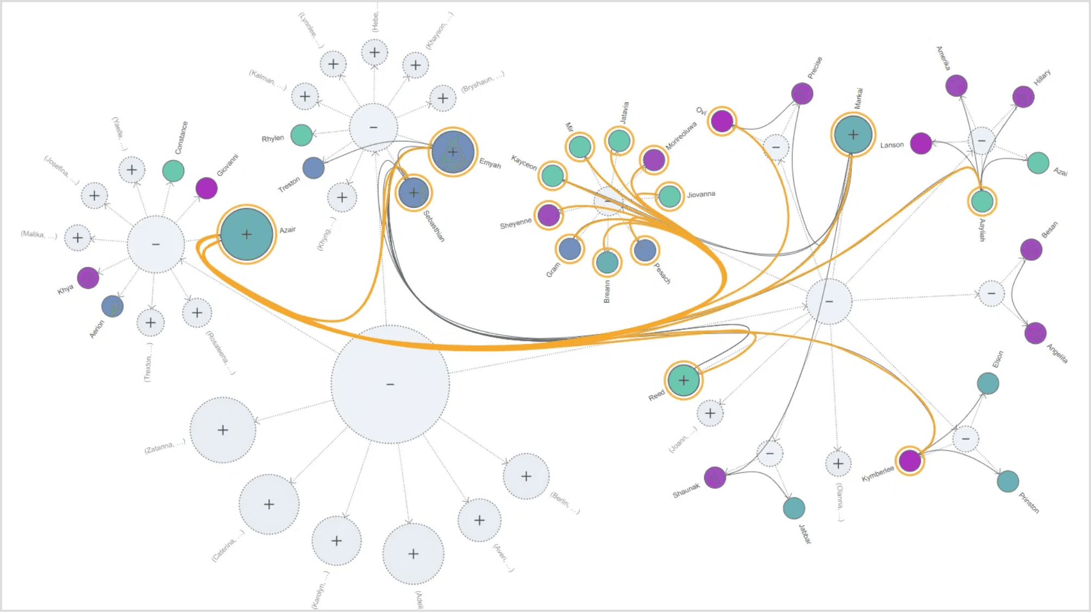
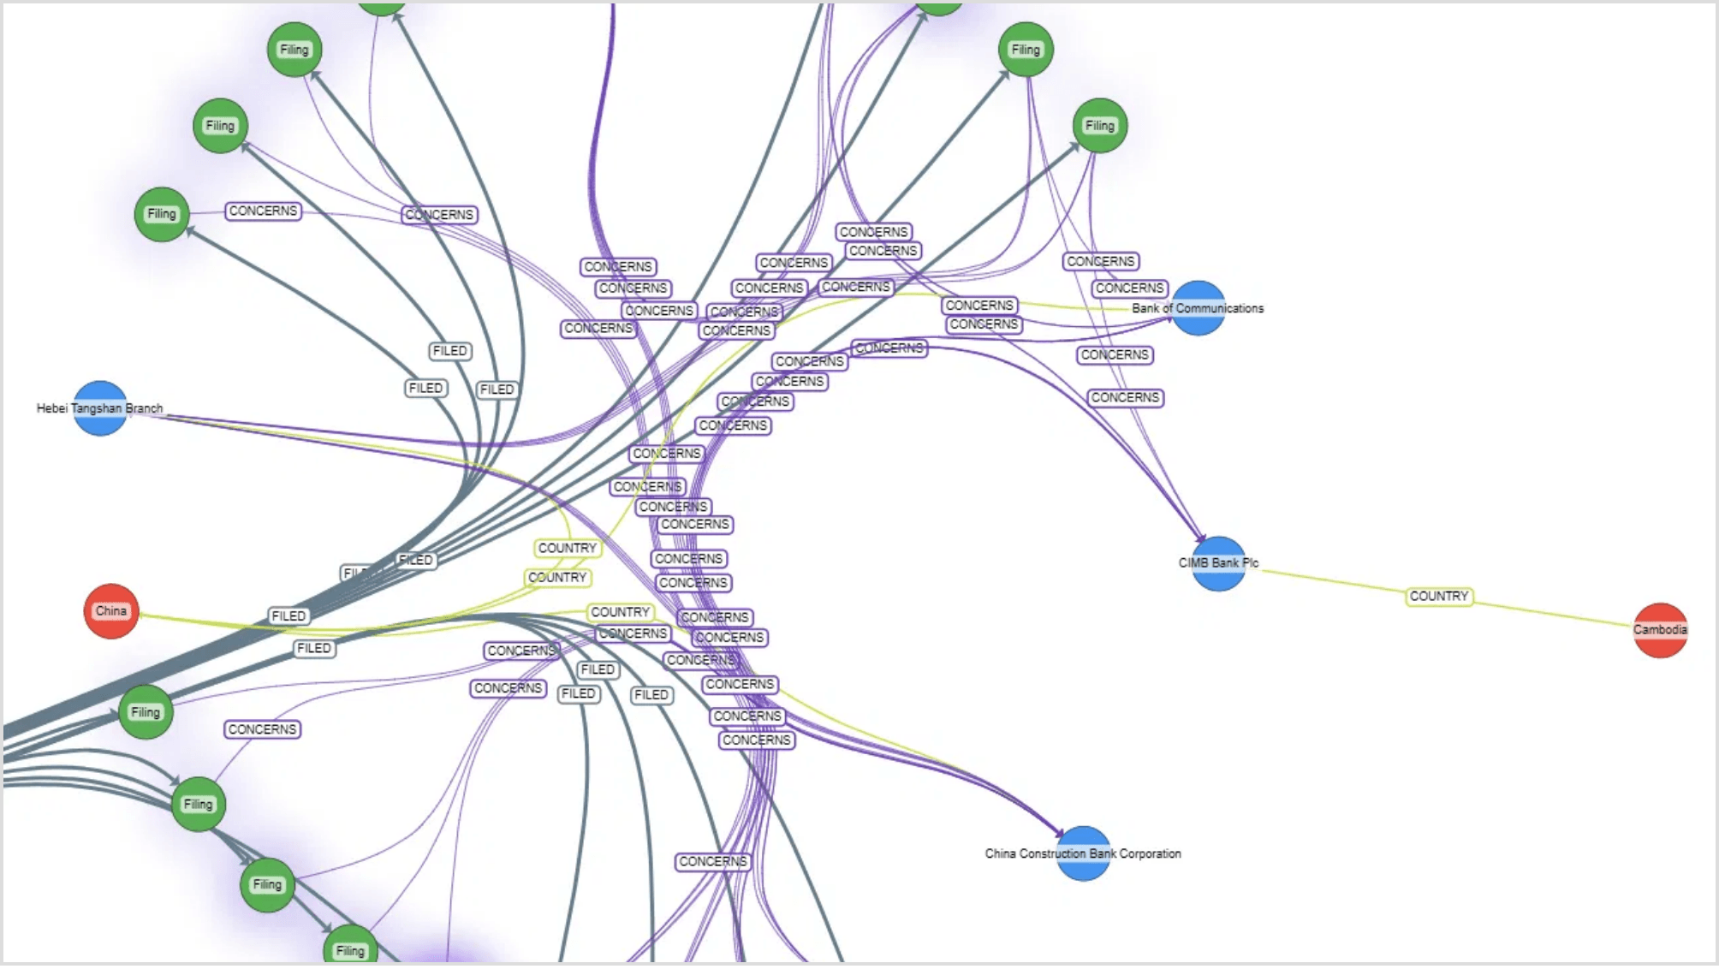
Dynamic Knowledge Graphs
Mastery Tracking
Pattern Recognition
Project Dependencies
Constructs a graph of concepts mastered, weak areas, and topics not yet learned.
Correlates mistakes with specific knowledge gaps for targeted intervention.
Maps project-specific dependencies to provide context-aware suggestions.

Slide 4

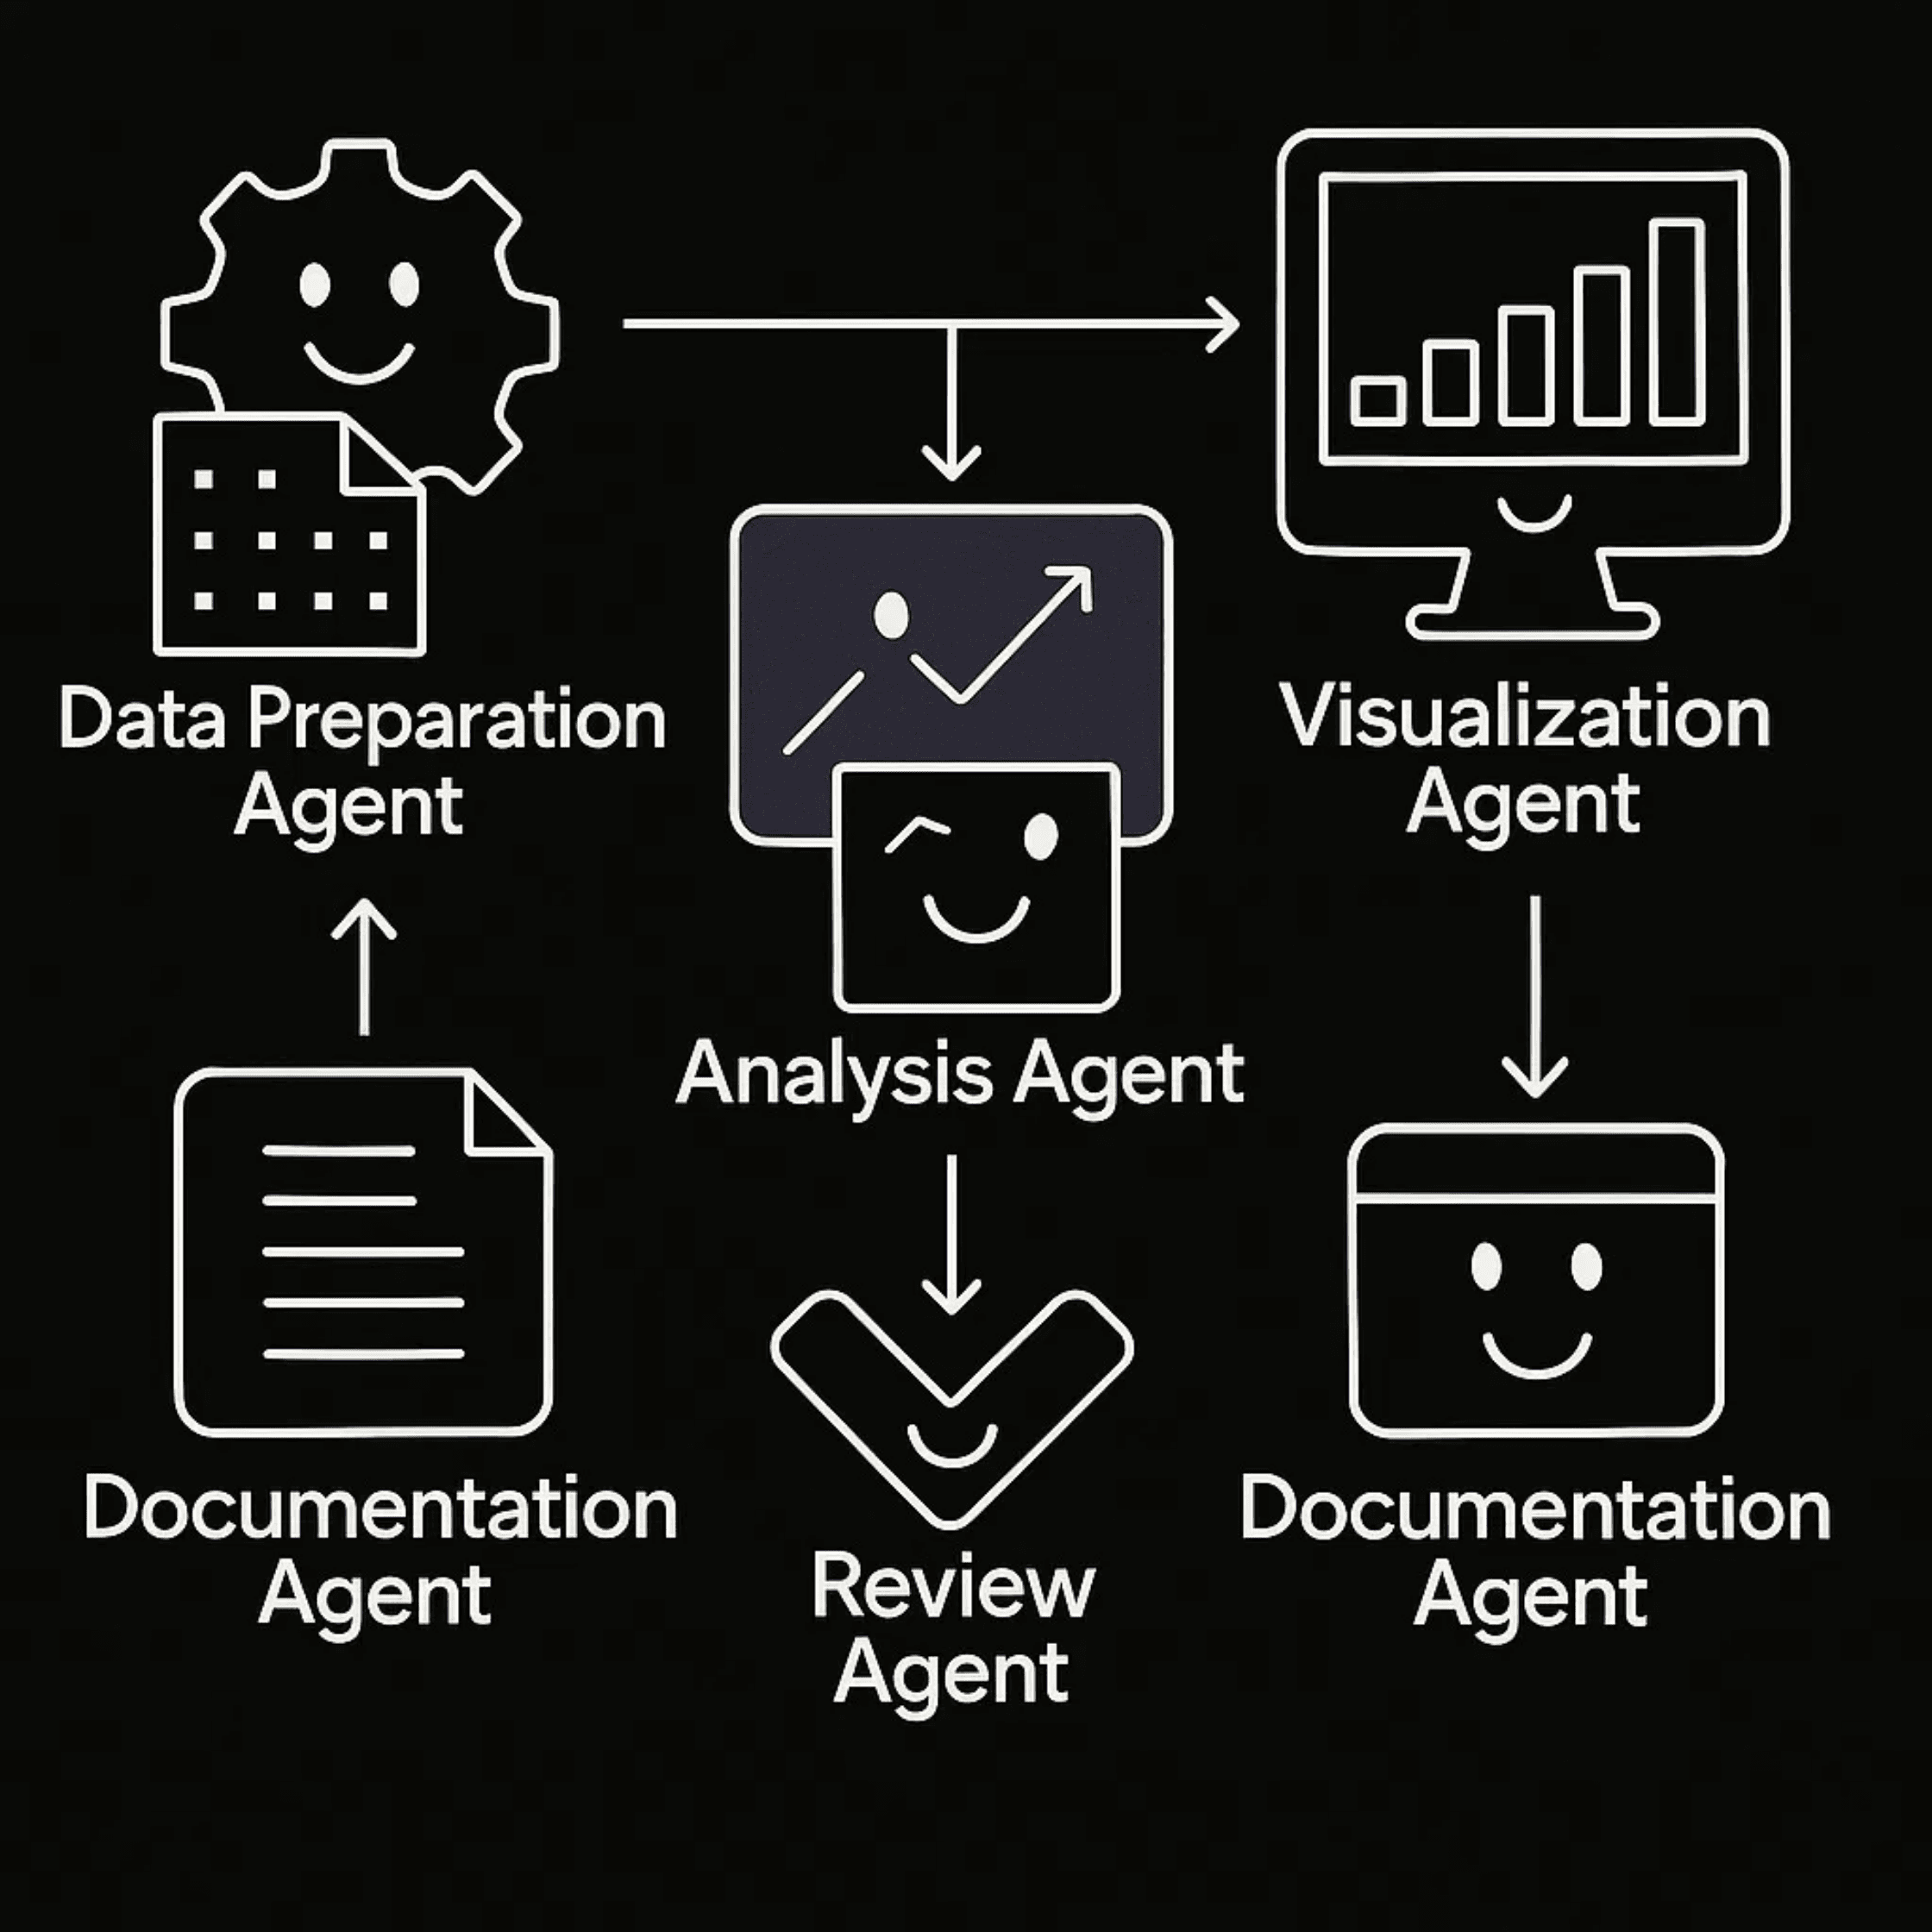
Autonomous Thought Loops
Continuous Monitoring
Detects logical errors and architectural flaws in real-time.
Identifies security vulnerabilities and design anti-patterns.
Proactive Intervention
Pre-emptive warnings before errors manifest.
Suggested architecture fixes and code improvements.

Slide 5

Adaptive Learning Modules
Micro-Lessons
Personalized Paths
Generates 30s quick references, 2min deep dives, and interactive simulators tailored to current tasks.
Tailors learning journeys based on error history, performance metrics, and individual mastery levels.
Interactive Drills
Just-in-Time Education
AI-generated quizzes and code drills designed to reinforce conceptual understanding and bridge knowledge gaps.
Delivers critical knowledge exactly when it's needed during the building process to maintain flow state.

Slide 6

Autonomous Builder Mode
Architecture Design
Code Scaffolding
Generates system diagrams, data models, and API specifications from feature requests.
Creates boilerplate code, folder structures, and initial implementations instantly.
Automated Testing
Iterative Evolution
Generates unit and integration tests to ensure code quality from the very first commit.
Refines solutions based on user feedback and project progression in real-time.

Slide 7

Explainability Layer: Building Trust Through Transparency
TRANSPARENCY
Reasoning Visualization
Execution Traces
Shows AI decision trees and reasoning flow diagrams for every action, demystifying the "why" behind every suggestion.
Provides real-time trace views for execution flow and dependency heatmaps to visualize system behavior.
Complexity Analysis
Black-Box Reduction
Visualizes memory and complexity graphs, allowing users to understand the impact of architectural decisions.
Ensures full transparency in AI logic, transforming the system from a black box into a collaborative partner.

Slide 8

Productivity Intelligence
Behavior Tracking
Skill Analytics
Monitors task completion time and focus drops.
Generates daily focus insights and skill-growth maps.
Identifies friction points in the development workflow.
Tracks concept mastery progression over time.
Efficiency Scores
Continuous Growth
Calculates personalized improvement plans.
Transforms behavior into data-driven strategies.
Benchmarks learning velocity against project goals.
Proactively suggests optimizations for peak performance.

Slide 9

Strategic Recommendations
MVP Focus
Security First
Prioritize core multimodal and adaptive learning loops for initial launch to ensure a stable and high-value user experience.
Implement robust encryption and data anonymization protocols to protect user intellectual property and sensitive project data.
Workflow Integration
Scalability Roadmap
Deepen integration with VS Code, JetBrains, and Git ecosystems to minimize friction and accelerate developer adoption.
Plan for high-performance inference and distributed knowledge graph storage to handle a growing user base and data complexity.

Slide 10
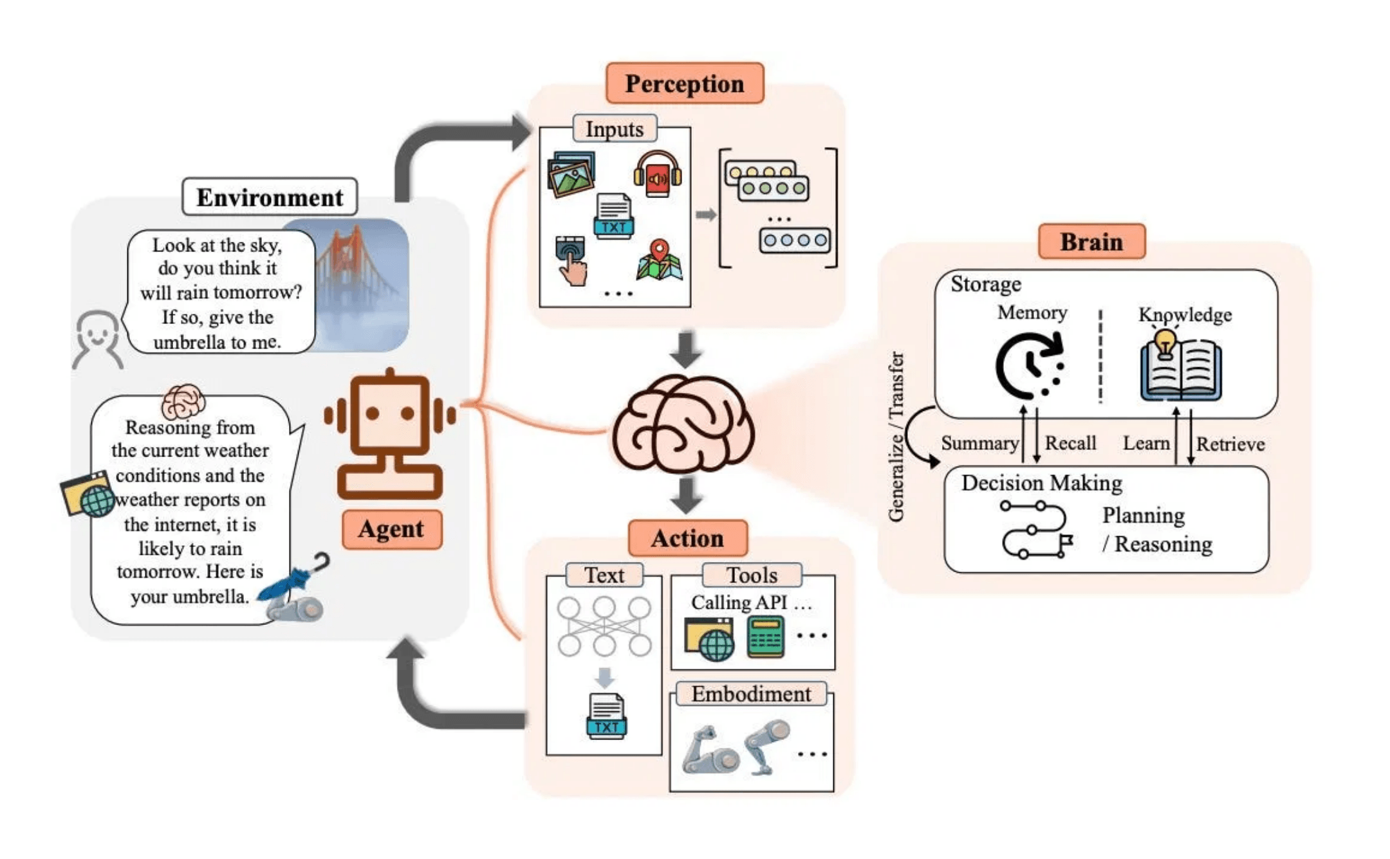

Redefining Human-AI Collaboration
Autonomous & Proactive:
Moving beyond reactive assistants to proactive partners.
Comprehensive Ecosystem:
Unifying the entire development lifecycle in one platform.
Pedagogical Power:
Empowering users to learn while they build.
Future Ready:
Leading the next generation of intelligent environments.
Thank You

