Slide 1

Data Science Methodologies Portfolio
Comparing CRISP-DM, SEMMA & KDD for Credit Card Fraud Detection
Bala Anbalagan | San Jose State University

Slide 2

Three Methodologies, One Challenge
This portfolio compares three fundamental data mining methodologies by applying each to the same problem: Credit Card Fraud Detection. Using a dataset of 284,807 European credit card transactions with only 492 frauds—a mere 0.17% rate—we demonstrate how methodology choice impacts approach, results, and real-world applicability.
CRISP-DM
SEMMA
Business-driven approach with comprehensive deployment planning
Rapid prototyping focused on technical experimentation
KDD
Knowledge discovery through unsupervised learning

Slide 3
Performance at a Glance
Each methodology achieved dramatically different results when applied to the same fraud detection challenge. The choice between supervised and unsupervised approaches, along with methodology-specific workflows, created a performance spectrum from 29% to 96% precision.
Methodology
Approach
Precision
Recall
F1 Score
ROC AUC
CRISP-DM
Supervised (Random Forest)
96.52%
75.00%
84.41%
92.46%
SEMMA
Supervised (Random Forest)
93.85%
82.43%
87.77%
97.79%
KDD
Unsupervised (Isolation Forest)
29.12%
16.87%
21.36%
N/A

Slide 4

CRISP-DM: Business-Driven Excellence
The CRISP-DM (Cross-Industry Standard Process for Data Mining) framework follows six phases from business understanding through deployment. Applied to fraud detection, this methodology achieved 96.52% precision with a Random Forest model—meaning when it flags a transaction as fraud, it's correct 96.5% of the time.
284,807
Total Transactions
492
The approach began with clear business objectives: flag fraudulent transactions before losses accrue while minimizing false positives that frustrate legitimate customers. The extreme 579:1 class imbalance shaped every modeling decision.
Fraud Cases
Only 0.17% of dataset
96.5%
Precision Achieved

Slide 5
CRISP-DM: From Data to Deployment
01
02
Business Understanding
Data Understanding
Define objectives: minimize fraud losses while avoiding false positives that harm customer experience
Explore 284,807 transactions with 30 PCA-transformed features, revealing extreme class imbalance
03
04
Data Preparation
Modeling
Engineer Hour feature from Time variable, standardize all features, stratify 70/30 train/test split
Train Logistic Regression baseline and Random Forest ensemble with 50 trees
05
06
Evaluation
Deployment
Compare models on precision, recall, F1, and ROC AUC; conduct cost-benefit analysis
Plan real-time integration with <100ms latency, threshold tuning, and monthly retraining

Slide 6
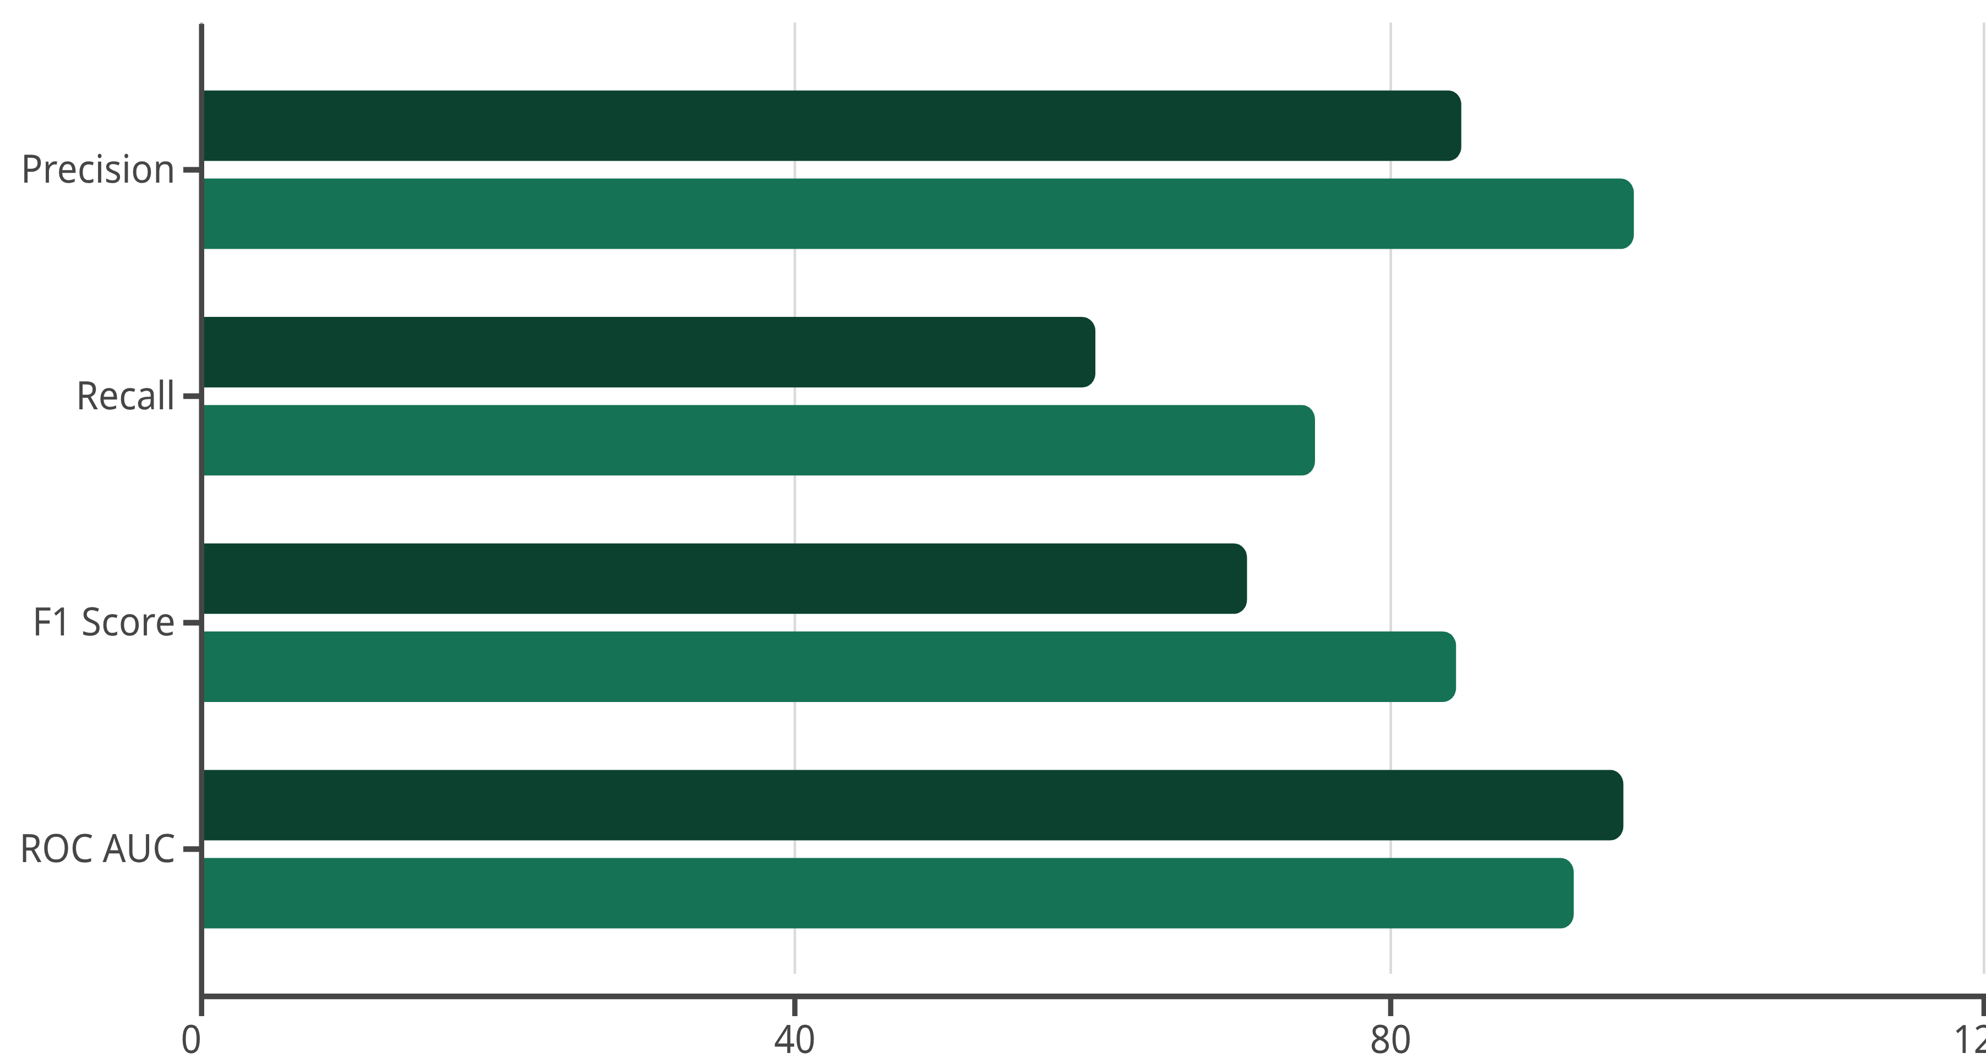
CRISP-DM Model Comparison
Two complementary models established both a linear baseline and captured nonlinear interactions. The Random Forest's ensemble approach dramatically improved both precision and recall.
Logistic Regression
Random Forest
Business Impact
Key Insight
The Random Forest caught 111 of 148 fraud cases with only 4 false positives, preventing approximately $11,500 in fraud losses on the test set alone. Scaled to millions of daily transactions, this translates to millions in annual savings.
While the 75% recall means 25% of frauds still slip through, the 96.5% precision ensures fraud analysts waste minimal time investigating false alerts—a critical operational consideration.

Slide 7





SEMMA: Rapid Prototyping Power
The SEMMA methodology (Sample, Explore, Modify, Model, Assess) emphasizes rapid iteration and exploratory analysis. Originally developed by SAS Institute, SEMMA focuses on the technical data mining workflow rather than comprehensive business planning.
Sample
Strategic reduction to 49,492 transactions
Explore
Visual discovery of patterns and correlations
Modify
Feature standardization and train/test split
Model
Random Forest with 100 trees
Assess
Critical evaluation and iteration planning

Slide 8



SEMMA: Strategic Sampling Success
Sampling Strategy
Exceptional Results
SEMMA's first phase involved creating a representative sample that balances computational efficiency with statistical validity:
Sample 49,000 legitimate transactions (17.2% of available)
Use all 492 fraud cases (100% retention)
Final sample: 49,492 transactions
93.85%
Improved fraud representation from 0.17% to 0.99%
This strategic sampling achieved 6x computational speedup while making fraud patterns more learnable through class rebalancing.
Precision
Correct when flagging fraud
82.43%
Recall
Frauds successfully caught
97.79%
ROC AUC
Near-perfect separation
The Random Forest achieved the highest ROC AUC of all three methodologies at 97.79%, indicating robust performance across all threshold settings.

Slide 9

KDD: Unsupervised Discovery
The Knowledge Discovery in Databases (KDD) process represents one of the earliest formalized data mining methodologies. Unlike supervised approaches, KDD's implementation used Isolation Forest for unsupervised anomaly detection—learning "normal" behavior without fraud labels during training.
Selection
Preprocessing
Transformation
All 284,807 transactions used to learn broadest definition of "normal"
Z-score normalization, intentionally dropped Class labels
Standardized features for equal weighting across V1-V28
Data Mining
Interpretation
Isolation Forest with 100 trees, 0.1% contamination parameter
Evaluated anomalies against true fraud labels post-training

Slide 10
Final Insights: Choosing Your Methodology
Each methodology excels in its intended context. The dramatic performance differences—96% vs 29% precision—demonstrate that methodology choice fundamentally shapes outcomes.
Use CRISP-DM When
Use SEMMA When
Use KDD When
Production deployment is the goal
Rapid prototyping is priority
Labels are unavailable or unreliable
Business alignment is critical
Technical experimentation drives value
Exploring new fraud patterns
Comprehensive documentation needed
Iterative refinement is planned
Research and hypothesis generation
Labels are available
Speed matters more than comprehensiveness
Discovering the undiscovered
Key Takeaway
Resources & Contact
Supervised methods dominate when labels exist, achieving ~$11,500 in prevented losses on test data alone. However, unsupervised approaches excel at discovering novel fraud patterns that supervised models would miss entirely.
Bala AnbalaganSan Jose State Universitybala.anbalagan@sjsu.edu
GitHub Repository | Dataset

