Slide 1

HOW DO YOU CHOOSE A PLACE FOR A NEW CAFÉ
(City of Toronto)
Bala Deekshith

Slide 2
Some major Factors
Neighborhood Information
Population
Income
Population and dwellings
Population Change(change in years)

Slide 3
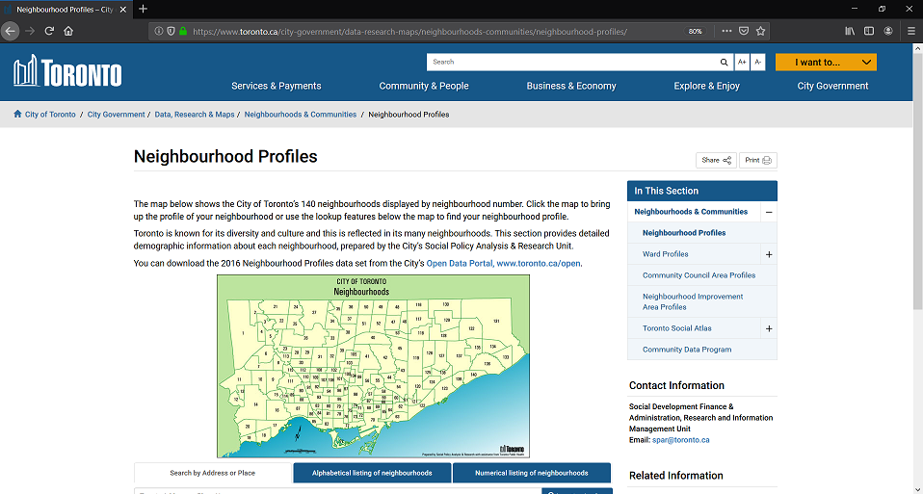
City of Toronto Neighborhood Profiles

Slide 4
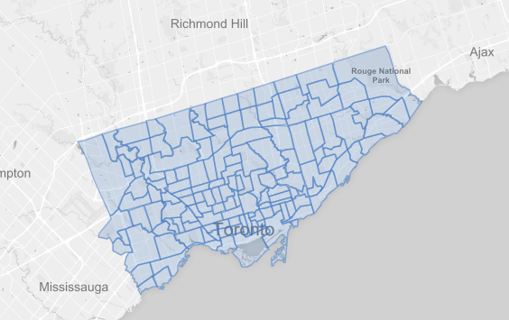
City of Toronto Neighborhood Shapes

Slide 5
Data Group 1
Stage A — Census Data 1. Data was pulled into from the City of Toronto Neighborhoods Profile Census CSV File to create a data frame. 2. This data frame contains all the census data (2016) of the neighborhoods of Toronto that will be filtered. 3. Data is filtered into columns based on neighborhood population and after-tax income.

Slide 6
Stage b
Web scraping to align neighborhoods with boroughs 1. Toronto Neighborhood Borough Designations is scraped using Beautiful Soup. 2. Scraped data is transformed to data frame. 3. Merge this data frame with Census Data data frame.

Slide 7
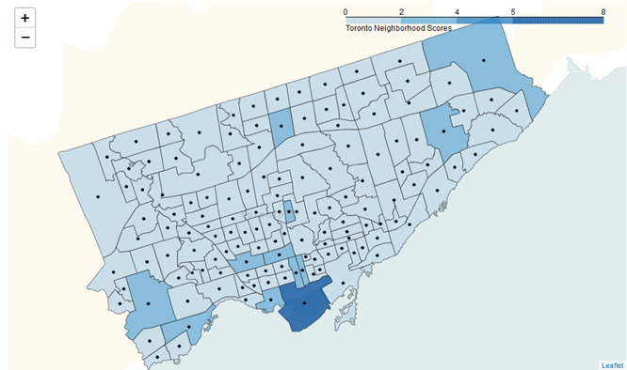
Calculate medians of the demographic columns across the 140 neighborhoods.
From here, utilizing a choropleth folium map, a clearer picture of the neighborhoods of Toronto becomes apparent.

Slide 8
Conclusion
In conclusion, the scope of this of the analysis is somewhat limited. The food industry is ever changing, and the information afforded us may be dated due to relying on user information via Foursquare. Overall though, the model created can easily be replicated again and again with monitored data via the Foursquare API and the data from the forthcoming census in 2021. With the data analyzed and scoring system established by the investor group, we stand by the recommendations made.

