Slide 1

SMART PARKING SYSTEM USING IOT NAME : J Bala Krishnan REG NO : 211921106305 DEP : ELECTRONICS AND COMMUNICATION
Rajiv Gandhi College of Engineering

Slide 2
CONTENTS
Introduction
Problem Statement
Requirements
Our Design
Program
Aims and Objectives
Methodology
Conclusion

Slide 3
INTRODUCTION
Smart Parking system consists of an on-site deployment of an IOT module that is used to monitor and signalize the state of availability of each single parking space.
Smart Parking is a parking system, usually a new one that is equipped with special structured devices (things) to detect the available parking slots at any parking area.

Slide 4
PROBLEM STATEMENT
With the growth of population and economical development , the number of vehicles on the road is increasing day by day . Parking is becoming one of the major problems for cities, and is becoming very costly .so to avoid Problems such as, traffic congestion, limited car parking facilities and road safety there is solution that is being addressed by Smart parking using IOT which is a solution to metropolitan cities to reduce congestion,
cut vehicle emission totals and save persons’ time by helping
them in finding a spot to park.

Slide 5
REQUIREMENTS
1) Arduino Uno:
This will act as the microcontroller for the project and all the other sensors will connected to it
2) IR sensors:
It will be used to sense the presence of vehicle in the parking slots by sending out IR radiations.
3) LED'S:
This will be giving the indication if the particular slot is empty or full screen that is the status of the parking slots and change real-time
As we are implementing using Iot we as usually use jumper wires, bread board and USB cable.

Slide 6
OUR DESIGN
We are using 4 IR sensors in the particular
parking slot. When a car or any vehicle enters
the IR sensor in the Parking slot sends signal to Arduino and Arduino triggers the signal to LED which goes ON or OFF accordingly that
indicates whether a parking slot is vacant or
not.

Slide 7
PROGRAM
#include <LiquidCrystal.h>
// IR sensor pins
const int irSensorPins[] = {2, 3, 4, 5, 6};
const int numSensors = 5;
// LCD pins
LiquidCrystal lcd(12, 11, 7, 8, 9, 10);
void setup() {
pinMode(irSensorPins[0], INPUT);
pinMode(irSensorPins[1], INPUT);
pinMode(irSensorPins[2], INPUT);
pinMode(irSensorPins[3], INPUT);
pinMode(irSensorPins[4], INPUT);
Serial.begin(9600);
lcd.begin(16,2);
lcd.print("Smart Parking");
delay(100);
lcd.clear();

Slide 8
}
void loop() {
int occupiedSpaces = 0;
for (int i = 0; i < numSensors; i++) {
if (digitalRead(irSensorPins[i]) == HIGH) {
occupiedSpaces++;
}
}
lcd.setCursor(0, 0);
lcd.print("Occupied: ");
lcd.print(occupiedSpaces);
lcd.print("/");
lcd.print(numSensors);
lcd.setCursor(0, 1);
if (occupiedSpaces == numSensors) {
lcd.print("Parking Full");
} else {
lcd.print("Available: ");
lcd.print(numSensors - occupiedSpaces);
}

Slide 9
delay(100);
lcd.clear();
for (int i = 0; i < numSensors; i++) {
if (digitalRead(irSensorPins[i]) ==LOW) {
if(i==0){
lcd.setCursor(0, 0);
lcd.print("slot 1: 50m");
delay(30);}
else if(i==1){
lcd.setCursor(0, 0);
lcd.print("slot 2: 55m");
delay(30);
}
else if(i==2){
lcd.setCursor(0, 0);
lcd.print("slot 3: 60m");
delay(30);
}
else if(i==3){
lcd.setCursor(0, 0);
lcd.print("slot 4: 65m");
delay(30);
}
else if(i==4){
lcd.setCursor(0, 0);
lcd.print("slot 5: 70m");
delay(30);
}
delay(10);
}
}

Slide 10
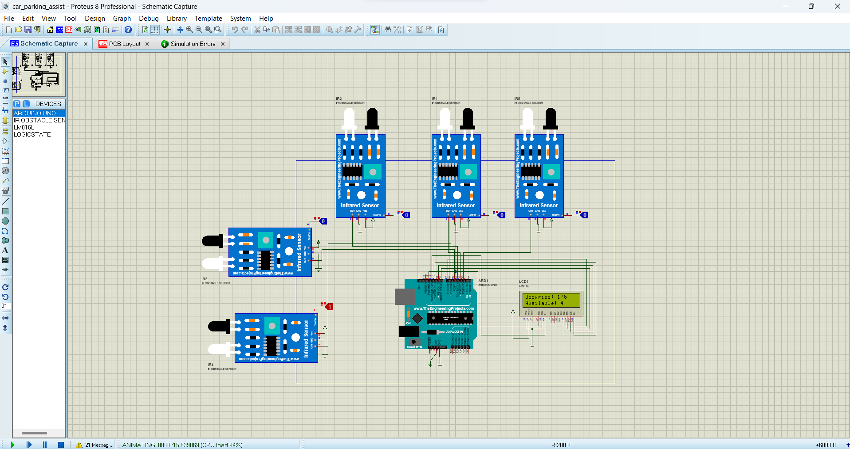
SCHEMATIC CAPTURE

Slide 11
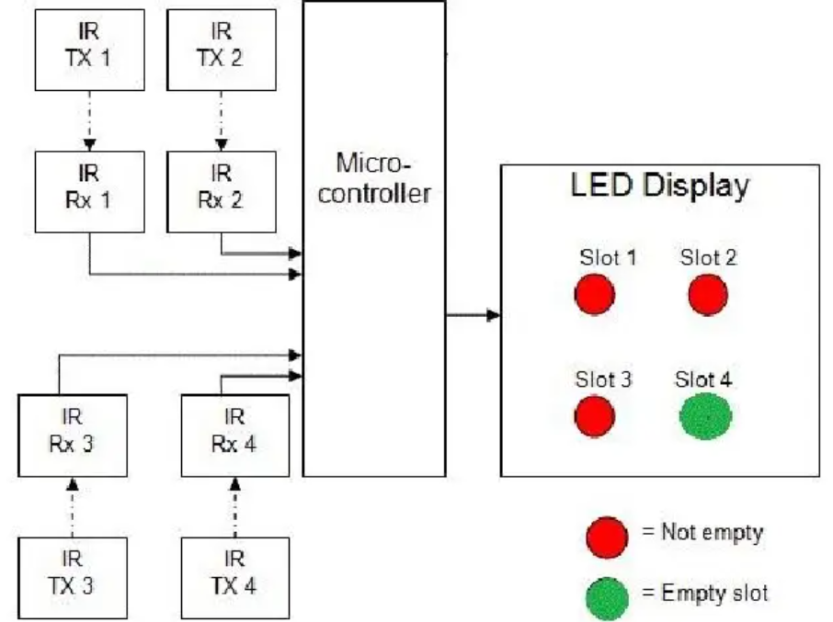
BLOCK DIAGRAM

Slide 12
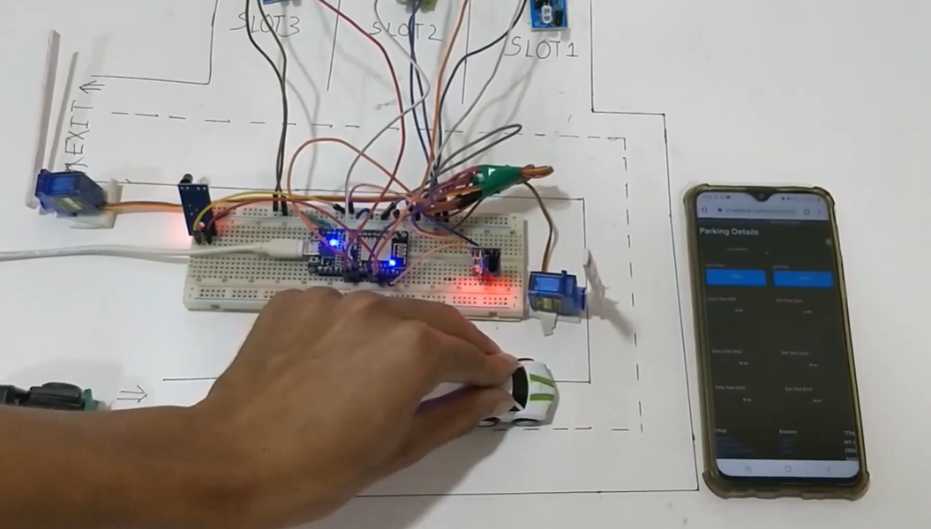
HARDWARE SETUP

Slide 13
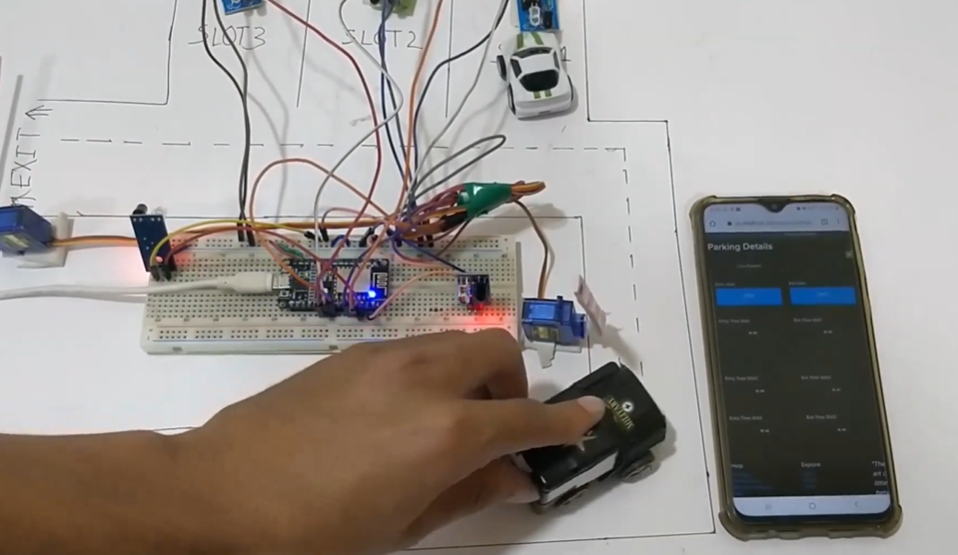
HARDWARE SETUP

Slide 14
AIMS AND OBJECTIVES
Enhance the security with Simplifying Parking
System
Parking System that pars a number of vehicles
with east possible space.

Slide 15
METHADOLOGY
The IR sensors should be placed in the appropriate places to clearly cover all the parking slots
The parking slots should be appropriately numbered to mark them on the system
These marked points will act as the control points and will be integrated as slots in the cloud
Then the setting will be saved and the microcontroller will be programmed to display the data online accordingly.

Slide 16
CONCLUSION
Thus phase 5 concludes The developed smart parking system provides a cheap and efficient monitoring system while still providing real-time information about parking spot to commuters.
We have Going to present a benefit analysis showing that with the successful implementation of smart parking.

