Slide 1
Angular
Bala Nagarajan

Slide 2
Angular – Basic Definition
SPA’s : Angular is a JavaScript Framework which helps to create a responsive single page application.
Provides you reactive experience
You just load the data in the background / Java script changes the DOM. That’s the reason you don’t see the page refresh / renders the server data by altering the DOM.
In short Java script framework changing your DOM (‘HTML’) at run time.

Slide 3
Angular Versions
Angular 1 – Widely used earlier and getting obsolete. Angular 1 also referred as Angular.js or Angular 1.
Angular → Angular 2 → Angular 4 → Angular 5 (Latest version). Reason its called as just Angular – It’s a complete re-write of Angular 1 or Angular.js

Slide 4
Buzzwords
Angular CLI – Tools to create / build / managing your angular application. Angular Command Line Interface. It takes care of building project structure / base template creation …developer can concentrate on Angular Code. Behind the scenes CLI uses webpack tool which bundles all your JS and CSS files and applies to index.html
Type Script – Super set of Java script / developed and maintained by Microsoft. (Angular uses Type Script language).Uses Classes / Interfaces / Types / Strings…Checks during compile time. It compiles to Java Script.Compilation done by CLI and not happens in browser.
Node JS : We need Node JS because CLI needs it / Build our project / package it / download libraries / to build local server to deploy our angular application

Slide 5
Angular Setup & IDE
Please refer the following document to do the Angular Setup.
Test your first Angular application.
IDE – Microsoft Visual Studio or Sublime . You can install plugins / libraries in your IDE using the following shortcuts

Slide 6
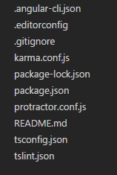
Angular Project Structured
The below files used for configuration
‘src’ – folder where you create the project specific files.
index.html – is the single page html that gets rendered. (you don’t need to change)
‘app’ folder is key folder.

Slide 7
App Component - details
Each HTML file tied up with TS file. The Angular renders the content dynamically by manipulating the DOM.
HTML file gets the data from the TS file.
CSS – file takes care of the UI display
App.module.ts – should have all imports of the features modules that we are going to use in Angular application
Every user key stroke the Angular updates the DOM.

Slide 8
What happens during the App startup ?
Index.html – is the page served by the server. That’s the reason its called as single page application.
<app-root> is not a default HTML root element. CLI creates the root element for us..The index.html gets dynamically changed.
The CLI injects the component automatically…you will see the list of script at the end..will imports our java script also.
Main.ts – file gets executed automatically. It boot straps the App module.
App.module.ts – All the components should be included. Tell Angular ..provide details about the app component.
After it gets the information about APP , it knows what needs to be rendered for <app-root>

Slide 9
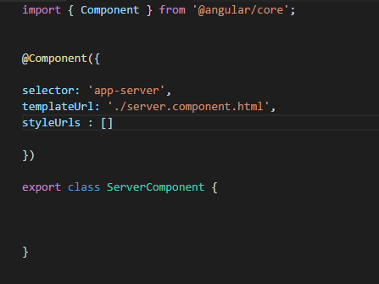
What is Component ?
You build your entire application as Components.
Start look @ your application as individual re-usable components.
Each component – has its own business logic / UI / CSS ..so it can be re-usable anywhere. Easy to update / exchange and re-usable.

Slide 10
What is Module ?
CLI builds group of components to a module. Basically building group of functions into a module.
In app.module.ts – contains the information about all components. You need to register all your custom components in app.module.ts
Imports helps to import modules. (more or less like bundling to different jars and those jars in your class path in order to use the necessary classes)

Slide 11
How to create a custom component ?
You can create custom components – manual or using commands
ng generate component “component_name” or ng g c “component_name”.
Verify the entry in ‘app.module.ts’
Include the new component in your ‘app.component.html’ to view your custom component changes

Slide 12
Data Binding
Communication between TS (business logic) and Template (HTML) – Data binding responsible for this communication.
Types of binding – output to HTML (TS to HTML)
Event binding (HTML to TS)
Two way binding (combination of both)

Slide 13
Directives & Models?
Directives are instructions to DOMS. Components are instructions to alter the DOM. Components are directives associated with HTML
You can also have directive without HTML. You can add attributes to the directive to change the behavior.
Lot of inbuilt custom directives are present in Angular.
Example : ngIf / ngFor
Models : You can create models

