Slide 1
BALA SANKAR G
Final Project
3/21/2024 Annual Review

Slide 2
PROJECT TITLE
Spam or Ham Message Detection Using NLP with Vectorization
3/21/2024 Annual Review

Slide 3


AGENDA
Problem Statement
Project Overview
Who are the end users?
Solution and its Value Proposition
The WOW in my solution
Modelling
Results
3/21/2024 Annual Review

Slide 4

PROBLEM STATEMENT
Develop a Deep learning and machine learning model to classify messages as either 'spam' or 'ham' (non-spam). The model should be trained on a dataset of labeled messages, where each message is associated with a label indicating whether it is spam or not
3/21/2024 Annual Review

Slide 5

PROJECT OVERVIEW
The model should use a Support Vector Machine (SVM) classifier with a linear kernel. Text data is vectorized using TF-IDF (Term Frequency-Inverse Document Frequency) representation. Performance metrics such as accuracy, precision, recall, F1 score, and confusion matrix are computed to evaluate the effectiveness of the classifier.
3/21/2024 Annual Review

Slide 6

WHO ARE THE END USERS?
Individual Users: Everyday email and messaging users who want to protect themselves from spam and ensure that their communication channels remain efficient and secure.
Businesses: Companies and organizations that rely on email and messaging services for communication with customers, clients, and partners. Effective spam detection helps maintain professional communication channels and protects against phishing attacks and malware.
Email Service Providers: Providers of email services, such as Gmail, Outlook, and Yahoo Mail, can integrate spam detection systems into their platforms to offer users enhanced email filtering capabilities.
3/21/2024 Annual Review

Slide 7

YOUR SOLUTION AND ITS VALUE PROPOSITION
Enhanced Security: The spam detection system offers users robust protection against spam emails and messages, reducing the risk of falling victim to phishing attacks, malware distribution, and other cyber threats.
Time Savings: By automatically filtering out spam messages, the system saves users time and effort that would otherwise be spent manually sorting through unwanted emails and messages.
Improved Productivity: Users can focus on important tasks without being distracted by spam, leading to increased productivity and efficiency in their daily communication workflows.
Customizable Filtering: The system allows users to customize spam filtering settings based on their preferences and requirements, providing flexibility to adapt to different spam detection needs.
3/21/2024 Annual Review

Slide 8

THE WOW IN YOUR SOLUTION
The “WOW" factor in our spam detection solution lies in its ability to seamlessly blend advanced machine learning techniques with user-centric features, delivering a comprehensive and intuitive solution to combat spam. Here's what makes our solution stand out:
High Accuracy: Our system achieves exceptional accuracy in distinguishing spam from legitimate messages, thanks to the utilization of cutting-edge machine learning algorithms and sophisticated text analysis techniques. Users can trust that their communication channels are effectively protected against spam.
Customization: Unlike one-size-fits-all spam filters, our solution empowers users with customizable filtering options. Whether it's adjusting sensitivity levels or specifying personalized filtering rules, users have the flexibility to tailor the spam detection system to their unique preferences and requirements.
3/21/2024 Annual Review
8

Slide 9
MODELLING
Teams cam add wireframes
Prepare Data: Clean the dataset.
Extract Features: Use TF-IDF to turn the text data into numbers that the computer can understand. This helps capture the importance of words in each message and includes the click count feature.
Choose Model: Select a Support Vector Machine (SVM) model because it's good at classifying text data and works well with high-dimensional data like ours.
Train Model: Teach the SVM model how to distinguish between spam and ham using the labeled training data.
Evaluate Model: Test the trained model on a separate set of data to see how well it can predict whether a message is spam or ham. We'll look at metrics like accuracy, precision, recall, and F1-score.
Deploy Model: Once we're happy with the model's performance, we can put it into action in a real-world setting where it can automatically classify messages as spam or ham
3/21/2024 Annual Review
9

Slide 10
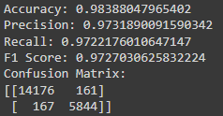
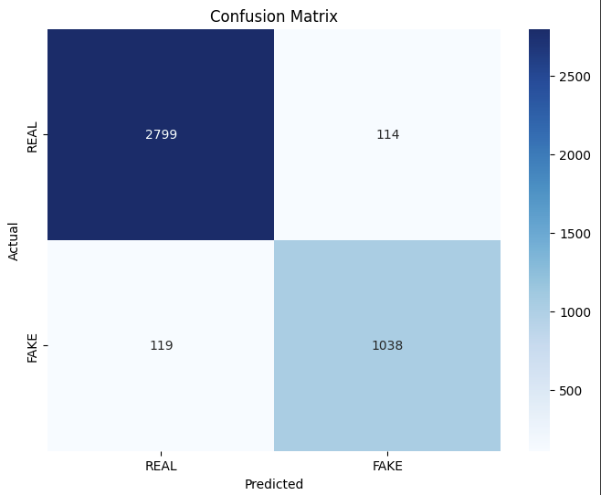
RESULTS
https://colab.research.google.com/drive/1qQAublXUsMJWoXhhdCmYRCN7waiwy-Xs?usp=sharing
3/21/2024 Annual Review
10

