Slide 1

Enhancing Search Engine Relevance for Video Subtitles
Submitted By
E B Shobha Rani
M Spandana Devi
Team_ID T211020

Slide 2
Title: Subtitle-Based Search Engine Development Enhancing Video Accessibility
Introduction:
Welcome to the presentation on Subtitle-Based Search Engine Development, where we delve into the realm of digital content accessibility.
In today's digital age, video content is ubiquitous, catering to a diverse audience with varying needs and preferences.
However, accessing and navigating video content, especially for individuals with hearing impairments or language barriers, can be challenging.
This project aims to address this challenge by developing an innovative subtitle-based search engine that enhances the accessibility of video content.
By leveraging natural language processing and machine learning techniques, we aim to provide users with a seamless and efficient way to search for relevant video content based on subtitle data.

Slide 3

Project Overview
This project focuses on the development of a subtitle-based search engine to enhance the accessibility and usability of video content.
By leveraging subtitle data, the search engine aims to provide users with accurate and relevant search results tailored to their preferences and needs.
Importance of Subtitle-Based Search Engines:
Subtitle-based search engines play a crucial role in improving the accessibility of video content for individuals with hearing impairments, language barriers, or those seeking specific content within videos.
They enable users to search for and navigate video content more effectively, enhancing the overall user experience and making digital media more inclusive.
Objectives of the Project:
Develop an advanced search engine algorithm capable of efficiently retrieving video content based on subtitle data.
Implement natural language processing and machine learning techniques to analyze and interpret subtitle text for accurate search results.
Enhance the relevance and accuracy of search results by considering the context and semantics of user queries and subtitle data.
Improve the accessibility of video content for individuals with hearing impairments or language barriers, promoting inclusivity and diversity in digital media consumption.

Slide 4
Keyword-based vs. Semantic Search Engines:
Keyword-based Search Engines: These search engines rely on exact keyword matches between user queries and indexed documents. They are effective for retrieving results based on specific keywords but may lack context and struggle with synonyms or variations in language.
Semantic Search Engines: Semantic search engines go beyond keyword matching to understand the meaning and context of user queries and documents. They analyze the intent behind the query and the content of documents to provide more relevant and meaningful search results. Semantic search engines utilize natural language processing (NLP) techniques to comprehend the nuances of language and deliver accurate results.
Comparison of Different Search Engine Approaches:
Keyword-based search engines are suitable for straightforward searches where exact keyword matches are sufficient.
Semantic search engines excel in understanding the context and intent behind user queries, leading to more relevant and accurate search results.
While keyword-based search engines focus on matching specific keywords, semantic search engines analyze the semantics of both queries and documents to provide a deeper level of understanding and relevance.
Core Logic of Subtitle Document Processing and Retrieval:
Preprocessing of data involves cleaning and tokenization of subtitle documents to prepare them for analysis.
Document vectorization techniques, such as Bag-of-Words (BoW) or Term Frequency-Inverse Document Frequency (TF-IDF), are applied to represent subtitle documents as numerical vectors.
Chunking of large documents into smaller, manageable chunks is performed to mitigate information loss and improve efficiency.
Retrieval involves calculating the similarity between the vector representation of user queries and subtitle documents, typically using cosine similarity, to identify the most relevant documents.

Slide 5
Data Preprocessing:
Cleaning:
Remove timestamps, special characters, and non-text elements.
Standardize text formatting and handle encoding issues.
Tokenization:
Split text into individual tokens (words or phrases).
Normalize tokens by converting to lowercase and removing stopwords.
Dataset Description:
Size:
Subtitle datasets can vary widely in size, from small collections to large corpora containing millions of subtitles.
Format:
Subtitles are typically stored in plain text files, often in formats like SRT (SubRip) or VTT (WebVTT).
Each subtitle file contains timestamped lines of dialogue or captions, along with metadata such as language and format information.

Slide 6
Document Vectorization Techniques:
BoW/TF-IDF: Represent text documents by word frequency or importance, respectively.
SentenceTransformers: Utilize pre-trained models like BERT for semantic embeddings.
Document Chunking:
Handling Large Documents: Break down lengthy texts into smaller chunks.
Mitigating Information Loss: Use overlapping windows to preserve context.
Embedding Storage:
Efficient Storage: Store embeddings in ChromaDB for optimized retrieval.
Optimized Retrieval: Enables quick access to relevant documents.

Slide 7
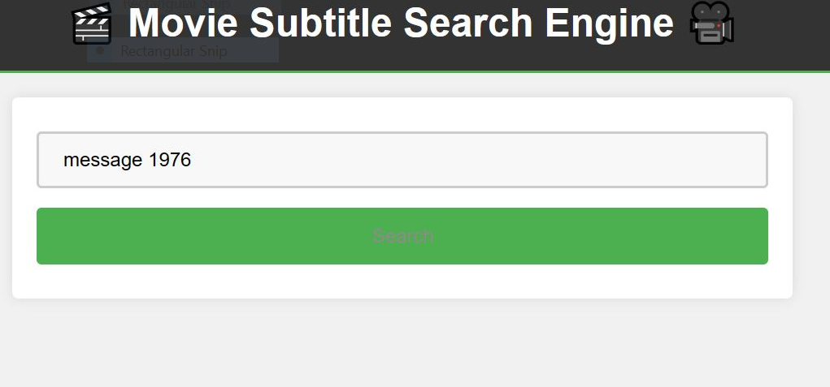
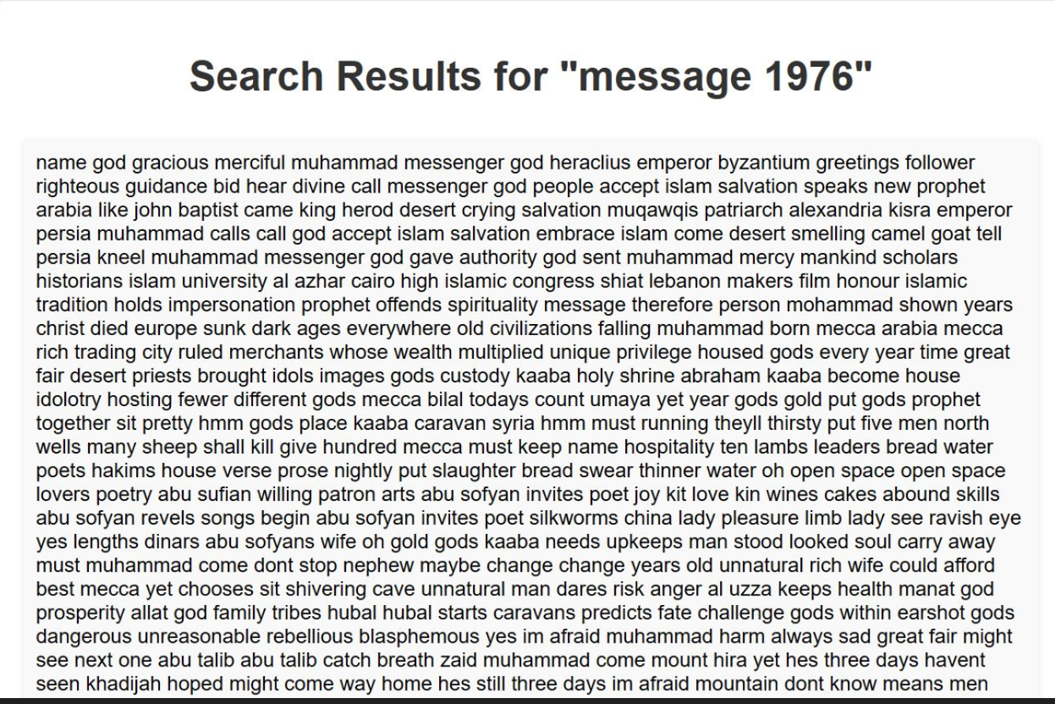
Demonstration:
During the live demonstration, we will showcase the functionality of our subtitle-based search engine, highlighting its capability to retrieve relevant video content based on user queries. Here are some example queries we will use, along with their corresponding search results

Slide 8
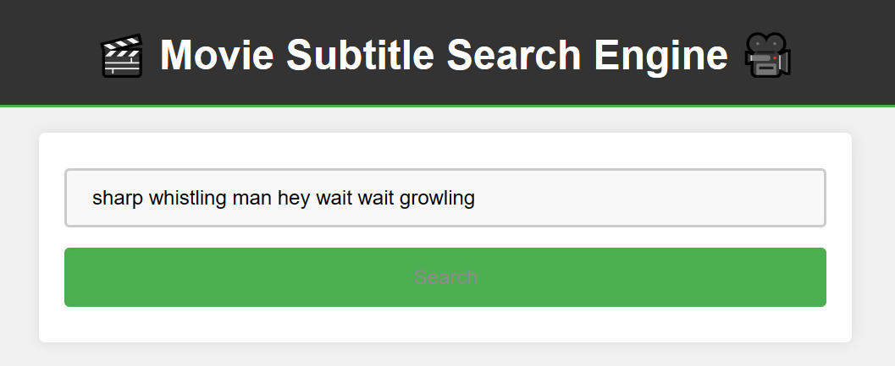
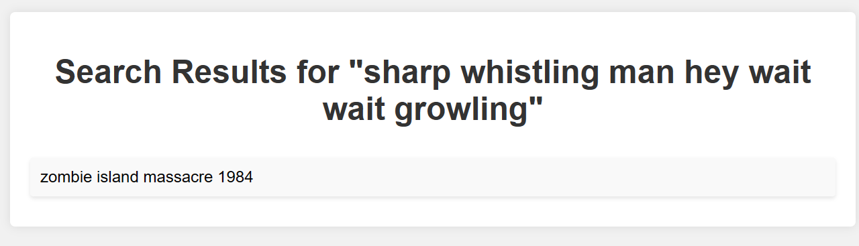
Search Engine Search Result

Slide 9
Conclusion:
In conclusion, this project has made significant strides in the field of video content accessibility through the development of an advanced subtitle-based search engine.
Key Findings and Project Contributions:
The implementation of both keyword-based (BOW/TF-IDF) and semantic-based (BERT-based SentenceTransformers) search engines has demonstrated the versatility and effectiveness of different search approaches.
The document chunking technique has proved instrumental in handling large subtitle documents, mitigating information loss, and enhancing search efficiency.
The storage of embeddings in ChromaDB has facilitated efficient storage and retrieval of document embeddings, contributing to the scalability of the search engine.
Implications for Enhancing Video Accessibility:
By providing users with a more accurate and relevant search experience, the search engine enhances the accessibility of video content, particularly for individuals with specific content preferences or accessibility needs.
Improved search functionality enables users to quickly find relevant video content, thereby saving time and effort in browsing through extensive libraries of media.

Slide 10
Future Directions and Potential Enhancements:
Further optimization of search algorithms and techniques to improve search accuracy and efficiency.
Integration of additional features such as personalized recommendations and filtering options based on user preferences.
Collaboration with content providers and platforms to enhance the availability and coverage of subtitle data for a more comprehensive search experience.
Overall, the development of this subtitle-based search engine represents a significant step forward in improving video accessibility and user experience in the digital content landscape.

Slide 11

THANK YOU

