Slide 1
B&J BISCUIT
Retail Revenue Analysis for Leadership Decision Making
Sales, products, customers and locations - Analysed in Excel
Presented by Bala Surya Prakash V

Slide 2
i
Dataset Overview
12,000
2
10
Sales transactions
Sheets: Transactions + Products
Analysis tasks
TRANSACTION DATA
PRODUCTS
Transaction Date, Buyer Name & Location, Buyer DOB, Payment Method, Quantity Purchased, Product Code, Sales Rep (1st & 2nd Name), Gender
Product Code, Biscuit Brand, Cost Price, Unit Price
Goal: clean the data, build KPIs and give leadership a clear view of what sells, to whom, where and how.
B&J Biscuit | Retail Revenue Analysis
2

Slide 3
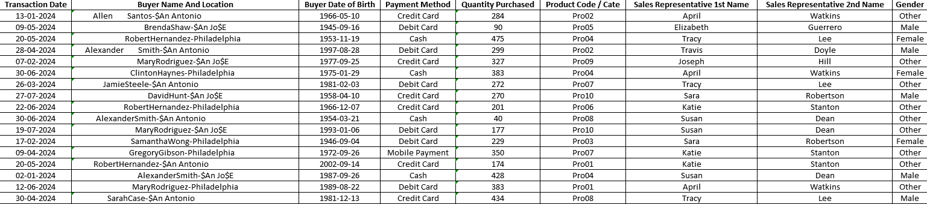
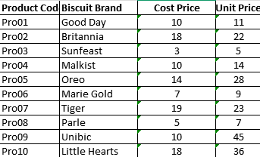
ii
Dataset Overview
Transaction Data
Products
B&J Biscuit | Retail Revenue Analysis

Slide 4
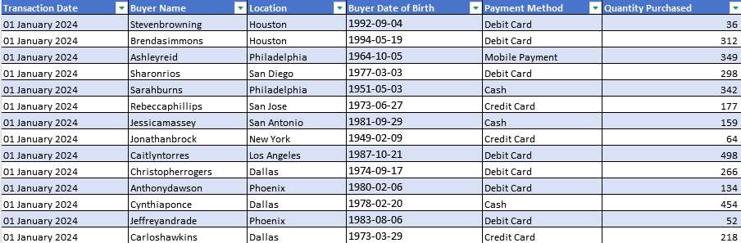
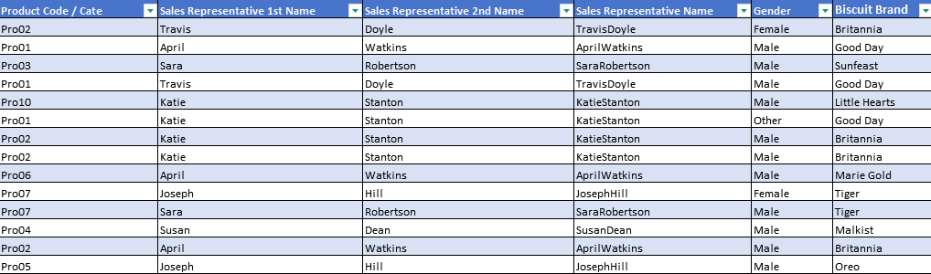
01
Data Cleaning & Formatting
WHAT I DID
Removed special characters and fixed them with correct text
Stripped extra spaces from every text field
Split Buyer Name and Location into separate columns
Standardised text case; converted data to an Excel Table
EXCEL TOOLS
TRIM
CLEAN
SUBSTITUTE
PROPER
Output : Clean, consistent 12,000-row table
B&J Biscuit | Retail Revenue Analysis
3
Notes:
Paste the Excel screenshot / pivot for this task in the frame and add your key insight while presenting.

Slide 5
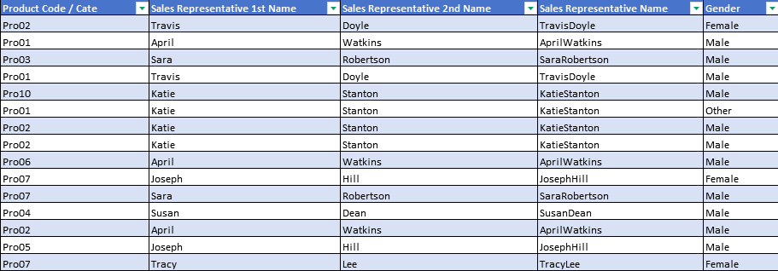
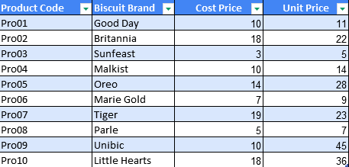
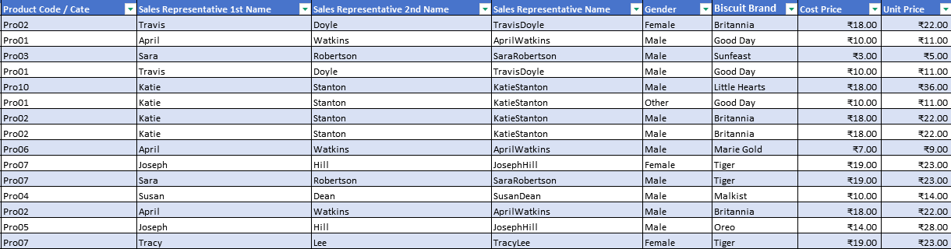
02
Lookup Mapping
WHAT I DID
Linked Products sheet to Transaction Data using Product Code
Fetched Unit Price, Cost, Product Category and Product Name
Checked for unmatched product codes
EXCEL TOOLS
XLOOKUP
Output : Unified dataset with product details
B&J Biscuit | Retail Revenue Analysis
4
Notes:
Paste the Excel screenshot / pivot for this task in the frame and add your key insight while presenting.

Slide 6
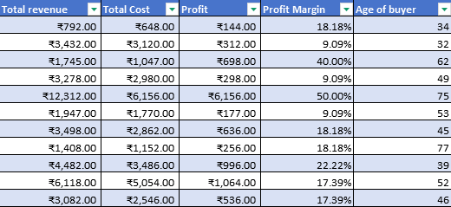
03
Calculation Columns
WHAT I DID
Total Revenue = Quantity x Unit Price
Cost Amount = Quantity x Cost
Profit = Revenue - Cost Amount
Profit Margin % = Profit / Revenue
Age = 2024 - Buyer birth year
EXCEL TOOLS
Formulas
YEAR
% Format
Output : Five new business columns per transaction
B&J Biscuit | Retail Revenue Analysis
5
Notes:
Paste the Excel screenshot / pivot for this task in the frame and add your key insight while presenting.

Slide 7
04
Product-Level Insights
WHAT I DID
Total Revenue by product - top earning biscuit
Total Profit by product - profitable vs weak items
Profit Margin % by product
Quantity Sold - best sellers vs slow movers
EXCEL TOOLS
Pivot Tables
Sort
Heatmap
Output : Four product pivots with ranking
B&J Biscuit | Retail Revenue Analysis
6
Notes:
Paste the Excel screenshot / pivot for this task in the frame and add your key insight while presenting.

Slide 8
05
Customer & Demographic KPIs
WHAT I DID
Revenue by Male / Female / Others
Age buckets: 18-28, 29-38, 39-48, 49-58, 59-68, 69+
Revenue and units sold by age group
Average purchase quantity and high-value buyer profiles
EXCEL TOOLS
Pivot Tables
Grouping
AVERAGEIFS
Output : Gender, age group
and buyer-segment KPIs
B&J Biscuit | Retail Revenue Analysis
7
Notes:
Paste the Excel screenshot / pivot for this task in the frame and add your key insight while presenting.

Slide 9
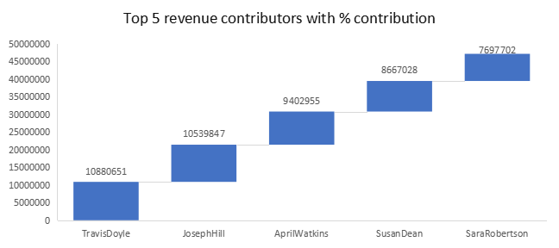
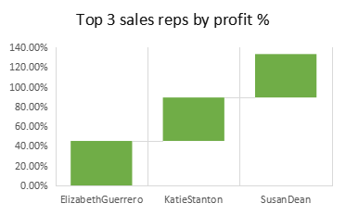
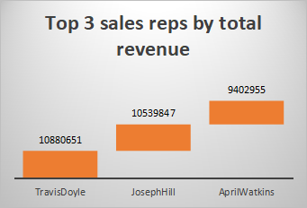
06
Sales Representative KPIs
WHAT I DID
Top 3 sales reps by total revenue
Top 3 sales reps by profit %
Top 5 revenue contributors with % contribution
EXCEL TOOLS
LIMIT
Output : Leaderboards with revenue and % share
B&J Biscuit | Retail Revenue Analysis
8
Notes:
Paste the Excel screenshot / pivot for this task in the frame and add your key insight while presenting.

Slide 10
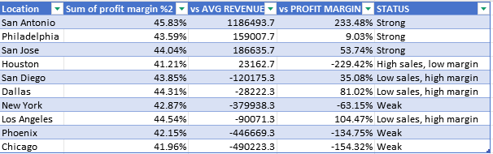
07
Location-Based KPIs
Compared city-level performance
WHAT I DID
Revenue and quantity sold by location
Ranked locations by profit margin
Compared city-level performance
EXCEL TOOLS
Pivot Tables
RANK
Output : Location ranking by revenue and margin
B&J Biscuit | Retail Revenue Analysis
9
Notes:
Paste the Excel screenshot / pivot for this task in the frame and add your key insight while presenting.

Slide 11
08
Payment Method Analysis
WHAT I DID
Revenue by payment type (UPI, Card, Cash)
Order count by payment method
Preferred payment method by gender and age group
EXCEL TOOLS
Pivot Tables
Output : Payment mix and preferences by segment
B&J Biscuit | Retail Revenue Analysis
10
Notes:
Paste the Excel screenshot / pivot for this task in the frame and add your key insight while presenting.

Slide 12
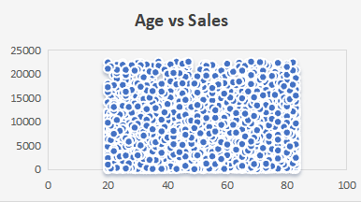
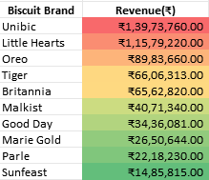
09
Visual Analysis
Column Product Revenue
Donut / Pie Gender-wise Sales
Histogram Age Group Distribution
Scatter Unit Price vs Profit
Scatter Age vs Sales
Line / Combo Sales + Profit Trend
Heatmap Product vs Revenue
B&J Biscuit | Retail Revenue Analysis
11

Slide 13
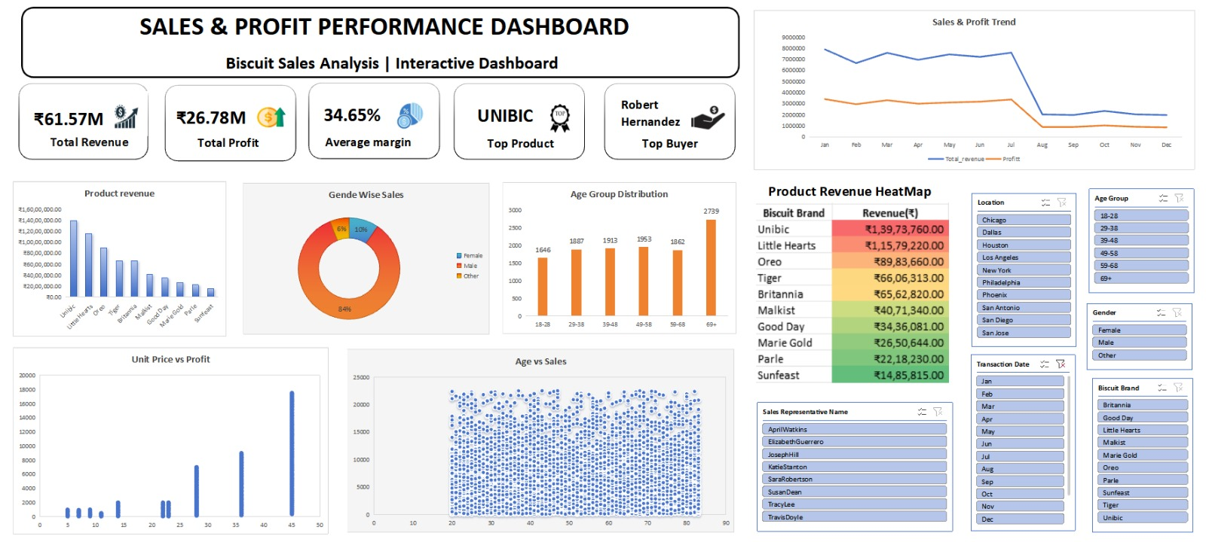
10
Interactive Dashboard
B&J Biscuit | Retail Revenue Analysis
12

Slide 14
Thank You

