Slide 1
PROBLEM + SOLUTION
Presenter 1
PA & TA
Application Automation
Professional and Teaching Assistantships
Academic Administration
Notes:
Presenter 1
Video cue: 00:00 to 00:10
Professional and Teaching Assistant recruitment involves applications, academic checks, reviews, and final lists. Manual coordination makes this process harder to manage.
Source: revised PA-TA-Demo.mp4 scene 1. Project demonstration and technical overview.

Slide 2
PROBLEM + SOLUTION
Presenter 1
Application workflow
Manual coordination
Proposed portal
Application collection
Academic checks
Candidate review
Final selection lists
Generated application forms
Eligibility checks at submission
Assigned faculty reviews
Approved results and exports
Notes:
Presenter 1
Video cue: 00:10 to 00:16
Our solution brings the complete workflow into one portal, from generated application forms to approved results.
Source: revised PA-TA-Demo.mp4 scene 2. Project demonstration and technical overview.

Slide 3
USERS + USAGE FLOW
Presenter 1
Users and responsibilities
Admin
Student
Faculty
Configures the semester
Sets rules and positions
Approves final results
Applies using academic data
Tracks application status
Views approved results
Reviews assigned courses
Shortlists candidates
Submits selections
Notes:
Presenter 1
Video cue: 00:16 to 00:24
Administrators configure and approve. Students apply and track progress. Faculty review candidates for their assigned courses.
Source: revised PA-TA-Demo.mp4 scene 3. Project demonstration and technical overview.

Slide 4
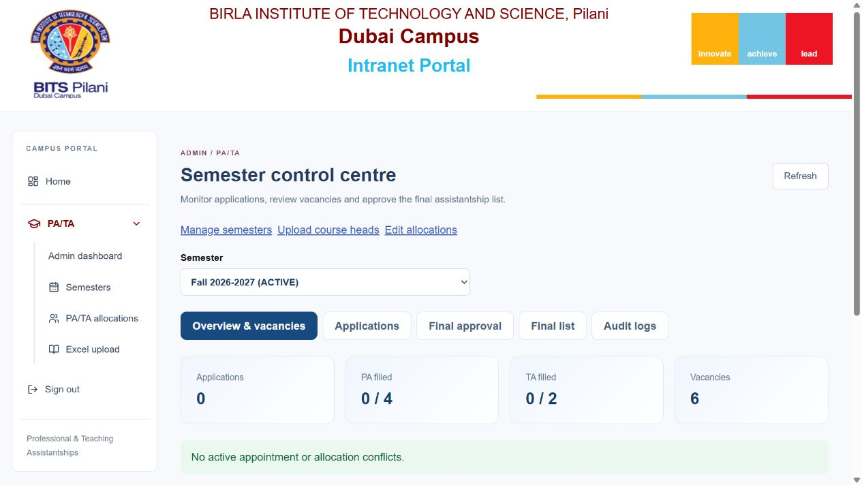
WORKING DEMONSTRATION / ADMIN
Presenter 1
Active semester dashboard
Live application counts, allocated positions, and vacancies
Notes:
Presenter 1
Video cue: 00:24 to 00:30
The Admin dashboard shows the active semester, application counts, filled positions, and vacancies.
Source: revised PA-TA-Demo.mp4 scene 4. Screen capture: admin.png. Synthetic demo records.

Slide 5
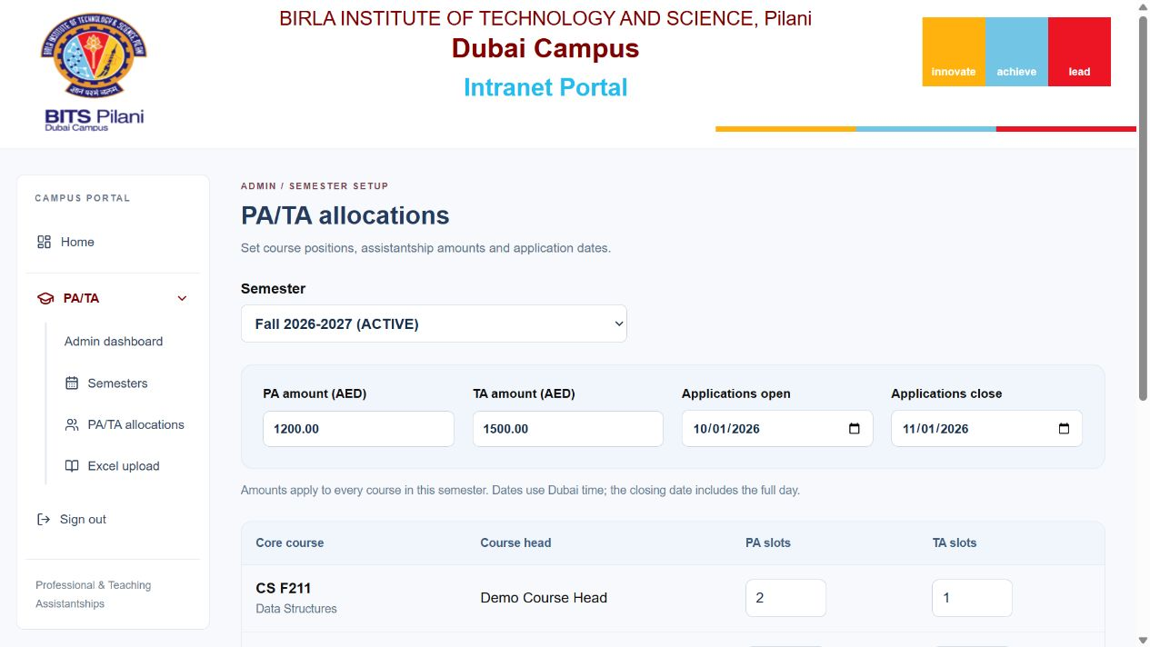
WORKING DEMONSTRATION / ADMIN
Presenter 1
Positions, amounts and application dates
Separate PA/TA slots and amounts, with one application window
Notes:
Presenter 1
Video cue: 00:30 to 00:36
Admin sets course slots, assistantship amounts, application dates, and course-head assignments.
Source: revised PA-TA-Demo.mp4 scene 5. Screen capture: allocations.png. Synthetic demo records.

Slide 6
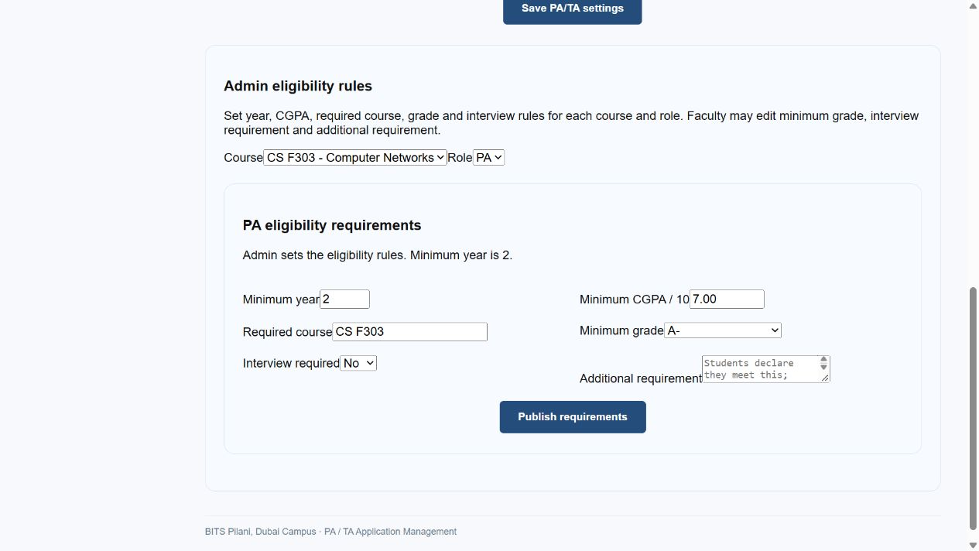
WORKING DEMONSTRATION / ADMIN
Presenter 1
Eligibility rules and generated forms
Year, CGPA, course grade, and interview rules drive eligibility
Notes:
Presenter 1
Video cue: 00:36 to 00:42
Publishing year, CGPA, grade, and interview rules generates the opportunities and forms.
Source: revised PA-TA-Demo.mp4 scene 6. Screen capture: rules.png. Synthetic demo records.

Slide 7
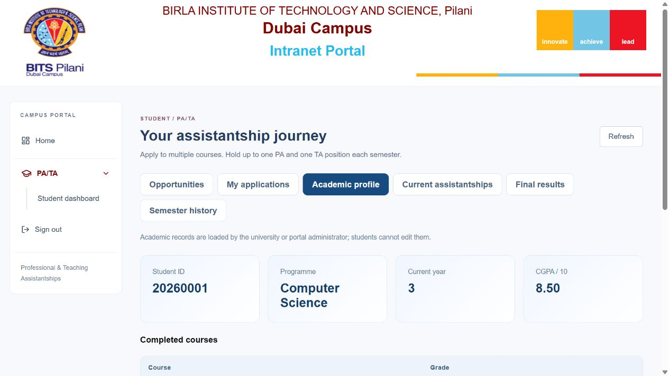
WORKING DEMONSTRATION / STUDENT
Presenter 2
Student academic profile
Academic information is preloaded and read-only
Notes:
Presenter 2
Video cue: 00:42 to 00:47
The student starts with a preloaded academic profile, reducing repeated data entry.
Source: revised PA-TA-Demo.mp4 scene 7. Screen capture: profile.png. Synthetic demo records.

Slide 8
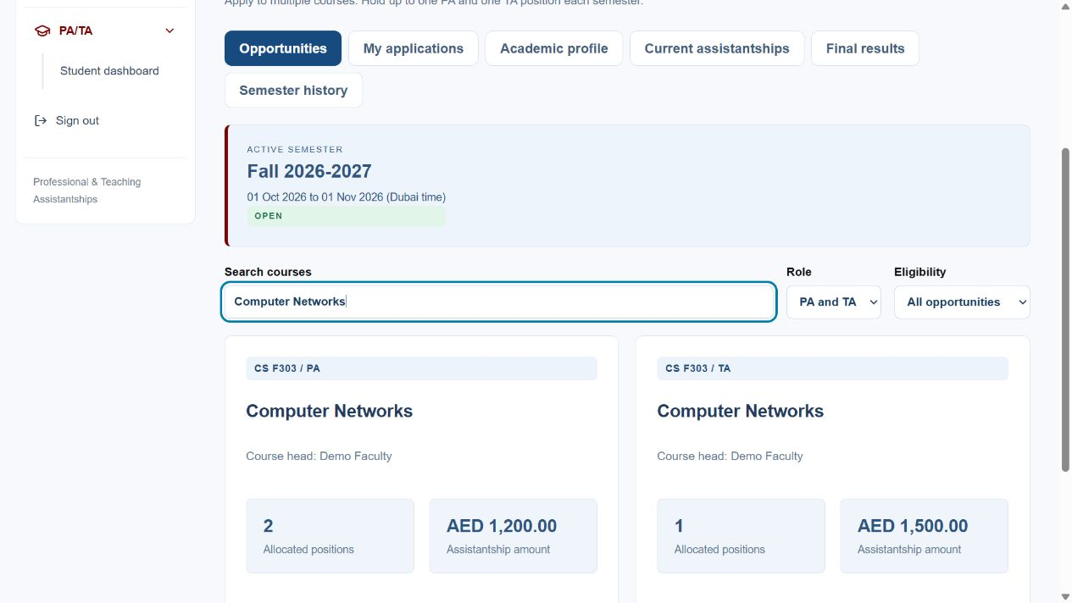
WORKING DEMONSTRATION / STUDENT
Presenter 2
PA and TA opportunities
Availability, requirements, amount, and eligibility appear together
Notes:
Presenter 2
Video cue: 00:47 to 00:56
Opportunities show eligibility, available positions, requirements, and assistantship amounts. The backend rechecks eligibility before submission.
Source: revised PA-TA-Demo.mp4 scene 8. Screen capture: opportunities.png. Synthetic demo records.

Slide 9
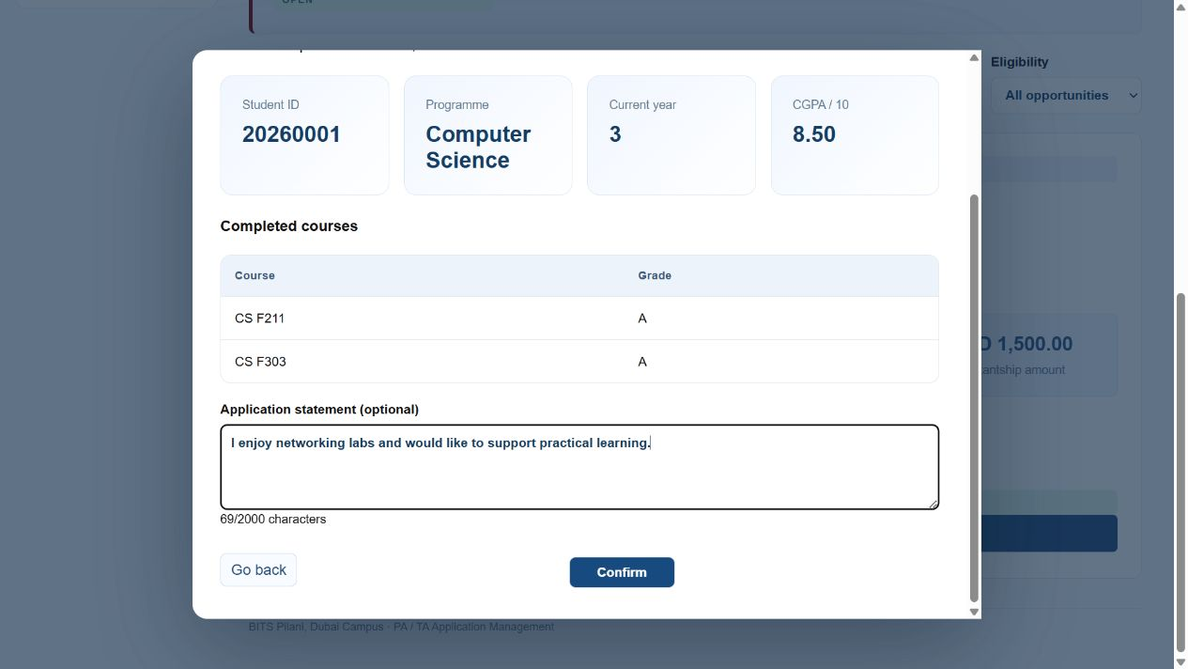
WORKING DEMONSTRATION / STUDENT
Presenter 2
Prefilled application
An optional statement adds context without retyping academics
Notes:
Presenter 2
Video cue: 00:56 to 01:02
This form already contains academic details. The student only adds an optional statement.
Source: revised PA-TA-Demo.mp4 scene 9. Screen capture: form.png. Synthetic demo records.

Slide 10
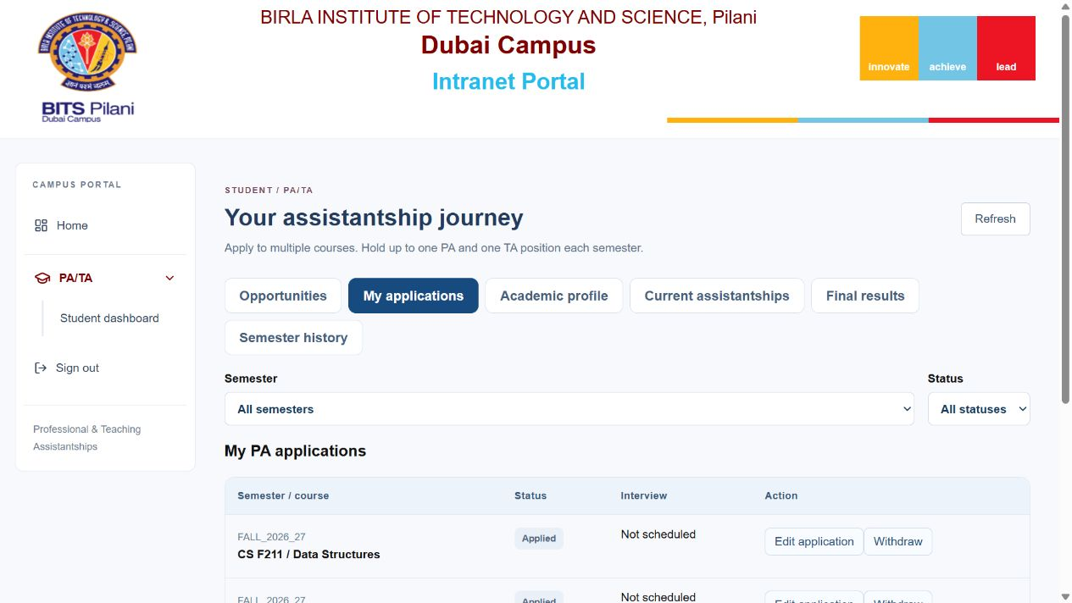
WORKING DEMONSTRATION / STUDENT
Presenter 2
Application tracking
Two PA applications and one TA application submitted successfully
Notes:
Presenter 2
Video cue: 01:02 to 01:07
Here, two PA applications and one TA application are submitted and tracked separately.
Source: revised PA-TA-Demo.mp4 scene 10. Screen capture: applications.png. Synthetic demo records.

Slide 11
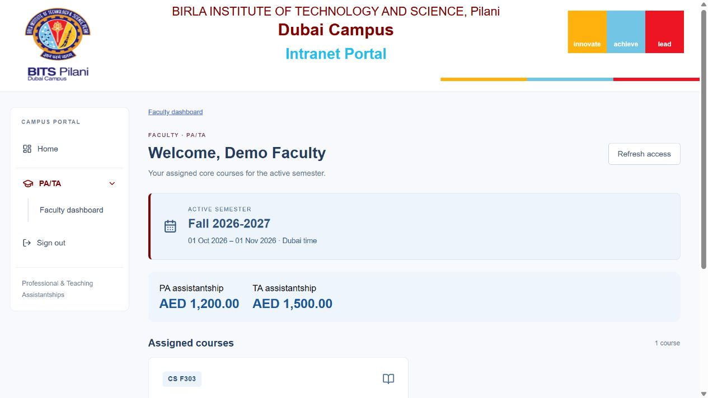
WORKING DEMONSTRATION / FACULTY
Presenter 2
Assigned faculty access
Only the assigned active-semester course is visible
Notes:
Presenter 2
Video cue: 01:07 to 01:13
Faculty can access only their assigned active-semester course. Let us follow the review process.
Source: revised PA-TA-Demo.mp4 scene 11. Screen capture: faculty-access.png. Synthetic demo records.

Slide 12
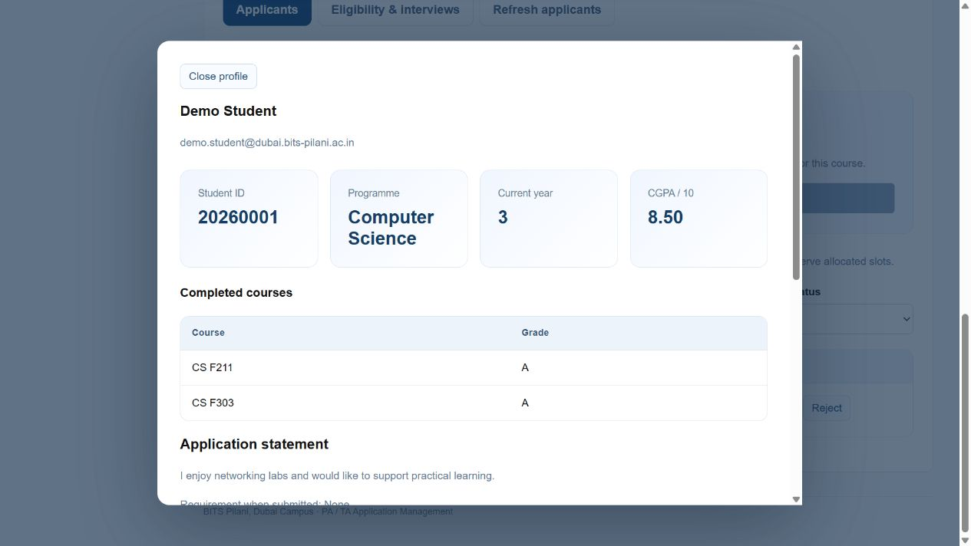
WORKING DEMONSTRATION / FACULTY
Presenter 3
Candidate academic review
Academics, statement, timetable, and private review notes
Notes:
Presenter 3
Video cue: 01:13 to 01:20
Faculty inspect the submitted academics, statement, and timetable. Private notes support their review.
Source: revised PA-TA-Demo.mp4 scene 12. Screen capture: candidate.png. Synthetic demo records.

Slide 13
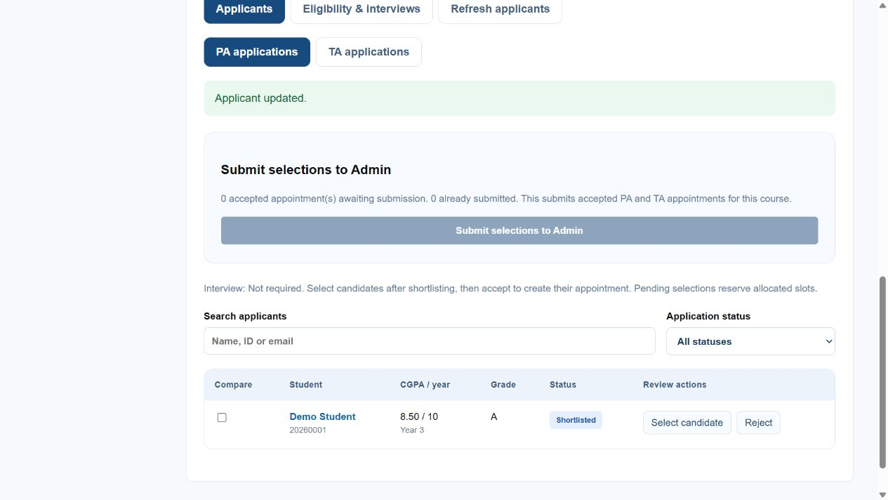
WORKING DEMONSTRATION / FACULTY
Presenter 3
Shortlisting and capacity checks
Shortlisted → Selected pending acceptance → Accepted
Notes:
Presenter 3
Video cue: 01:20 to 01:26
The candidate is shortlisted and selected. Capacity checks prevent the course from being overfilled.
Source: revised PA-TA-Demo.mp4 scene 13. Screen capture: shortlist.png. Synthetic demo records.

Slide 14
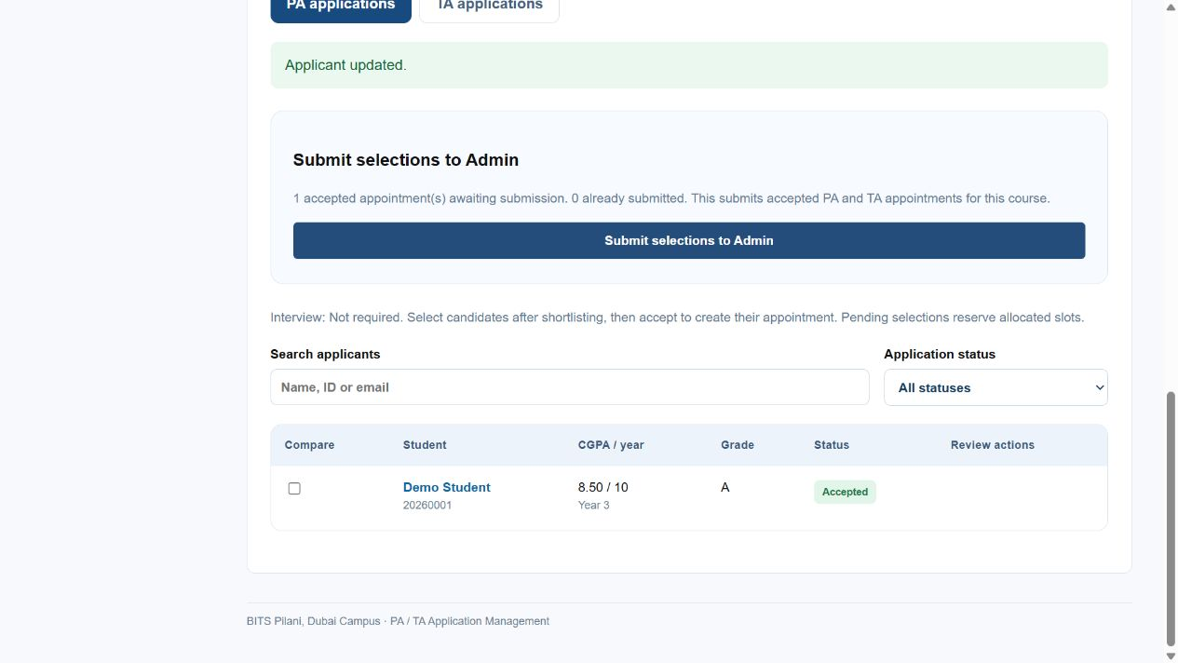
WORKING DEMONSTRATION / FACULTY
Presenter 3
PA acceptance and automatic cancellation
Appointment created; remaining same-role applications close automatically
Notes:
Presenter 3
Video cue: 01:26 to 01:31
Accepting the PA appointment automatically cancels other pending applications for the same role.
Source: revised PA-TA-Demo.mp4 scene 14. Screen capture: accepted.png. Synthetic demo records.

Slide 15
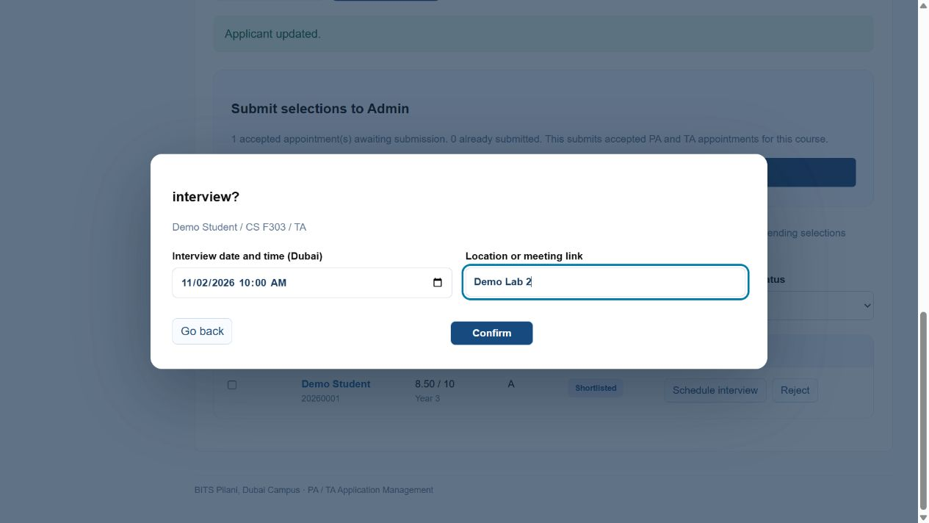
WORKING DEMONSTRATION / FACULTY
Presenter 3
TA interview schedule
Synthetic rehearsal: schedule an interview in Dubai time
Notes:
Presenter 3
Video cue: 01:31 to 01:37
For the interview-required TA role, faculty schedule an interview with its time and location.
Source: revised PA-TA-Demo.mp4 scene 15. Screen capture: interview.png. Synthetic demo records.

Slide 16
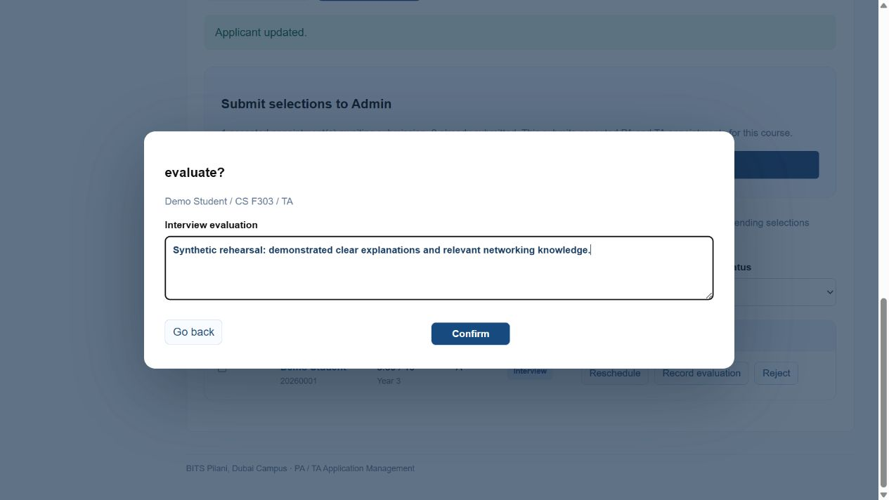
WORKING DEMONSTRATION / FACULTY
Presenter 3
Interview evaluation and TA acceptance
Demo evaluation required before selecting and accepting the TA
Notes:
Presenter 3
Video cue: 01:37 to 01:42
An evaluation must be recorded before selection. The TA appointment is then accepted.
Source: revised PA-TA-Demo.mp4 scene 16. Screen capture: evaluation.png. Synthetic demo records.

Slide 17
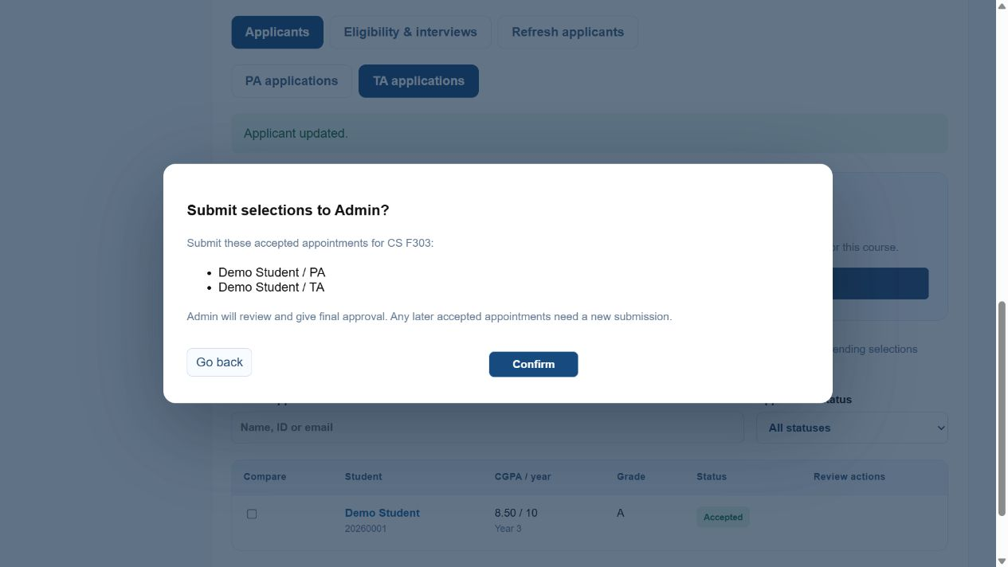
WORKING DEMONSTRATION / FACULTY
Presenter 3
Appointment submission to Admin
One PA and one TA are permitted; both require final approval
Notes:
Presenter 3
Video cue: 01:42 to 01:48
One student may hold one PA and one TA. Faculty submit both appointments to Admin.
Source: revised PA-TA-Demo.mp4 scene 17. Screen capture: submission.png. Synthetic demo records.

Slide 18
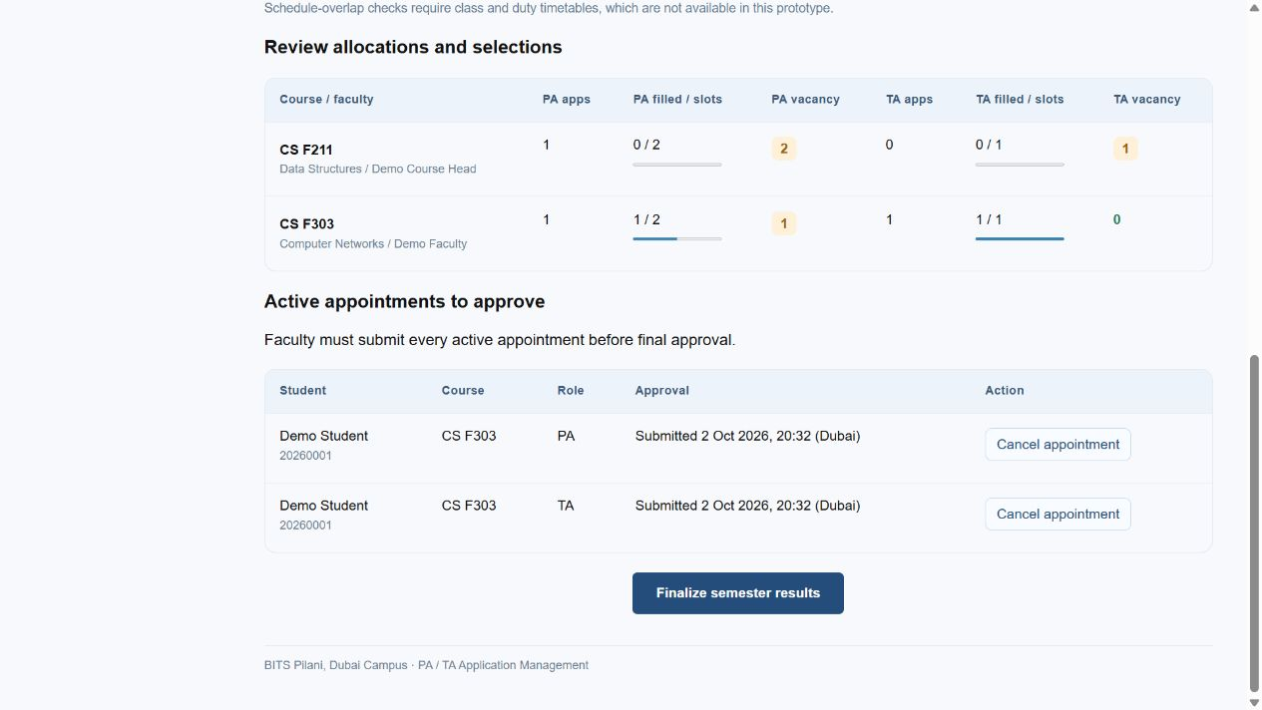
WORKING DEMONSTRATION / ADMIN
Presenter 4
Admin review and semester finalization
Admin checks submitted appointments, capacity, and conflicts
Notes:
Presenter 4
Video cue: 01:48 to 01:54
Admin reviews submitted appointments and conflicts, then finalizes the semester, locking the approved results.
Source: revised PA-TA-Demo.mp4 scene 18. Screen capture: approval.png. Synthetic demo records.

Slide 19
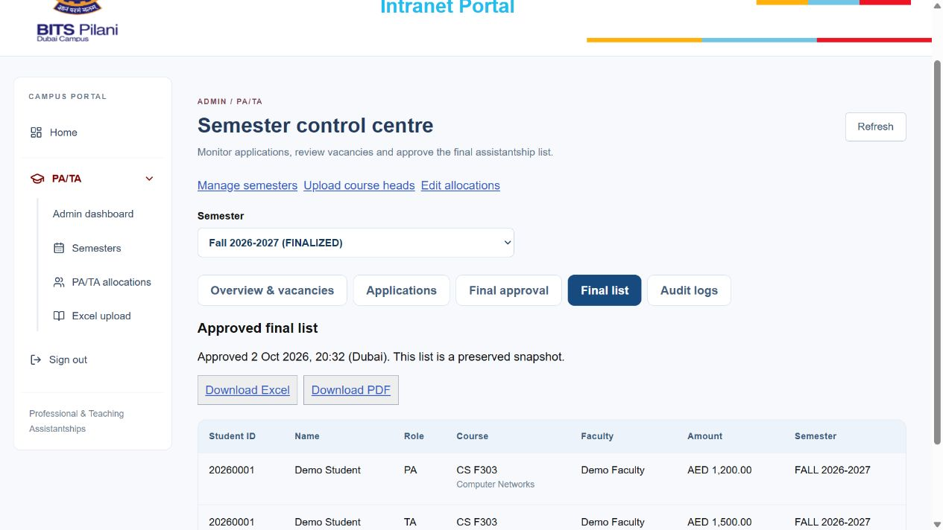
WORKING DEMONSTRATION / ADMIN
Presenter 4
Final selected list and exports
Approved PA/TA results · Verified Excel and PDF downloads
Notes:
Presenter 4
Video cue: 01:54 to 02:00
The final selected list is generated automatically and can be downloaded as Excel or PDF.
Source: revised PA-TA-Demo.mp4 scene 19. Screen capture: final-list.png. Synthetic demo records.

Slide 20
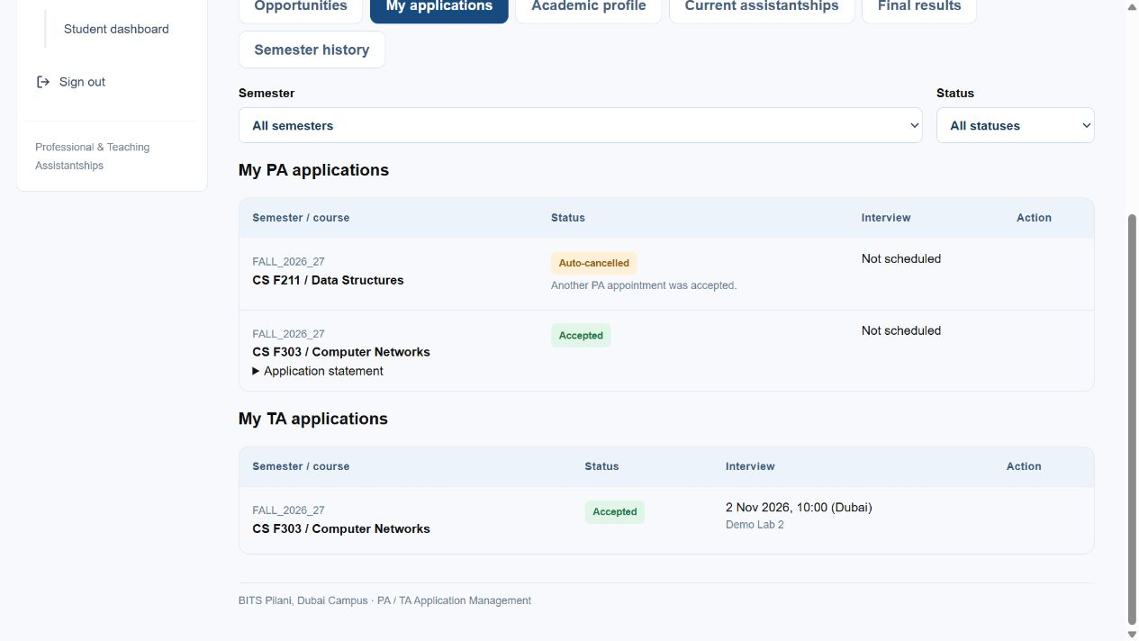
WORKING DEMONSTRATION / STUDENT
Presenter 4
Student application outcomes
Other PA auto-cancelled · Accepted PA and TA retained
Notes:
Presenter 4
Video cue: 02:00 to 02:06
The student can see the other PA application automatically cancelled, with both accepted roles retained.
Source: revised PA-TA-Demo.mp4 scene 20. Screen capture: auto-cancel.png. Synthetic demo records.

Slide 21
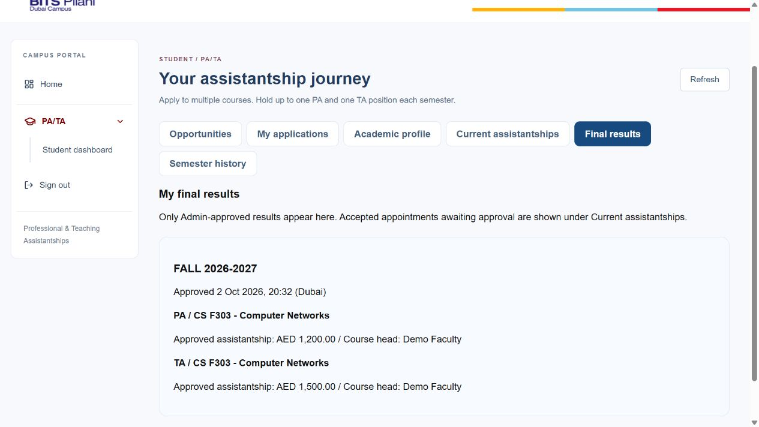
WORKING DEMONSTRATION / STUDENT
Presenter 4
Personal approved results
Only the signed-in student's approved results are shown
Notes:
Presenter 4
Video cue: 02:06 to 02:10
Personal final results show only that student's approved appointments and amounts.
Source: revised PA-TA-Demo.mp4 scene 21. Screen capture: student-results.png. Synthetic demo records.

Slide 22
TECHNICAL CHOICES
Presenter 4
Frontend, API and database
Frontend
React and Vite provide the role workspaces
API
Express enforces access and workflow rules
Database
PostgreSQL transactions protect appointments
PGlite supports local embedded storage
Notes:
Presenter 4
Video cue: 02:10 to 02:20
React and Vite provide the frontend. Express enforces access and workflow rules. PostgreSQL transactions protect appointments; local mode uses PGlite.
Source: revised PA-TA-Demo.mp4 scene 22. Project demonstration and technical overview.

Slide 23
TECHNICAL CHOICES
Presenter 4
University authentication and academic sync
Local access
Optional intranet interface
Hashed passwords
Signed cookies
Revocable database sessions
Signed institutional assertions
Verified campus identity
Academic record synchronization
Live university integration remains to configure
Notes:
Presenter 4
Video cue: 02:20 to 02:28
Revocable sessions protect access. An optional signed intranet interface supports institutional identity and academic synchronization.
Source: revised PA-TA-Demo.mp4 scene 23. Project demonstration and technical overview.

Slide 24
EXPECTED IMPACT
Presenter 4
Expected impact
Less repeated data entry
Organized reviews and clearer application status
Saved approvals and exportable final lists
Expected benefits, with no measured time-savings claim
Notes:
Presenter 4
Video cue: 02:28 to 02:35
The expected impact is less manual entry, organized reviews, clearer status tracking, and auditable final lists.
Source: revised PA-TA-Demo.mp4 scene 24. Project demonstration and technical overview.

Slide 25
IMPACT + NEXT STEPS
Presenter 4
Current scope and next steps
Current demonstration
Next steps
Working local prototype
Synthetic academic records
Complete application and selection flow
Configure university sign-in
Set up production hosting
Add duty timetable-overlap detection
Applications and approved results in one place
Notes:
Presenter 4
Video cue: 02:35 to 02:45
This demonstration uses synthetic data. Real university sign-in and production hosting remain to configure; duty timetable-overlap detection is a future extension.
Source: revised PA-TA-Demo.mp4 scene 25. Project demonstration and technical overview.

