Slide 1
Delta Rule Learning

Slide 2
Delta Rule Learning
Among neural network models, the Delta rule learning is Supervised learning algorithm.
Developed by Widrow and Hoff, the delta rule, also called the Least Mean Square (LMS) method, is one of the most commonly used learning rules

Slide 3
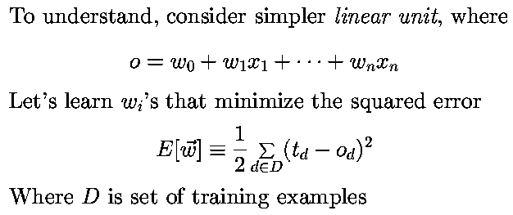
Delta Rule Learning
Note: output value o is a real value (not binary)
Delta rule: learning rule for an un-thresholded perceptron (i.e. linear unit).
Delta rule is a gradient-descent rule

Slide 4
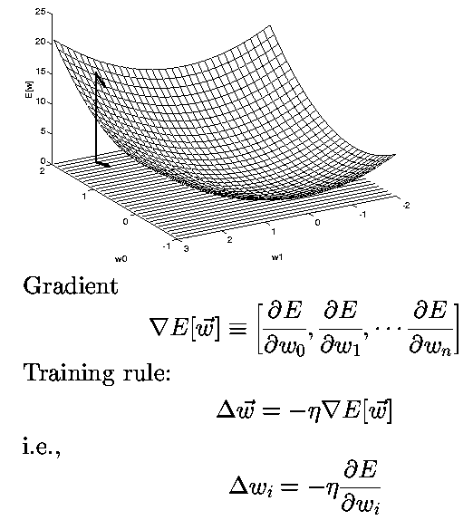
Delta Rule Learning

Slide 5
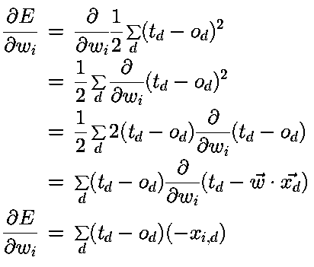
Delta Rule Learning

Slide 6
Code review

Slide 7
References
Delta Rule : https://en.wikipedia.org/wiki/Delta_rule
The Adaptive Filters, Simon Haykin -https://books.google.de/books/about/Adaptive_filter_theory.html?id=E5hTAAAAMAAJ&redir_esc=y
Neural networks Delta rule : http://uhavax.hartford.edu/compsci/neural-networks-delta-rule.html
Adaptive Filters , Bernard Widrow : http://www-isl.stanford.edu/~widrow/papers/b1971adaptivefilters.pdf
System Identification: https://en.wikipedia.org/wiki/System_identification
Black Box : https://en.wikipedia.org/wiki/Black_box

Slide 8
Any Questions ?

Slide 9
Thank You

