Slide 1
Parch & Posey Sale Performance Analysis by DataPioneers Team (Group 3) Submitted by: Bala Mairiga Abduljalil. Olaniyi Adewunmi.

Slide 2
Contents:
Overview
Objective of the Analysis
Visual and Analysis Insights
Recommendation

Slide 3
Overview
Paper goods are the primary focus of the American Posey. It employs fifty sales reps in all, who work in four US regions. Standard paper, glossy paper, and poster paper are the here types that the company sells. The CSV formatted results of the SQL were extracted, redirected, and entered into analysis to draw an insight and recommendation to enhance the business decision.

Slide 4
Objective of the Analysis:
The purpose of this analysis is to gain valuable insights from the company’s data and improve its sales performance and any decisions by the stakeholders.

Slide 5
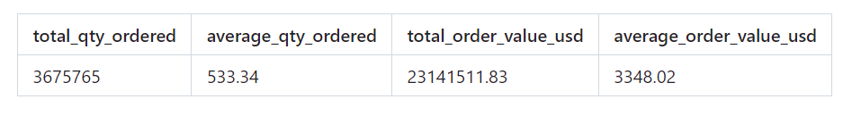
Sale Performance Overview
The company has sold a total of 3,675,765 units, making $23,141,511.83 in revenue. The average order size is 533.34 units, and the average transaction value is $3,348.02.

Slide 6
Quantity by Product type
The standard product type has the highest total quantity, followed by Gloss and Poster. This shows that Standard products are the most frequently ordered, which may indicate higher demand or preference for these items.

Slide 7
Sale performance by Product type
Standard products generate the highest revenue, while posters contribute the least in revenue generation.

Slide 8
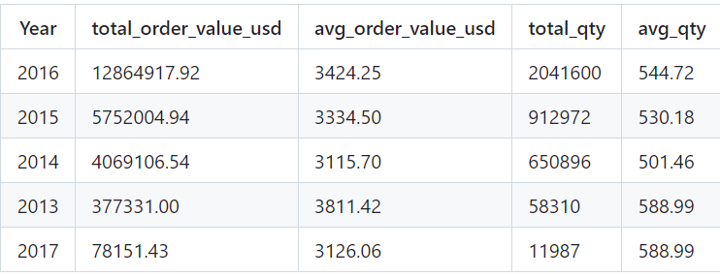
Sales and Quantity Trends by Year
2016 had the highest total order value and quantity, indicating that it was the year of peak sales and order volume. While the average order value was highest in 2013, lower overall sales indicate fewer but more expensive transactions. The decrease in sales in 2017 compared to previous years may require additional inquiry into potential explanations.

Slide 9
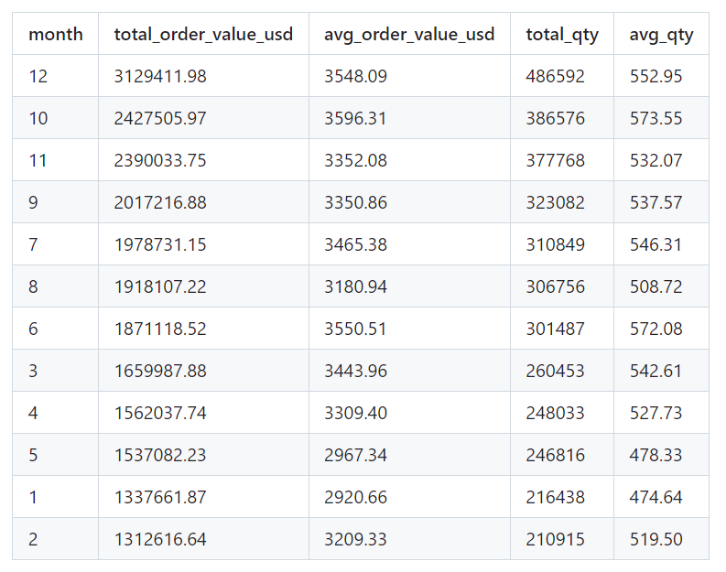
Sales and Quantity Trends by Year
December had the largest total order value in USD and a large number of orders, signifying strong end-of-year results. October also has strong sales and the greatest average order value, indicating that buyers are eager to spend more money this month. In contrast, months such as May and January, with lower total order values and average amounts, may benefit from specific promotions or campaigns to increase sales.

Slide 10
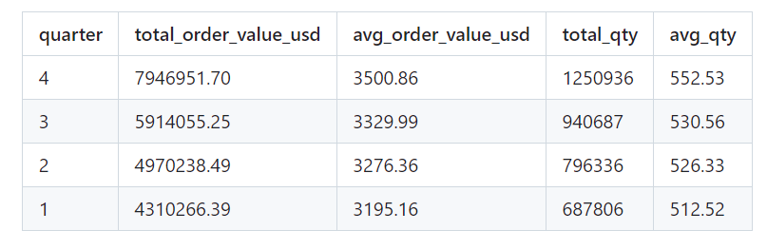
Sales and Quantity Trends by Quater
Q4 has the highest overall order value and quantity, indicating excellent end-of-year sales performance, while Q1 has the lowest values in both categories. This pattern indicates that the company has a sales high in the fourth quarter, potentially owing to seasonal demand or end-of-year promotions, and may require tactics to improve sales in the first quarter.

Slide 11
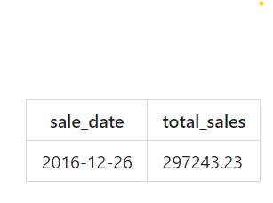
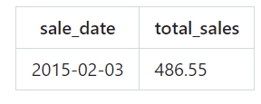
Peak Sales date
The highest sales were recorded on December 26, 2016, with a total of $297,243.23. While the lowest sales were recorded on February 3, 2015, with a total of $486.55. This indicates that the company experienced peak sales activity during holiday season shopping or post-holiday promotions
Highest Sales date
Lowest Sales date

Slide 12
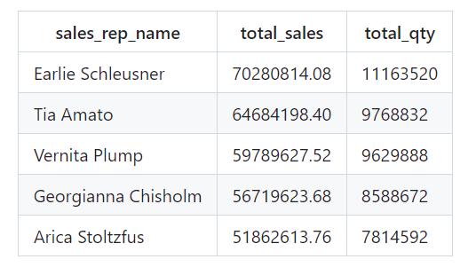
Top 5 Sales Reps
Earlie Schleusner leads in total sales and quantity sold, exhibiting a great ability to drive revenue and manage big volumes of orders. The remaining top sales representatives likewise demonstrate significant sales statistics, with a noticeable difference in both total sales and quantity.

Slide 13
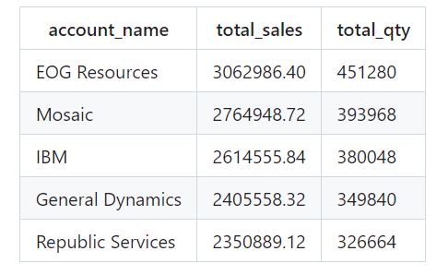
Top 5 Customers
EOG Resources leads in overall sales and amount purchased, showing that it is the most valuable customer. The remaining top customers have substantial sales and purchase volumes, emphasizing critical accounts that contribute significantly to overall revenue and order quantities

Slide 14
Regional Account Distribution
The Northeast region has the highest number of customers, Midwest has the fewest accounts indicating prospects for regional expansion or targeted sales efforts.

Slide 15
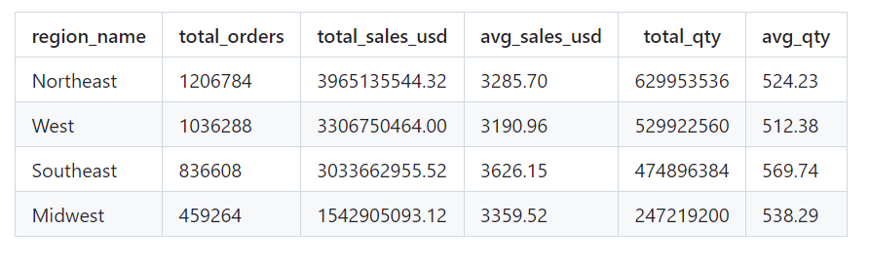
Sales and Quantity by Region
The Northeast region leads in total sales and quantity, indicating it is the highest revenue-generating region with a substantial number of orders. The Southeast region has the highest average sales per order, suggesting a stronger per-order performance. The Midwest has the lowest total sales and orders, which may indicate a need for increased focus or strategies to boost performance in that region.

Slide 16
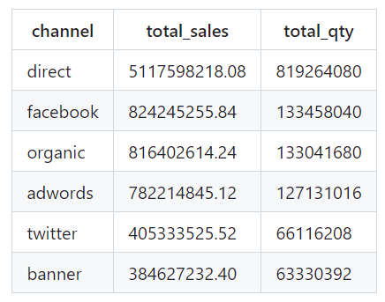
Sales and Quantity by Channel
The direct channel generates the highest sales and quantity, significantly outperforming other channels. This indicates that marketing through the direct channel is highly effective in driving revenue and underscores its importance in the overall sales strategy.

Slide 17
Recommendations
Consider increasing marketing efforts and promotions during the holiday season to capitalize on high consumer spending.
To sales in Lower Performing Quarters and Months Implement targeted campaigns or special offers to boost sales during these periods, potentially using data-driven insights to identify optimal strategies.
Develop loyalty programs or personalized offers to retain high-value customers and potentially increase their spending.
exploring opportunities to increase market share in the Midwest.

Slide 18
THANK YOU

