Slide 1
Exploratory Data Analysis of Posey Data Tables by DataPioneers Team (Group 3).
Submitted by:
Bala mairiga abduljalil.
OLANIYI ADEWUNMI.

Slide 2
List of Contents:
Overview
Objective of the Analysis
Data
Visual Insights
Analysis of the Insight
Recommendation

Slide 3
Overview
Paper goods are the primary focus of the American Posey. It employs fifty sales reps in all, who work in four US regions. Standard paper, glossy paper, and poster paper are the here types that the company sells. The CSV formatted results of the SQL were extracted, redirected, and entered in to analysis to drawn an insight and recommendation to enhance the business decision.

Slide 4
Objective of the Analysis:
The purpose of this analysis is to gain valuable insights from the company’s data and improve its sales performance and any decision by the stakeholders.

Slide 5
DATA:
The data underwent a comprehensive cleaning process prior to analysis. Every blank and duplication was removed. PostgreSQL was used for the exploratory data analysis with the goal of minimizing revenue loss and optimizing revenue and sales across the four regions.

Slide 6
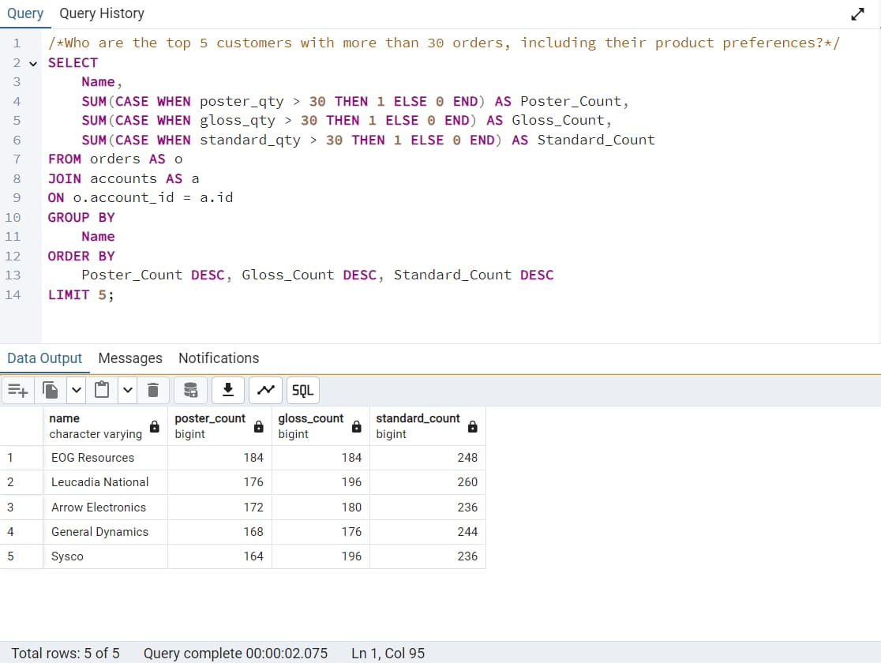
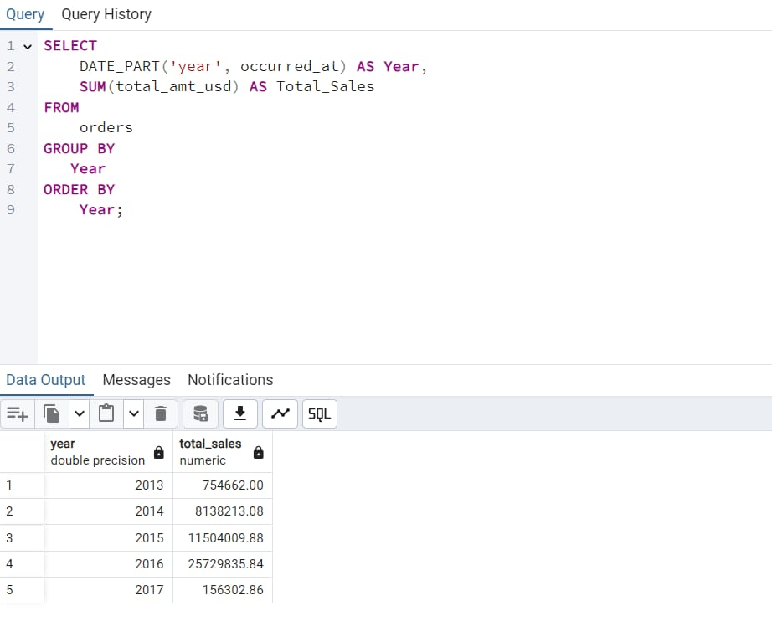
VISUAL INSIGHT:

Slide 7
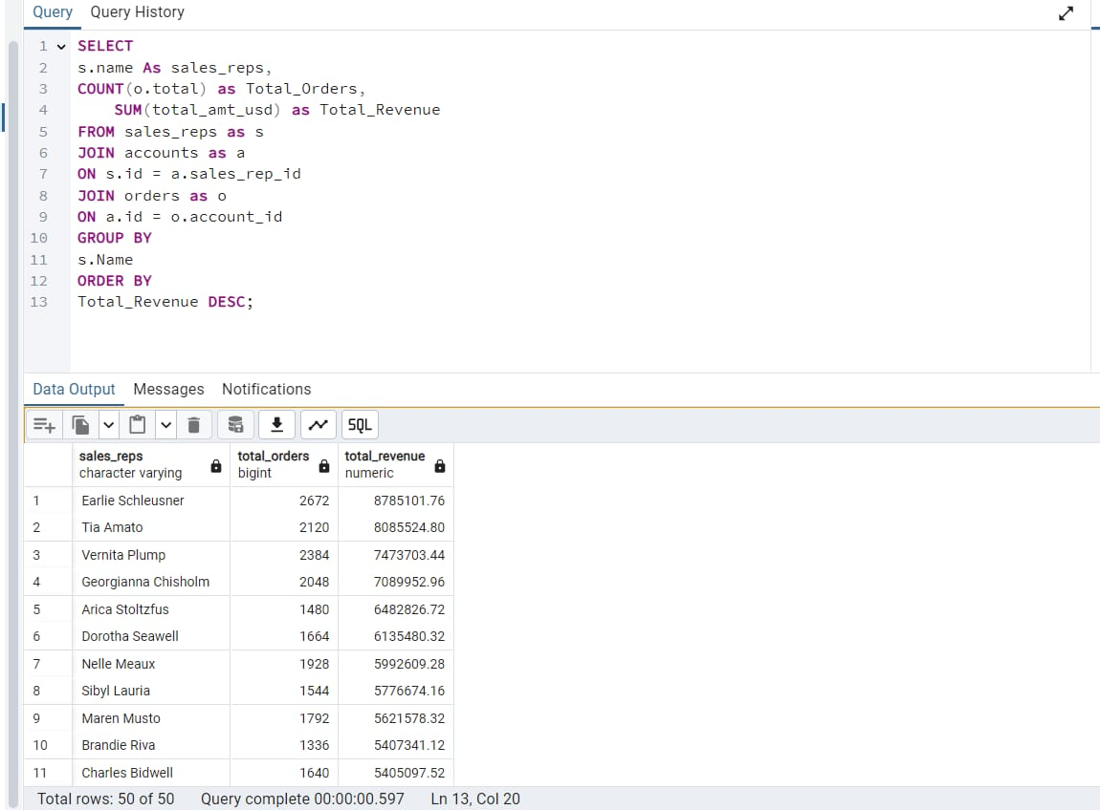
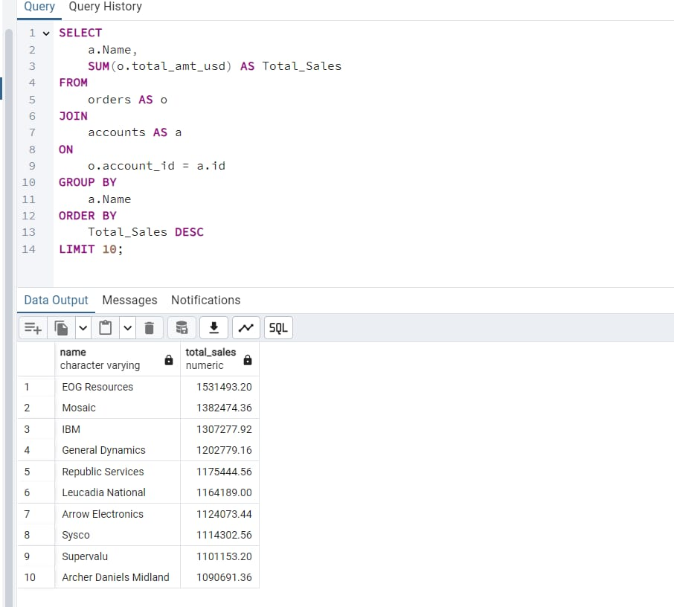
CONT.

Slide 8
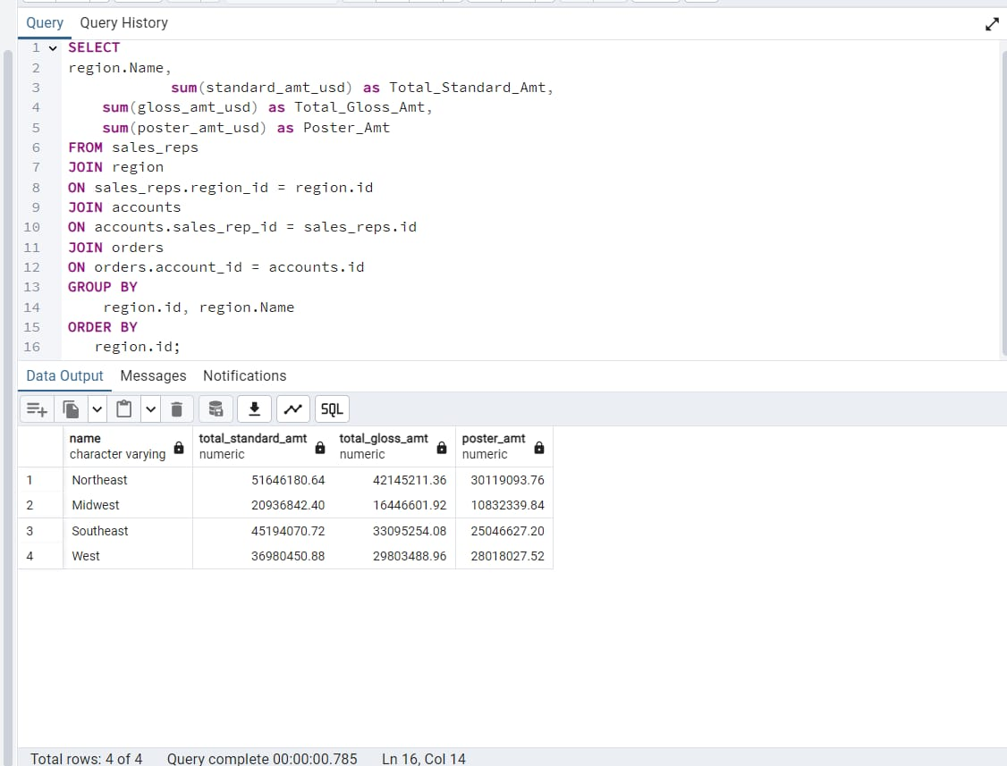
CONT.

Slide 9
ANALYSIS OF INSIGHTS:
The first query aims to identify the top 5 frequent buyers and customers, indicating their loyalty to the business and also understanding these customers’ product preferences (standard, glass and poster) to help tailor marketing efforts to cater to their interests.
The second query aims to provide an overview of the totals sales and how they are distributed across documented years from 2013-2017 which help in the analyzing sales data over time to identified the trends, patterns and potential growth or decline in sales for different years.

Slide 10
Cont.
Thirdly, the query’s objective is to identify and highlight the sales representatives who excel in terms of both order volume and revenue generation by considering both order count and revenue criteria, the query helps to pinpoint the top performing sales representatives who significantly contribute to the company’s success.
Fourthly, the query aims to asses and quantify the patronage rate of companies, which can be a key metric for understanding their Performance. This insight can guide decision making, allowing for targeted strategies to retain or improve relationship with key customers and address issues with underperforming ones.

Slide 11
Cont.
Lastly, the query aims to identify and highlight the regions that contributed the most to the company’s revenue and analyze the total revenue by regions, for the stakeholders to decide on prioritize regions for further expansion or allocation of resources to regions with the highest revenue potential.

Slide 12
RECOMMENDATION:
Analysis identify EOG Resources, Leucadia National and Arrow Electronic are the top three customers purchases with both preferences products standard papers which indicate from 248 pieces to the highest purchases of 260 by Leucadia National.
Between 2013 and 2016 possey experienced remarkable growth in term of sales and revenue but however, in 2017, the company witnessed a significant decline in sales leading to a drop in revenue. This trend could be attributed to various factors, including changes in consumer behavior, market competition or company strategy policy.

Slide 13
Cont.
Analysis identify Earlier Schleusner, Tia Amato and Vernita Plumps to be the top three company representatives with top total revenue sales based on their orders, while also EOG Resources, Mosaic and IBM are the top three names with high resources.
Finally, we were able to analyze Northeast region of the US followed by Midwest are the regions with most of posey papers.

Slide 14
THANK YOU

