Slide 1
ABC FASHION PVT. LTD.
EXECUTIVE SALES & PRODUCTION PERFORMANCE DASHBOARD
Presented by: Bala Abineshwar B

Slide 2




Introduction
OVERVIEW
ABC Fashion Pvt. Ltd. Executive Sales & Production Performance Analytics focuses on analyzing apparel manufacturing and regional distribution data to understand revenue generation, inventory costs, product line performance, and operational efficiency.
Revenue Generation
Inventory Costs
Product Line Performance
Operational Efficiency

Slide 3
Objectives
Analyze overall revenue and sales quantity performance
1
5
Identify trends in monthly revenue and sales momentum
2
Understand product style, size, and manufacturing performance
3
Objectives guiding the analysis
Evaluate operational metrics such as factory planning, actual production output, fulfillment rates, and distributor distribution
4
Generate actionable insights and interactive executive dashboards to support strategic decision-making
5

Slide 4

Dataset
DOMAIN
PERIOD
Women’s Apparel Manufacturing & Distribution
Semi-Annual Performance Cycle
January to June
DATASET STRUCTURE · 2 CORE TABLES
Jan
Feb
Mar
Apr
May
Jun
Sales_Data
Production Data

Slide 5




Tools Used
CORE TOOL
Advanced DAX Measures & Modeling
CALCULATE, SUM, FORMAT
Star Schema Relational Architecture
Centralized bridging table
Power BI Desktop
Dynamic Month and Product Slicers
Top-header dropdown filters for full-page control

Slide 6




Data Preparation & Modeling
01
02
03
Inspect the Schema
Create Calculated Columns
Check Data Quality
Inspected relational schema and verified primary/foreign key integrity across dimension and fact tables.
Created custom calculated columns such as MonthName within the Calendar Table for streamlined UI filtering.
Checked data consistency, formatting, and numeric aggregations prior to building the command center interface.
Result: a verified, consistent model ready for the command center interface

Slide 7
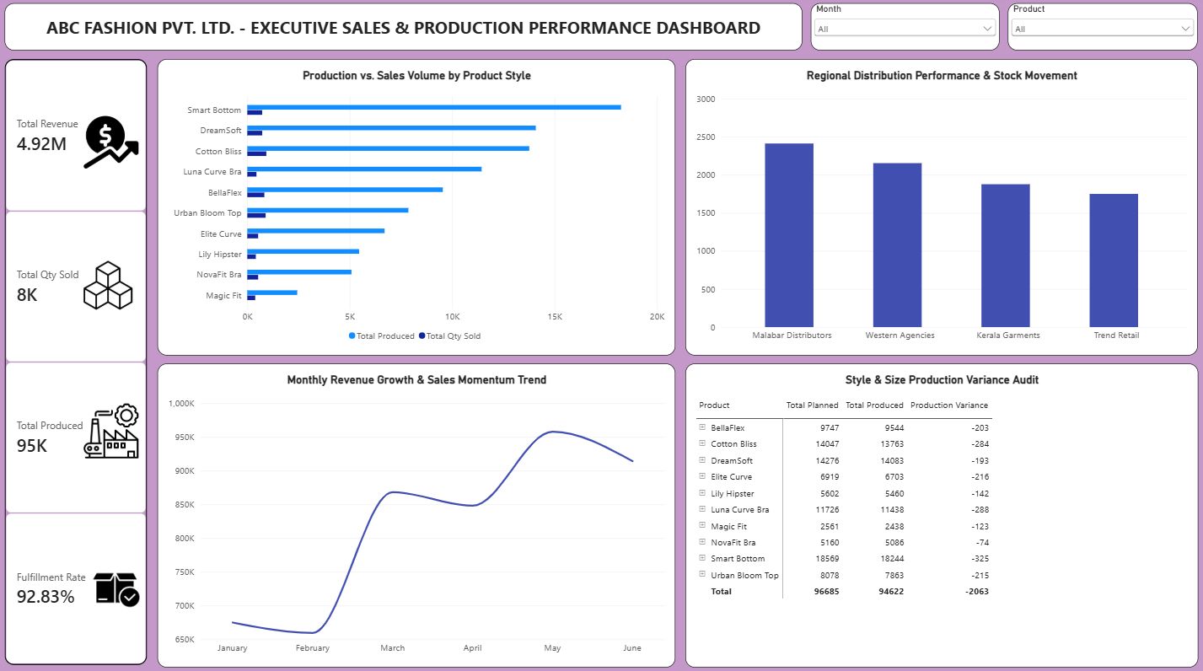
Dashboard Visual Layout & Analysis
Executive command center: KPI cards, trends, production vs. sales, distributors, variance matrix, and slicers.
Notes:
Dashboard components: (1) Executive Title Banner - bold uppercase header defining the command center scope. (2) Vertical left-side KPI panel - Total Revenue (4.92M), Total Qty Sold (8K), Total Produced (95K), Fulfillment Rate (92.83%) with custom icons. (3) Monthly Revenue Line Chart - timeline tracking sales fluctuations from January through June. (4) Production vs. Sales Clustered Bar Chart - factory output (Total Produced) against customer purchases (Total Qty Sold) by product style. (5) Distributor Quantity Sold Chart - column chart of sales volume across regional partners (Malabar Distributors, Western Agencies, etc.). (6) Production Variance Matrix Table - planned vs. produced quantities and variances by style and size. (7) Executive Slicers - top-header dropdown filters for Month and Product enabling full-page dynamic control.

Slide 8
Key Insights
Concentrated output: Styles like Smart Bottom and DreamSoft recorded high production volumes, highlighting concentrated manufacturing output.
Factory production vs. customer sales
Top regions: Malabar Distributors and Western Agencies captured the highest regional sales volume share.
Mid-period peak: Monthly revenue trends show distinct sales acceleration peaking toward the middle of the active period.
Inventory gap: A significant volume gap exists between factory production totals (95K) and actual customer sales (8K), pointing directly to heavy inventory accumulation.
92.83%
Order fulfillment rate
Strong fulfillment: The overall order fulfillment rate stands strong at 92.83%, while style-level size variances reveal specific manufacturing shortfalls.

Slide 9


Business Observations
Rising inventory holding costs
Potential stock imbalances
Heavy manufacturing batches without proportional sales demand indicate rising inventory holding costs.
Regional distribution shows varying movement speeds across wholesale partners, suggesting potential stock imbalances.
Factory planning inefficiencies
Production tracking gap
Production variances across sizing variants point to planning inefficiencies at the factory level.
The absence of direct date-stamped production tracking requires monitoring manufacturing output as a stable baseline against dynamic sales.

Slide 10
Recommendations
01
02
03
04
05
Re-align Production Targets
Optimize Regional Stock Allocation
Monitor Style-Level Variances
Streamline Working Capital
Enhance Distributor Support
Adjust future factory manufacturing schedules to match real market demand, mitigating excess inventory costs.
Address distributor-specific sales velocities to ensure high-demand regions avoid stock shortages.
Utilize the size-and-style matrix to correct sizing production imbalances before launching new batches.
Reduce tied-up capital in slow-moving apparel lines by leveraging sales trend visibility.
Work closely with lower-performing regional partners to accelerate sell-through rates.

Slide 11
Conclusion
THE ANALYSIS
THE DASHBOARD
The Power BI analysis provided a comprehensive view of sales trends, production output, inventory variance, and regional distribution at ABC Fashion Pvt. Ltd.
The executive command center dashboard successfully unifies financial reporting and manufacturing metrics into a single interface, empowering leadership to identify cost inefficiencies and support data-driven decision-making.
Sales trends
Production output
Inventory variance
Regional distribution

Slide 12


Key Learnings
Mastered star schema data modeling and bridging relationships in complex supply-chain and sales structures.
01
Practiced building responsive, executive-grade single-page command center layouts with custom UI elements.
02
Learned how to convert raw manufacturing data and retail transactions into actionable business recommendations.
03

Slide 13
Thank You!
Questions & Answers

