Slide 1
BALAASTRATECH
LIVE ON SCREEN NOW →
AI ADVISOR
AI Negotiation
Copilot
for Android XR
“Counter their offer of $500 with a price closer to your target, such as $700.”
$600–800
market range, auto-researched
<1s
coaching latency
A real-time coaching agent on your glasses — it listens to a live negotiation and surfaces the next move on your lens, hands-free, eyes-up.
Deployed
live on Google Cloud Run
POWERED BY GEMINI LIVE
DISPLAY & AUDIO GLASSES
Balaastratech · AI Negotiation Copilot
Android XR Developer Catalyst — May 2026
1

Slide 2
The problem
High-stakes conversations demand your full attention — exactly when you most need help.
1
2
3
You can't look away
Information arrives too late
Most people negotiate blind
Salary talks, deals, big purchases — glancing at a phone breaks eye contact and signals weakness. The help has nowhere to live.
The right counter-offer or market price is useless after the moment has passed. Negotiation is real-time or it's nothing.
Without prep or live data, people leave money on the table on the most expensive decisions of their lives.
On glasses, the advisor finally has a home: in your field of view, the instant it matters.
Balaastratech · AI Negotiation Copilot
Android XR Developer Catalyst — May 2026
2

Slide 3
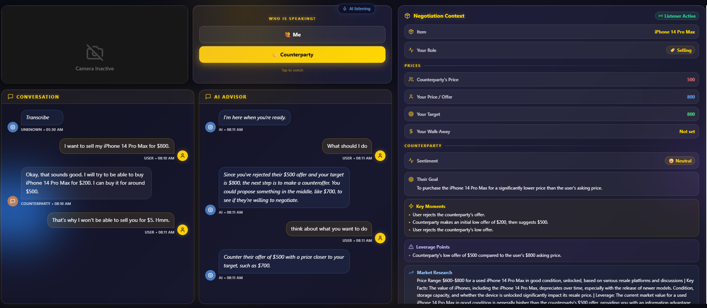
The solution — working today
Our live web/desktop app already does the hard part: listen, understand, and coach in real time. XR is the natural home for it.
Balaastratech · AI Negotiation Copilot
Android XR Developer Catalyst — May 2026
3
Live session: selling an iPhone 14 Pro Max. The copilot extracts item, prices & sentiment, flags the $500-vs-$800 leverage gap, pulls market data, and says “counter at ~$700” — instantly.

Slide 4
Why Android XR — why glasses
This is a glanceable, hands-free, conversational utility — the exact profile Google describes for Display & Audio glasses.
ON THE LENS
✓
Eyes-up & hands-free
Coaching on the lens; no phone, no broken eye contact.
● AI ADVISOR
✓
Real-time & ambient
Counter their $500 with a price closer to your target — try $700.
Sub-second cards appear the moment leverage shifts.
✓
Voice-first
MARKET $600–$800
SENTIMENT NEUTRAL
“Ask AI” by voice; spoken guidance back.
LEVERAGE HIGH
TACTIC BATNA
✓
All-day contextual
From a car lot to a boardroom — always ready.
Mock — glanceable HUD concept built from the live product UI
Balaastratech · AI Negotiation Copilot
Android XR Developer Catalyst — May 2026
4

Slide 5
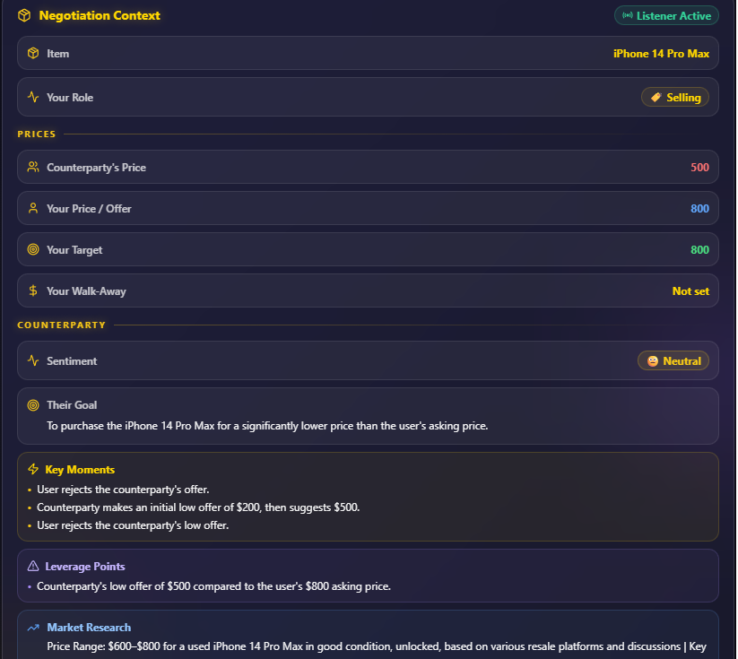
Built on Gemini — already deployed
A production multimodal agent on Google's own stack. The XR client reuses this backend unchanged.
Gemini Live API
Real-time native-audio voice — listens & speaks back
Gemini Flash · ListenerAgent
Background extraction: prices, sentiment, leverage
Google Search grounding
Live market data ($600–$800 range, auto-pulled)
FastAPI + WebSockets
16 kHz PCM streaming, sub-second round-trip
Real output: auto-built negotiation context — item, prices, leverage points & researched market tactics.
Balaastratech · AI Negotiation Copilot
Android XR Developer Catalyst — May 2026
5

Slide 6
Roadmap to Play — and the ask
Native Kotlin + Jetpack Compose client on the Jetpack XR SDK, reusing our deployed cloud backend.
0–2 mo
2–4 mo
4–8 mo
8–12 mo
Port WebSocket audio client to native Jetpack XR; coaching cards on lens
On-glasses mic capture + voice “Ask AI”; latency tuning for the HUD
Closed testing on dev-kit hardware; ambient-listening consent UX
Android XR closed/open testing track → Play, target Mar 2027
THE ASK
Dev kit
Tech support
Grant
Display & Audio glasses hardware (shipping to eligible region)
Jetpack XR SDK guidance for low-latency on-glasses audio
~3–4 mo focused engineering to port & harden the native client
Balaastratech · AI Negotiation Copilot
Android XR Developer Catalyst — May 2026
6

