Slide 1
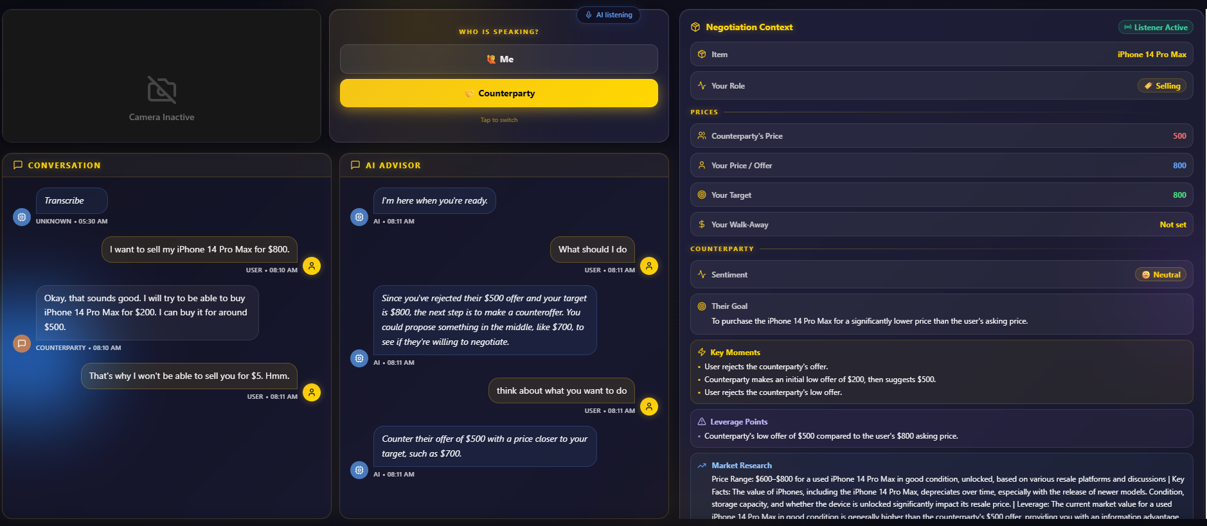
BALAASTRATECH
Android XR Developer Catalyst Program
AI Negotiation Copilot — One-Page Brief
Form factor: Display & Audio glasses
Stack: Android + Jetpack Compose (XR SDK)
What it is: A real-time coaching agent on your glasses. It listens to a live, in-person negotiation and surfaces the next move on your lens — hands-free, eyes-up, in under a second.
THE PROBLEM
You can't look at a phone mid-negotiation — it breaks eye contact and signals weakness.
The right counter-offer or market price is worthless after the moment passes.
Most people negotiate blind on their most expensive decisions.
WHY GLASSES (FORM-FACTOR FIT)
Glanceable & hands-free — coaching lives in your field of view.
Real-time & ambient — cards appear the instant leverage shifts.
Voice-first — “Ask AI” by voice, spoken guidance back.
Live session: the copilot extracts context, flags the $500-vs-$800 gap, pulls market data, and says “counter at ~$700.”
<1s
$600–800
Deployed
TECH — BUILT ON GEMINI, ALREADY DEPLOYED
coaching latency
auto-researched
Cloud Run, live
Gemini Live API — real-time native-audio voice.
Gemini Flash ListenerAgent — extracts prices, sentiment, leverage.
Google Search grounding + FastAPI/WebSockets, live on Google Cloud Run.
ROADMAP 0–2 mo port to Jetpack XR · 2–4 mo on-glasses audio + voice · 4–8 mo dev-kit testing · 8–12 mo Play (Mar 2027).
THE ASK Display & Audio glasses dev kit · Jetpack XR SDK technical support · grant for ~3–4 months to port & harden the native client.
Live app: negotiation-frontend-219079068693.us-central1.run.app Health: …run.app/health

