Slide 1
DATABASE PROJECT PRESENTATION
STUDENT MANAGEMENT SYSTEM
MySQL • SQL • Relational Database Design
Presented by | B. Chaitanya
PROJECT OVERVIEW • QUERIES • EXPECTED OUTPUTS

Slide 2
PROBLEM STATEMENT
02
KEY CHALLENGES
• A college wants to digitize student information and academic records.
• Manual maintenance makes it difficult to track student details.
• Course registrations and examination results are harder to monitor.
• A relational database is needed to maintain consistency and generate reports.
STUDENT MANAGEMENT SYSTEM • MYSQL CAPSTONE PROJECT

Slide 3
PROJECT OBJECTIVE
03
WHAT WE WILL BUILD
• Design and implement a Student Management System using MySQL.
• Manage departments, faculty, courses and course enrollments.
• Maintain examination and marks records accurately.
• Generate useful SQL reports for college administration.
STUDENT MANAGEMENT SYSTEM • MYSQL CAPSTONE PROJECT

Slide 4
DATABASE DESIGN — CORE TABLES
04
DEPARTMENTS
STUDENTS
FACULTY
dept_id (PK)
dept_name • hod_name
location
student_id (PK)
student_name • phone • email
city • admission_date • dept_id (FK)
faculty_id (PK)
faculty_name • email • designation
hire_date • dept_id (FK)
COURSES
ENROLLMENTS
EXAMS
course_id (PK)
course_name • credits • fee
dept_id (FK)
enrollment_id (PK)
student_id (FK) • course_id (FK)
enrollment_date • enrollment_status
exam_id (PK) • course_id (FK)
exam_name • exam_date • max_marks
MARKS
mark_id (PK)
student_id (FK) • exam_id (FK)
marks_obtained
STUDENT MANAGEMENT SYSTEM • MYSQL CAPSTONE PROJECT

Slide 5
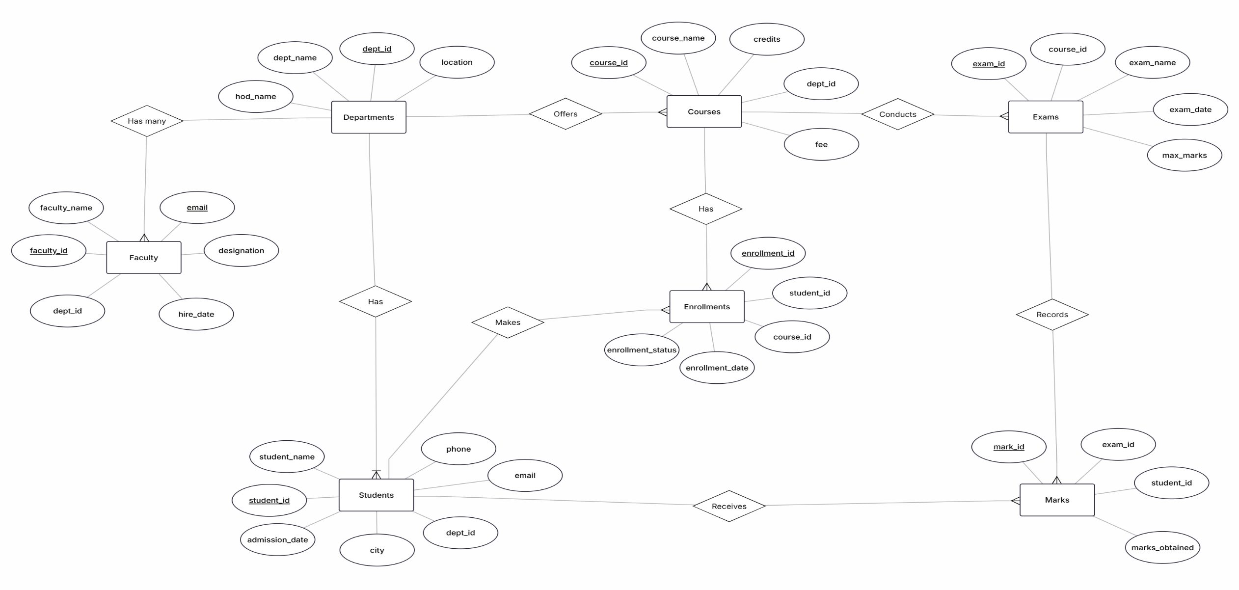
ENTITY RELATIONSHIP DIAGRAM
05
STUDENT MANAGEMENT SYSTEM • MYSQL CAPSTONE PROJECT

Slide 6
SAMPLE DATA TABLES
06
DEPARTMENTS (SAMPLE ROWS)
dept_id | dept_name | hod_name | location
1 | Computer Science | Dr. Ramesh Kumar | Block A, Floor 2
2 | Electronics | Dr. Lakshmi Rao | Block B, Floor 1
3 | Mechanical | Dr. Arjun Verma | Block C, Floor 1
4 | Commerce | Dr. Sneha Iyer | Block D, Floor 3
STUDENTS (SAMPLE ROWS)
student_id | student_name | dept_id | city | admission_date | phone
101 | Anil Kumar | 1 | Hyderabad | 2023-07-15 | 9876543210
103 | Priya Sharma | 1 | Warangal | 2024-07-10 | 9123456780
104 | Rahul Reddy | 2 | Vijayawada | 2024-07-12 | 9988776655
106 | Sneha Patel | 3 | Guntur | 2025-07-08 | 9012345678
STUDENT MANAGEMENT SYSTEM • MYSQL CAPSTONE PROJECT

Slide 7
SAMPLE DATA TABLES
07
FACULTY (SAMPLE ROWS)
faculty_id | faculty_name | email | designation | hire_date | dept_id
501 | Dr. Meera Nair | meera.nair@college.edu | Professor | 2015-06-01 | 1
502 | Mr. Kiran Das | kiran.das@college.edu | Assistant Professor | 2019-07-15 | 2
503 | Ms. Divya Menon | divya.menon@college.edu | Associate Professor | 2017-01-10 | 3
504 | Mr. Suresh Babu | suresh.babu@college.edu | Lecturer | 2021-08-01 | 4
COURSES (SAMPLE ROWS)
course_id | course_name | credits | fee | dept_id
201 | Database Management Systems | 4 | 12000 | 1
202 | Digital Electronics | 3 | 9000 | 2
203 | Engineering Mechanics | 4 | 10500 | 3
204 | Financial Accounting | 3 | 8000 | 4
EXAMS (SAMPLE ROWS)
exam_id | exam_name | exam_date | max_marks | course_id
401 | Mid Semester 1 | 2026-08-18 | 50 | 201
402 | Mid Semester 2 | 2026-10-12 | 50 | 202
403 | Internal Test | 2026-09-05 | 30 | 203
404 | Semester Final | 2026-12-10 | 100 | 201
STUDENT MANAGEMENT SYSTEM • MYSQL CAPSTONE PROJECT

Slide 8
SAMPLE DATA TABLES
08
ENROLLMENTS (SAMPLE ROWS)
enrollment_id | student_id | course_id | enrollment_date | enrollment_status
501 | 101 | 201 | 2026-06-20 | Enrolled
502 | 103 | 201 | 2026-06-21 | Enrolled
503 | 104 | 202 | 2026-06-22 | Completed
504 | 106 | 203 | 2026-06-23 | Enrolled
MARKS (SAMPLE ROWS)
mark_id | student_id | exam_id | marks_obtained
601 | 101 | 401 | 42
602 | 103 | 402 | 38
603 | 104 | 403 | 25
604 | 106 | 404 | 76
STUDENT MANAGEMENT SYSTEM • MYSQL CAPSTONE PROJECT

Slide 9
AGGREGATE FUNCTIONS
10
➢
Definition:
Aggregate functions perform calculations on a group of rows and return a single value.
➢
Use:
They summarize data, such as counting students or calculating average marks.
➢
Advantage:
They provide compact statistical summaries for reports and analysis.
➢
Example:
COUNT(), SUM(), AVG(), MIN(), and MAX().
STUDENT MANAGEMENT SYSTEM

Slide 10
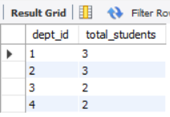
AGGREGATE FUNCTIONS | TOTAL STUDENTS IN EACH DEPARTMENT
11
SQL QUERY
SELECT dept_id, COUNT(student_id) AS total_students
FROM students
GROUP BY dept_id;
OUTPUT SCREENSHOT
STUDENT MANAGEMENT SYSTEM • MYSQL CAPSTONE PROJECT

Slide 11
NUMERIC FUNCTIONS
12
➢
Definition:
Numeric functions perform mathematical operations on numeric values.
➢
Use:
They help round, adjust, and calculate numerical data such as marks and fees.
➢
Advantage:
They make numerical results easier to compare and present.
➢
Example:
CEIL(), FLOOR(), ROUND(), and ABS().
STUDENT MANAGEMENT SYSTEM

Slide 12
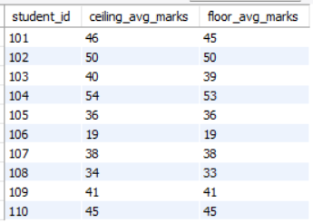
NUMERIC FUNCTIONS | CEILING AND FLOOR OF AVERAGE MARKS
13
SQL QUERY
SELECT student_id, CEIL(AVG(marks_obtained)) AS ceiling_avg_marks,
FLOOR(AVG(marks_obtained)) AS floor_avg_marks
FROM marks
GROUP BY student_id;
OUTPUT SCREENSHOT
STUDENT MANAGEMENT SYSTEM • MYSQL CAPSTONE PROJECT

Slide 13
STRING FUNCTIONS
14
➢
Definition:
String functions manipulate character data and return formatted text values.
➢
Use:
They combine, change, or extract text stored in columns.
➢
Advantage:
They make names and other text fields easier to display consistently.
➢
Example:
CONCAT(), UPPER(), LOWER(), LENGTH(), and SUBSTRING().
STUDENT MANAGEMENT SYSTEM

Slide 14
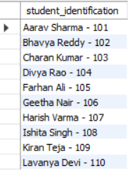
STRING FUNCTIONS | STUDENT IDENTIFICATION USING CONCAT
15
SQL QUERY
SELECT CONCAT(student_name, ' - ', student_id) AS student_identification
FROM students;
OUTPUT SCREENSHOT
STUDENT MANAGEMENT SYSTEM • MYSQL CAPSTONE PROJECT

Slide 15
DATE FUNCTIONS
16
➢
Definition:
Date functions work with date and time values to extract or format date information.
➢
Use:
They display dates in readable formats and retrieve parts such as the month or year.
➢
Advantage:
They support date-based reports and comparisons.
➢
Example:
DATE_FORMAT(), MONTHNAME(), YEAR(), and CURDATE().
STUDENT MANAGEMENT SYSTEM

Slide 16
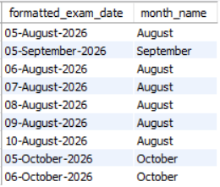
DATE FUNCTIONS | FORMATTED EXAMINATION DATES
17
SQL QUERY
SELECT DATE_FORMAT(exam_date, '%d-%M-%Y') AS formatted_exam_date,
MONTHNAME(exam_date) AS month_name
FROM exams;
OUTPUT SCREENSHOT
STUDENT MANAGEMENT SYSTEM • MYSQL CAPSTONE PROJECT

Slide 17
SET OPERATIONS
16
➢
Definition:
Set Operations combine the results of two or more SELECT queries into a single result.
➢
Use:
They retrieve and compare data from multiple queries.
➢
Advantage:
They help combine related records, identify common data, and find differences between query results.
➢
Example:
UNION, UNION ALL, INTERSECT, and EXCEPT.
STUDENT MANAGEMENT SYSTEM

Slide 18
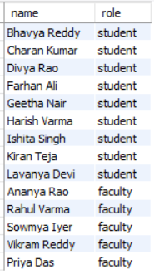
SET OPERATIONS | UNION EXAMPLE
17
SQL QUERY
SELECT student_name AS name, 'student' AS role
FROM students
UNION
SELECT faculty_name AS name, 'faculty' AS role
FROM faculty;
OUTPUT SCREENSHOT
STUDENT MANAGEMENT SYSTEM • MYSQL CAPSTONE PROJECT

Slide 19
SQL JOINS
18
➢
Definition:
A JOIN combines rows from two or more tables using a related column.
➢
Use:
It retrieves connected information, such as student names with department names.
➢
Advantage:
It avoids unnecessary data duplication and presents related records together.
➢
Example:
INNER JOIN, LEFT JOIN, RIGHT JOIN, and CROSS JOIN.
STUDENT MANAGEMENT SYSTEM

Slide 20
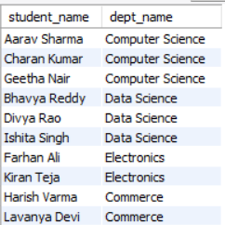
JOINS | STUDENT NAMES WITH DEPARTMENT NAMES
19
SQL QUERY
SELECT s.student_name, d.dept_name
FROM students s JOIN departments d
ON s.dept_id=d.dept_id;
OUTPUT SCREENSHOT
STUDENT MANAGEMENT SYSTEM • MYSQL CAPSTONE PROJECT

Slide 21
SUBQUERIES
20
➢
Definition:
A subquery is a SELECT statement written inside another SQL statement.
➢
Use:
It supplies a result that the outer query uses for filtering or comparison.
➢
Advantage:
It helps solve complex questions in a structured query.
➢
Example:
A correlated subquery compares each student's marks with the average for that exam.
STUDENT MANAGEMENT SYSTEM

Slide 22
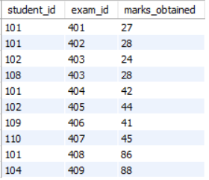
SUB QUERIES | CORRELATED SUBQUERY FOR ABOVE-AVERAGE MARKS
21
SQL QUERY
SELECT m1.student_id, m1.exam_id, m1.marks_obtained
FROM marks m1
WHERE m1.marks_obtained >
(SELECT AVG(m2.marks_obtained) FROM marks m2
WHERE m1.exam_id=m2.exam_id)
ORDER BY m1.exam_id;
OUTPUT SCREENSHOT
STUDENT MANAGEMENT SYSTEM • MYSQL CAPSTONE PROJECT

Slide 23
VIEWS
22
➢
Definition:
A view is a virtual table created from a saved SELECT statement.
➢
Use:
It presents selected information from one or more related tables.
➢
Advantage:
It simplifies repeated queries and provides a reusable way to display data.
➢
Example:
CREATE VIEW Student_Course_Details AS SELECT ...
STUDENT MANAGEMENT SYSTEM

Slide 24
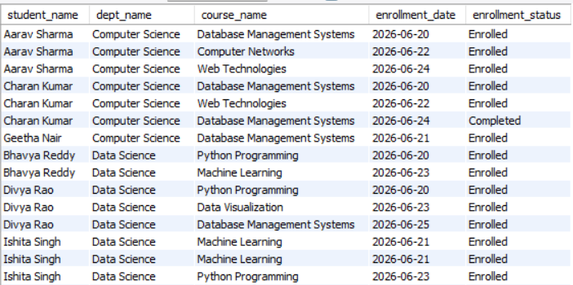
VIEWS | STUDENT_COURSE_DETAILS VIEW
23
SQL QUERY
CREATE VIEW Student_Course_Details AS
SELECT s.student_name, d.dept_name, c.course_name,
e.enrollment_date, e.enrollment_status
FROM students s JOIN departments d ON d.dept_id=s.dept_id
JOIN enrollments e ON s.student_id=e.student_id
JOIN courses c ON c.course_id=e.course_id;
SELECT * FROM Student_Course_Details;
OUTPUT SCREENSHOT
STUDENT MANAGEMENT SYSTEM • MYSQL CAPSTONE PROJECT

Slide 25
TCL — TRANSACTION CONTROL LANGUAGE
24
➢
Definition:
TCL commands manage transactions and control when database changes are saved or cancelled.
➢
Use:
They group related SQL operations into a transaction.
➢
Advantage:
They help maintain data consistency if an operation must be rolled back.
➢
Example:
COMMIT, ROLLBACK, and SAVEPOINT.
STUDENT MANAGEMENT SYSTEM

Slide 26
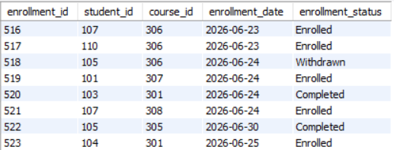
TCL | SAVEPOINT TRANSACTION
25
SQL QUERY
START TRANSACTION;
INSERT INTO enrollments VALUES (523,104,301,'2026-06-25','Enrolled');
SAVEPOINT sp1;
INSERT INTO enrollments VALUES (524,106,322,'2026-06-25','Enrolled');
ROLLBACK TO sp1;
COMMIT;
OUTPUT SCREENSHOT
STUDENT MANAGEMENT SYSTEM • MYSQL CAPSTONE PROJECT

Slide 27
STORED PROCEDURES
26
➢
Definition:
A stored procedure is a named group of SQL statements saved in the database.
➢
Use:
It performs reusable database operations and can accept parameters.
➢
Advantage:
It reduces repeated SQL code and makes common tasks easier to execute.
➢
Example:
3 types of parameters are used in stored procedures they are: IN, OUT, INOUT parameter.
STUDENT MANAGEMENT SYSTEM

Slide 28
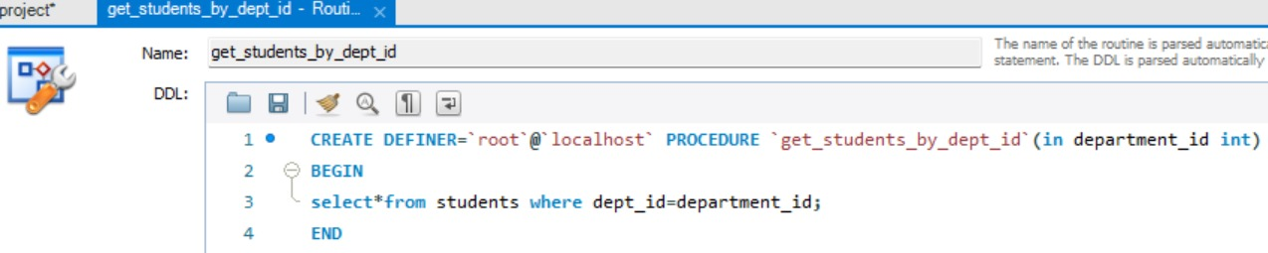
STORED PROCEDURE
27
SQL QUERY
CREATE PROCEDURE get_students_by_dept_id(IN department_id INT)
BEGIN
SELECT * FROM students WHERE dept_id = department_id;
END
MYSQL WORKBENCH DDL
STUDENT MANAGEMENT SYSTEM • MYSQL CAPSTONE PROJECT

Slide 29
STORED PROCEDURE — CALLING A PROCEDURE
28
➢
Definition:
CALL executes a stored procedure that has already been created in the database.
➢
Use:
A value can be passed to an IN parameter to select the required department's students.
➢
Advantage:
The same saved operation can be reused with different input values.
➢
Example:
CALL get_students_by_dept_id(2);
STUDENT MANAGEMENT SYSTEM

Slide 30

STORED PROCEDURE | STUDENTS BY DEPARTMENT
29
SQL QUERY
CALL get_students_by_dept_id(2);
OUTPUT SCREENSHOT
STUDENT MANAGEMENT SYSTEM • MYSQL CAPSTONE PROJECT

Slide 31
TRIGGERS
30
➢
Definition:
A trigger is a stored database program that runs automatically when a specified table event occurs.
➢
Use:
It can respond to INSERT, UPDATE, or DELETE operations.
➢
Advantage:
It automates actions such as keeping an audit history when marks are changed.
➢
Example:
BEFORE and AFTER INSERT, BEFORE and AFTER UPDATE, BEFORE and AFTER DELETE.
STUDENT MANAGEMENT SYSTEM

Slide 32
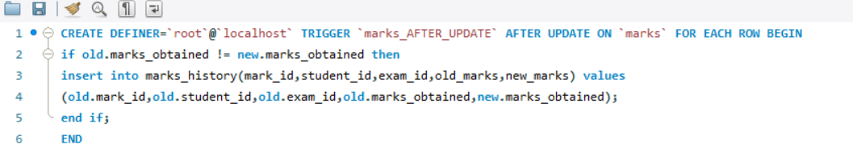
TRIGGERS | CREATING AFTER UPDATE TRIGGER ON MARKS
31
SQL QUERY
SQL QUERY-CREATING TABLE FOR MARKS_HISTORY
CREATE TABLE marks_history (
h_id INT AUTO_INCREMENT PRIMARY KEY, mark_id INT,
student_id INT, exam_id INT, old_marks INT, new_marks INT);
STUDENT MANAGEMENT SYSTEM • MYSQL CAPSTONE PROJECT

Slide 33

TRIGGERS | AFTER UPDATE TRIGGER ON MARKS
31
SQL QUERY
UPDATE marks SET marks_obtained=25
WHERE student_id=103 AND exam_id=402;
OUTPUT SCREENSHOT
STUDENT MANAGEMENT SYSTEM • MYSQL CAPSTONE PROJECT

Slide 34
Thank You
Student Management System
B. Chaitanya

