Slide 1

Azure Policy Governance, Resource tagging and regions
A GRC-Oriented Cloud Governance and Compliance Project
HACKATHON PROJECT
G. Bala Bharath — 2400090258 | V. Sai Siddarth — 2400090244 | Manoj J — 2400090275 | Prachet — 2400090242
Azure Cloud
Azure Policy
Rules Resources Compliance

Slide 2
Introduction
Cloud environments allow organizations to create resources quickly but without proper governance, they become
difficult to manage.
Resources may be deployed in
unauthorized regions, created without proper tags, or configured outside
organizational standards.
Azure Cloud → Azure Policy → Rules → Resources → Compliance
Our project uses Azure Policy to
introduce governance and compliance controls for Azure resources.

Slide 3
What is GRC?
Governance Defines rules and standards for using cloud resources.
Risk Identifies and reduces issues wrong regions, missing tags, configuration mistakes.
Compliance Checks whether resources follow defined organizational rules.
Our project mainly focuses on Cloud Governance and Compliance, with Risk reduction as the practical outcome.

Slide 4
Problem Statement
Many Azure resources created by
+-------------+
+--------------+ +------------+ +----------------+
different users
Resources deployed in wrong or unapproved regions
Important tags (e.g., Environment) missing
Manual checking becomes difficult at scale
Policy violations cause governance and compliance issues
| Azure Cloud | -> | Azure Policy | -> | Rules | -> | Resources |
+-------------+ +--------------+
+------------+
| v
+----------------+
+----------------+
| Compliance |
+----------------+

Slide 5
Objectives
1 | Enforce approved Azure deployment regions | 2 | Require essential tags on Azure resources | 3 | Prevent non-compliant resource deployments
4 | Monitor policy compliance | 5 | Provide evidence of governance enforcement | 6 | Demonstrate a practical GRC approach using Azure Policy
7
Reduce cloud management and governance risks

Slide 6
System Flow
Azure Subscription
Azure Policy
Policy Assignment
Resource Deployment
A simple linear flow showing how Azure Policy evaluates every resource deployment against assigned rules before allowing or denying it.

Slide 7
Implementation Environment
Cloud Platform | Microsoft Azure
Subscription | Azure for Students
Governance Tool | Azure Policy
Operating System | Ubuntu Server 24.04 LTS
Virtual Machine | Azure VM
Remote Access | SSH
Container Platform | Docker
Resource Group | policy-test-rg
Ubuntu VM and Docker were used as supporting infrastructure and testing environment.

Slide 8
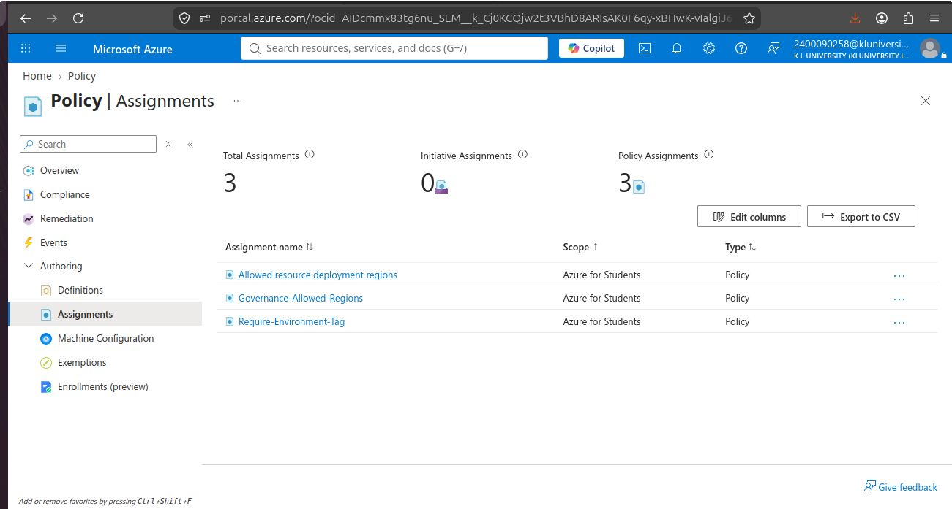
Azure Policy Implementation
1. Governance-Allowed-Regions
Policy: Allowed Locations
Azure Portal
Policy assignment settings
Policy Assignment
Allowed locations and required tags
Allowed regions: South India, Central India
Purpose: Restricts deployment to approved Azure regions.
Resource Group
policy-test-rg
VM Resources
Azure VM on Ubuntu Server 24.04 LTS
2. Require-Environment-Tag
Policy: Require a tag on resources
Required tag: Environment
Compliance
Resources are checked against policy rules
Purpose: Ensures Azure resources contain the required Environment tag.

Slide 9
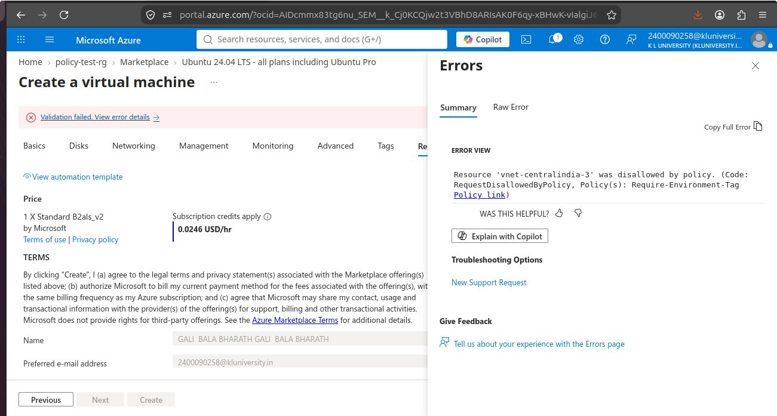
Resource Organization & Actual Policy Enforcement Outcome :
Azure Portal
Resource group overview
Resource Group
policy-test-rg
Organizes test resources and demonstrates policy behavior.
policy-test-rg
Test resources and deployment
Policy Enforcement
During VM deployment, Azure attempted to create a VNet. The VNet lacked the required Environment tag — policy blocked it.
VM → VNet
VNet creation attempted
Policy Check
Missing Environment tag
"Resource 'vnet-centralindia-3' was disallowed by policy." — Policy: Require-Environment-Tag
AZURE POLICY DENIAL ERROR :

Slide 10
VM, Docker & Compliance Monitoring
Azure VM
Ubuntu 24.04 LTS VM created in Central India. SSH access verified.
Docker Validation
docker run hello-world — confirmed Docker correctly installed and communicating with daemon.
Azure Portal
Azure VM
Docker Validation
Compliance Monitoring
Azure Policy Compliance view shows compliant/non-compliant status of resources.
Policy Compliance

Slide 11
Conclusion & Key Achievements
The Azure Policy project established a practical governance and compliance framework for cloud resources.
Enforced deployments in approved regions only
Applied mandatory tagging for resource consistency
Enabled real-time compliance monitoring in Azure Policy
Demonstrated Governance, Risk, and Compliance integration in practice

