Slide 1


Department of Computer Science and Engineering
TURF FLASH: FOOTBALL CLUBS MATCHMAKING AND TURF BOOKING APPLICATION
BALACHANDAR B (211419104035)
ARUL VIJO V (211419104018)
CHRISWIN JOEL ANTO D (211419104048))
Mrs.R.SALINI,
ASSISTANT PROFESSOR
Dr.N.PUGHAZENDI,
PROFESSOR

Slide 2
Introduction
In today's world every process and action can be done through the internet. Internet plays a major role in making our daily activities to be completed in a quick, easy and efficient way. Internet must be used to ease our life activities. One such life activity is playing physical games/sports. Playing a sport for two or three times a week can be very effective for a human body as it greatly increases our metabolic activities. But finding players to play in a new environment is difficult because we do not know the surrounding and the people in the place. Booking sports facilities is difficult nowadays because people are quite busy and do not have enough time to go to sports center just for making a reservation. To overcome this problem, this project will helps their residents to organize the data and the information into better style and format and so their customers can make a reservation easily through online, Even though there is a playground or turf to play players often are unable to play due to inadequate number of players. Also if they are in an unknown place they do not know the players around them which acts as another difficulty for them. This system overcomes these issues by collecting the data’s of the players from each location and displaying it to the users based on their location. Users can login and check the players and clubs around them for their respective sports and book matches within a mutually preferred place. The level or the players and clubs can be understood by the ratings they have.

Slide 3
Objective of the Project
• To develop and design an online system that can help users book the match with other users(club) in this system. For example the users can make a reservation for the match and also several facilities. The online service allows users to achieve the same thing at their own time and convenience.
• To enable wide access and provide users with the ability to change the schedules, cancel the reservation and so on. During time reservation, the users can check the availability before making a reservation or change the date, venue, day and etc… before submitted the application.
• Easy and efficient solution so this system can decrease time of old method done during make a match .
• To help administrator keep track records from the traditional systems. This system can help administrator to keep track the booking records, locate in the database and can manage the booking also the schedules from redundancy.

Slide 4
Literature Survey
AUTHOR | TITLE | SOURCE
S. Sri Gowtham | Smart Appointment Reservation System | International Journal of Innovative Research in Science, Engineering and Technology Vol. 4, Issue 6, June 2015.

Slide 5
Literature Survey
AUTHOR | TITLE | SOURCE
Gunther Eysenbach | Web-Based Medical Appointment Systems | J Med Internet Res. 2021

Slide 6
Literature Survey
AUTHOR | TITLE | SOURCE
M. Landry | There Are Good and Bad Ways To Set Up An Appointment System | CMA Journal Vol. 115, No. 2, pp. 160- 168, 2021 .

Slide 7
Literature Survey
AUTHOR | TITLE | SOURCE
Bashir Omolaran Bello | Student-Teacher Online Booking Appointment System in Academic Institutions | J. Hydrol. 2021, 582, 124482.

Slide 8
Literature Survey
AUTHOR | TITLE | SOURCE
Nan Liu, Serhan Ziya, Vidyadhar G. Kulkarni | Dynamic Scheduling of Outpatient Appointments Under Patient No-Shows and Cancellation | Manufacturing & Service Oper. Management 12(2) 347–364

Slide 9
Literature Survey
AUTHOR | TITLE | SOURCE
Suresh Sankarananrayanan ; Swabik Musa Abdallah Wani | NFC enabled intelligent hospital appointment and medication scheduling | 2021, 2nd International Conference on Information and Communication Technology,Vol 4, Issue 6.

Slide 10
Problem Statement
Users need to analyse and know about the other clubs by going personally and speaking with them. Even though they do not get the information they wished for the clubs or sports centre. They need get the contact numbers of the club manager or captain which is difficult and arrange players for that game. There will be more tasks like the team captain may not be present at the club or players for the game may not sufficient. Today’s kids average seven hours daily in front of electronics, such as television, tablets, laptops and phones - and kids are swapping active, outdoor play for a more sedentary lifestyle, causing severe consequences for their health and overall well-being. One of the reasons for this is lack of friends to play with.

Slide 11
Proposed System
Our proposed provides its users a personalized experience using the data provided to us by you to show posts, events, stadiums, activity centers and other features you might use. There are apps only which includes video games and there are no apps which has the technology that unifies people for outdoor through smart phones. Thereby, we are introducing a new technology through this application. This app will allow users to easily find partners to play various outdoor games like football, cricket, tennis etc. Our application enables you to connect with people, group, businesses, organizations, and others. We use the data provided to us by you to make suggestions for you and to personalize your experience. Turf Town enables you to explore events and tournaments that are conducted near your locality and connect with sportsmen who share similar interest as you.

Slide 12
Software / Hardware used
FLUTTER
FIREBASE
AN MOBILE DEVICE WITH AN GOOD INTERNET CONNECTION
DART

Slide 13
Architecture / Methodology used
This system contains a user module which allows the user to navigate through the processes of the system.
LOGIN
• User enters into the app by entering one’s own unique credentials like user id and password.
REGISTER
•If the user is new he must create a new user profile by entering his details. The details include user information like user name, date of birth etc…
BOOK
•The user can search the nearby clubs by entering his location. The user can also search the clubs by entering the club id of the club.
•User and then book matches with the club. Users can view the Booking History.

Slide 14
Architecture / Methodology used
PROFILE
•Users can VIEW/UPDATE the profile.
•Users can UPDATE the password.
HOST
•User can host a new game by entering his location, time, date etc…
•He can then post this information on the app

Slide 15
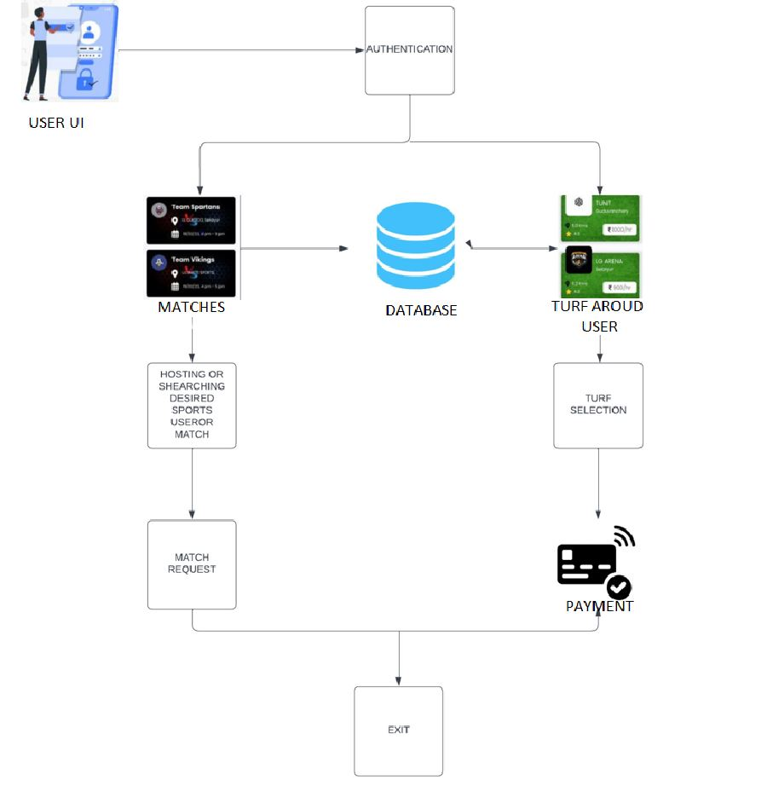
Architecture / Methodology used

Slide 16
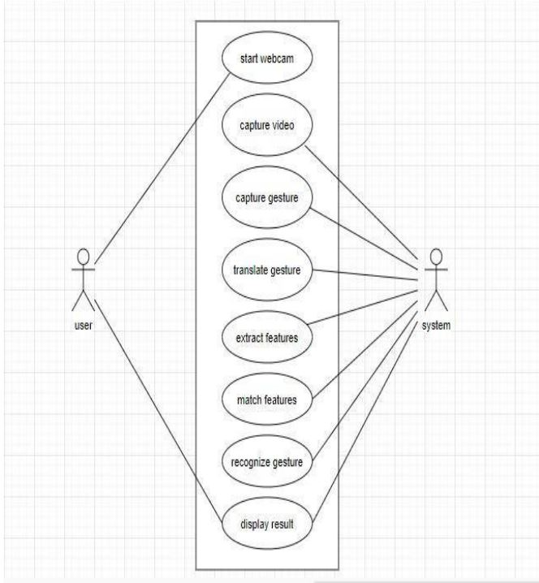
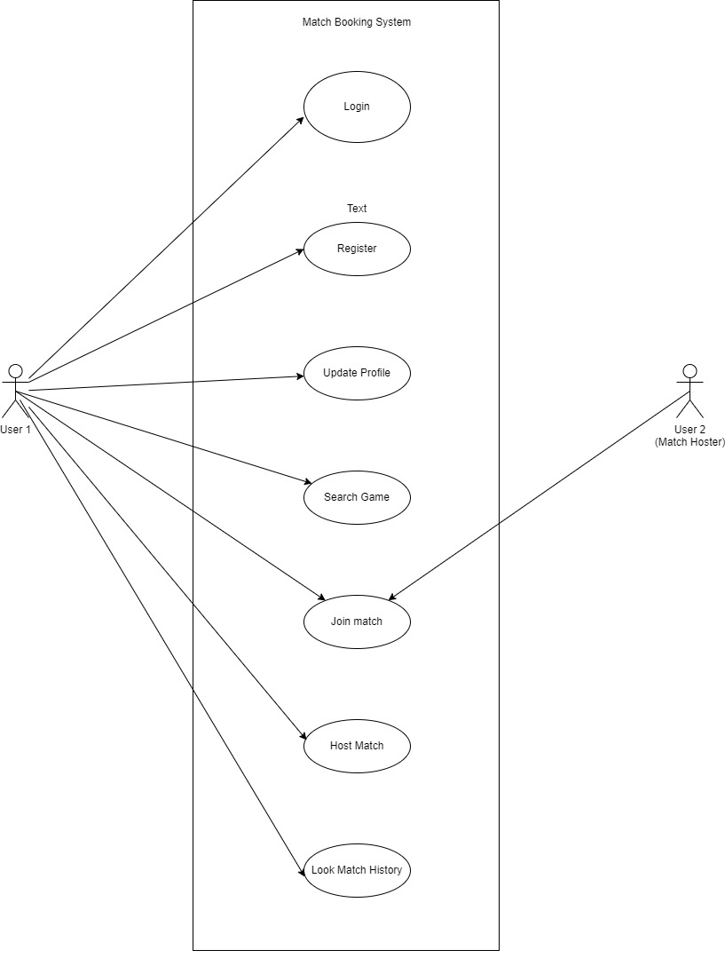
System Design –Use Case Diagram
Use case diagrams are considered for high level requirement analysis of a system. When the requirements of a system are analyzed, the functionalities are captured in use cases. We can say that use cases are nothing but the system functionalities written in an organized manner.

Slide 17
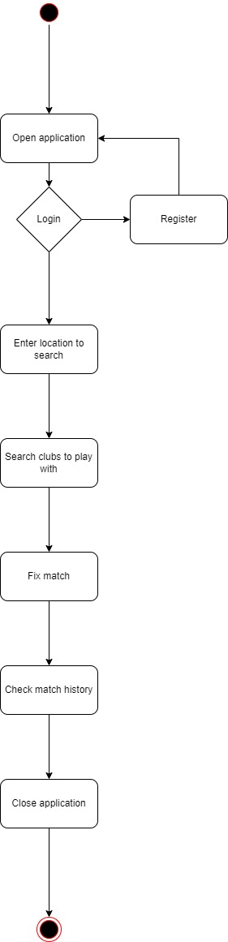
System Design – Activity Diagram
An activity diagram is a behavioral diagram i.e. it depicts the behavior of a system. An activity diagram portrays the control flow from a start point to a finish point showing the various decision paths that exist while the activity is being executed. We can depict both sequential processing and concurrent processing of activities using an activity diagram.

Slide 18
Module Description
.
Module Description is about study of methods that had been used in order to complete task or project. Thus, in this section, the project modules will be discussed in aspect of modules, which is the system overview or the flow of the sub tasks and the development tools that has been used for developing the online sport booking system. In system overview, it would be more into lifecycle model that had been identified as appropriate for the project while in development tools section; it will be brief explanation on what development and DBMS software that will be used throughout the project.

Slide 19
Module Description
1. Procedure Identification
As for this project, waterfall methodology has been considered to be applied as the methodology. A waterfall methodology structures a project into distinct phases with defined deliverables from each phase. The phases are definition, design, coding, testing and implementation stages.
2. Definition stage
The first phase of this project is to try to capture what the system will do (its requirements) based on milestones. This is to ensure the system will be on track. Here, comprehensive research has been done to study the basic concept of the system itself. During this stage, the problem definition and problem statement of the system have been started.

Slide 20
Module Description
3. Design stage
The second stage determines how it will be designed. Here, some relevant diagrams such as the use case diagram, flow diagram, Entity Relationship Diagram (See Appendix 6) and so on have been taken into consideration in order to structure the development of the project.
4. Coding stage
In the middle of the stage is the actual programming started. Here, the appropriate software and hardware tools as mentioned below are being applied in order to facilitate the project development process.

Slide 21
Module Description
5. Testing stage
The fourth phase is the full system testing where the stages of testing like unit testing, integration testing, system testing and user acceptance testing involved in order to ensure quality of the system. Testing stage is very important in doing a new system because to figure out the errors that was not noticed by the developer. For example, after completing the system, it should be tested.
6. Implementation stage
The final phase is focused on implementation tasks such as go-live, training, and documentation. Here, the documentation is being prepared to conclude on the overall research and experiment, which is basically to know which method can be applied.

Slide 22
Testing /Performance Evaluation / Results
UNIT TESTING
Unit testing is conducted to verify the functional performance of each modular component of the software. Unit testing focuses on the smallest unit of the software design (i.e.), the module. The white-box testing techniques were heavily employed for unit testing.
FUNCTIONAL TESTS
Functional tests focus on the business requirements of an application. They only verify the output of an action and do not check the intermediate states of the system when performing that action. There is sometimes a confusion between integration tests and functional tests as they both require multiple components to interact with each other. The difference is that an integration test may simply verify that you can query the database while a functional test would expect to get a specific value from the database as defined by the product requirements.
PERFORMANCE TESTING
In general testing performed to determine how a system performs in terms of responsiveness and stability under a particular workload. It can also serve to investigate, measure, validate or verify other quality attributes of the system, such as scalability, reliability and resource usage. Performance testing is a subset of performance engineering, an emerging computer science practice which strives to build performance into the implementation, design and architecture of a system.

Slide 23
Testing /Performance Evaluation / Results
INTEGERATION TESTING
Integration tests verify that different modules or services used by your application work well together. For example, it can be testing the interaction with the database or making sure that microservices work together as expected. These types of tests are more expensive to run as they require multiple parts of the application to be up and running.
ACCEPTANCE TESTING
Acceptance tests are formal tests that verify if a system satisfies business requirements. They require the entire application to be running while testing and focus on replicating user behaviors. But they can also go further and measure the performance of the system and reject changes if certain goals are not met

Slide 24
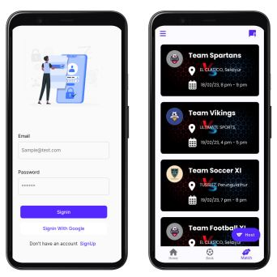
Screen Shots

Slide 25
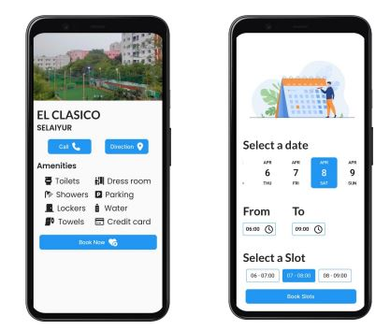
Screen Shots

Slide 26
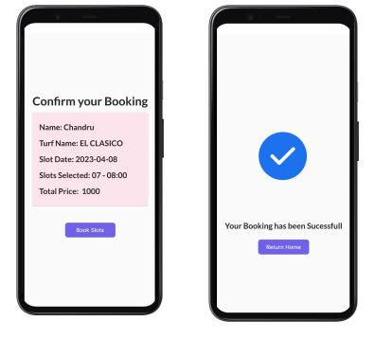
Screen Shots

Slide 27
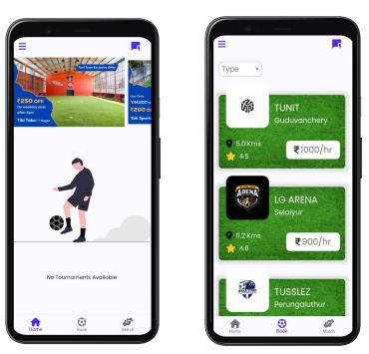
Screen Shots

Slide 28
Conclusion
The Sports club management system categorizes its visitors into different categories and presents them with the respective functionality as per their level of access. As a conclusion, the reliability, authentication and authorization and security are very important issues even if this system was fully implemented. Here users can see number one games and select which is preferred for them. The whole purpose of this project is to explicitly show how the internet and software applications can be utilized to improve the work activities today. It gives user access to data of his interest based on his location and choice of sports. It makes booing ease of aceess.

Slide 29
Future Enhancement
In future hopefully this system can be implemented via phone and SMS reservation. By having this system, it can reduce time constraint of browsing on the internet. The undertaking worked here is simply to guarantee that this item could be substantial in today genuine testing world. Here all the capacity are made and tried. Presently a-days the framework works for limited number of figure out how to function. In not so distant future it will be extend for various sorts of confirmation strategies with the goal that proficiency can be Prosperous.
Some of the additions that we feel are needed for it to happen are:
• Making it deployable on Cloud for global accessibility.
• Advancing the system to maintain other club activities.
• Making User Interface more User Friendly.

Slide 30
Reference Paper
[1] Gunther Eysenbach “Web-Based Medical Appointment Systems”, J Med Internet Res. 2017
[2] Arthur Hylton III and Suresh Sankaranarayanan “Application of Intelligent Agents in Hospital Appointment Scheduling System”, International Journal of Computer Theory and Engineering, Vol. 4, No. 4, August 2012
[3] Shelar Pooja, Hande Nilima, Dhamak Prajakta, Hingane Nisha, Jadhav Vinayak “SMART APPOINTMENT GENERATION FOR PATIENT”, International Journal of Advance Engineering and Research Development, Technophilia-2018
[4] S. Sri Gowthem, K.P. Kaliyamurthie “Smart Appointment Reservation System”, International Journal of Innovative Research in Science, Engineering and Technology Vol. 4, Issue 6, June 2015.
[5] Bashir Omolaran Bello “Student-Teacher Online Booking Appointment System in Academic Institutions”, November 2016

Slide 31
Conference / Publication / Project Contest Winner Certificates

