Slide 1
Unlocking Sales Insights: Data-Driven Performance with the Superstore Dashboard
By
Balachandru S Intern at Elevate Labs

Slide 2
Project Overview
Content:
Objective: Design an interactive dashboard to support data-driven decision-making.
Tool Used: Power BI
Dataset: Superstore Sales & Financial Data (sourced from Kaggle)
Deliverables: Interactive Dashboard + Executive Summary Presentation

Slide 3
Dashboard Design & Features
Content:
KPI Cards: Total Sales, Total Orders, Total Customers, Avg Sales/Month
Time-Series Visualization: Sales performance from 2015 to 2018
Segmented Views: By Region, Segment, Product Category, City, and Ship Mode
Interactivity: Dropdown filter to explore data dynamically
Design Aesthetic: Clean layout, consistent color theme, and varied visuals (bar, line, pie, donut)

Slide 4
Key Business Insights
Content:
South region generates the highest total sales (31.4%)
Standard Class is the most used shipping method (59.29%)
Technology & Furniture lead in product category sales
New York has the highest number of orders and sales
a
Sales have shown a steady upward trend from 2016 to 2018

Slide 5
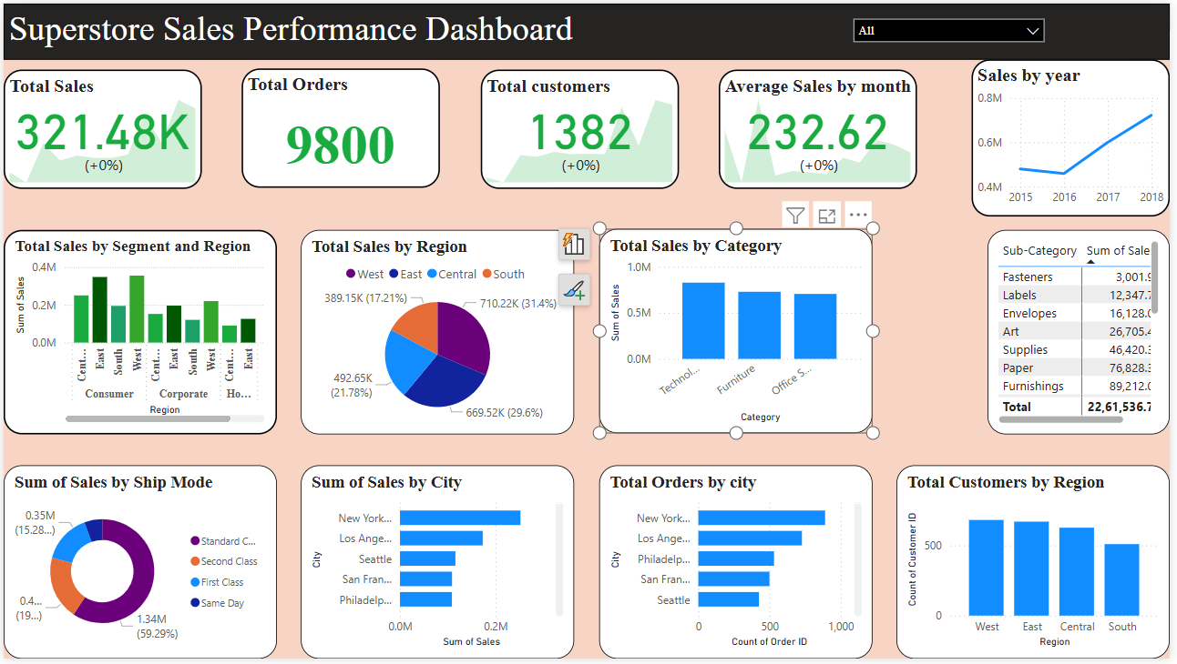

Slide 6
Thank You

