Slide 1
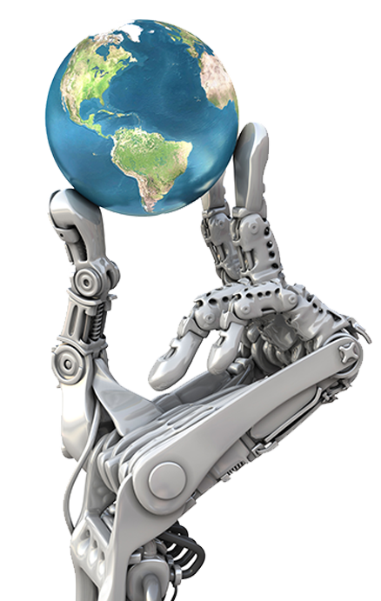
ARTIFICIAL INTELLIGENCE
AI That Works for You

Slide 2
Introduction:
Artificial Intelligence (AI) is a branch of computer science focused on creating machines and software capable of performing tasks that typically require human intelligence. These tasks include learning from experience, understanding natural language, recognizing patterns, solving problems, and making decisions. AI systems use algorithms, large datasets, and computational power to simulate cognitive functions, allowing them to perform complex activities such as speech recognition, image analysis, and autonomous navigation. The goal of AI is to build systems that can adapt, improve, and operate independently, making processes more efficient and effective across various industries.
AI encompasses a wide range of technologies, including machine learning, deep learning, natural language processing, and robotics. Machine learning, a subset of AI, involves training models on data so they can identify patterns and make predictions without explicit programming for each task. Meanwhile, natural language processing enables machines to understand and interact with human language, powering applications like virtual assistants and translation services. As AI continues to advance, it is becoming increasingly integrated into daily life and business operations, driving innovation and transforming how we live and work.

