Slide 1
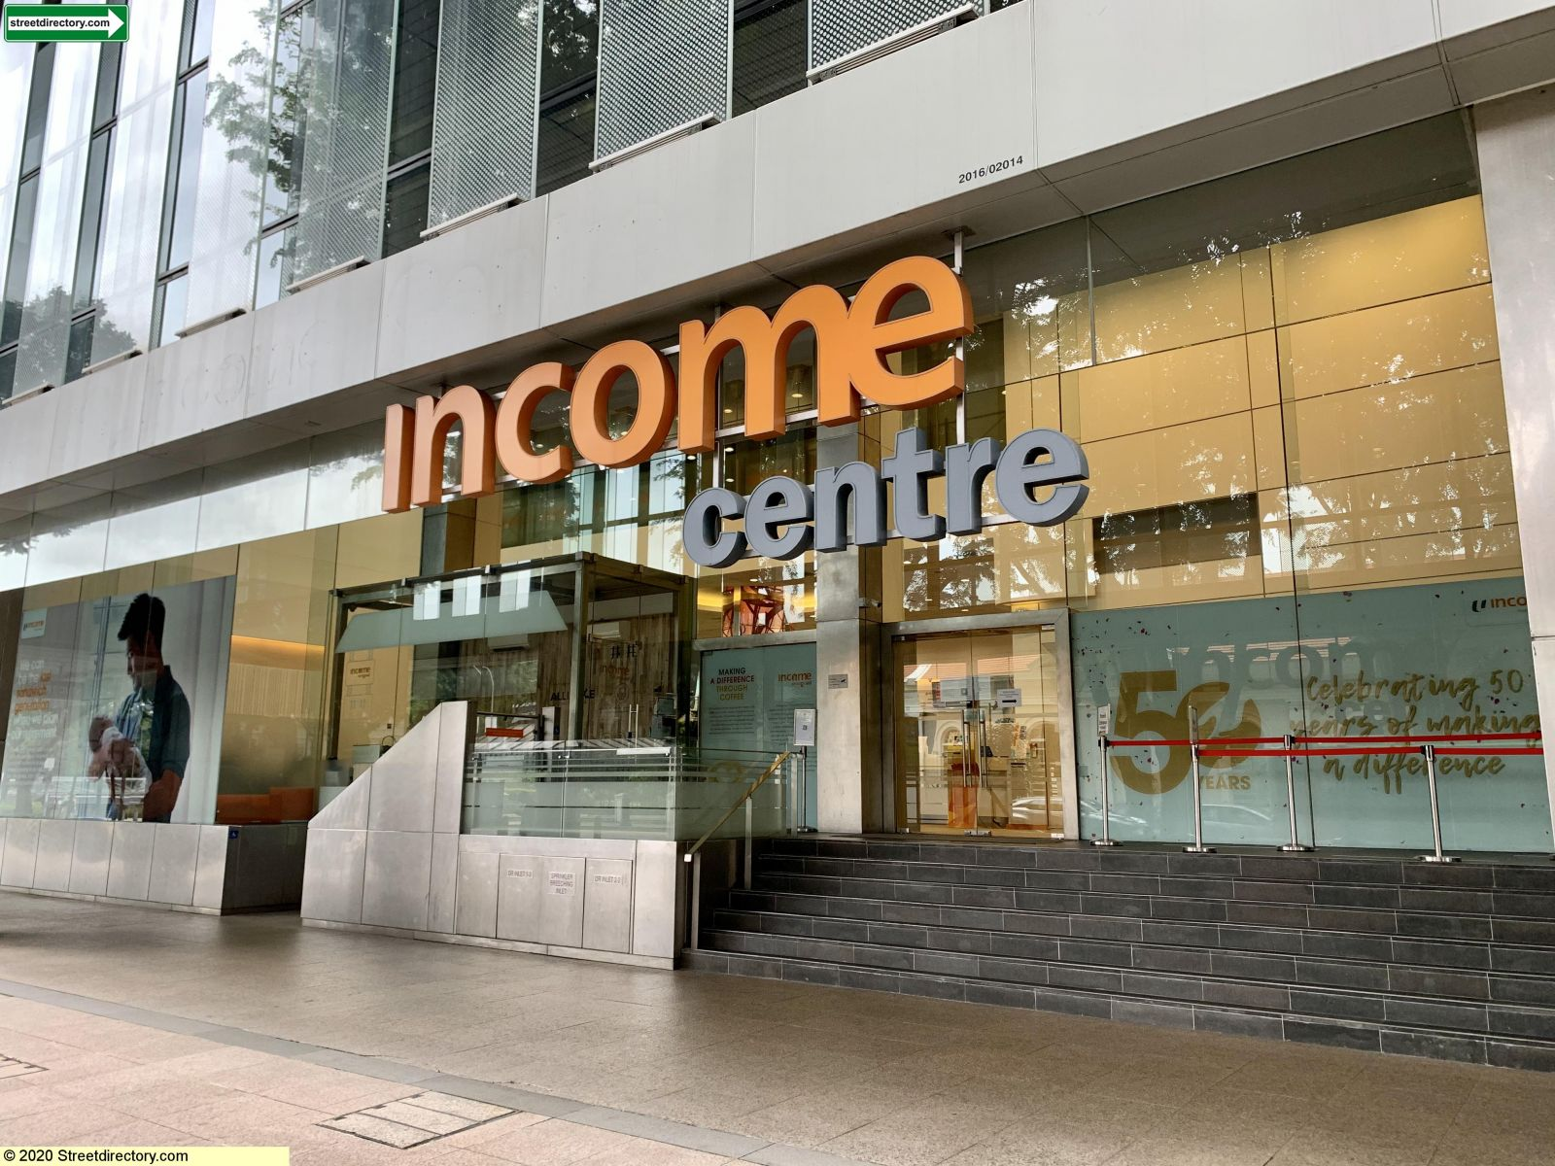
Customer Churn Analysis
13 March 2022
Balacoumarane Vetrivel

Slide 2
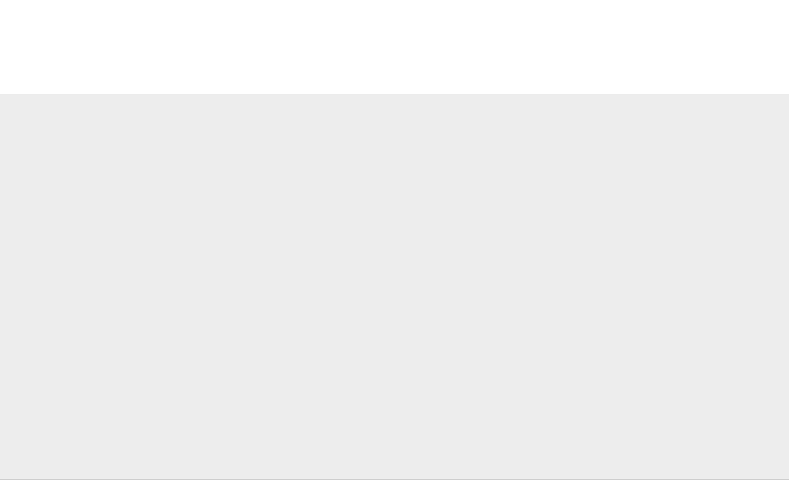
Agenda
Introduction
Data Understanding
Exploratory Analysis
Feature Engineering
Train model
Model Performance
Model Interpretability
Prediction/Score
Recommendations
Wish to do

Slide 3
Introduction
Problem Statement
To predict the customers, who are likely to renew their existing policies and the ones who are likely to churn based on the customer demographics and vehicle properties.
Solution workflow
Clean the column names and fix datatype in the data with the help of column mapping file
Perform Exploratory Analysis on the data with the help of the pandas-profiling and PowerBI.
Use XGBoost algorithm (Ensemble) to train the model on historical customer renewal data.
Evaluate the model on the test data.
Score/predict the policy renewal probability.
The Marketing team can use the scores/probability along with attributes like region, age group to perform targeted offerings.

Slide 4
Data Understanding
Customer Demographics
The file ‘train.csv’ consists of customer demographics like age, gender, region and vehicle information like damage present or not, policy premiums etc.
The ‘cust_id’ represents the customer identifier in the file, and it is unique.
The data is at snapshot level/ aggregated at the customer level.
All the variables are considered.
Please find the datatype for the variable in the below table.
Column | Data type
cust_id | Character
gender | Character
age | numeric
driving_license | Character
region_code | Character
previously_insured | Character
Column | Data type
vehicle_age | Character
vehicle_damage | Character
annual_premium($) | numeric
policy_sales_channel | Character
days_since_insured | Character
Response | numeric

Slide 5
Exploratory Analysis
Exploratory Analysis was done by using the pandas-profiling package.
Profiling report for train table can be found:reports\Data Quality Report-Train.html
Profiling report for test table can be found: reports\Data Quality Report-Prediction.html
There is no strong correlation between the predictor and the target variable.
There are no NaN in the variables.
Created premium analysis report in PowerBI to identify segments to target for offers.
Created churn analysis report in PowerBI to identify the churn patterns in the variables.
PowerBi link: EDA_Churn.pbix

Slide 6
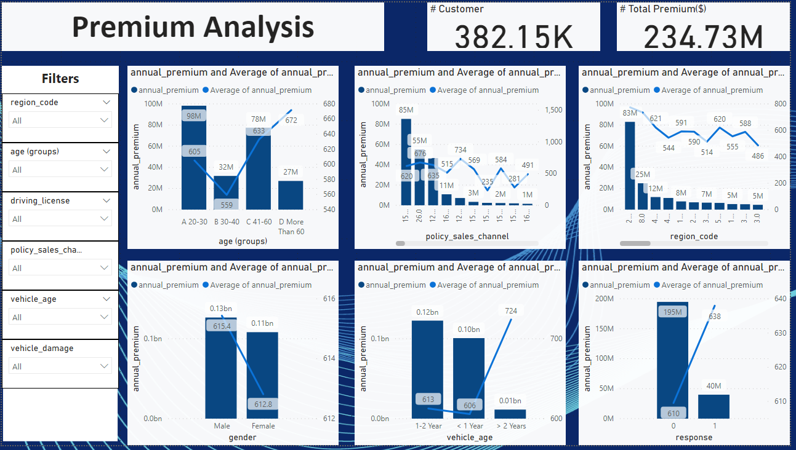
Exploratory Analysis – Premium distribution
Observation
The focused Age group should be 20 – 30 and 41- 60 years old
The policy channels 152, 26 and 124 covers 80% of the premium. Predominately it contains younger age group
Priorities should be given to the customer in region 28.
Premiums are mainly from relatively young vehicles.

Slide 7
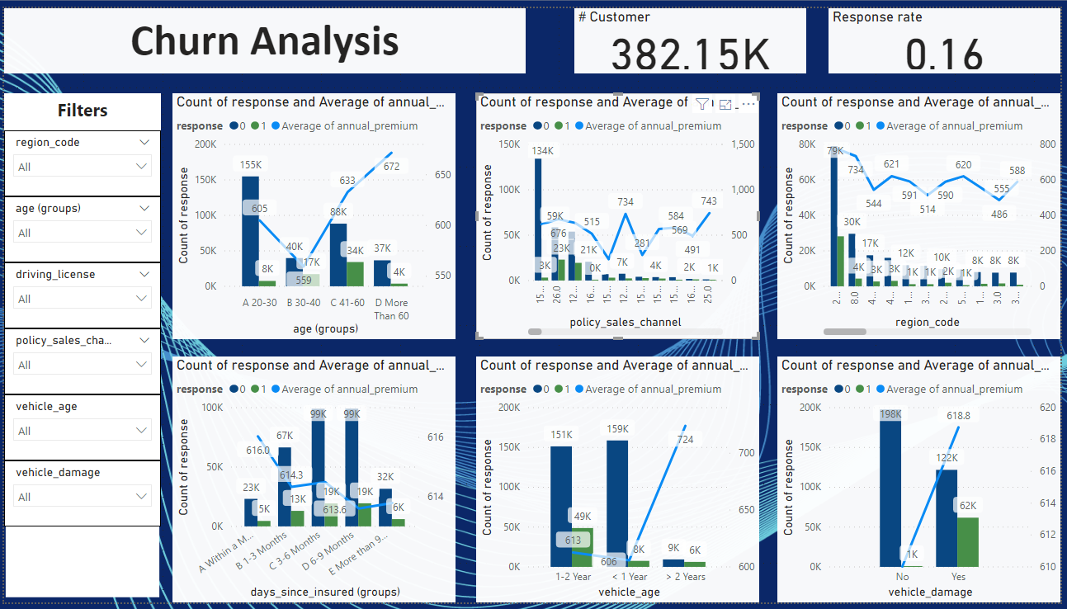
Exploratory Analysis – Churn pattern in the variables
Observation
The response rate is low in the young age group.
The policy renewal rate is low in top sales channels and regions
The renewal rate is low in young vehicle groups.
Unsurprisingly, the response rate is good if the vehicle has been damaged. It will be difficult to better deal with the pre-existing damages.

Slide 8
Feature Engineering
The customer data is present at the snapshot level.
Any engineered feature can be correlated with the existing variables. It won’t have an impact on model performance.
If Customer Data is in transaction format, features like the number of responses and historical renewals can be calculated before aggregating.

Slide 9
Model Training
XGBoost was used to perform the binary classification task
The dataset isn’t highly imbalanced. Sampling methods are implemented to tackle the imbalance problem
Random Grid search and Hyperparameter tuning were implemented (Not used due to high training time).
Considered 80:20 as train and test split
The source file for model training is ChurnModule\train_executor.py
To run the training from the terminal. Execute file: train_main.py
Requirements are mentioned in the environment.yml

Slide 10
Model Performance
Model is evaluated on F1-Score, Precision and Recall.
Accuracy is not the best metric to use in the binary classification problem
Model results are stored: model and metrics are found in the log file: log
Experiment 1 - ‘XGB_Model_0311-17-26-25’
Imbalance ratio: 0.2
Model threshold: 0.5
F1: 0.47
Precision: 0.54
Recall: 0.42
Experiment 2 – ‘XGB_Model_0312-18-17-52’
Imbalance ratio: 0.2
Model threshold: 0.5
F1: 0.46
Precision: 0.53
Recall: 0.41
Model conclusion
The difference between the two models is in experiment -2; cardinality reduction is applied on ‘region’ and ‘policy_sales_channel’ before one-hot encoding.
Experiment-1 has better results.
Overall model predictive power is less.
Tweaking model threshold and imbalance ratio have enhanced the model results.

Slide 11
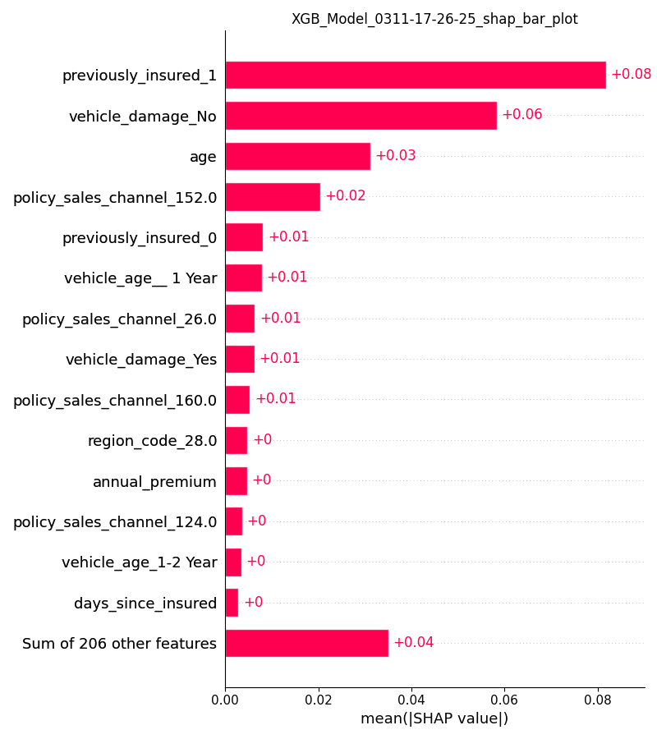
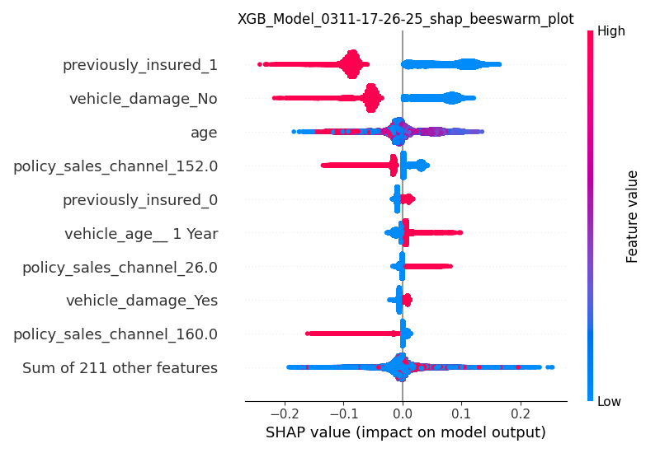
Model Interpretability
Feature Importance
XGBoost calculates variable importance by the gain method.
Variable importance can be found in: model\XGB_Model_0311-17-26-25\feature_importance.csv
Utilized the shap package to explain the variable impact on the predicted results.
Shap results are shown below for experiment 1 – ‘XGB_Model_0311-17-26-25’.

Slide 12
Prediction/Scoring
Score new customer
Test/predict new customer data location: ./data/predict
There is no response column in the customer data
Model and required parameter will be loaded from the specified path
The Model will predict based on the trained data. Unseen columns will be dropped.
The source file for model training is ChurnModule\predict_executor.py
Results are stored in the specified path in CSV format score\Score_0313-06-07-08\Customer_Churnscore0313-06-07-22.csv
To run the prediction from the terminal: predict_main.py

Slide 13
Recommendations to the teams for targeted campaigns
It is important to do customer segments and perform targeted campaigns
Along with model propensity consider other variables (RFM) to create segments.
Few examples for targeted campaigns:
Target customers in Region 28 as they got high annual premiums.
The churn rate is high in young vehicles. Discount/policy add-on coverages like late-night assistance, the no-claim bonus could be added to the offerings.
Check the Loss ratio in the pre-existing damaged vehicle segments. If the loss ratio is high then premiums have to be increased.

Slide 14
Wish to do
Improvement Scope
To get a better understanding of data with the help of a data dictionary.
To derive more features from the transaction, policy coverages and vehicle details.
Build various algorithms in the SK-learn pipeline method.
Try out clustering to perform customer segmentation.
Adding docstring to the functions in the module.

