Slide 1
Employee Data Analysis using Excel
STUDENT NAME: V.BALAGANESAN
REGISTER NO:122200247(FF11B9130CEDC0FBDDD4FF63093D2728)
DEPARTMENT:B.Com(cs)
COLLEGE:SRI SUBRAMANIYASWAMY GOVERNMENT ARTS
COLLEGE TIRUTTANI.

Slide 2
PROJECT TITLE
Employee Performance Analysis using Excel

Slide 3


AGENDA
Problem Statement
Project Overview
End Users
Our Solution and Proposition
Dataset Description
Modelling Approach
Results and Discussion
Conclusion
3/21/2024 Annual Review

Slide 4

PROBLEM STATEMENT
Analysis allows you to uncover patterns, trends, and relationships within data, which can be used to identify opportunities, inform strategic decision making, and improve overall performance.

Slide 5

PROJECT OVERVIEW
Improved project management: Employee data can help a company manage its projects better.
Improved employee performance management: Employee data can help a company identify high-performing employees and areas for improvement.
Reduced legal liabilities: Employee data can help a company reduce legal liabilities caused by noncompliant benefits plans.
.

Slide 6
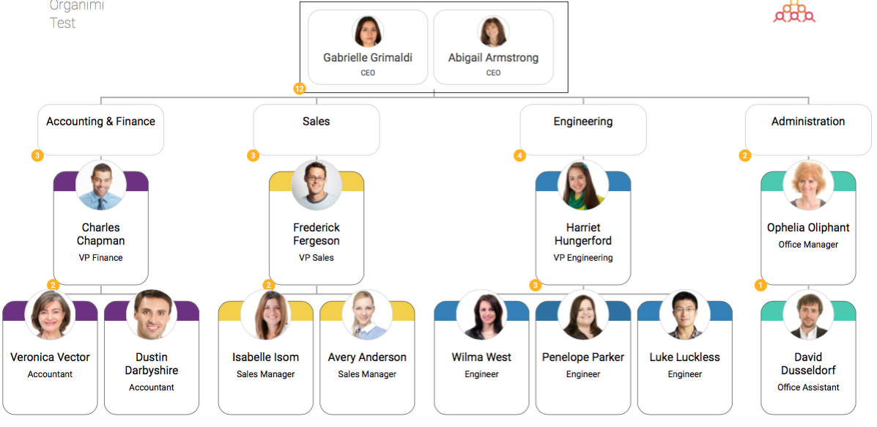
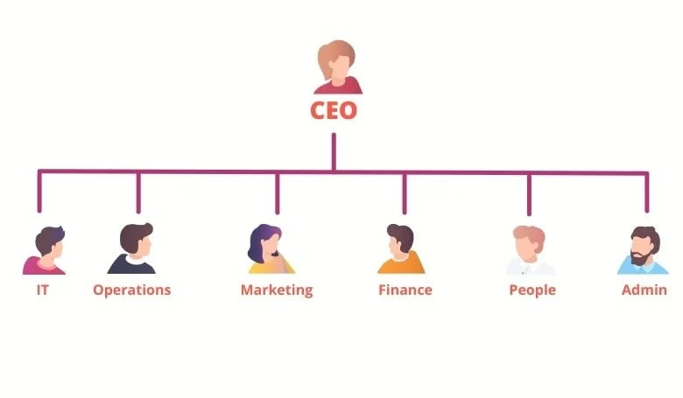

WHO ARE THE END USERS?

Slide 7

OUR SOLUTION AND ITS VALUE PROPOSITION
Conditional formatting -missing
Filter-remove
Formula-performance
Pivot-summay
Graph-data visualiztion

Slide 8
Dataset Description
employee =Kaggle
26-features
9- features
Emp id -num
Name-text
Emp type
Performance level
Gender-male female
Employee rating - num

Slide 9

THE "WOW" IN OUR SOLUTION
Performance level= IFS (Z8>=5,"VERY HIGH", Z8>=4,"HIGH", Z8>=3,"MED",TRUE,"LOW")
3/21/2024 Annual Review
9

Slide 10
MODELLING
Step 1: Identify the use cases and logical data model.
Step 2: Create a preliminary cost estimation.
Step 3: Identify your data-access patterns.
Step 4: Identify the technical requirements.
Step 5: Create a DynamoDB data model.
Step 6: Create data queries.
Step 7: Validate the data model.
Step 8: Review the cost estimation.
10

Slide 11
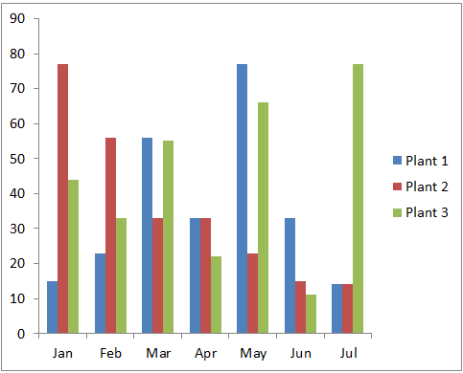
RESULTS
11

Slide 12
conclusion
Administrative burden
Accurate employee data can make the HR department's job easier and less stressful.
Performance monitoring
Accurate employee data can help you monitor performance and productivity levels.
Business growth
Accurate employee data can help you determine strengths, weaknesses, and gaps in your organization.
Compliance
Data privacy regulations are becoming more stricter all over the world, and employee data management can help you stay compliant.
Workforce trends
Employee data management can help you spot positive and negative trends within your workforce.

