Slide 1
Project Overview
Dashboard Design Using Power BI
Objective
To design an interactive business dashboard that helps stakeholders analyze sales performance, profitability, and business trends using data visualization techniques.
Dataset
Financial Sample Dataset
Tools Used
Power BI Desktop
Microsoft Excel
DAX Measures
KPIs Tracked
SaleTotals
Total Profit
Total Units Sold
Profit Margin %

Slide 2
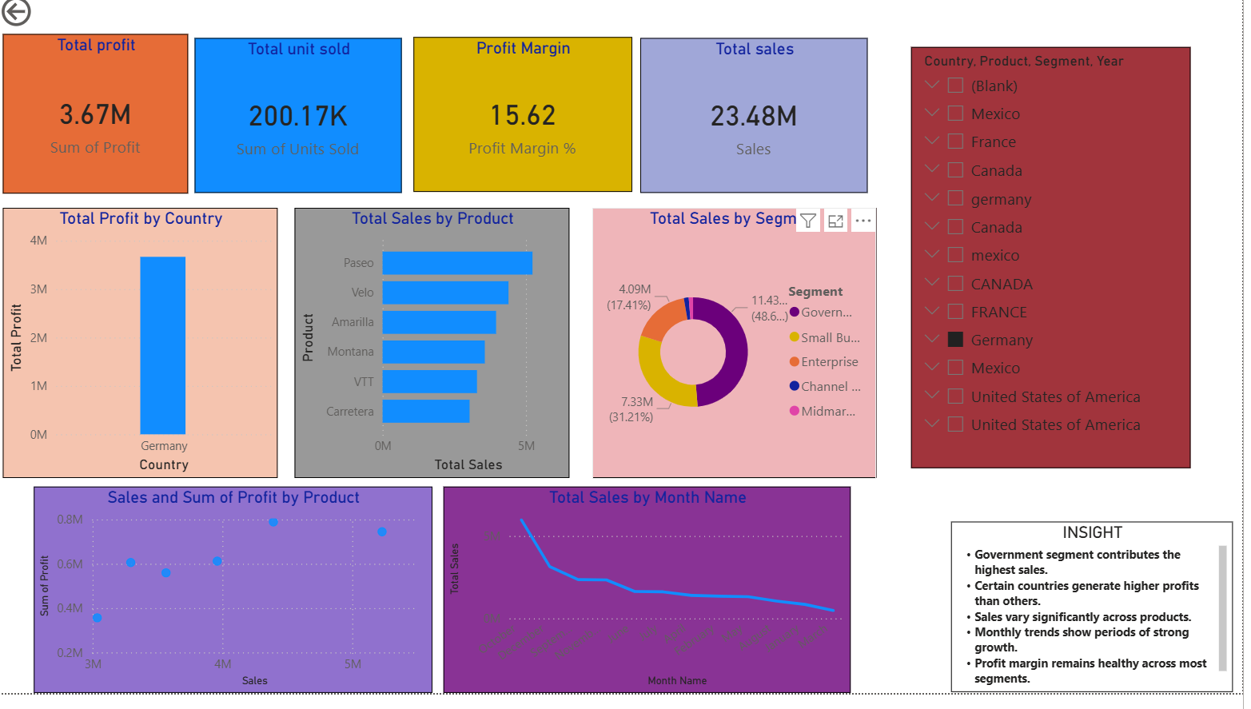
Dashboard Screenshot
Features: KPI Cards, Sales Trend Analysis, Profit Analysis, Product Performance, Slicers.

Slide 3
Key Insights
Business Insights
Total Sales and Profit can be monitored in real time.
Sales performance varies across different products and countries.
Some products contribute significantly more revenue than others.
Profit Margin helps evaluate overall business efficiency.
Interactive filters allow detailed analysis by country, segment, and product.
Sales trends provide insights into business growth over time.

Slide 4
Tools & Technologies Used
Software
Power BI Desktop
Dashboard Creation
Data Visualization
KPI Monitoring
Microsoft Excel
Dataset Storage
Data Preparation
DAX (Data Analysis Expressions)
Used to create measures such as:
Total Sales Total Profit Total Units Sold
Profit Margin % Sales Growth %

Slide 5
Conclusion
The Power BI dashboard successfully transforms raw financial data into meaningful business insights through interactive visualizations and KPI tracking.
Benefits
Improved decision-making
Better sales and profit monitoring
Interactive data exploration
Clear visualization of business performance
Outcome
This project demonstrates the effective use of Power BI for business intelligence and dashboard development, enabling stakeholders to make data-driven decisions efficiently.

