Slide 1
Introduction to Machine learning models
Balaguhan. K
192124151

Slide 2

Importance of Optimizing and Regularizing Models
Optimizing models
Techniques to enhance model performance and efficiency.
2) Regularizing models
Methods to prevent overfitting and improve generalization.

Slide 3
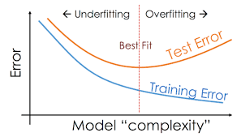
Understanding overfitting and underfitting
Overfitting:
When the model learns the training data too well.
Underfitting:
When the model is too simple and fails to capture the underlying patterns.

Slide 4
Techniques for optimizing Machine learning Models
Learning rate
The rate at which the model's weights are updated during training.
Model architecture
Adapt and modify layers and connections for optimal performance.
Gradient descent
An iterative optimization algorithm to minimize the loss function.

Slide 5
Regularization Methods for Preventing Overfitting
1
L1 and L2 Regularization
Introduce penalties for large coefficients to minimize the model complexity.
2
Early stopping
Drop out
3
Randomly deactivate neurons during training to prevent co-adaptation.
Terminate training when the model's validation performance starts degrading.

Slide 6
CONCLUSION
Performance enhancement
Generalization improvement
Optimizing models ensures accurate predictions and efficient resource usage.
Regularization techniques facilitate better performance on unseen data.

