Slide 1
Front-End developement

Slide 2

Front-end
Front-end
Client side in which may able to interact with an application with design controls and several front-end technologies.
--→ HTML
--→CSS
--→JS(React, angular and vue types )

Slide 3
How Does Internet actually work

Slide 4
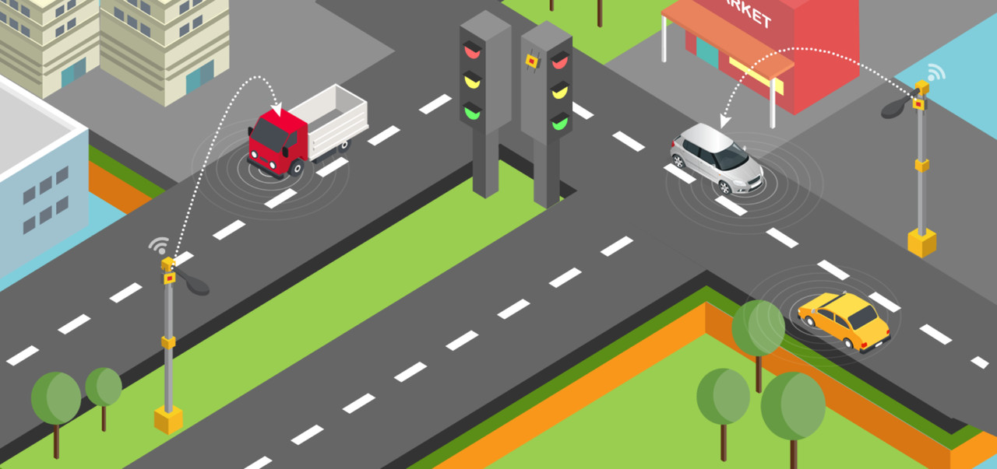
How Does Internet actually work
Imagine how roads are interconnected
throughout the world: small streets connect to city lanes that turn into regional roads who then merge with national and international highways.
You can drive from your house to any other house in the world. There is no actual center in this road network either.

Slide 5
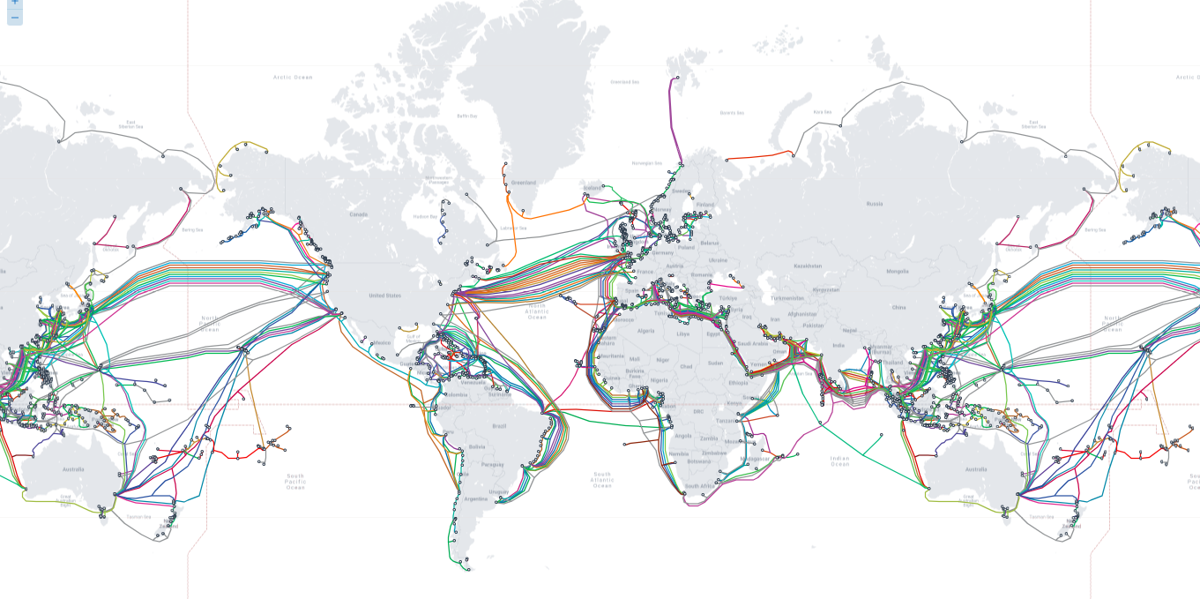
How Does Internet actually work
It’s all connected under the Ocean

Slide 6
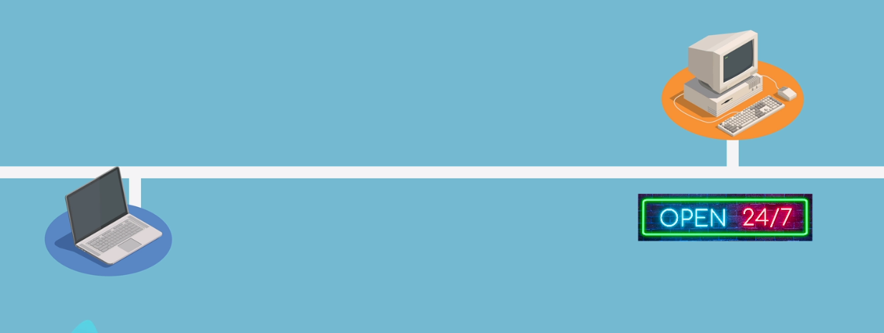
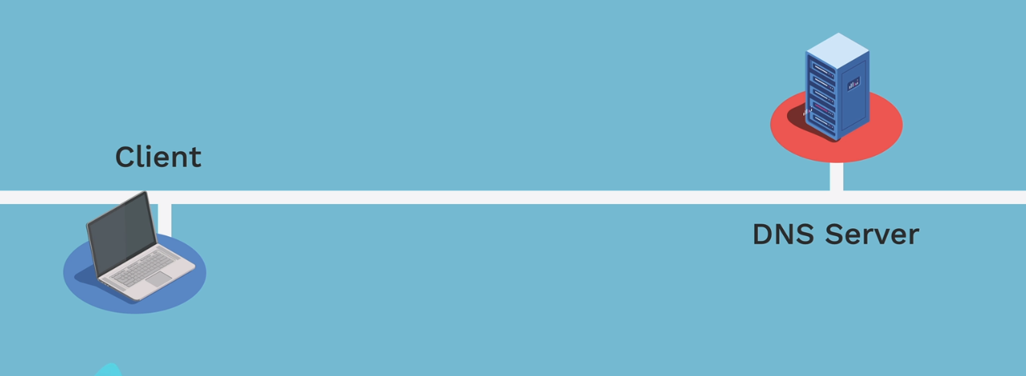
Client and Server
Usually, a connection on the Internet takes place between 2 computers only
=> one that has the information (the server)
=> one that wants it (the client).

Slide 7
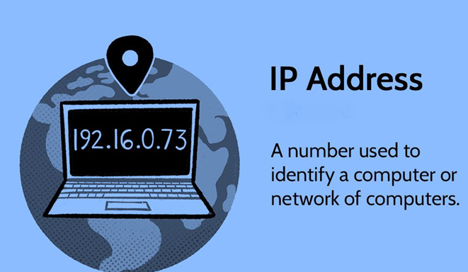
IP Address
An IP address usually looks like a combination of 4 numbers:
[ 91.198.174.192 ]

Slide 8
Domains
you can go to https://142.251.46.174 or
https://google.com and end up on the exact same
website.
They associate an IP address like 91.198.174.192 with a string of text like wikipedia.org
https:// 142.251.46.174
https://google.com

Slide 9
Domains
A domain has 3 parts
Top-Level Domain
Domain name
Subdomain
( .com, .org, .net ) & ( .in, .us, .fr )
there are generic ones & country-specific ones
Wikipedia,marksheet
that can include letters, numbers, but no space or dot.
www
most websites use www as the default subdomain

Slide 10
Protocols
And like humans talk in different languages, computers on the Internet talk using protocols
Types
Hyper Text Transfer Protocol (HTTP) -1989
Hyper Text Transfer Protocol Secure (HTTPS) - 1994

Slide 11
URL
Now that we’ve seen how domains and protocols, we can build a URL: a Uniform Resource Locator.
https://amazon.in/products
https:// -> is the protocol
amazon.in -> is the domain
/products -> is the path

Slide 12
How Do Website work

Slide 13
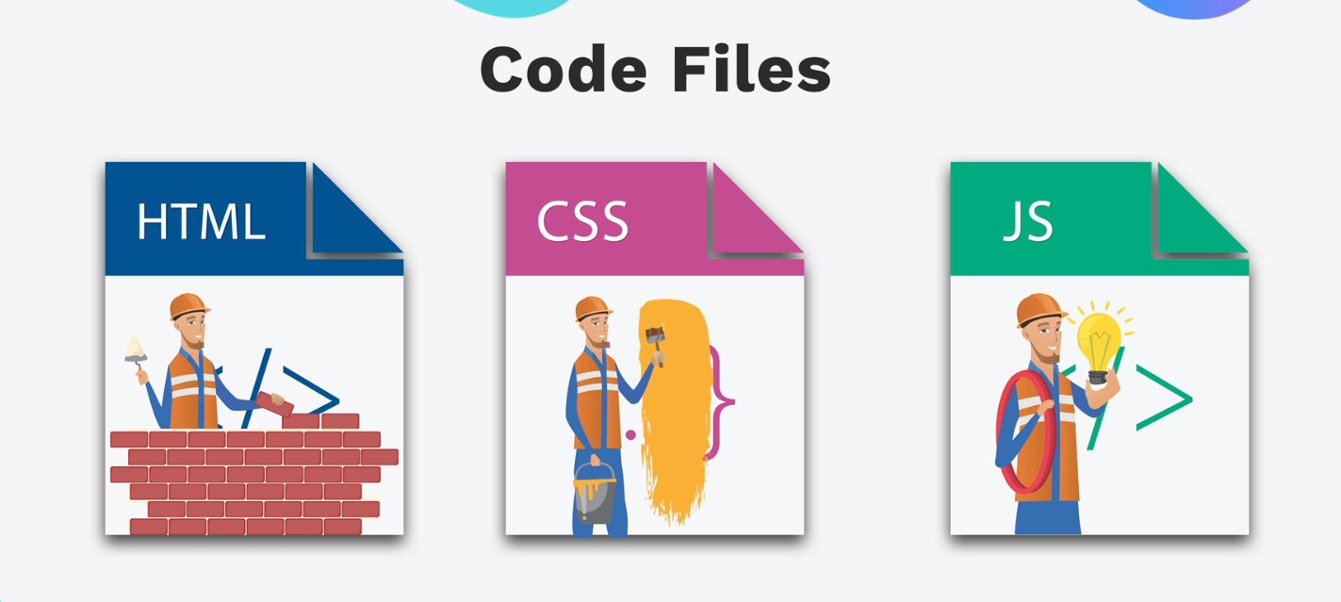
How Do Website work

Slide 14
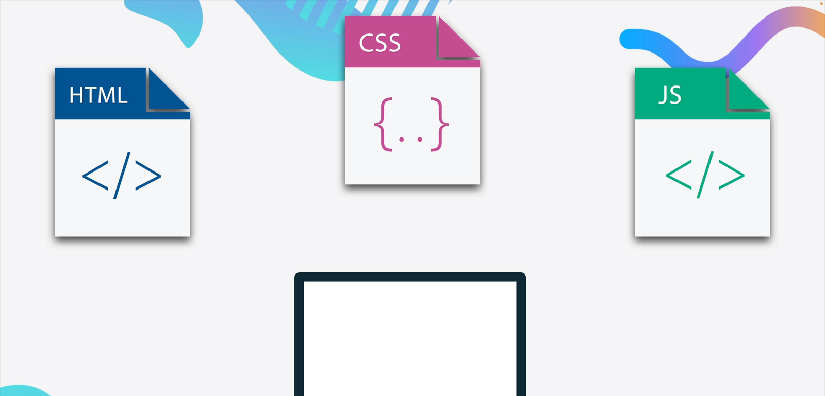
How Do Website work

Slide 15
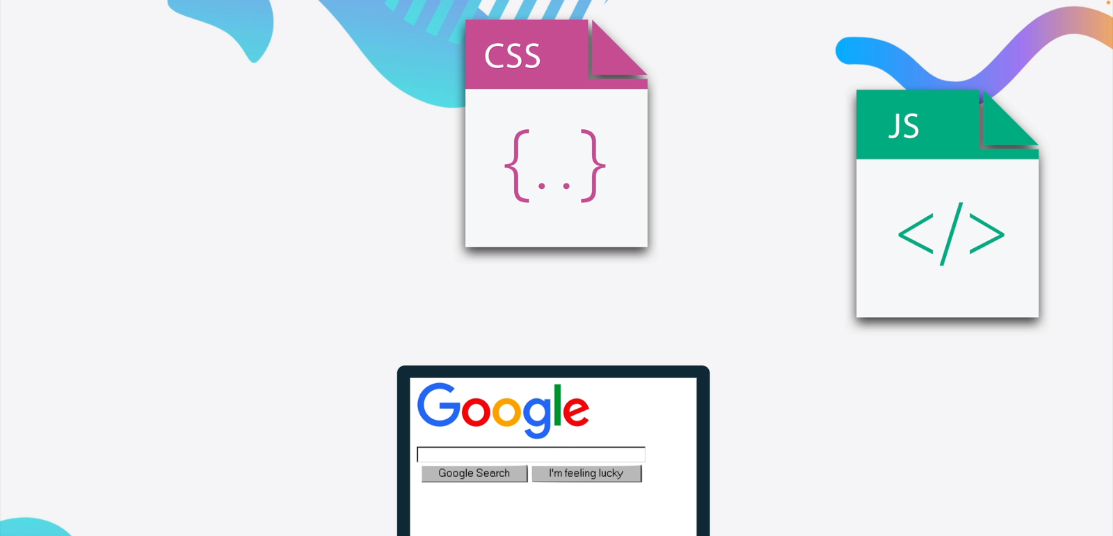
How Do Website work

Slide 16
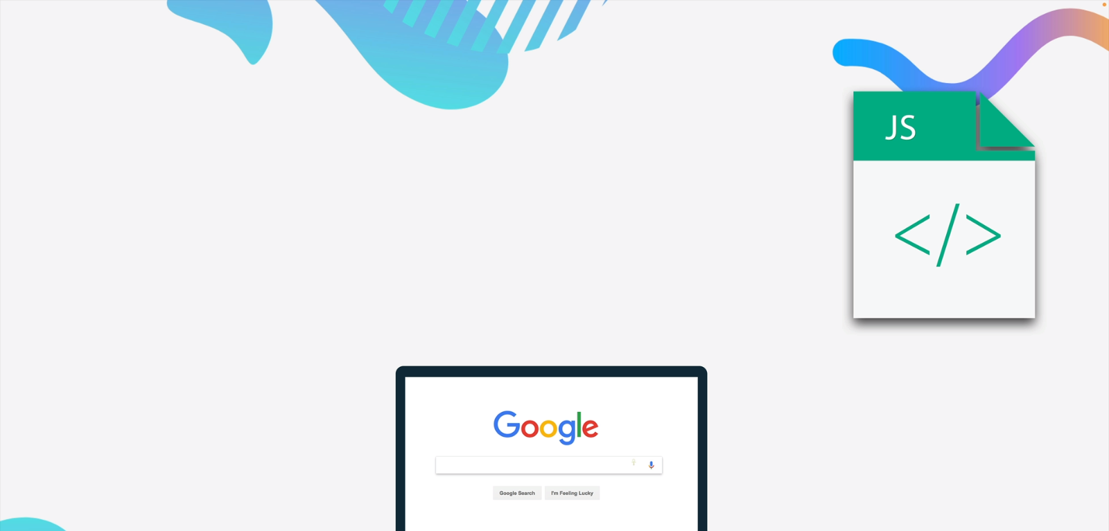
How Do Website work

Slide 17
How Do Website work

Slide 18
What is HTML
HTML stands for Hyper Text Markup Language
HTML is the standard markup language for Web pages
HTML elements are the building blocks of HTML pages
HTML elements are represented by <> tags
The first version of HTML was written by Tim Berners-Lee in 1993

Slide 19
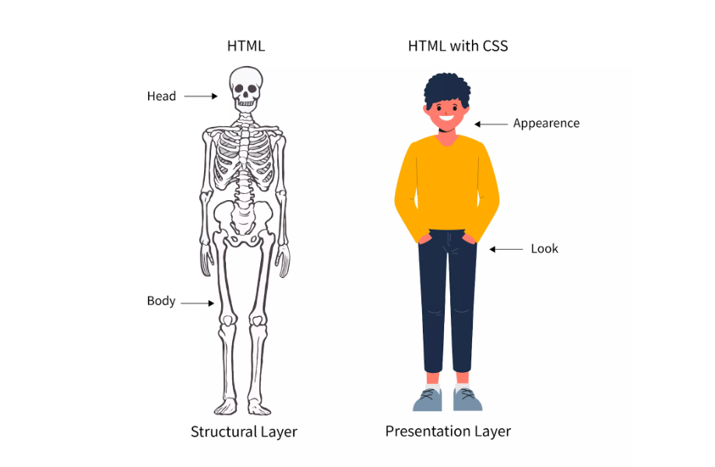
STRUCTURE BASE
<html>
</html>
<head>
<title>Page title</title>
</head>
<body>
<h1>This is a heading</h1>
<p>This is a paragraph.</p>
<p>This is another paragraph.</p>
</body>

