Slide 1

Development classify
Front-end
Back-end

Slide 2
Front-end
Front-end
Client side in which may able to interact with an application with design controls and several front-end technologies.
--→ HTML
--→CSS
--→JS(React, node, angular types )
Both Client and server side scripting validation

Slide 3
Back-end Technologies
Back-end Technologies
server side of a website.
It is the part of the website that users cannot see and interact.
Portion of software that does not come in direct contact with the users.
It is used to store and arrange data.
Example technologies -→ JAVA, PERL ,RUBY ON RAILS, PYTHON, DJANGO, MONGO, SQL, PHP, DBMS

Slide 4
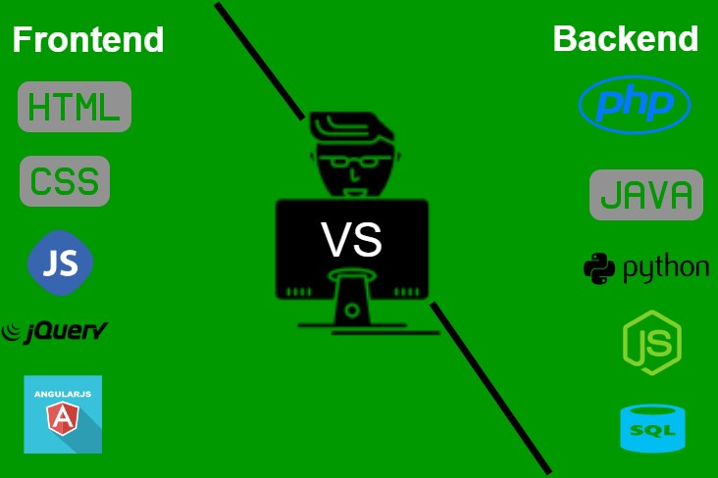

Slide 5
How Does Internet actually work

Slide 6
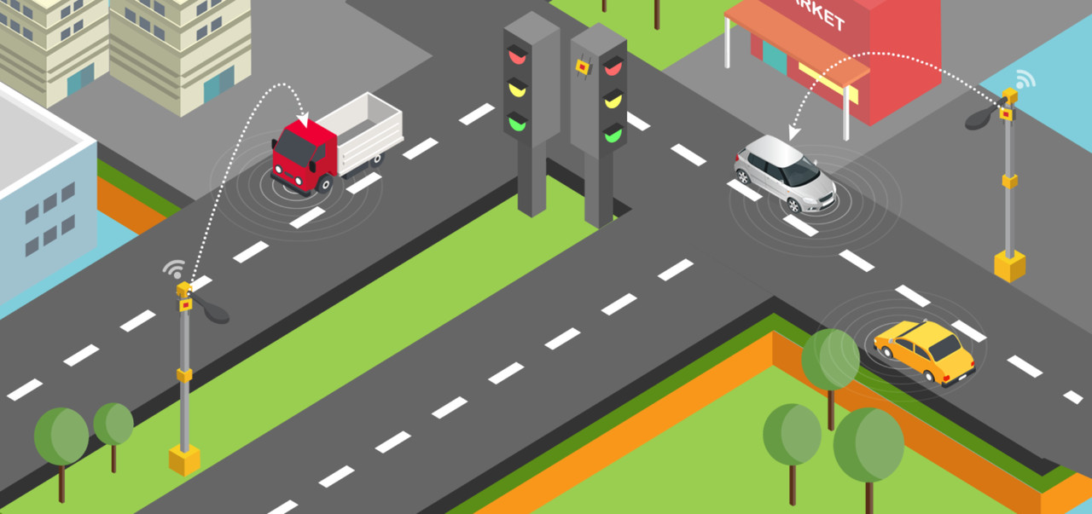
How Does Internet actually work
Imagine how roads are interconnected
throughout the world: small streets connect to city lanes that turn into regional roads who then merge with national and international highways. You can drive from your house to any other house in the world. There is no actual center in this road network either.

Slide 7
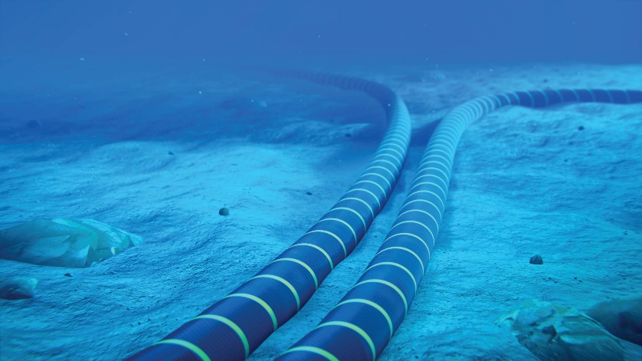
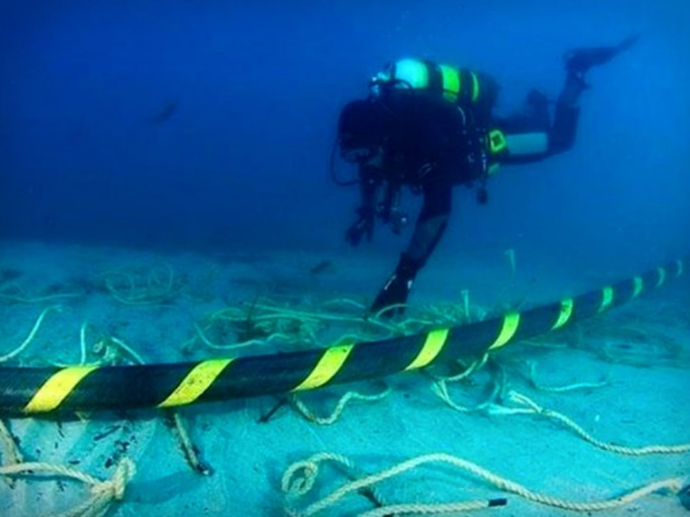
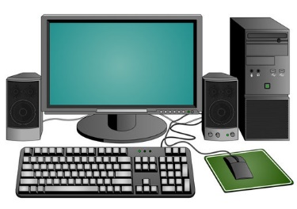
How Does Internet actually work
The Internet is similar. But instead of roads, it’s cables. And instead of houses, it’s computers. And instead of cars traveling on this network, it’s information.

Slide 8
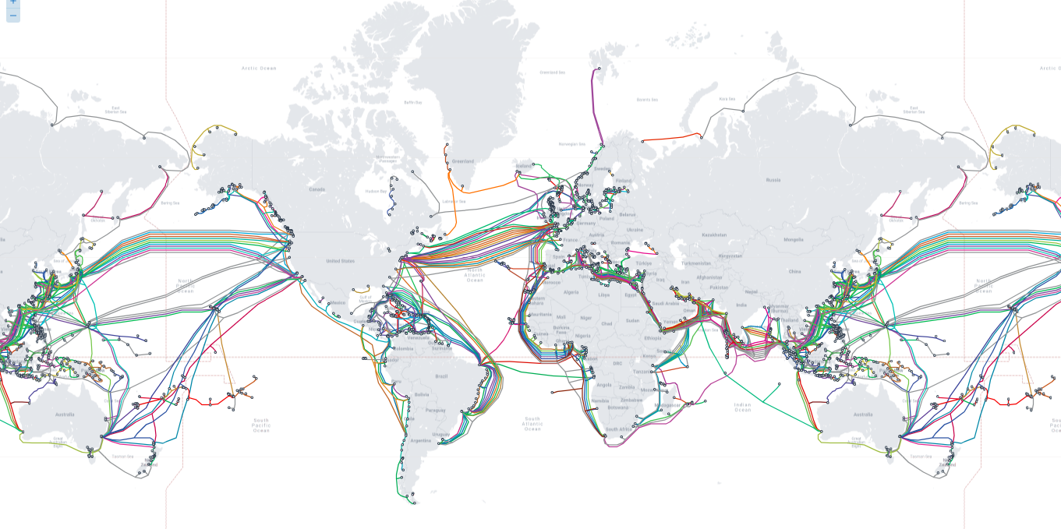
How Does Internet actually work
It’s all connected under the Ocean

Slide 9
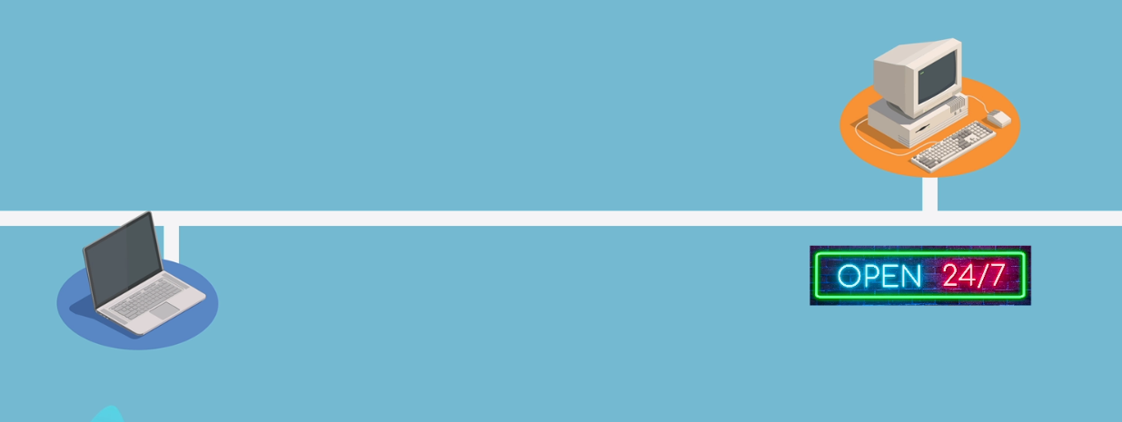
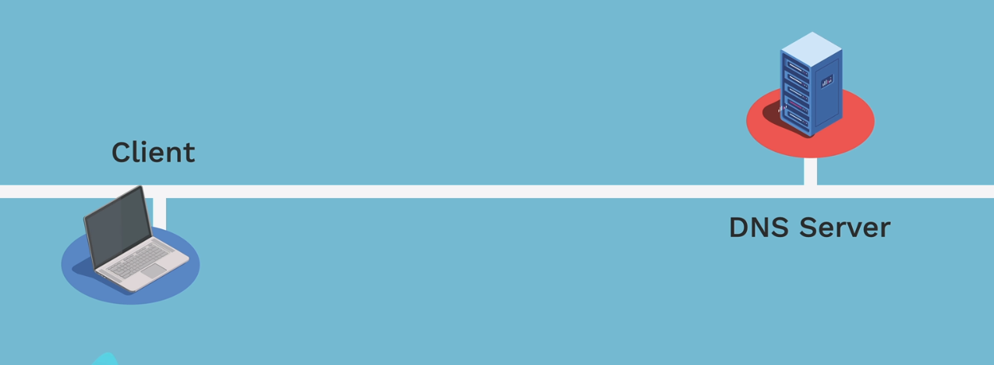
Client and Server
Usually, a connection on the Internet takes place between 2 computers only
=> one that has the information (the server)
=> one that wants it (the client).

Slide 10
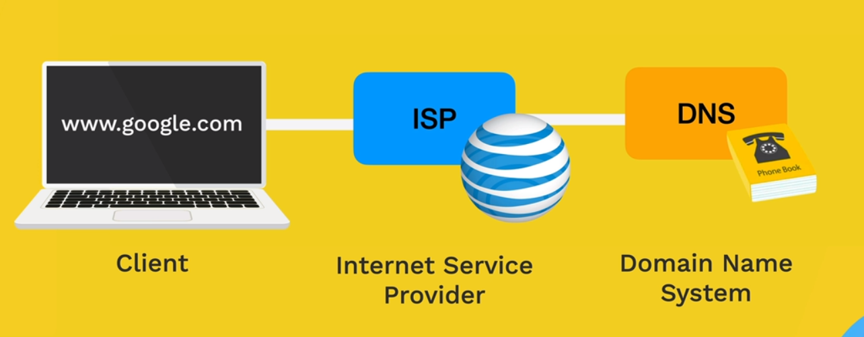
Client and Server
Although any device connected to the Internet can be both a client and a server at the same time, most devices we use are considered clients, because we only retrieve data, and don’t deliver any.

Slide 11
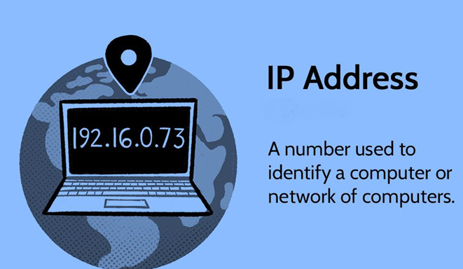
IP Address
Like every house has a specific and unique postal address, each computer connected to the Internet is given an IP address, in order to be identified on the network

Slide 12
IP Address
An IP address usually looks like a combination of 4 numbers:
[ 91.198.174.192 ]

Slide 13
Domains
Although IP addresses are useful for computers to tell each other apart thanks to their uniqueness, they are hard to read and remember for us humans.
Wikipedia.org
Amazon.in
Google.com

Slide 14
Domains
you can go to https://142.251.46.174 or
https://google.com and end up on the exact same
website.
That is why domains were created in 1985.
They associate an IP address like 91.198.174.192 with a string of text like wikipedia.org
https:// 142.251.46.174
https://google.com

Slide 15
Domains
A domain has 3 parts
Top-Level Domain
Domain name
Subdomain
( .com, .org, .net ) & ( .in, .us, fr )
there are generic ones & country-specific ones
Wikipedia,marksheet
that can include letters, numbers, but no space or dot.
www
most websites use www as the default subdomain

Slide 16
Protocols
And like humans talk in different languages, computers on the Internet talk using protocols
HTTP is designed for transferring a hypertext among two or more systems.
HTML tags are used for creating links.
These links may be in any form like text or images.
Types
Simple mail transport Protocol (SMTP) - 1971
File Transfer Protocol (FTP) - 1971
Hyper Text Transfer Protocol (HTTP) -1989
Hyper Text Transfer Protocol Secure (HTTPS) - 1994

Slide 17
Protocols
HTTP is designed for transferring a hypertext among two or more systems.
HTML tags are used for creating links.
These links may be in any form like text or images.

Slide 18
URL
Now that we’ve seen how domains and protocols, we can build a URL: a Uniform Resource Locator.
https://amazon.in/products
https:// -> is the protocol
amazon.in -> is the domain
/products -> is the path

Slide 19
How Do Website work

Slide 20
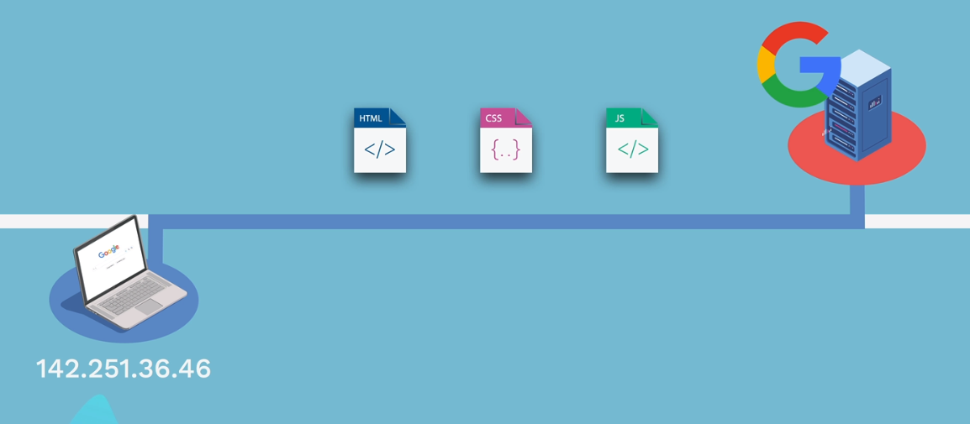
How Do Website work

Slide 21
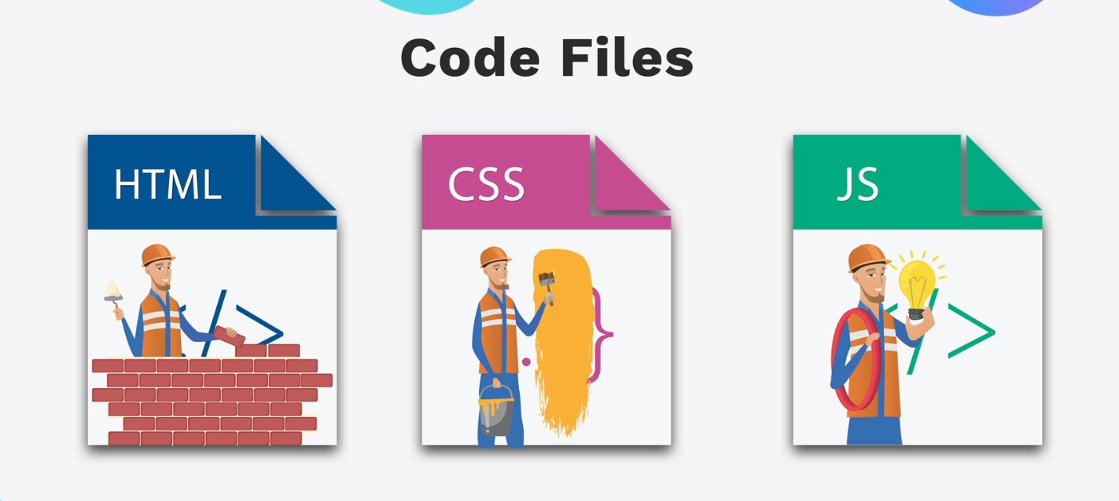
How Do Website work

Slide 22
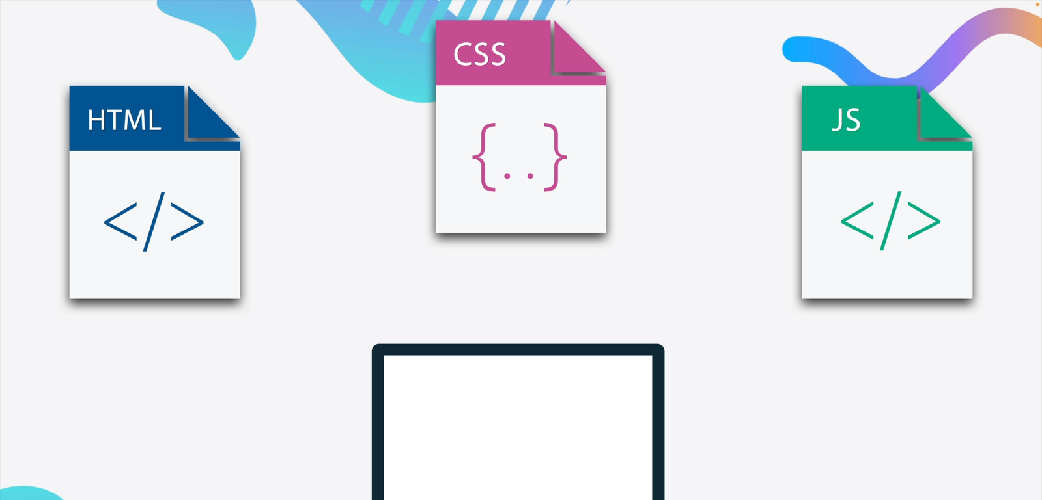
How Do Website work

Slide 23
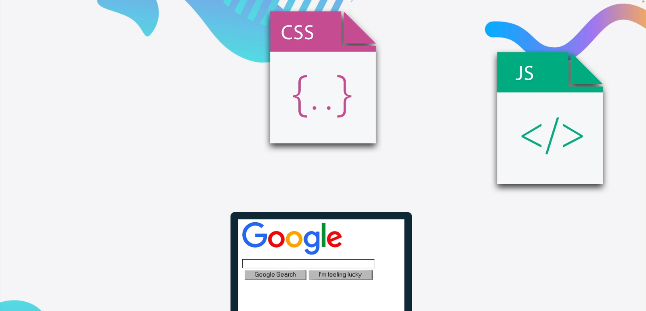
How Do Website work

Slide 24
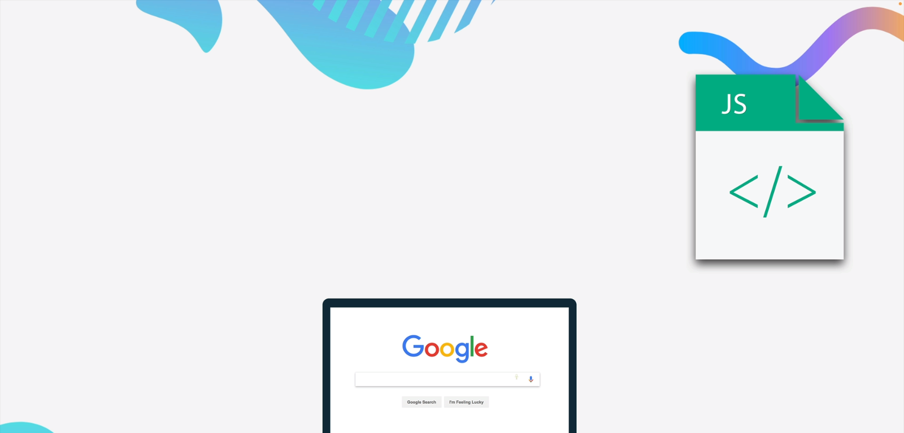
How Do Website work

Slide 25
How Do Website work

