Slide 1
INTRODUCTION TO JAVASCRIPT

Slide 2

What is JavaScript?
JavaScript is the world's most popular programming language.
JavaScript is easy to learn.
JavaScript is a lightweight, cross-platform and interpreted compiled programming language. It is also known as the scripting language for webpages.
It is well-known for the development of web pages, and many non-browser environments also use it.

Slide 3
History of JavaScript
You don't have to get or download JavaScript.
JavaScript is already running in your browser on your computer,
on your tablet, and on your smart-phone.
JavaScript is free to use for everyone.
The Original JavaScript ES1 ES2 ES3 (1997-1999)
The First Main Revision ES5 (2009)
The Second Revision ES6 (2015)
All Yearly Additions (2016, 2017, 2018, 2019, 2020)

Slide 4
JavaScript
Developed by Netscape and Sun
Initiated by Netscape and called liveScript
JavaScript enahance web pages with dynamic and
Interactive features
JavaScript runs in client software
Uses- Validate data,create cookies,read ,write &
modify html elements
<script> console.log(‘Hello World’) or alert(“Hello Every One”) </script>

Slide 5
Varialbles
Variables are Containers for Storing Data
JavaScript Variables can be declared in 4 ways:
Automatically
Using var
Using let
Using const
use case of variables
The let,const keyword was introduced in ES6 (2015)
Variables defined with let,const have Block scope
Variables defined with let must be Declared before use
Variables defined with const cannot be Reassigned

Slide 6
JavaScript Data Types
String
Number
Boolean
Undefined
Null
Object
Object
An object
An array
A date

Slide 7
Operators
Arithmetic Operators
Assignment Operators
Comparison Operators
Logical Operators
Ternary Operators
typeof operator
+, - , *, **, /, %, ++, --
=, += , -=, *=, /=, %=, **=
==,===, !=, !==,> , <,<= ,>=
&& , || , !
?

Slide 8
Conditional Statements
Conditional statements are used to perform different actions based on different conditions.
if (condition) { // condition is true } else { // condition is false }
If
else if
else
switch
switch(expression) { case x: break; case y: break; default: }

Slide 9
Loops
Loops are handy, if you want to run the same code over and over again, each time with a different value
while (condition) { // code block to be executed }
while
do-while
for
do { // code block to be executed } while (condition);
for (expression 1; expression 2; expression 3) { // code block to be executed }

Slide 10
Functions
A JavaScript function is a block of code designed to perform a particular task.
function name(parameter1, parameter2, parameter3) { // code to be executed }
Normal Function =>
function name(parameter1, parameter2, parameter3) { // code to be executed
return }
return Function =>
(parameter1, parameter2) => { // code to be executed
return }
arrow Function =>

Slide 11

Document Object Model
DOM

Slide 12
DOM
change the content of HTML elements
change the style (CSS) of HTML elements
react to HTML DOM events
add and delete HTML elements
<html> <body> <p id="demo"></p> <script> document.getElementById("demo").innerHTML = "Hello World!"; </script> </body> </html>

Slide 13
DOM
document.getElementById(id)
document.getElementsByTagName(name)
document.getElementsByClassName(name)
document.querySelector(#,.,name)
document.createElement(Tagname)
element.innerHTML = new html content
element.attribute = new value
element.src = new value
element.style.property = new style
document.write (new value)
addEventListener(click)

Slide 14
String Methods
. Length - get length of the string
. replace() - replaces a specified value with another value in a string.
. replaceAll() - method allows you to specify a regular expression instead of a string to be replaced.
. toUpperCase() - string is converted to upper case
. toLowerCase() - string is converted to lower case
. trim() - method removes whitespace from both sides of a string
. padStart() - method pads a string from the start.
. padEnd() - method pads a string from the end.
. split() - A string can be converted to an array
. slice() - method allows you to extracting a part of a string

Slide 15
Arrays
An array is a special variable, which can hold more than one value
const array_name = [item1, item2, ...];
const cars = [ "Saab", "Volvo", "BMW" ];
const cars = []; cars[0]= "Saab"; cars[1]= "Volvo"; cars[2]= "BMW";
const cars = new Array("Saab", "Volvo", "BMW");

Slide 16
Array Methods
.length - get length of the array
.toString() - get string value of the array
.pop() - delete a value in the end of the array
.push() - add a value in the front
.shift() - delete a value in the end
.unshift() - add a value in the front
.join() - get string value with symbols
.concat() - add one & more array
.splice() - to get one & more values -its affect original array
.slice() - to get one & more values -create a new array
.reverse() - reverse the array
.sort() - orderwise

Slide 17
Math Methods
Math.random() - get random number
Math.round(x) - Returns x rounded to its nearest integer
Math.ceil(x) - Returns x rounded up to its nearest integer
Math.floor(x) - Returns x rounded down to its nearest integer
Math.trunc(x) - Returns the integer part of x (new in ES6)
Math.abs(-x) - returns the absolute (positive) value of x Math.pow(x,y) - returns the value of x to the power of y
Math.sqrt(x) - returns the square root of x
Math.min() - find the lowest value
Math.max() - find the highest value

Slide 18
Objects
Objects are variables too. But objects can contain many values.
The name:values pairs in JavaScript objects are called properties
const objectName= {
name1 : value,
name2 : value,
name3 : value,
}
objectName.name1
objectName.name2
objectName.name3

Slide 19
Dates
By default, JavaScript will use the browser's time zone and display a date as a full text string
getFullYear()
getMonth()
getDate()
getDay()
getHours()
getMinutes()
getSeconds()
const date = new Date()

Slide 20
Destructuring
The destructuring assignment syntax is a JavaScript expression that makes it possible to unpack values from arrays, or properties from objects,
Array
Object
const tech= {
name : ‘marcello’,
place : ‘Trichy’
}
const arr= [1,2]
const [a,b] = arr
const {name ,place} = tech

Slide 21
Array Iteration
Array iteration methods operate on every array item.
forEach()
map()
filter()
reduce()
find()
every()
some()
includes()
indexOf()
findIndexOf()
flat ()

Slide 22
Synchronous & Asynchronous
setTimeout(code, delay)
method calls a function after a number of milliseconds.
Then you can to stop the execution by calling clearTimeout()
setInterval(code, delay)
method calls a function at specified intervals (in milliseconds).
Then you can to stop the execution by calling clearInterval()

Slide 23
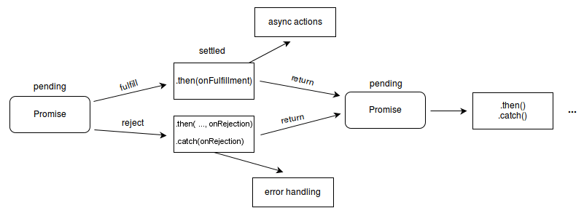
Promise
A promise is said to be settled if it is either fulfilled or rejected, but not pending.

Slide 24
API
API stands for Application Programming Interface.
Fetch API
The Fetch API interface allows web browser to make HTTP requests to web servers.
Fetch(‘URL’)
.then(res => res.json())
.then(data=>console.log(data))
.catch(error => console.log(error.message))

Slide 25
json
JSON stands for JavaScript Object Notation
JSON is a lightweight format for storing and transporting data
JSON is often used when data is sent from a server to a web page
JavaScript program can easily convert JSON data into native JavaScript objects.
const objectName= {
name1 : value,
name2 : value,
name3 : value,
}
const json= [{
“name1”: “value”,
“name2”: “value”,
“name3”: “value”,
}]

