Slide 1
INTRODUCTION TO REACT

Slide 2

What is React JS?
React is a JavaScript library for building user interfaces.
React is used to build single-page applications.
React allows us to create reusable UI components.
React, sometimes referred to as a frontend JavaScript framework, is a JavaScript library created by Facebook.
React is a tool for building UI components.

Slide 3
COMPONENTS
React Components
Components are independent and reusable bits of code. They serve the same purpose as JavaScript functions, but work in isolation and return HTML.
Components come in two types, Class components and Function components ,we will concentrate on Function components.

Slide 4
JSX
JSX stands for JavaScript XML.
JSX allows us to write HTML in React.
JSX makes it easier to write and add HTML in React.
JSX converts HTML tags into react elements.
You are not required to use JSX, but JSX makes it easier to write React applications.

Slide 5
virtual dom vs real dom
DOM is the actual document object model that exists in the browser, while virtual DOM is a lightweight DOM tree constructed in memory.
Directly manipulating the DOM may be slow, while using virtual DOM can improve performance because virtual DOM updates only the changed parts.

Slide 6
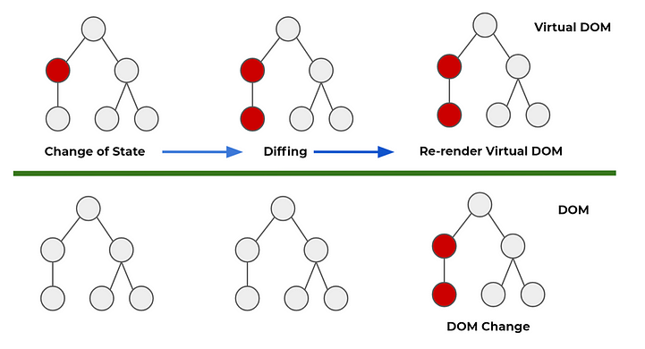
virtual dom vs real dom

Slide 7
create-react-app
install - node
npx create-react-app folder-name

Slide 8
PROPS VS STATE
Props are used to pass data from a parent component to a child component.
Props are immutable and cannot be changed within a component.
state is used to manage data within a component.
state is mutable and can be updated using the setState function.

Slide 9
useState()
The useState() hook works by handling and managing state in your applications.
The useState() hook takes the first (initial) value of the state variable as its argument. The second value then sets your state
const [state, setState] = useState(initial value)

Slide 10
useContext()
What is it? useContext is a tool in React that makes it easy for components to share and use information without passing it through every level of the component tree.
Why does it matter? It eliminates the hassle of passing data from parent to child components when they're in the middle and don't really need that data. It keeps your code cleaner and more maintainable.
How does it work? You create a 'context' to hold your data, and then any component can use useContext to tap into that data directly, no matter how deeply nested it is.

