Slide 1



Department of Computer Science and Engineering
GE19621 - Professional Readiness for Innovation,Employability and Entrepreneurship
EXPLOSION RISK DETECTION AND MANAGEMENT SYSTEM
Dr . T.Kumaragurubaran M.Tech.,Ph.D.,AP(SG)
Akshaya R 210701023
Balaharinath C 210701037

Slide 2
Abstract
The oil and gas industry is inherently prone to explosion risks, primarily due to the potential for leaks. In response to this critical safety concern, we present a comprehensive solution designed to detect and mitigate such risks effectively. Our approach integrates Internet of Things (IoT) technology, machine learning algorithms, and modern web development principles to create a robust and responsive system. At the core of our solution are sensor-equipped Arduino devices strategically deployed in key areas within oil and gas facilities. These sensors, including UV and MQ2 sensors, continuously monitor for the presence of oil and gas leaks. Upon detecting levels exceeding predefined thresholds, alerts are triggered, initiating swift actions to mitigate potential hazards. The alerts are transmitted via an ESP8266 module, which communicates with a REST API for logging and immediate notification to relevant personnel. To facilitate real-time monitoring and response coordination, we have developed a backend system using the MERN (MongoDB, Express.js, React.js, Node.js) stack. This backend manages the transmission of sensor data, employee information, and system status updates.

Slide 3
Existing System
The existing system for explosion risk detection in the oil and gas industry predominantly relies on conventional methods, including manual inspections and periodic monitoring. These methods often involve visual inspections conducted by personnel or the use of handheld sensors and fixed monitoring stations. While these approaches serve as essential safety measures, they present limitations such as labor intensiveness, susceptibility to human error, and restricted coverage of critical areas within the facility. Moreover, these systems may lack real-time data analysis capabilities and predictive functionalities, resulting in delayed response times to potential hazards.

Slide 4
Proposed System
The proposed system is an IoT-based explosion risk detection system designed specifically for the oil and gas industry to enhance safety measures and mitigate potential hazards. It integrates cutting-edge IoT technologies, real-time monitoring capabilities, and predictive analytics to provide early detection and prompt response to abnormal conditions indicative of potential explosion risks.
At the core of the proposed system are IoT sensors strategically placed throughout oil and gas facilities to continuously monitor environmental parameters such as gas levels, temperature, and pressure. These sensors collect data in real-time and transmit it to a central processing unit for analysis.

Slide 5
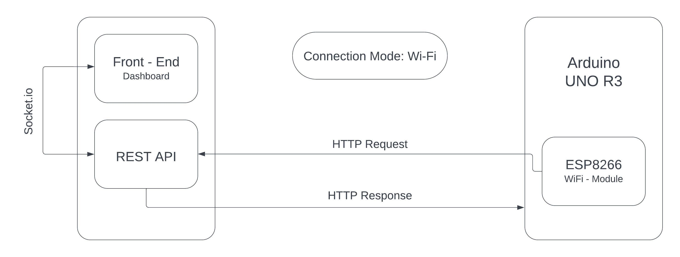
System Architecture

Slide 6
List of Modules
Arduino Uno R3
ESP8266 Wi-Fi Module
MQ2 Gas Sensor
UV Sensor

Slide 7
Functional Description for each modules
□ Arduino UNO R3
The Arduino Uno R3 serves as the central microcontroller in this system. It interfaces with various sensors and modules, reads data from the connected MQ2 Gas Sensor and UV Sensor, and processes this data to determine if it exceeds predefined safety thresholds. The Arduino Uno R3 is equipped with 14 digital input/output pins, 6 analog inputs, a 16 MHz quartz crystal, a USB connection, a power jack, an ICSP header, and a reset button. This board is designed to be user-friendly for beginners while providing enough flexibility for advanced users. When sensor readings indicate a potential hazard, the Arduino triggers alerts and communicates with the ESP8266 Wi-Fi module to send data to the monitoring system.

Slide 8
Functional Description of Module
□ ESP8266 WIFI MODULE:
The ESP8266 Wi-Fi Module is a low-cost microchip with full TCP/IP stack and microcontroller capability, produced by Espressif Systems. It enables microcontrollers to connect to a Wi-Fi network and make simple TCP/IP connections. In this system, the ESP8266 module receives sensor data from the Arduino Uno R3 via serial communication. It then transmits this data over a Wi-Fi network to a remote server or cloud platform for real-time monitoring and further processing. This wireless communication capability allows for remote access to the system’s data, enabling timely alerts and notifications when anomalies are detected, thus enhancing overall safety.

Slide 9
Functional Description of Module
□ MQ2 GAS SENSOR:
The MQ2 Gas Sensor is a semiconductor sensor capable of detecting various gases, including LPG, smoke, alcohol, propane, hydrogen, methane, and carbon monoxide. It is widely used in gas leakage detecting equipment in both household and industrial settings. The sensor operates by heating a small sensing element to a high temperature, allowing it to detect gases. When gas is detected, the sensor’s resistance changes, and this change is converted into an analog signal by the Arduino Uno R3. The Arduino processes this signal to determine the gas concentration levels. If the levels exceed predefined safety thresholds, it triggers an alert and sends the data to the ESP8266 module for transmission.

Slide 10
Functional Description of Module
□ UV SENSOR:
The UV Sensor measures the intensity of ultraviolet light, which can be crucial in environments where UV radiation might be present, such as certain industrial settings. The UV sensor generates an analog voltage that is proportional to the intensity of the UV light it detects. This voltage is read by the Arduino Uno R3’s analog input pins. The Arduino processes this signal to determine the UV intensity. If the UV intensity exceeds safe levels, the Arduino triggers an alert and communicates this information to the ESP8266 Wi-Fi module, which then transmits the data for real-time monitoring and alerts. This helps in monitoring environments for potentially harmful UV exposure, ensuring safety measures can be promptly enacted.

Slide 11
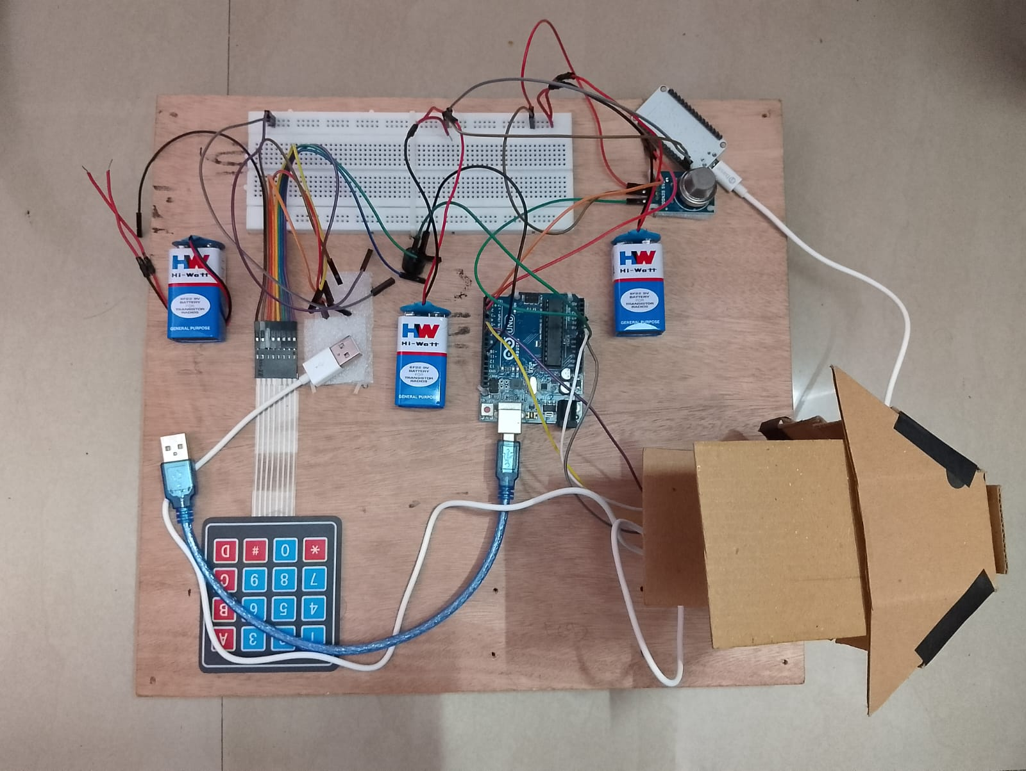
Output

Slide 12
Conclusion
In conclusion, the development and implementation of the IoT-based explosion risk detection system represent a significant advancement in enhancing safety measures within the oil and gas industry. Through real-time monitoring, data analysis, and predictive analytics, the system has demonstrated its effectiveness in mitigating potential hazards and reducing the likelihood of incidents.
The system's ability to continuously monitor environmental parameters and detect abnormal conditions indicative of potential explosion risks has provided invaluable insights into operational safety. Machine learning algorithms applied to sensor data have enabled early identification of patterns associated with potential hazards, facilitating proactive intervention and mitigation measures.
Department of Computer Science and Engineering
12

Slide 13
References
A.S. Mohamed and N. G. Raja, "Smart Gas Leakage Detection and Prevention System Using IoT and Machine Learning," 2020 International Conference on Emerging Trends in Smart Technologies (ICETST), 2020, pp. 1-5, doi:10.1109/ICETST51473.2020.9216432.
P. Varshini and R. Priyadharshini, "Smart Gas Leakage Detection and Monitoring System Using IoT," 2020 International Conference on Smart Electronics and Communication (ICOSEC), 2020, pp. 632-636, doi:10.1109/ICOSEC49006.2020.9185793
S. S. Bhatia and M. Manikandan, "IoT Based Gas Leakage Monitoring and Detection System Using MQ-2 Sensor," 2020 International Conference on Recent Advances in Electronics and Communication Technology (ICRAECT), 2020, pp. 1-4, doi:10.1109/ICRAECT48207.2020.9150122
Department of Computer Science and Engineering
13

Slide 14
Thank You
Department of Computer Science and Engineering
14

