Slide 1

SMART INDIA HACKATHON 2026
Problem Statement ID – 26199
Problem Statement Title – Student Innovation
Theme – Miscellaneous
PS Category – Software
Team ID –
Team Name – HackNova

Slide 2
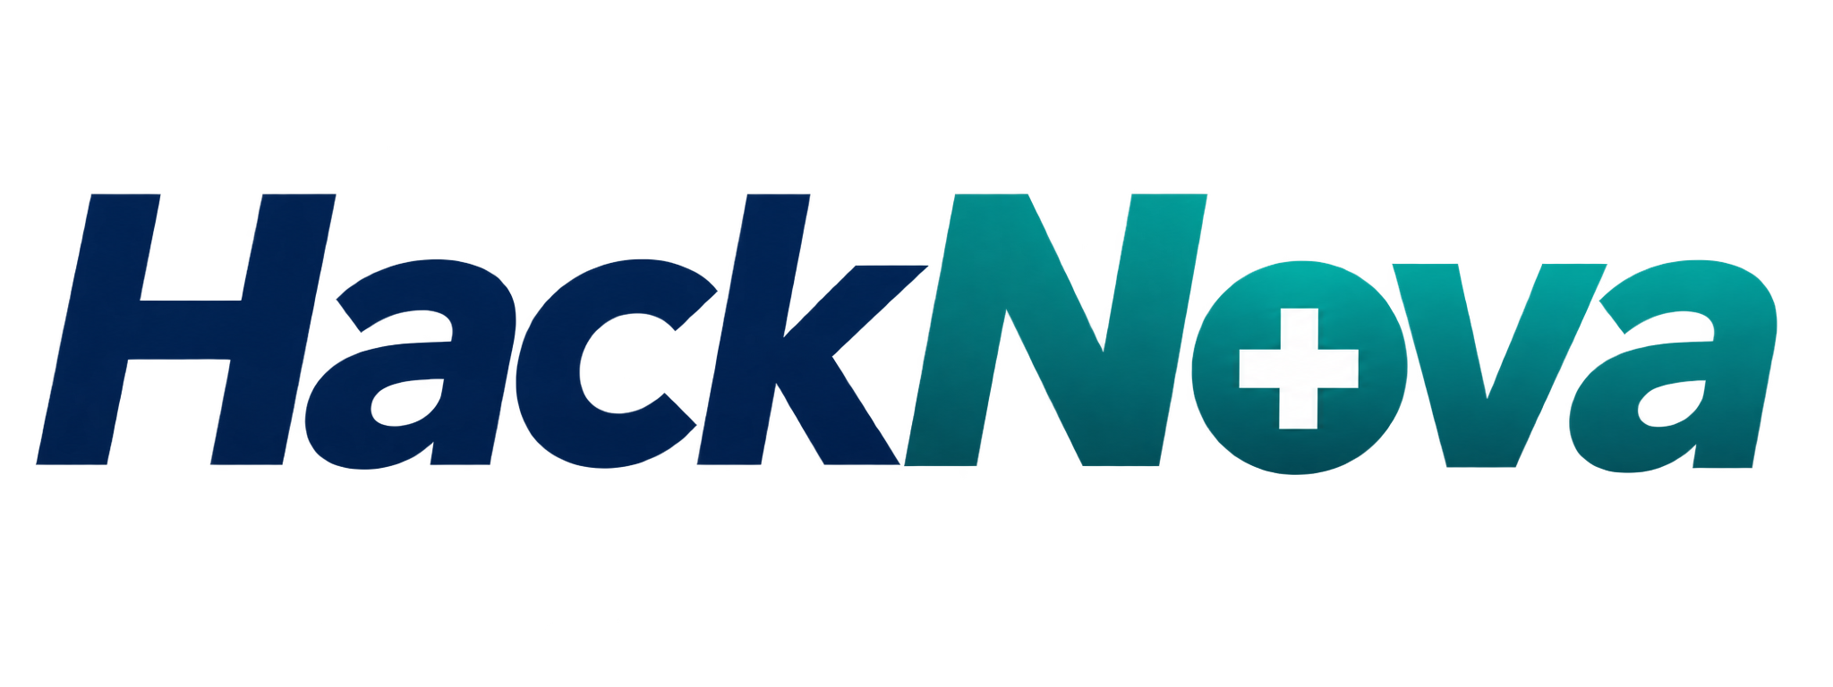
PROBLEMS/CHALLENGES
OUR INNOVATION
• The Death rate is increasing due to lack of resources
Ambulance Drivers Struggle to track exact location of the patient
Many of the people Can't Find a Right Hospital for their Problem
Saving lives through connected Healthcare and Microservices
An AI integrated smart healthcare network that connects patients, doctors, hospitals, ambulances, and administrators to deliver faster emergency response, seamless healthcare access, digital health management, and Automated analytics reports
REAL WORLD EXAMPLES REGARDING THE ABOVE STATEMENTS
In 2017, a 14-year-old kidney patient in Kanchipuram reportedly waited nearly 7 hours for an ambulance to transfer her from Kanchipuram to Chennai. She died during the delay.
The Struggle
The hospital's ambulance drivers were unavailable because it was a Sunday, and calls to the emergency 108 ambulance service faced severe delays
2. In 2024, Karnataka around 90,000 road-crash victims did not
receive timely medical care.
Through MEDILINK these kind of problems may reduce in INDIA
3. India records nearly about 40,000 deaths in a day due to lack of resources and faults of ambulance services

Slide 3
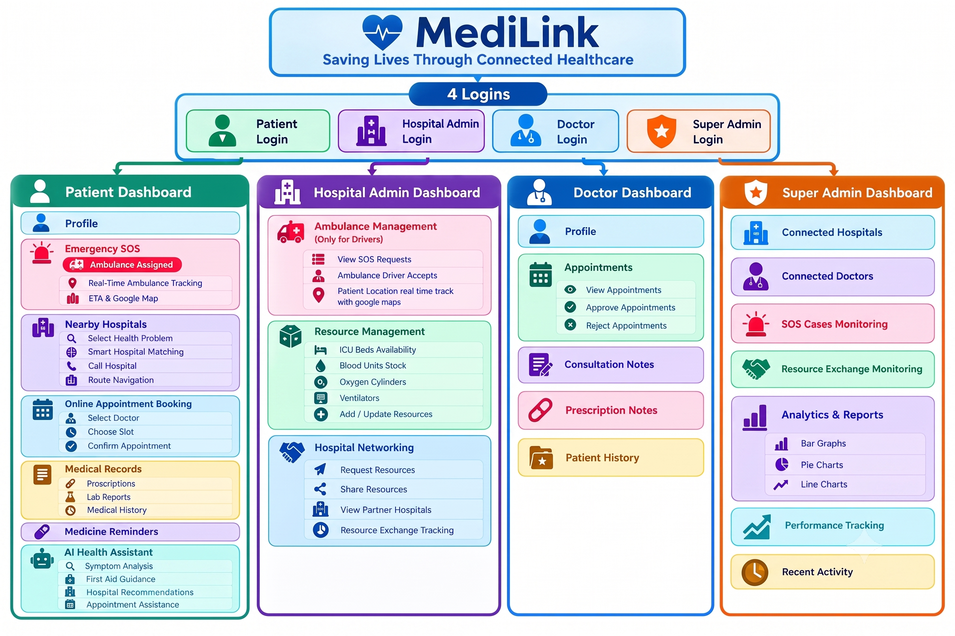








TECHNICAL APPROACH
API, AI Integrated
+
BACKEND
TECHNOLOGIES
USED FOR DEMO
(Auth+Storage)
v
React
Tailwind CSS
TypeScript
PostgreSQL
Vite
Lovable

Slide 4
FEASIBILITY AND VIABILITY
FEASIBILITY
Technically Possible: Uses GPS, cloud, AI, and databases to connect users with healthcare services.
Easy to Scale: Can start with a few hospitals and expand to multiple cities.
Cost-Effective: Uses existing digital infrastructure with minimal physical setup.
Verified Data: Hospitals and authorized providers can update resource availability.
Fast Implementation: The basic platform can be developed and tested using existing technologies.
VIABILITY
Solves a Real Problem: Reduces delays and find emergency medical resources.
High Social Impact: Can help patients access hospitals, blood, oxygen, beds, and ambulances faster.
Hospital Partnerships: Hospitals, blood banks, and ambulance services can join the network.
Sustainable Model: Can grow through partnerships and healthcare organizations.
Long-Term Potential: Can expand into a wider emergency healthcare coordination platform.

Slide 5
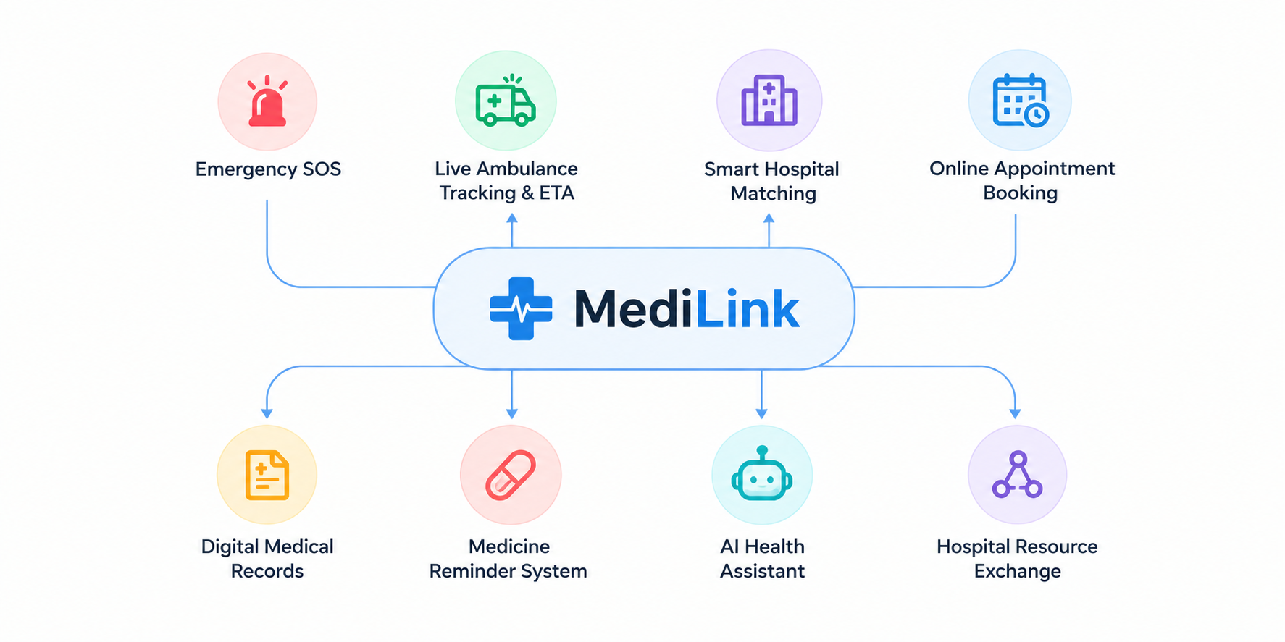
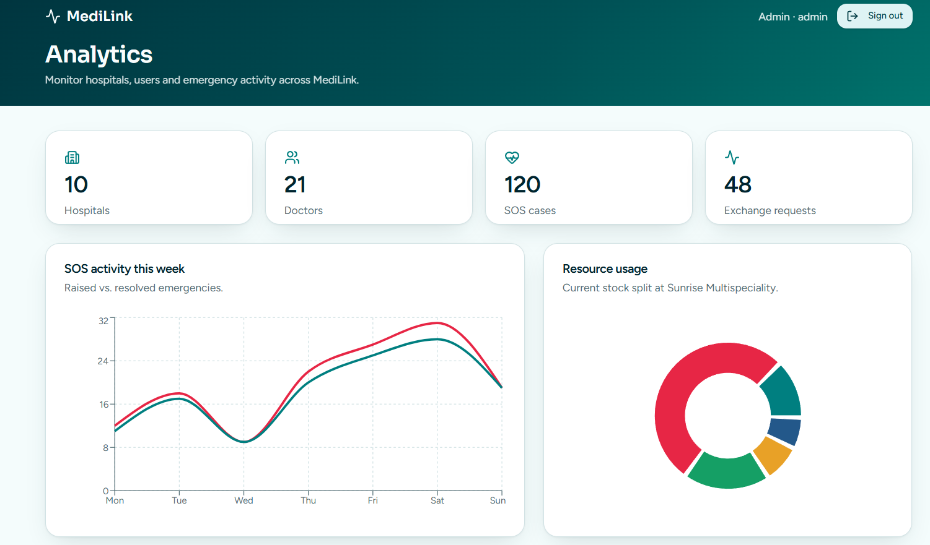
MAIN IMPACTS AND BENEFITS

Slide 6
RESEARCH AND REFERENCES
RESEARCH :
Resource | Official Portal
ABDM Real-time Dashboard & Maps | dashboard.abdm.gov.in
Hospital Registry (HFR) | facility.abdm.gov.in
Doctor Registry (HPR) | hpr.abdm.gov.in
HMIS Web Reports | hmis.mohfw.gov.in
National Emergency Directory | india.gov.in/directory/helpline
PRODUCT / POLICY REFERENCES
An emergency and hospital collaboration platform: instant SOS with ambulance dispatch, hospital discovery with live routing, appointments, medical records and a hospital-to-hospital resource exchange network.
• MediLink prototype : https://health-aid-relay.lovable.app/

