Slide 1
BALAJI R 711721243015 KGISL INSTITUTE OF TECHNOLOGY
3/21/2024 Annual Review

Slide 2
PROJECT TITLE
Generative Adversarial Network (GAN) for MNIST Digit Generation using TensorFlow
3/21/2024 Annual Review

Slide 3


AGENDA
PROBLEM STATEMENT
PROJECT OVERVIEW
WHO ARE THE END USERS
YOUR SOLUTION AND ITS VALUE PROPOSITION
THE WOW IN YOUR SOLUTION
MODELLING
RESULTS
3/21/2024 Annual Review

Slide 4

PROBLEM STATEMENT
Develop a Generative Adversarial Network (GAN) model capable of generating realistic images of handwritten digits, leveraging the MNIST dataset. The goal is to train the GAN to generate high-quality digit images that closely resemble those found in the MNIST dataset. The generated images should exhibit characteristics such as clear digit shapes, smooth transitions between digits, and realistic textures. The project aims to explore the capabilities of GANs in generating synthetic data and to provide a tool for generating digit images that can be used for various applications such as data augmentation, digit recognition model training, and artistic generation.
3/21/2024 Annual Review

Slide 5

PROJECT OVERVIEW
The objective of this project is to train a Generative Adversarial Network (GAN) using TensorFlow to generate realistic images of handwritten digits from the MNIST dataset. The goal is to create a model capable of producing high-quality digit images that closely resemble the real digits in the MNIST dataset.
3/21/2024 Annual Review

Slide 6

WHO ARE THE END USERS?
1. Machine Learning Researchers
2. Data Scientists
3. Software Developers
4. Artists and Designers
5. Educators
3/21/2024 Annual Review

Slide 7

YOUR SOLUTION AND ITS VALUE PROPOSITION
Generative Adversarial Network (GAN) for MNIST Digit Generation using TensorFlow, offers several value propositions:
Data Augmentation
Synthetic Data Generation
Cost-Effective Solution
Versatility
Innovation and Exploration
3/21/2024 Annual Review

Slide 8

THE WOW IN YOUR SOLUTION
Realism
Versatility
Data Augmentation
Cost-Effectiveness
Innovation and Exploration
3/21/2024 Annual Review
8

Slide 9
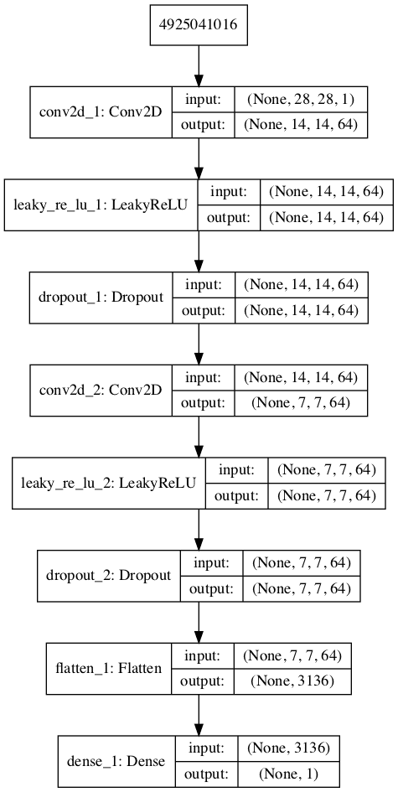
MODELLING
3/21/2024 Annual Review
9

Slide 10
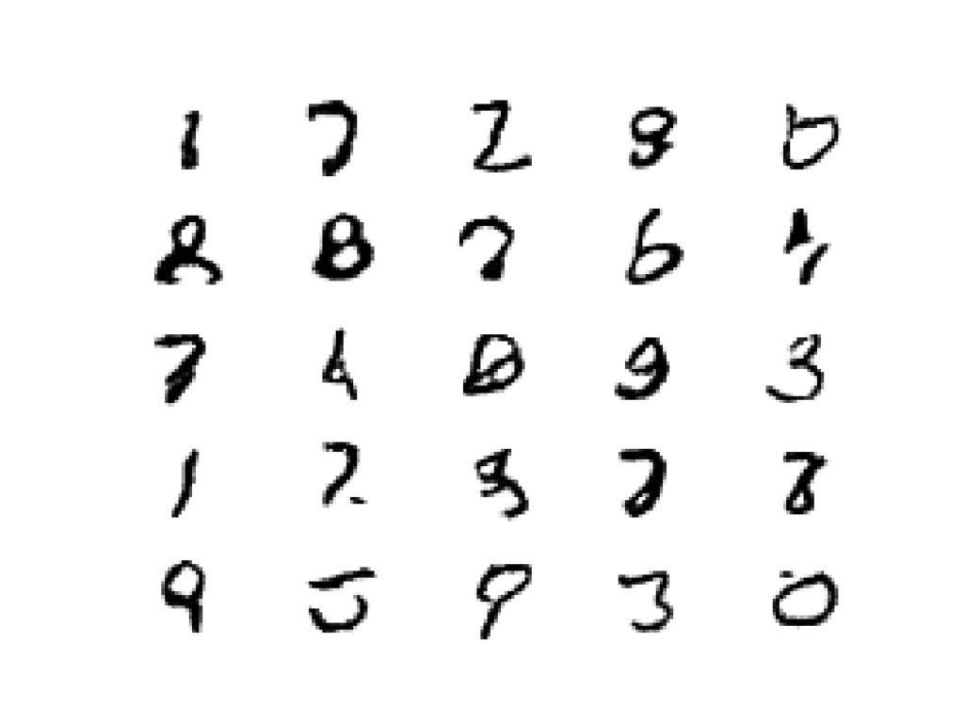
RESULTS
Demo Link
3/21/2024 Annual Review
10

