Slide 1
DeepGuard
AI-Powered Deepfake Detection System
with Forensic Visualization for Cybersecurity Applications
Student: Balajabamani D
Company: Purplesynapz Technologies Pvt. Ltd.
Duration: March 2026 – September 2026
EfficientNetB4
MTCNN
Grad-CAM
Streamlit
AUC: 0.9634
Internship Project Presentation | 2026

Slide 2
Presentation Agenda
01
Problem Statement
05
Key Features
Why deepfake detection matters
Grad-CAM, verdicts, reports
02
Project Overview
06
Results
What DeepGuard does
Performance metrics and comparison
03
System Architecture
07
Application Demo
How the pipeline works
Screenshots of the working app
04
Dataset & Training
08
Conclusion
Data used and model training
Summary and learnings

Slide 3
Problem Statement
Deepfake technology uses AI to create highly realistic fake images and videos of real people. These synthetic images are increasingly being used for identity fraud, misinformation, and social engineering attacks. The human eye can no longer reliably distinguish real from fake — making automated detection essential.
🪪
📰
🎣
⚖️
Identity Fraud
Misinformation
Social Engineering
Legal Tampering
Deepfakes used to impersonate individuals in financial or legal systems
Fabricated images of public figures spread false narratives
Synthetic media makes phishing attacks more convincing
Deepfake images used as fabricated evidence
DeepGuard was developed to address this growing cybersecurity threat using deep learning and forensic AI.

Slide 4
Project Overview
What is DeepGuard?
Technology Stack
DeepGuard is a complete AI-powered deepfake image detection system. It accepts images through file upload or live webcam, detects the face using MTCNN, runs the image through a fine-tuned EfficientNetB4 neural network, and provides a forensic analysis result with a Grad-CAM heatmap showing exactly which facial regions triggered the prediction.
Model
EfficientNetB4 (ImageNet pretrained)
Face Detection
MTCNN
Explainability
Grad-CAM
Framework
TensorFlow 2.17 / Keras 3.4
Interface
Streamlit (dark theme)
0.9634
89.6%
Reports
ReportLab PDF + CSV
Validation AUC
Accuracy
Language
Python 3.10
147K
5 Levels
Training Platform
Google Colab T4 GPU
Training Images
Verdict System

Slide 5
System Architecture
01
02
03
04
05
INPUT
→
FACE DETECT
→
PREPROCESS
→
INFERENCE
→
OUTPUT
Upload image
or Webcam capture
MTCNN
+ 20% padding
Resize 224×224
EfficientNet preprocess_input
EfficientNetB4
Sigmoid output
Verdict + Grad-CAM
+ PDF Report
Component Details
Stage
Component
Input
Output
Face Detection
MTCNN (3-stage cascade)
Full RGB image
Bounding box coordinates
Preprocessing
OpenCV + EfficientNet preprocess_input
Cropped face region
224×224 normalised array
Inference
EfficientNetB4 + Dense head (256→128→1)
Normalised face array
Sigmoid score 0.0–1.0
Grad-CAM
GradientTape on last Conv2D layer
Sigmoid score + conv outputs
Heatmap overlay image
Output
Streamlit UI + ReportLab
Score + heatmap
5-level verdict + PDF report

Slide 6
Dataset & Model Training
Dataset Used
Training Strategy
Split
Real
Fake
Total
Phase 1 — 10 epochs
Train
77,220
70,001
147,221
lr = 1e-3
Base frozen — only classification head trained
Validation
19,787
19,641
39,428
Test
5,413
5,492
10,905
Phase 2 — 10 epochs
lr = 1e-5
Sources: Kaggle (manjilkarki/deepfake-and-real-images)
+ ashwingupta3012/human-faces (7,219 diverse real photos)
Last 30 layers unfrozen — fine-tuning
Data Augmentation Applied
Training Platform: Google Colab T4 GPU | ~5 minutes per epoch
• Rotation ±15°
• Zoom ±15%
• Horizontal flip
• Brightness ±20%

Slide 7
Key Features
★ UNIQUE FEATURE
★ UNIQUE FEATURE
🔬 Grad-CAM Forensic Heatmap
📊 5-Level Verdict System
Highlights which regions of the face most influenced the prediction. Red/yellow = suspicious. Blue = normal.
Definitely Real / Likely Real / Uncertain / Likely Fake / Definitely Fake — more informative than binary classification for forensic use cases.
★ UNIQUE FEATURE
🖼️ Image Metadata Display
📄 PDF + CSV Report Download
Shows filename, dimensions, file size, face region size, and analysis time in milliseconds — giving the tool a genuine forensic tool appearance.
Every detection session can be exported as a formatted PDF forensic report or CSV file — including timestamps, confidence scores, verdict levels, and analysis time.
📷 Webcam + Upload Detection
🎨 Professional Dark UI
Supports both file upload (JPG/PNG) and live webcam capture via Streamlit's camera widget for real-time forensic analysis.
Custom CSS cybersecurity-themed dark interface with colour-coded verdict cards, confidence progress bars, and session statistics sidebar.

Slide 8
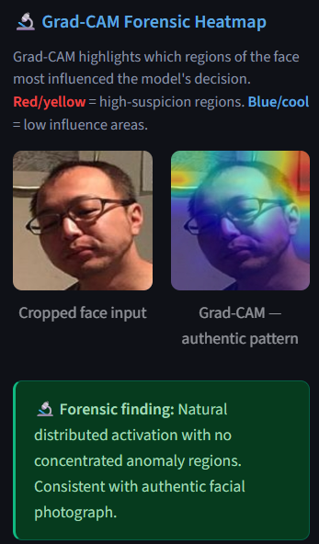
Grad-CAM: What Makes Us Different
Gradient-weighted Class Activation Mapping (Grad-CAM)
Grad-CAM is a research technique published at ICCV 2017. It uses the gradients of the model's output with respect to the last convolutional layer to produce a spatial heatmap. This shows exactly which parts of the face the model focused on when making its decision.
1
Run the face image through EfficientNetB4 and record the last Conv2D layer output
2
Compute the gradient of the prediction score with respect to those feature maps
3
Weight each feature map channel by its average gradient (global average pooling)
4
Apply ReLU to keep only positive activations, resize to face dimensions
5
Apply JET colour map and overlay on the face image at 50% transparency

Slide 9
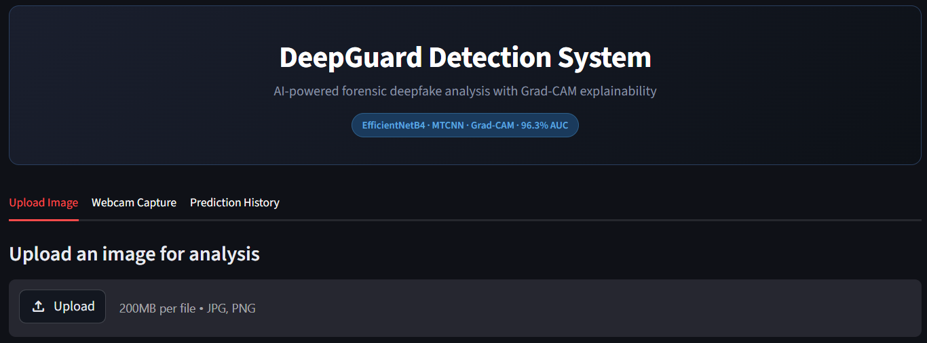
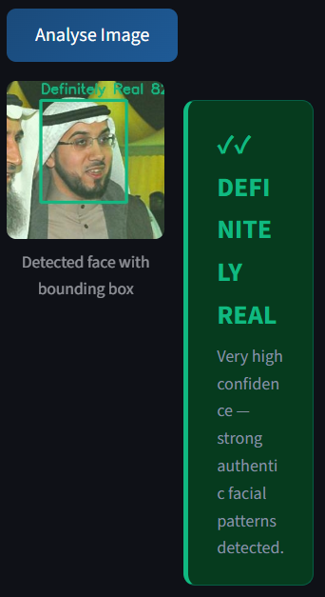
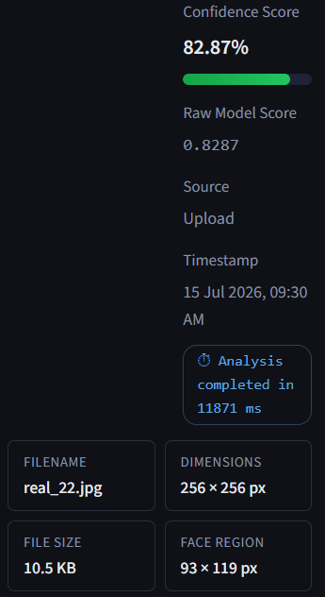
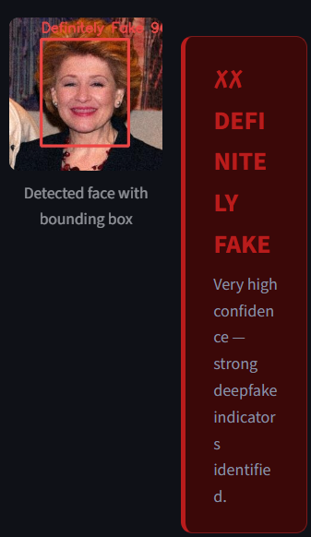
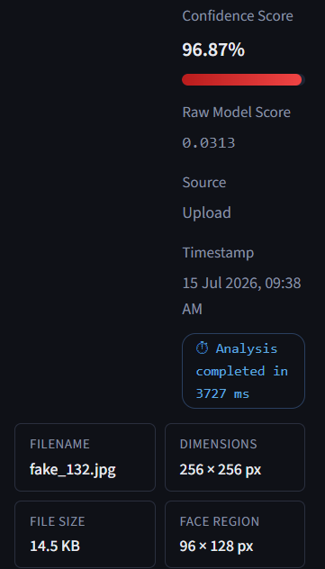
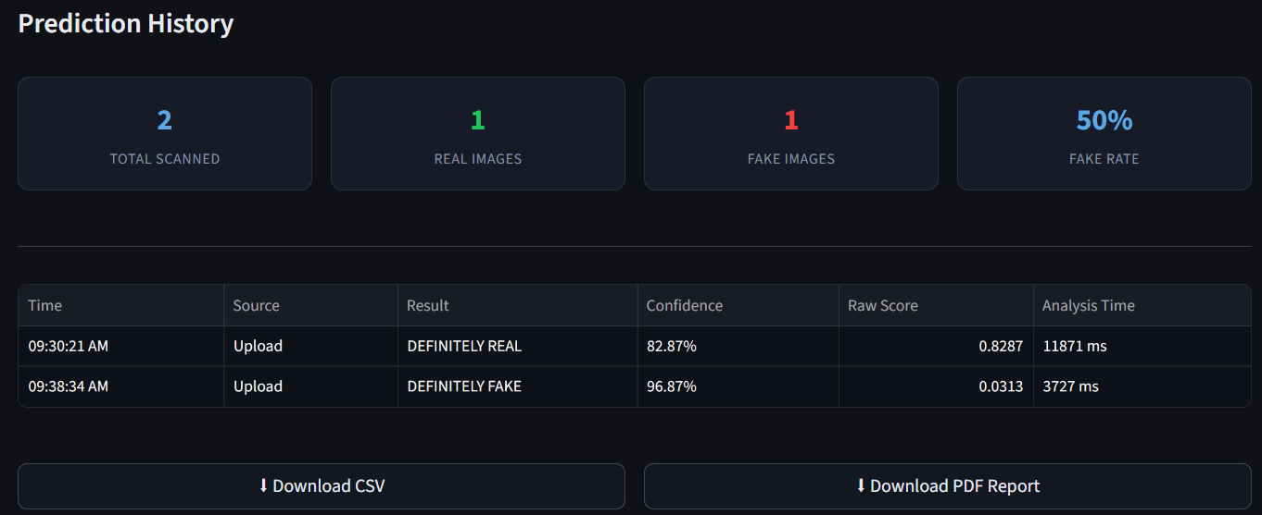
Application Screenshots
Main Interface (Upload tab)
Real Image Detection Result
Fake Image Detection Result
Prediction History Tab

Slide 10
Results & Performance
0.9634
89.6%
96.7%
~1 sec
Validation AUC
Validation Accuracy
Training AUC
Inference Time
Comparison: Old System vs DeepGuard
Metric
Old System (MobileNetV2)
DeepGuard (EfficientNetB4)
Validation AUC
Test AUC: 0.9192
0.9634
Accuracy
Test Accuracy: 81.25%
~89.6%
Training Data
10,000 images
147,221 images
Face Detector
MTCNN
MTCNN
Real-world Photos
Poor generalization observed
Improved Prediction Consistency
Explainability
None
Grad-CAM heatmap
Reports
None
PDF + CSV download
Verdict Levels
Binary (Real/Fake)
5 levels

Slide 11
5-Level Verdict System
Score ranges were defined based on empirical analysis of the model's sigmoid output score distribution and iterative testing.
✓✓
Score ≥ 0.80
Very high confidence — strong authentic facial patterns
DEFINITELY REAL
✓
Score 0.40–0.79
Probable authentic image — no significant manipulation indicators
LIKELY REAL
?
Score 0.20–0.39
Borderline result — manual verification recommended
UNCERTAIN
✗
Score 0.10–0.19
Probable AI-generated image — suspicious patterns detected
LIKELY FAKE
✗✗
Score < 0.10
Very high confidence — strong deepfake indicators identified
DEFINITELY FAKE

Slide 12
Security & Limitations
Security Features
Known Limitations
✓
All processing is local — no images sent to external servers
!
Very high-quality StyleGAN fakes may score above threshold
✓
No user data stored beyond current session memory
!
Poor lighting or extreme angles may fail face detection
✓
File input restricted to JPEG and PNG formats only
!
Still image only — no video stream support currently
✓
Session history cleared on application restart
!
Threshold calibrated for this dataset — may need adjustment for new contexts
✓
No authentication data or personal information collected
!
CPU inference takes 1–2 seconds per image
Despite these limitations, DeepGuard achieved a validation AUC of 0.9634, demonstrating strong classification performance during model validation.

Slide 13
Conclusion
✅ Developed an end-to-end AI-based deepfake detection system using transfer learning, achieving a
validation AUC of 0.9634.
✅ Integrated Grad-CAM forensic heatmap — a genuine research technique for explainability
✅ Developed 5-level verdict system more suitable for forensic analysis than binary output
✅ Delivered professional Streamlit application with PDF/CSV report export
✅ Addressed real-world domain gap by adding diverse consumer photographs to training data
✅ Resolved cross-version Keras deployment issues using NumPy weight serialisation
DeepGuard demonstrates that an AI-based deepfake detection prototype with forensic visualization can be developed using open-source tools and publicly available datasets.

Slide 14
Thank You
Balajabamani D
Purplesynapz Technologies Pvt. Ltd.
EfficientNetB4
0.9634
147,221
Grad-CAM
Model
AUC
Training Images
Explainability
AI-Powered Deepfake Detection System with Forensic Visualization for Cybersecurity Applications

