Slide 1

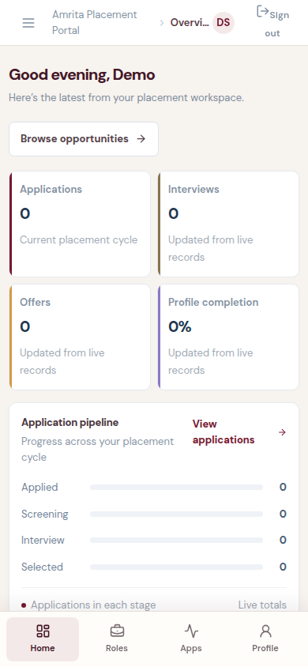
PLACEMENT WORK,
IN ONE PORTAL.
Amrita Placement Portal · Bengaluru Campus
Student, recruiter and placement-team workflows
connected to one Oracle-backed system.
Synthetic Demo Student · QA capture
DBMS VIVA / PRODUCT + IMPLEMENTATION
Notes:
Product framing. Replace the labeled capture placeholder only with the fresh QA-frozen screenshot at test-results/showcase/dashboard-mobile.png. The supplied Amrita logo is used without recoloring.

Slide 2
01 / ARCHITECTURE
One request path. Clear boundaries.
The portal UI, API and Oracle remain distinct; email and SQL Workshop sit on separate paths.
01
02
03
04
Student / recruiter / placement team
Cloudflare
Express API
Oracle · FREEPDB1
Responsive React + TypeScript
Static assets · Worker · private VPC/tunnel
Role checks · bound SQL · transactions
PLACEMENTS_PORTAL relations
GMAIL SMTP
Carries OTP messages. Oracle keeps challenge and session state.
APEX SQL WORKSHOP
Read-only business-table inspection examples for the viva.
Source: README.md · docs/team-viva/DBMS-WALKTHROUGH.md · server/src/ · cloudflare/
Notes:
Architecture source: React/TypeScript client, Express API with bind variables, Oracle FREEPDB1, Cloudflare Worker and private tunnel. Gmail is mail transport only. APEX examples use read-only business-table access.

Slide 3
02 / DATABASE DESIGN
The ER model becomes working relations.
Keys and constraints protect the workflow while API joins shape the views.
18 TABLES
IDENTITY
PLACEMENT
ENGAGEMENT
PLATFORM
DEPARTMENTS
COMPANIES
USERS
STUDENTS
STUDENT_PHONE_NUMBERS
OPPORTUNITIES
OPPORTUNITY_
ELIGIBLE_DEPARTMENTS
OPPORTUNITY_SKILLS
APPLICATIONS
PLACEMENTS
INTERNSHIPS
HACKATHONS
HACKATHON_REGISTRATIONS
CERTIFICATES
OTP_EMAIL_LOCKS
OTP_CHALLENGES
SESSIONS
UPLOADS
[DERIVED] · counted from
CREATE TABLE in schema DDL
Phones and opportunity eligibility/skills have relation rows. JSON arrays remain serialization mirrors; placement requirements also retain a historical snapshot.
INTEGRITY + SQL + TRANSACTIONS
PK / FK / UNIQUE / CHECK protect links, participation and valid values.
JOIN: Applications → Students → Opportunities → Companies · GROUP BY status · COUNT(*)
Profile + student + phone replacement commits or rolls back together in the API.
Count method: `rg -c "CREATE TABLE" database/001_schema.sql` → 18 [DERIVED]. Source: database/001_schema.sql · database/SCHEMA.md · server/src/db.ts
Notes:
The displayed table total is derived by counting CREATE TABLE occurrences in database/001_schema.sql. Relationship map is selective, not the entire ER diagram. Opportunity requirements use normalized child relations plus JSON serialization mirrors; placement rows retain a requirements snapshot. Transactions are in the API, not stored procedures.

Slide 4
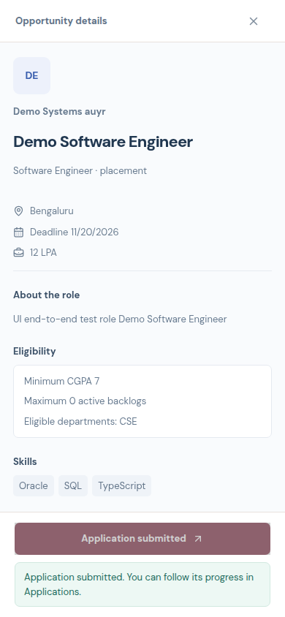
03 / MOBILE WORKFLOWS
From opportunity to outcome.
The same Oracle-backed workflow supports students, recruiters and the placement team.
01
Student
Profile → eligible opportunity → application
02
Recruiter
Company opportunity → application stage
03
Placement team
Approval → outcomes and reports
04
Student team
Hackathon registration → team list
QA counts [MEASURED]: 29 brand · 35 shell · 43 flows · 19 layout
Synthetic Demo Student · apply flow
Layout [MEASURED]: 12 CSS widths; 200% text-size emulation at four widths. Browser checks cover exercised journeys, not every validation case.
QA [MEASURED], 2026-11-10: public-device-results.json · public-release/qa-publish-report.md
Notes:
Fresh QA dated 2026-11-10: mobile gates passed typecheck, build, 29 brand/landing, 35 shell/navigation and 43 three-role functional browser checks. App gates passed typecheck, build, 87 Oracle integration and 14 email/MIME checks. Public landing QA passed 19 checks across 12 CSS viewport widths; it also checked computed-font-size emulation at 200% at 320, 390, 650 and 651 CSS px, plus reduced motion. These are automated test results, not performance benchmarks or institutional placement statistics. Browser emulation is not physical-device certification; 200% text checks are not browser-chrome zoom. Mail used in-process JSON capture, no external email was sent. Reports-screen aggregate values have unverified provenance and are excluded. Sources: .superpowers/sdd/public-release/qa-publish-report.md and docs/showcase/public-device-results.json.

Slide 5
VALIDATE THE MODEL. TRACE THE WORKFLOW.
Follow one record through relational rules, SQL and an atomic API operation.
01
02
03
INTEGRITY
QUERY
TRANSACTION
Primary and foreign keys connect the student, opportunity and application records. UNIQUE and CHECK rules reject invalid combinations.
Join applications to students, opportunities and companies. Group by status to explain a report result.
A profile update changes related user, student and phone rows together—or rolls the operation back.
DEMO PATH
student application → recruiter stage update → APEX read-only query → team handoff
Use synthetic demo records. APEX is for read-only inspection; application writes go through the API.
DBMS VIVA / AMRITA PLACEMENT PORTAL
5
Notes:
Close by tracing one application from the student action to the recruiter update, then inspect the resulting business rows with a read-only APEX query. Explain which constraint protects the relationship and where the API transaction groups related writes. Use synthetic demo records and state that the walkthrough covers selected flows rather than every validation case.

