Slide 1
RailGuard: Railway Track Surface Defect Detection
PROJECT TITLE
Name: Balaji S
Department: CSE
Register no: 312424104040
WHAT THIS PROJECT ADDS
1
Single-class baseline
2
Like-for-like comparison of YOLOv8n, YOLO11n and YOLO26n
PROBLEM
Manual track inspection is slow, labour-intensive and risky, and a missed defect can cause a derailment. Cameras record far more imagery than people can review, and surface defects are small and blend into normal rail wear.
3
Object-level error analysis: TP, FP, FN and worst-case images
4
Working web app: upload an image and see the detections
OBJECTIVES
(1) Locate rail defects with bounding boxes
(2) Compare three nano YOLO detectors
(3) Analyse missed defects and false alarms
(4) Deliver an operator web app
Source: Railway Track Surface Faults Dataset v2, Mendeley Data, 2022 (DOI 10.17632/8hxtgyyxrw.2)
Notes:
About 2 minutes. Problem: manual track inspection is slow and risky, and a missed defect can derail a train; cameras record more imagery than people can review. Inspiration: the Mendeley Railway Track Surface Faults dataset, recorded at 120 FPS at Kotri Junction. Gap: edge-sized detectors need a like-for-like comparison on real footage, and a detector alone is not usable by an operator. What I added: a single-class baseline, a comparison of three nano YOLO models, object-level error analysis, and a working web app.

Slide 2
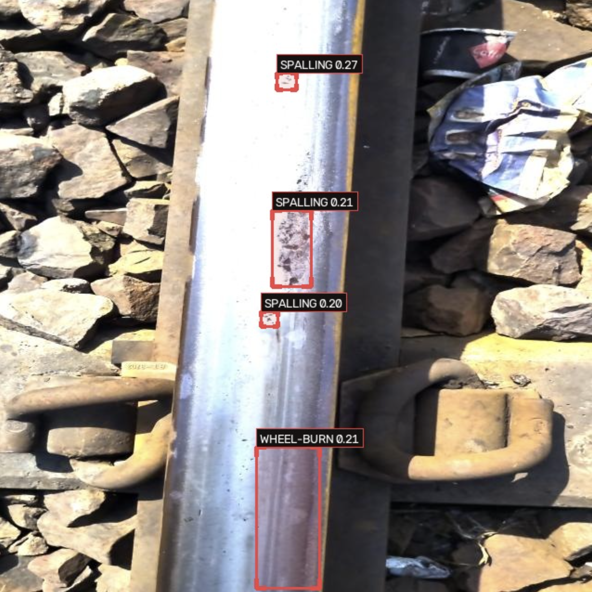
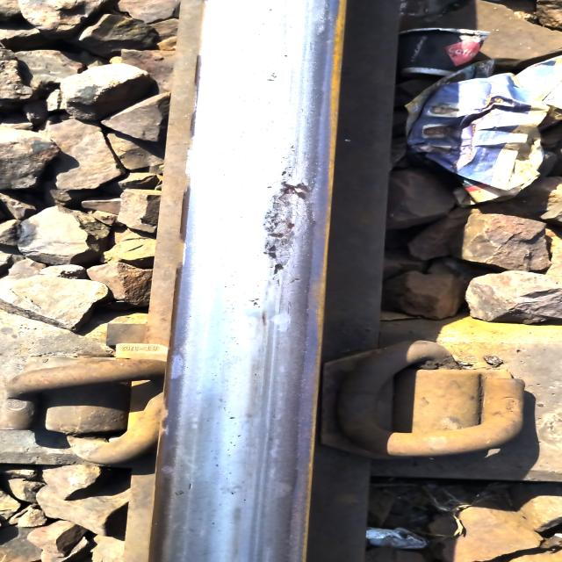
Architecture: Pipeline and Models
METHOD
PROJECT PIPELINE
Mendeley dataset
Merge 10 classes into 1
Fine-tune 3 YOLO models
Test and error analysis
Web app
MODEL ARCHITECTURES
SAMPLE PREDICTIONS
YOLOV8N
CNN backbone
Neck (feature fusion)
Detection head
NMS
YOLO11N
CNN backbone
Neck (feature fusion)
Detection head
NMS
YOLO26N
CNN backbone
Neck (feature fusion)
End-to-end head
No NMS
TRAINING METHOD
Fine-tuned from COCO-pretrained weights: 50 epochs, batch 16, 640 x 640, AdamW, Kaggle T4 GPU. Augmentation: HSV shifts, flip, scale, translate. Validation and test images are never augmented.
Notes:
About 2 minutes. Pipeline: the Mendeley data comes as a Roboflow YOLO export with a predefined split. For Phase 1 I merged the 10 defect classes into one class, fine-tuned three nano models from COCO-pretrained weights, then tested on the held-out set and did object-level error analysis. The same models sit behind the web app pipeline. All three are CNN detectors: YOLOv8n and YOLO11n use NMS, YOLO26n is end-to-end and needs no NMS. Mosaic augmentation stitches four images so the model sees defects at different scales; it is switched off for the last 10 epochs.

Slide 3
Model Comparison and Metrics
RESULTS
DESIGN AND SPEED
EVALUATION METRICS (VALIDATION AND TEST)
Metric | YOLOv8n | YOLO11n | YOLO26n
Type | CNN | CNN | CNN, end-to-end
NMS needed | Yes | Yes | No
Parameters | 3.01M | 2.58M | 2.38M
GFLOPs | 8.2 | ~6.5 | 5.3
Checkpoint | 5.96 MiB | 5.22 MiB | 5.14 MiB
Training time | 0.69 h | 0.84 h | 0.92 h
Best epoch | 47 | 46 | 50
Model | Split | Prec. | Recall | F1 | mAP50 | mAP50-95
YOLOv8n | Val | 0.432 | 0.377 | 0.402 | 0.354 | 0.129
 | Test | 0.432 | 0.426 | 0.429 | 0.398 | 0.137
YOLO11n | Val | 0.447 | 0.417 | 0.431 | 0.390 | 0.145
 | Test | 0.477 | 0.406 | 0.439 | 0.400 | 0.144
YOLO26n | Val | 0.438 | 0.372 | 0.403 | 0.355 | 0.133
 | Test | 0.434 | 0.376 | 0.403 | 0.375 | 0.136
SAME SETUP FOR ALL THREE
Same dataset, image size, epochs, batch size and optimizer. Test metrics are at the peak-F1 threshold on 1,494 defect objects. YOLO26n was tested on 300 images (background images removed). Best model by validation fitness: YOLO11n.
Notes:
About 2 minutes. Left table: design and cost. YOLO26n is smallest at 2.38M parameters and needs no NMS; YOLOv8n is largest at 3.01M. Right table: validation and test. YOLO11n is best on F1 (0.439 test) and mAP@50 (0.400) with fewer parameters than YOLOv8n; YOLOv8n has the highest test recall (0.426). mAP@50 is about 0.40 but mAP@50-95 is about 0.14, so the model finds the defect region but boxes are loose at strict overlap.

Slide 4
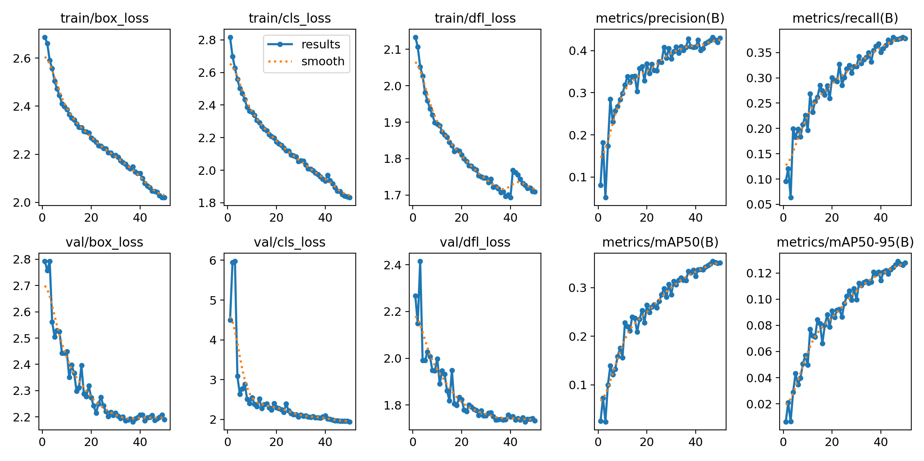
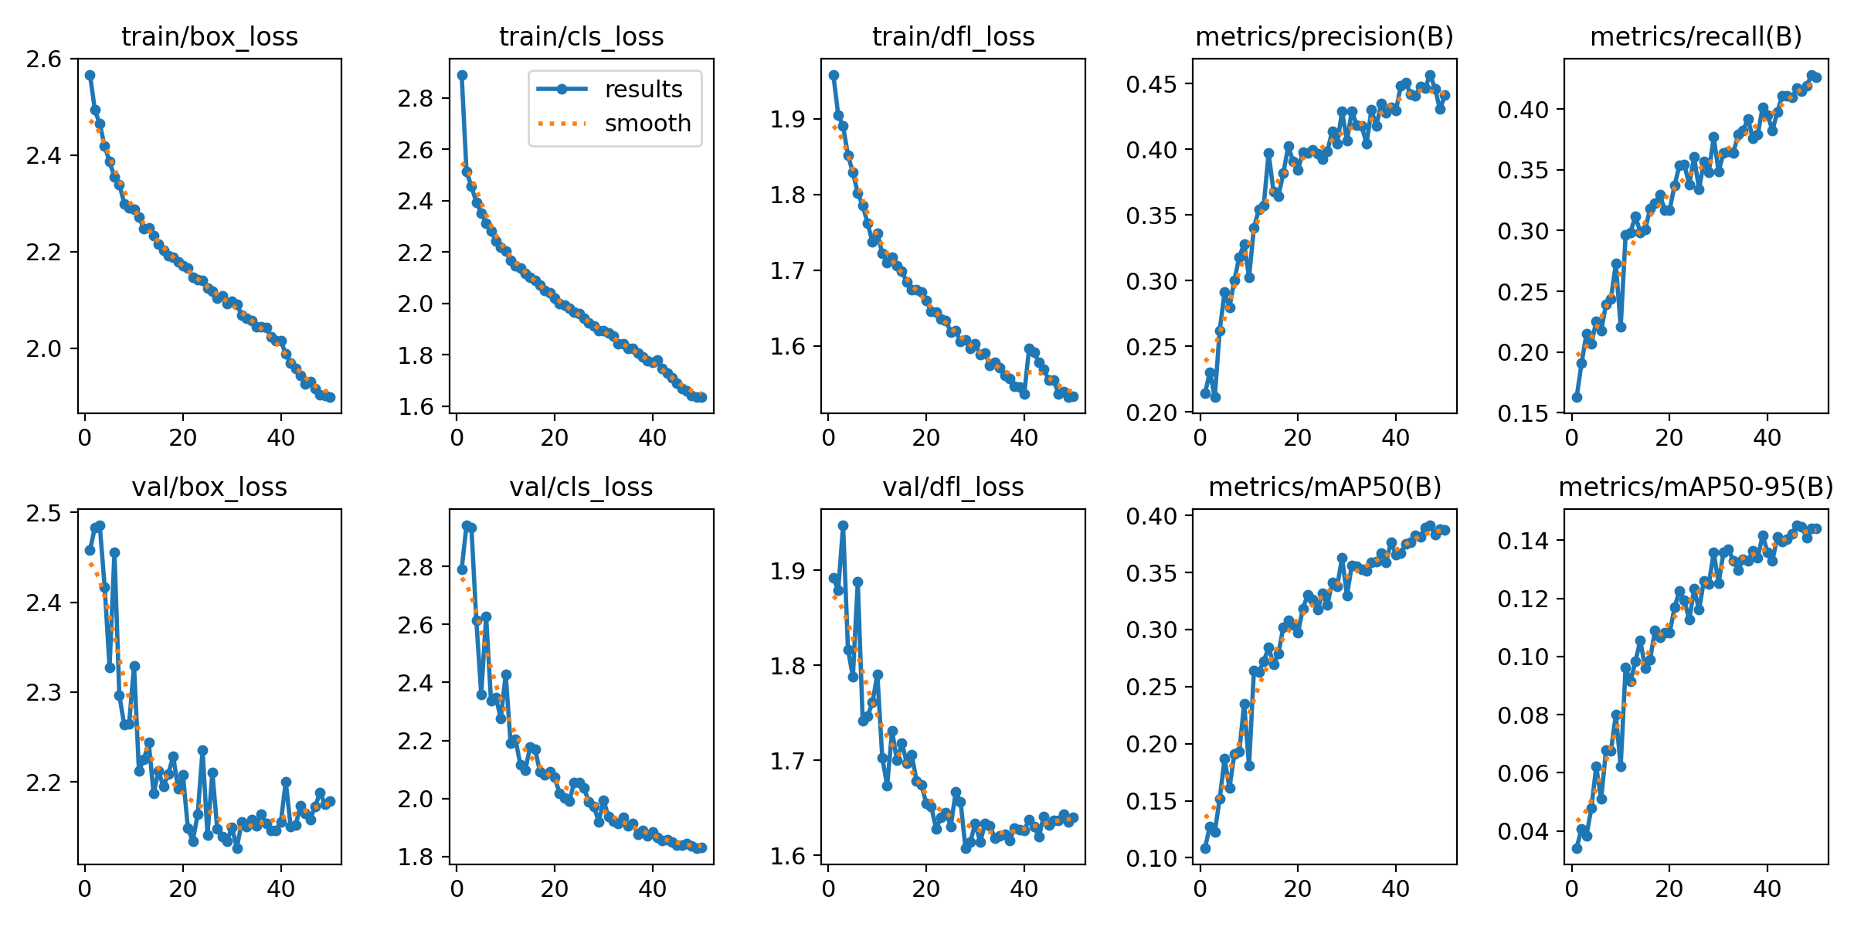
Results: YOLOv8n and YOLO11n
RESULTS
YOLOV8N RESULT
YOLO11N RESULT
Notes:
About 2 minutes. Left: training and validation curves over 50 epochs (losses fall steadily, metrics plateau). Right: F1 against confidence; peak F1 is about 0.43 to 0.44 for both. Best epochs were 47 for YOLOv8n and 46 for YOLO11n, chosen by validation fitness (0.1 x mAP@50 + 0.9 x mAP@50-95). Early stopping never triggered.

Slide 5
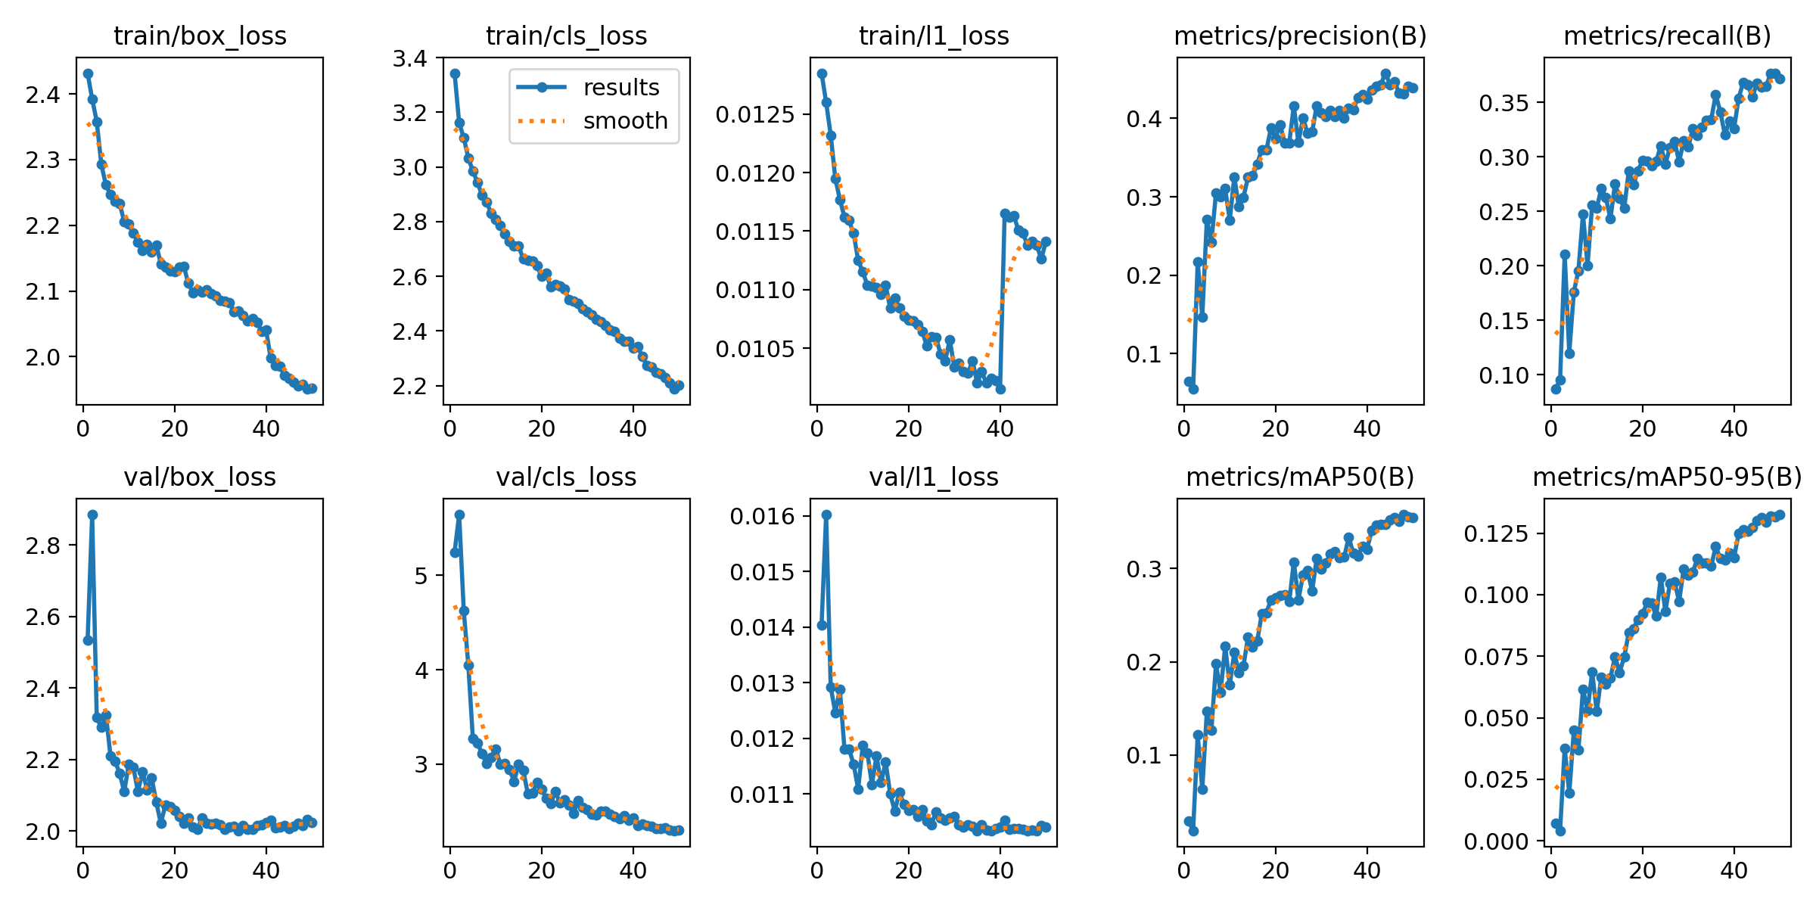
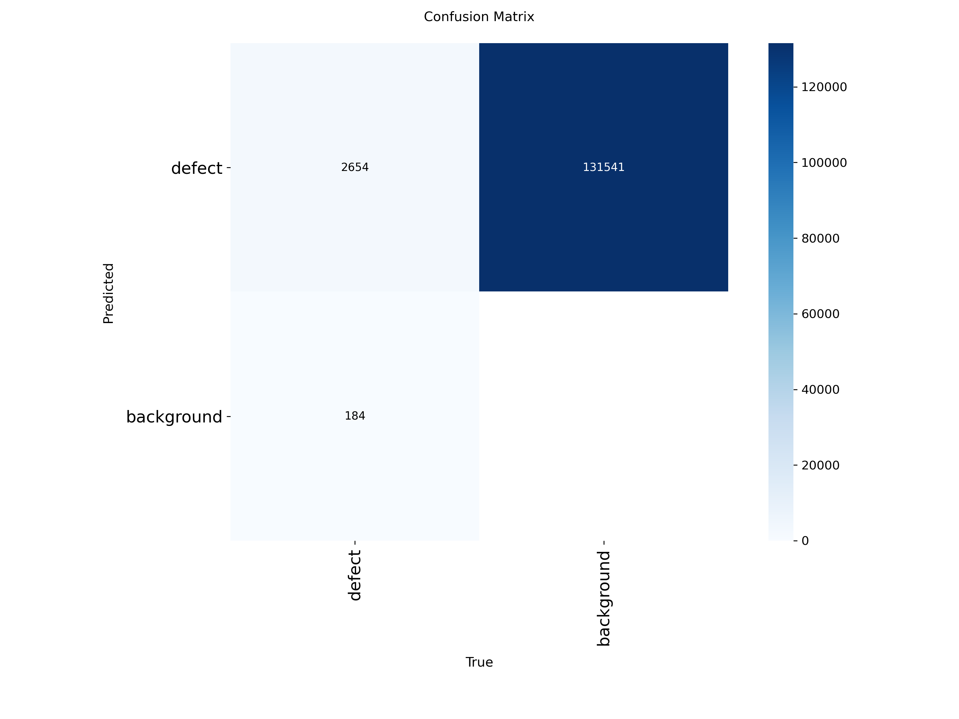


Results: YOLO26n and Error Analysis
RESULTS
YOLO26N RESULT
KEY FINDINGS
YOLO11n is best overall: F1 0.439 and mAP@50 0.400 on test, with fewer parameters than YOLOv8n.
Recall is the weak point: at confidence 0.25 the models find only 25% to 35% of defects.
CONFUSION MATRICES: YOLOV8N, YOLO11N, YOLO26N
YOLO26n makes the fewest false alarms (225 FP) but misses the most defects (1,118 FN).
ERROR ANALYSIS (CONF 0.25)
Model | TP | FP | FN
YOLOv8n | 463 | 398 | 1,031
YOLO11n | 520 | 485 | 974
YOLO26n | 376 | 225 | 1,118
Notes:
About 2 minutes. Top left: YOLO26n curves. Bottom left: confusion matrices; with one class they mainly show defects against background. Error analysis on 1,494 ground-truth defects at confidence 0.25 and IoU 0.5: YOLO11n found 520 with 485 false positives and 974 misses; YOLO26n is the most conservative with 225 false positives but 1,118 misses. Likely causes of misses (small defects, resizing to 640, motion blur) are hypotheses I have not tested.

Slide 6
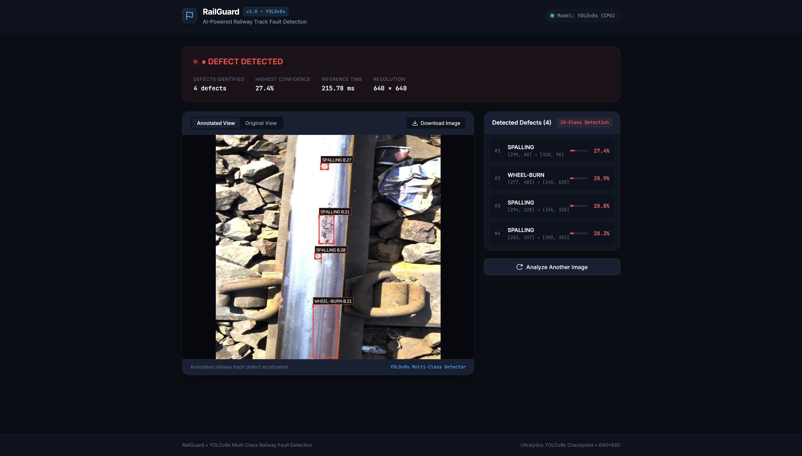
Limitations, Web App and Next Steps
DISCUSSION
LIMITATIONS
Low recall: only 25% to 35% of defects found at confidence 0.25
Likely frame leakage: 120 FPS video split at image level
Single location: all data from Kotri Junction
640 px resizing may hide fine cracks
One merged class cannot separate severe from minor defects
WEB APPLICATION
FastAPI backend with a Single-class YOLOv11n detector
React 19 and Vite frontend
Upload an image, set confidence, view detections
PHASE 2: NEXT STEPS
Multi-class benchmarking (in progress)
Video-disjoint train, val and test split
Higher-resolution
Transformer detectors such as RT-DETR
Notes:
About 2 minutes. Limitations first: recall is low, so this is a research baseline and not a safety system; there is likely frame leakage because the split is image-level on 120 FPS video; all data is from one location. Web app: FastAPI serves a 10-class YOLOv8s model, React 19 with Vite is the frontend. Phase 2: multi-class benchmarking is in progress, so I am not presenting multi-class numbers today; then a leakage-safe split, higher resolution or sliced inference, transformer detectors and FPGA edge deployment.

