Slide 1
Secure Data Hiding in Image Using Steganography
CAPSTONE PROJECT
Presented By:
Student Name : Balaji Shivcharan Dhakare
College Name & Department : Sinhgad Institute of Technology
E&tc

Slide 2
OUTLINE
Problem Statement
Technology used
Wow factor
End users
Result
Conclusion
Git-hub Link
Future scope

Slide 3
Problem Statement
The increasing reliance on digital communication necessitates robust methods for secure data transfer. Traditional encryption methods, while effective, often reveal the very fact that a secret message is being transmitted. This can attract unwanted attention and potentially compromise sensitive information. Steganography, the art of hiding data within other seemingly innocuous data, offers a solution to this problem. Current steganographic techniques vary in their capacity, security, and undetectability. This project aims to develop a steganographic method that maximizes data hiding capacity while maintaining a high level of security and minimizing the perceptible changes to the carrier image. The challenge lies in balancing these three crucial factors.

Slide 4
Technology used
Programming Language: Python, chosen for its versatility and extensive libraries.
Image Processing: OpenCV (cv2) library, used for efficient image manipulation and analysis.
Encryption: LBC encryption to secure the data before embedding.
Steganography Technique: Least Significant Bit (LSB) modification,
selected for its balance of simplicity and data capacity.
Execution Environment: Python interpreter, required to run the project code.

Slide 5
Wow factors
The "wow" factor of this project lies in its ability to conceal significant amounts of data within an image without leaving any visually detectable traces. The stego-image, containing the hidden information, appears virtually identical to the original image, making it extremely difficult for an observer to suspect the presence of hidden data. Furthermore, the optional integration of encryption adds an extra layer of security, ensuring that even if the steganography is detected, the hidden data remains protected. simplifies the process of embedding and extracting data, making it accessible to users with varying levels of technical expertise. The potential applications of this technology in secure communication and data transfer are vast.

Slide 6
End users
Military personnel can use this for secure communication in the field, transmitting mission-critical
information without alerting the enemy. This could include tactical plans, or logistical details.
Journalists and whistleblowers can securely communicate sensitive information, protecting sources
and preventing censorship or retaliation.
Businesses can protect confidential data, such as trade secrets, financial records, or strategic plans,
during transmission and storage.
Individuals can discreetly share personal information when privacy is a primary concern.
Security agencies and law enforcement can leverage steganography for covert communication,
intelligence gathering, and sensitive operations.
Researchers in information security can use this project as a foundation for developing more
advanced steganographic techniques.

Slide 7
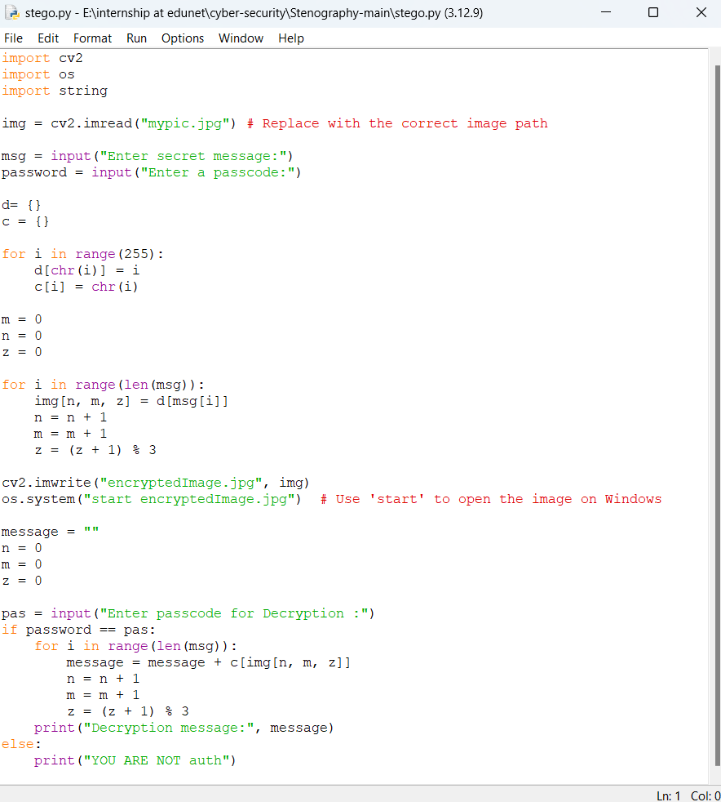
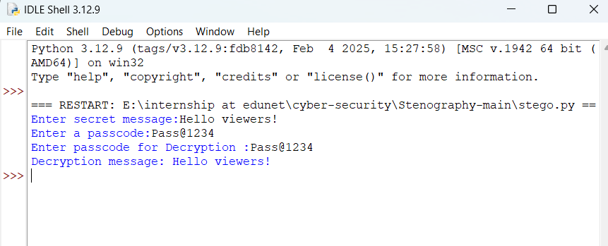

Results

Slide 8
Conclusion
This project contributes to the field of information security by providing a practical and effective method
for secure data hiding, addressing a critical need.
The developed steganographic technique offers a compelling balance between data capacity, security,
and imperceptibility, making it suitable for real-world applications.
While LSB-based steganography has limitations, the modifications implemented in this project mitigate
some of these weaknesses and enhance its practicality.
Future work could explore more advanced steganographic methods, such as frequency domain techniques,
to further enhance security, capacity, and resistance to detection.
The project serves as a valuable resource for anyone interested in learning about and implementing
steganography for secure communication, offering a clear and well-documented example.
It highlights the ongoing potential of steganography as a crucial tool for protecting sensitive information in
an increasingly interconnected and potentially hostile world.

Slide 9
GitHub Link
https://github.com/Balaji-Dhakare/Steganography.git

Slide 10
Future scope(optional)
Advanced Techniques: Explore frequency domain embedding (DCT), adaptive algorithms,
combining methods, and deep learning for steganography.
Enhanced Security: Implement stronger encryption (RSA, ECC), robust key management,
steganalysis countermeasures, and watermarking.
Expanded Functionality: Support diverse file types, increase data capacity, create a GUI, develop
a mobile app, and integrate with communication systems.
Performance: Analyze and optimize performance, conduct robustness testing against various attacks.
Research: Perform theoretical analysis, comparative studies, and potentially publish findings.

Slide 11
THANK YOU

