Slide 1

SMART INDIA HACKATHON 2026
APAAR-VERIFY AI
Problem Statement ID – SIH 26263
Problem Statement Title - Development of an APAAR ID-Based Student Data Management and Verification Platform for AICTE-Approved Institutions
Theme - Smart Automation
PS Category - Software
Team ID - 199231
Team Name - Code DevCore

Slide 2

APAAR-VERIFY AI
Proposed Solution
Innovation & Uniqueness
1
Centralized platform for student-level data from AICTE-approved institutions
Smart validation
Rule-based checks combined with intelligent anomaly detection
2
APAAR ID as the unique academic identifier, subject to authorized validation
3
Bulk CSV/Excel upload and secure API-based data submission
Cross-institution alerts
Duplicate-risk alerts beyond a single institution's records
4
Automated checks for missing IDs, duplicates, inconsistencies and cross-institution enrolment
Explainable results
Shows why each record was flagged
5
Intake vs actual enrolment monitoring, incl. supernumerary, NRI, OCI and foreign national seats
6
AICTE and institution dashboards with alerts, reports and authorized verification
Consent-aware access
Role-based access and traceable verification history
7
Verifiable record references; APAAR ID beside student ID on eligible certificates, subject to authorization

Slide 3
TECHNICAL APPROACH
Recommended technology stack
Layer | Technology | Purpose
Frontend | React + TypeScript + Tailwind CSS | Institution portal and dashboards
Backend | Python + FastAPI | Secure REST APIs and business logic
Database | PostgreSQL | Student, institution, intake and audit records
Validation | Python + Pandas + rule engine | Bulk validation and duplicate detection
Analytics | Recharts | Admission monitoring and visual reports
Security | JWT/OAuth 2.0, RBAC | Authentication and access control
Deployment | Docker + Nginx | Containerized application deployment
System workflow
01
Institution Portal
02
APAAR & Data Validation
03
Intake Compliance Engine
04
Central Student Repository
05
Dashboards & Verification
Login and upload student data
Check format, required fields and duplicate risks
Compare enrolment against approved intake and seat categories
Store validated records with access controls and audit trails
AICTE monitoring, reports and authorized record checks
Note: The prototype validates APAAR ID format and data consistency. Official identity verification needs an authorized integration or service; format checks are not APAAR authentication.

Slide 4
FEASIBILITY AND VIABILITY
Challenge | Mitigation strategy
Incorrect or incomplete student data | Mandatory fields, validation rules and error reports
Duplicate student records | APAAR-based matching and duplicate-risk alerts
Admissions exceeding approved intake | Automated capacity calculations and exception alerts
Sensitive student information | Encryption, least-privilege RBAC and audit logs
Different institutional data formats | Standard data schema, CSV templates and API integration
Limited access to official APAAR services | Simulated validation in prototype; integrate authorized services when available
Feasibility
• Open-source frameworks and standard web technologies
• MVP demos uploads, validation, dashboards and reports
• Modular APIs for institutional system integration
• Scales from a pilot to multiple institutions
Viability
A phased rollout reduces costs, tests data quality and sets integration requirements before wider adoption.

Slide 5
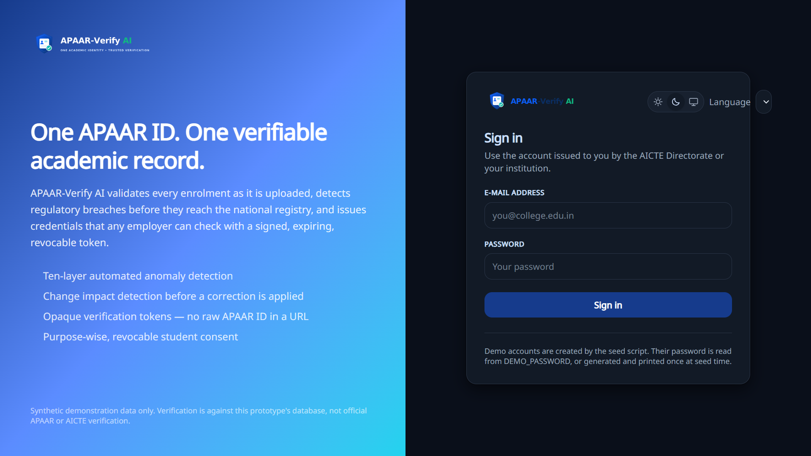
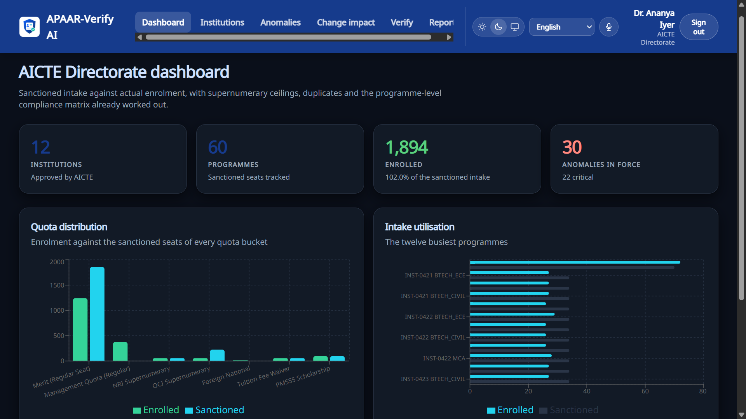
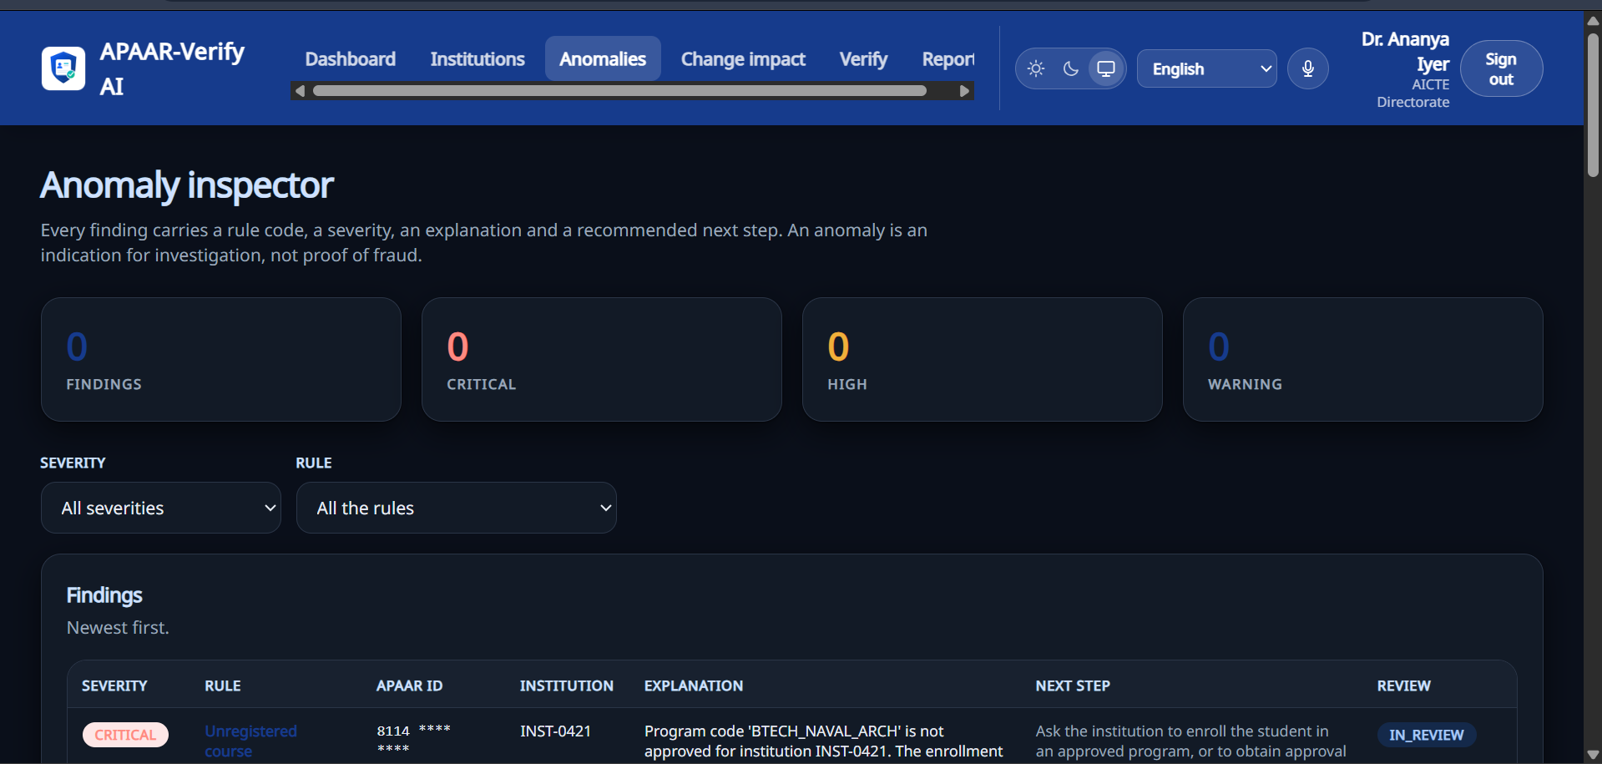
IMPACT AND BENEFITS
01 SIGN-IN EXPERIENCE
02 AICTE DIRECTORATE DASHBOARD
03 ANOMALY INSPECTOR
1
Data integrity
2
Regulatory monitoring
3
Faster operations
4
Trusted verification
Flags duplicate, incomplete and inconsistent enrolment records.
Compares approved intake with reported enrolment.
Streamlines bulk validation, anomaly review and reporting.
Enables controlled access with traceable review actions.
TARGET BENEFICIARIES
EXPECTED OUTCOME
AICTE, approved institutions, students, degree-awarding bodies and employers.
A transparent, dependable and data-driven student information ecosystem.

Slide 6
RESEARCH AND REFERENCES
1
APAAR Official Portal
National academic identity information and updates
https://apaar.education.gov.in/
AICTE Official Website
Regulatory information and institutional approval context
https://www.aicte-india.org/
FastAPI Documentation
Backend APIs and request validation
https://fastapi.tiangolo.com/
1
2
2
3
3
PostgreSQL Documentation
Relational storage and database security
https://www.postgresql.org/docs/
4
4
5
React Documentation
Frontend implementation and UI components
https://react.dev/
6
Pandas Documentation
Structured data processing and CSV validation
https://pandas.pydata.org/docs/
5
Project Documentation
Detailed solution design, workflow and project notes
https://docs.google.com/document/d/1e0dfJ36B0Bq8fWRm3JGJowPpWP-x6fzxYYEph6pf-K4/
7
APAAR-Verify AI GitHub
Project source code, modules and implementation
https://www.github.com/Balaji-P-A/APAAR-Verify-AI
8
6
9
Project Demo Video
Video walkthrough and solution demonstration
https://youtube.com/@codedevcore
Note: Project links are provided for review. Any live APAAR or AICTE integration is subject to official access, authorization and applicable data-sharing requirements.
Note: These links are project references and resources; they do not confirm public API access or official integration approval. Verify access and data-sharing requirements before implementation.

