Slide 1
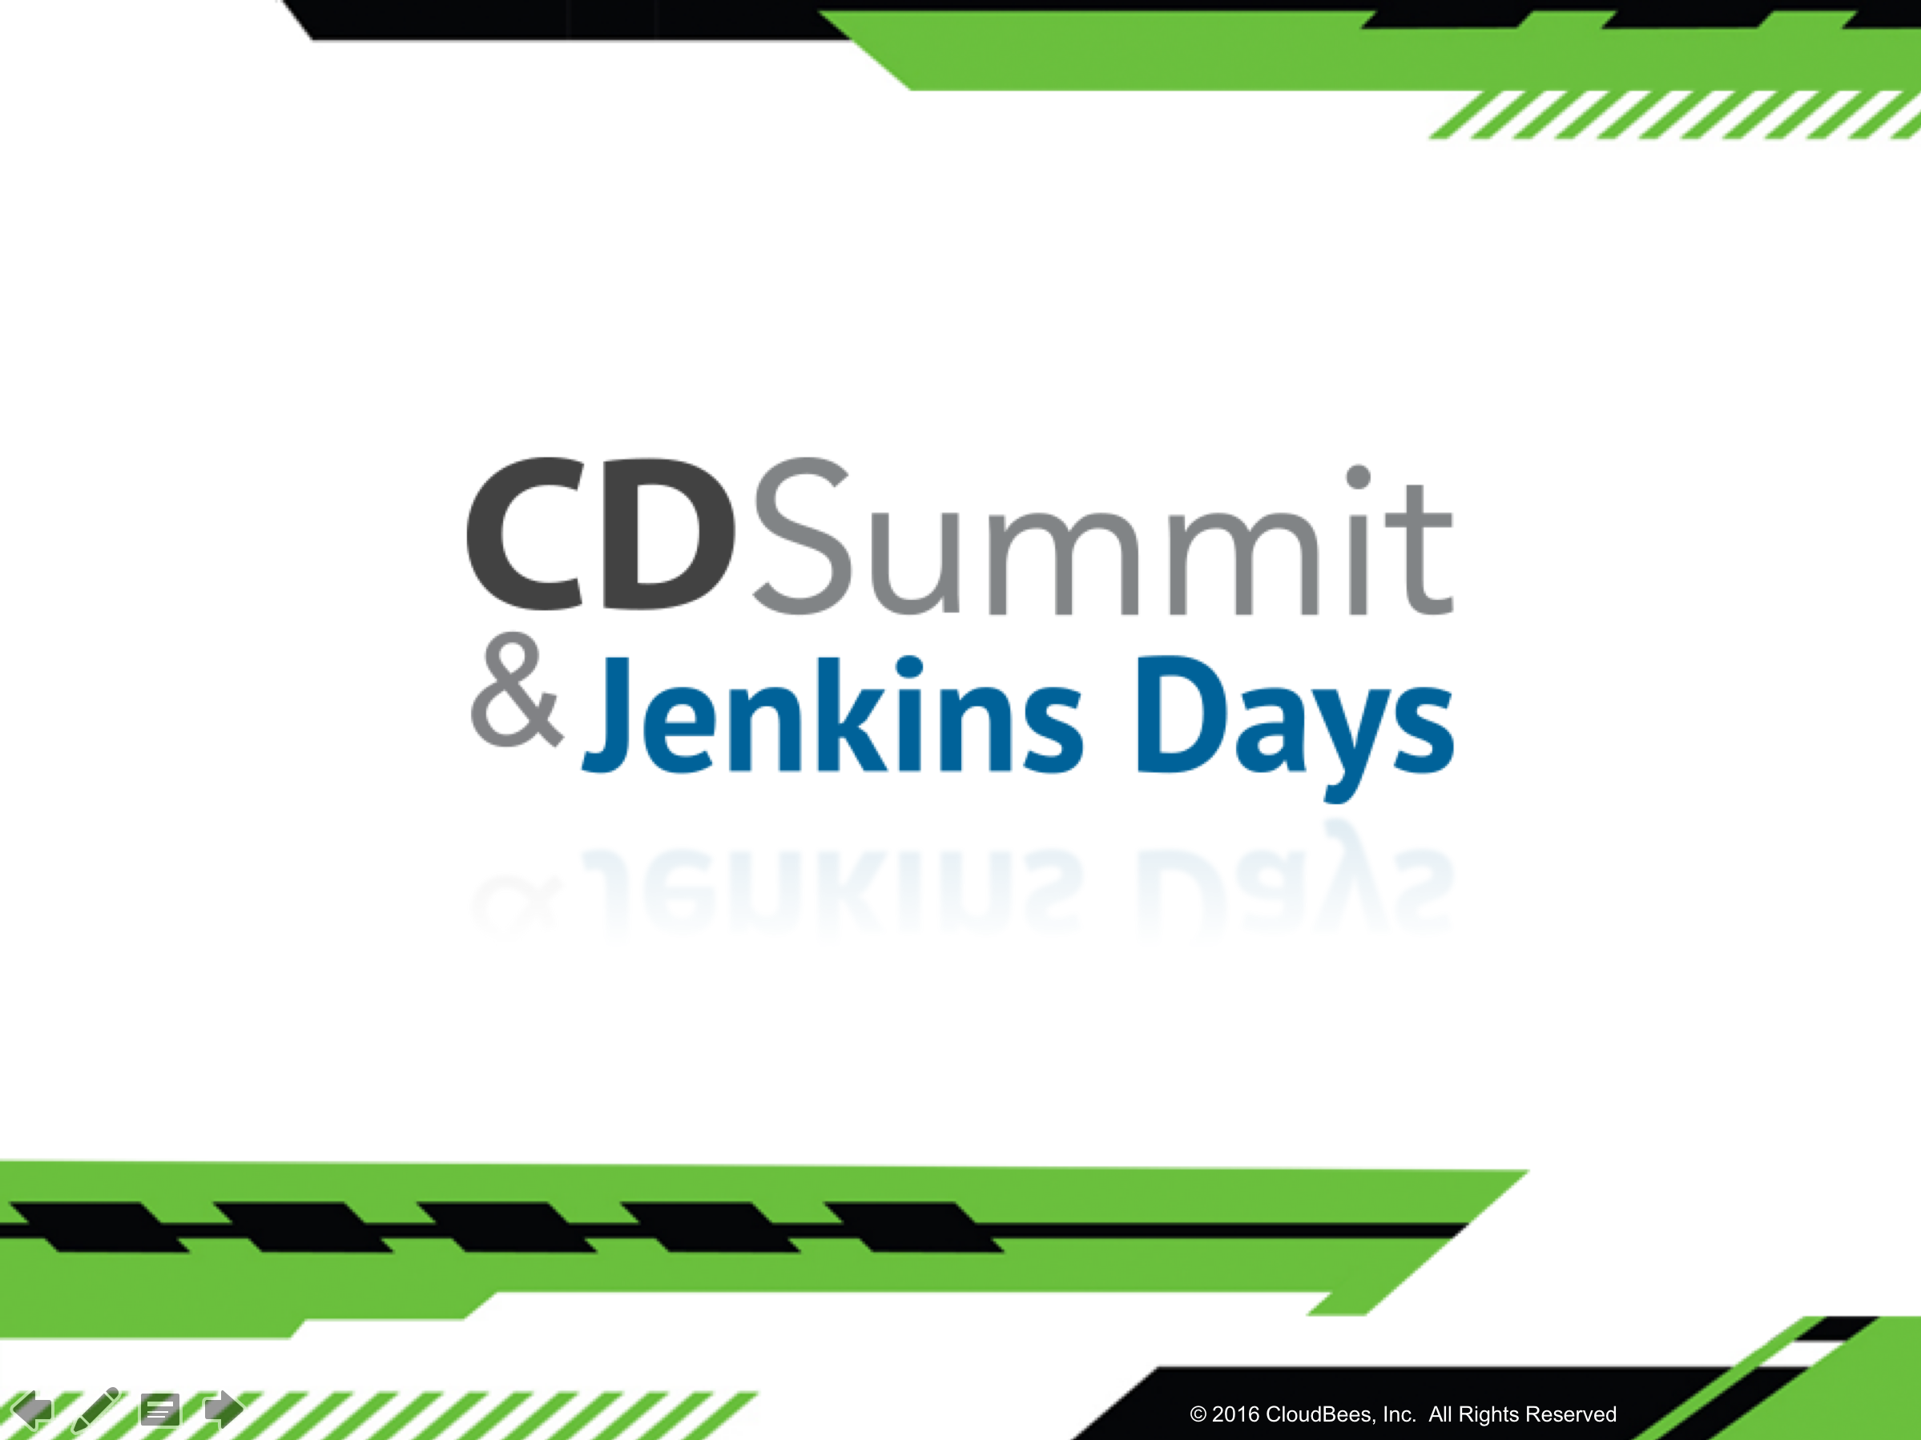

Slide 2
Let’s Build a Jenkins Pipeline
Jenkins Days Workshop

Slide 3
Welcome!
Goals for today
Install Jenkins Enterprise
Create a Jenkins Pipeline
Try the basics
See what else is possible and get connected!
1
2
3
4

Slide 4

What is Jenkins?
Well that’s a funny question.
A CI server? A CD Server?
An automation server

Slide 5
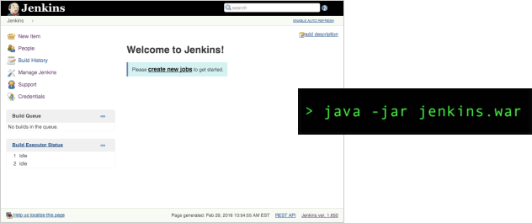
Easy to Start
java -jar jenkins.war

Slide 6
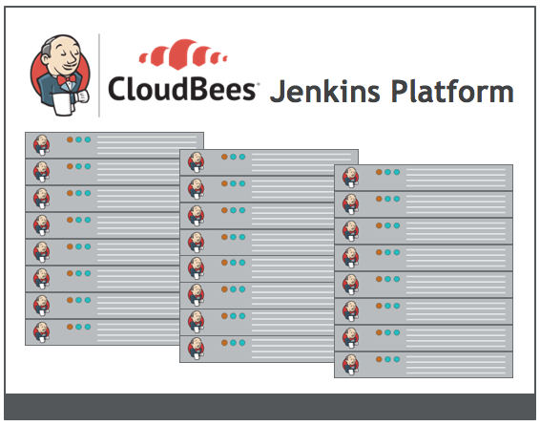
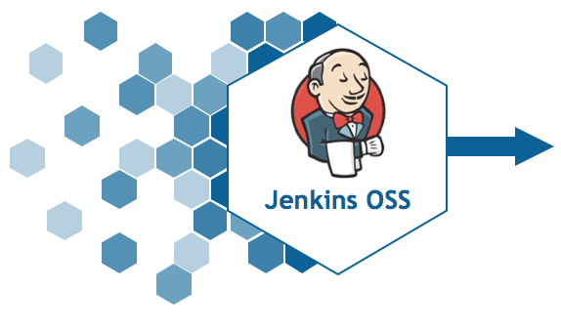
CloudBees Jenkins Enterprise
… part of CloudBees Jenkins Platform
Community Innovation
Jenkins for the Enterprise

Slide 7
Lab Exercise:
Install Jenkins Enterprise

Slide 8

Install Jenkins Enterprise
Have Docker?
No Docker? No problem.
https://www.cloudbees.com/get-started
docker run -d -p 80:8080 cloudbees/jenkins-enterprise-trial

Slide 9
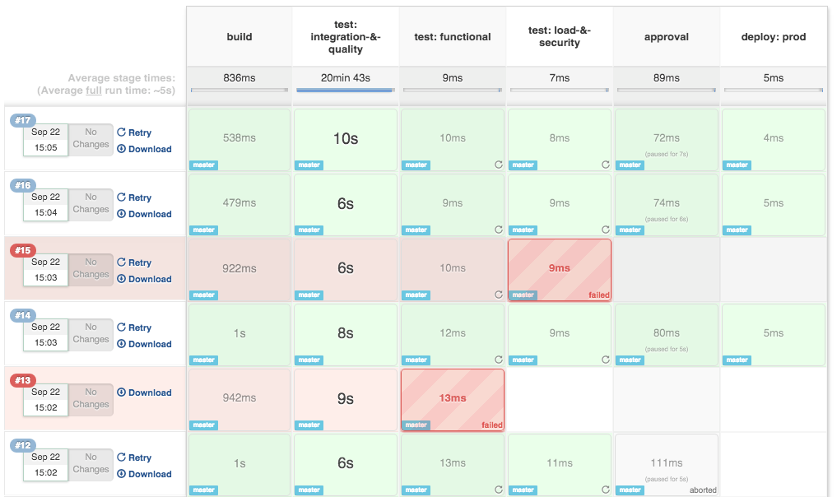
What is Jenkins Pipeline?

Slide 10
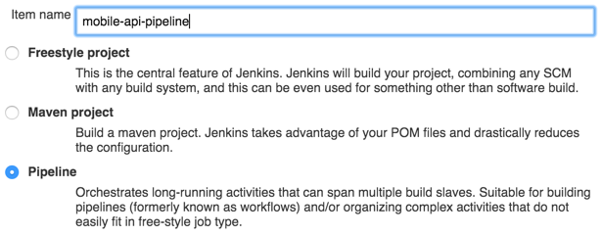
Pipeline: a new job type

Slide 11
Pipeline: a new job type
Key Benefits
✓ Long-running
✓ Durable
✓ Scriptable
✓ One-place for Everything
✓ Makes building Pipelines Simple(r)

Slide 12
Domain Specific Language
Simple, Groovy-based DSL (“Domain Specific Language”) to manage build step orchestration
Can be defined as DSL in Jenkins or as Jenkinsfile in SCM
Groovy is widely used in Jenkins ecosystem. You can leverage the large Jenkins Groovy experience
If you don’t like/care about Groovy, just consider the DSL as a dedicated simple syntax

Slide 13
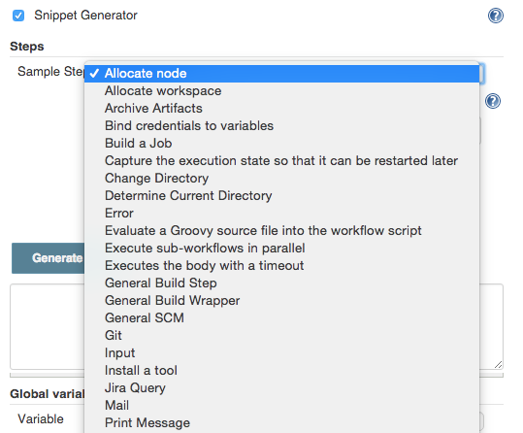
Snippet Generator

Slide 14
Lab Exercise:
Create a Pipeline

Slide 15
Create a Pipeline
stage - group your build step into its component parts and control concurrency
node - schedules the steps to run by adding them to Jenkins' build queue and creates a workspace specific to this pipeline
sh (or bat) - execute shell (*nix) or batch scripts (Windows) just like freestyle jobs, calling any tools in the agent

Slide 16
Create a Pipeline
stage 'build'
echo 'hello from jenkins master'
node{
sh 'echo hello from jenkins agent'
}
stage 'test'
echo 'test some things'
stage 'deploy'
echo 'deploy some things'

Slide 17
Files
stash - store some files for later use
unstash - retrieve previously stashed files (even across nodes)
writeFile - write a file to the workspace
readFile - read a file from the workspace

Slide 18
Lab Exercise:
Checkout from SCM

Slide 19
Checkout from SCM and stash Files
stage 'build'
node{
git 'https://github.com/cloudbees/todo-api.git'
stash includes: 'pom.xml', name: 'pom'
}
stage name: 'test', concurrency: 3
node {
unstash 'pom'
sh 'cat pom.xml'
}

Slide 20
Flow Control
try up to N times
retry(5) {
// some block
}
wait for a condition
waitUntil {
// some block
}
wait for a set time
sleep time: 1000, unit: 'NANOSECONDS'
timeout
timeout(time: 30, unit: 'SECONDS'){
// some block
}

Slide 21
Flow Control
You can also rely on Groovy control flow syntax!
while(something) {
// do something
if (something_else) {
// do something else
}
}
try{
//some things
}catch(e){
//
}

Slide 22
Advanced Flow Control
input - pause for manual or automated approval
parallel - allows simultaneous execution of build steps on the current node or across nodes, thus increasing build speed
parallel 'quality scan': {
node {sh 'mvn sonar:sonar'}
}, 'integration test': {
node {sh 'mvn verify'}
}
checkpoint - capture the workspace state so it can be reused as a starting point for subsequent runs

Slide 23
Lab Exercise:
Input and Checkpoints

Slide 24
Input Approval & Checkpoints
input message: 'Do you want to deploy?'

Slide 25
Input Approval & Checkpoints
checkpoint 'testing-complete'
stage 'approve'
timeout(time: 7, unit: 'DAYS') {
input message: 'Do you want to deploy?',
submitter: 'ops'
}

Slide 26
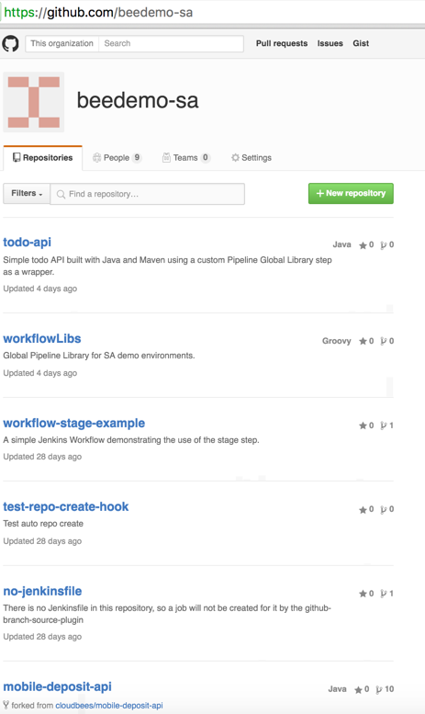

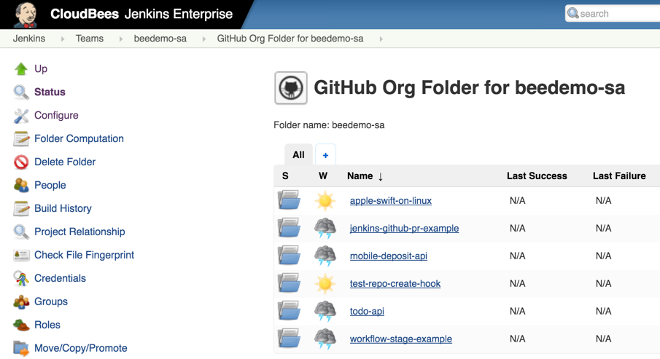
Pipeline-as-Code

Slide 27
What Next?

Slide 28
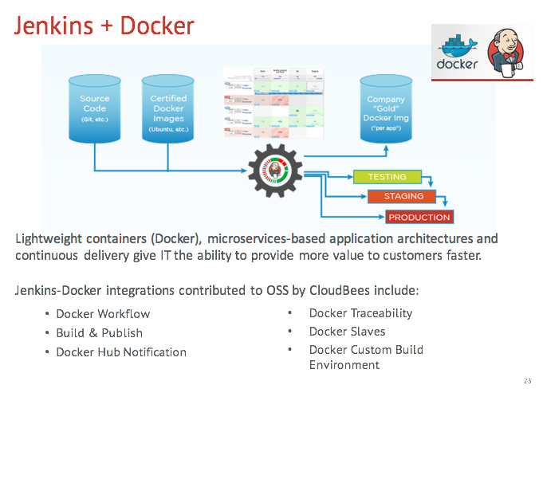

Slide 29
More Advanced Steps
Send email
mail body: 'Uh oh.', subject: 'Build Failed!', to: 'dev@cloudbees.com'
step([$class: 'Mailer', notifyEveryUnstableBuild: true, recipients: 'info@cloudbees.com'])
Deploy to Amazon Elastic Beanstalk
wrap([$class: 'AmazonAwsCliBuildWrapper', credentialsId: 'aws-beanstalk-credentials', defaultRegion: 'us-east-1']) {
sh 'aws elasticbeanstalk create-application-version'
}
Integrate with Jira
step([$class: 'hudson.plugins.jira.JiraReleaseVersionUpdaterBuilder',
jiraProjectKey: 'MOBILEAPP', jiraRelease: '1.1.1'])

Slide 30
DRY Pipelines: Global Libs
A DSL could look as simple as
mavenProject {
org = 'sa-team'
repo = 'todo-api'
hipChatRoom = '1613593'
jdk = '8'
}
https://github.com/beedemo-sa/todo-api/blob/master/Jenkinsfile
https://github.com/beedemo-sa/workflowLibs/blob/master/vars/mavenProject.groovy
https://jenkins.io/blog/2016/04/21/dsl-plugins/

Slide 31
Get Involved!
https://jenkins.io/doc/pipeline/

Slide 32
