Slide 1


K.RAMAKRISHNAN COLLEGE OF ENGINEERING
(AUTONOMOUS)
HOUSE SECURITY SYSTEM
Presented by,
Name : BALAJI S
Register No. : 8115U23AM2310
Roll. No. : AM2310
Year : II

Slide 2
PRESENTATION OVERVIEW
Introduction
Problem identification
Objectives
Literature review
Architecture diagram
Dataset description / Working Principle
Exploratory Data Analysis
Modules identification

Slide 3
INTRODUCTION
AI is transforming house security by making systems smarter and more responsive.
With features like facial recognition and motion detection, AI-based security systems can identify potential threats more accurately.
They also learn from patterns, improving over time to reduce false alarms. These systems integrate easily with other smart home devices, offering a more comprehensive security solution.

Slide 4
PROBLEM IDENTIFICATION
Rise in Security Threats: Increasing incidents of burglaries and unauthorized access.
Limitations of Traditional Systems: Conventional systems often lack real-time threat detection and response capabilities.
False Alarms: High rate of false alarms in existing security systems, leading to inefficiency.
User Privacy Concerns: Balancing security with the need to protect user privacy.

Slide 5
OBJECTIVES
Enhance Threat Detection: Improve accuracy in identifying potential security threats.
Reduce False Alarms: Minimize false alarms through advanced AI algorithms.
Real-Time Alerts: Provide instant notifications and alerts to homeowners.
Integrate with Smart Devices: Seamlessly connect with existing smart home systems.
Ensure User Privacy: Implement strong privacy safeguards for data and monitoring.

Slide 6
LITERATURE REVIEW
S.NO | YEAR | TITLE | AUTHORS | ALGORITHM | DISADVANTAGE
1 | 2022 | “Smart Home Security System and IoT” | A.Sharma, R.Patel, S.Kumar | Convolutional Neural Networks (CNNs) | High computational requirements for real -time processing.

Slide 7
LITERATURE REVIEW
S.NO | YEAR | TITLE | AUTHORS | ALGORITHM | DISADVANTAGE
2 | 2022 | “Enhanced Home Security with Deep learning and Edge Computing” | J.Lee, M.Zhang, L.Patel | YOLOv5 for real time object detection. | Complexity in deployment and integration of edge devices.

Slide 8
LITERATURE REVIEW
S.NO | YEAR | TITLE | AUTHORS | ALGORITHM | DISADVANTAGE
3 | 2023 | “Integrated smart home Security System using Blockchain and AI” | R.Gupta, S.Chen, A.Hernandez | Reinforcement learning for adaptive security. | Scalability issues with blockchain integration, increased system complexity.

Slide 9
LITERATURE REVIEW
S.NO | YEAR | TITLE | AUTHORS | ALGORITHM | DISADVANTAGE
4 | 2023 | AI-Powered Home Security using Deep Learning | John Smith, Emma Jones | CNN (Convolutional Neural Network) for facial recognize | High false alarm rate in low-light conditions

Slide 10
LITERATURE REVIEW
S.NO | YEAR | TITLE | AUTHORS | ALGORITHM | DISADVANTAGE
5 | 2024 | Advanced Home security with Federated Learning | Michael O’connor, Fatima zain | Federated Learning combinated with CNN | Slower model updates due to decentralized data training

Slide 11
ARCHITECTURAL DIAGRAM
FACE RECOGNITION
(FINGER PRINT)
.
SMART DEVICES
(CCTV)
HOUSE
CAMERA NODE
(RASPBERRY Pi)
LABEL IMAGES
(SMART PHONES)

Slide 12
DATASET DESCRIPTION
Image and Video Data: Footage from security cameras covering various angles and conditions (day/night, indoor/outdoor).
Sensor Data: Inputs from motion detectors, door/window sensors, and other smart devices.
Anomaly Events: Labeled data of normal vs. suspicious activities, including unauthorized access attempts.
Audio Data: Recordings capturing sounds like breaking glass, alarms, or voices.

Slide 13
EXPLORATORY DATA ANALYSIS
Univariate Analysis
Understand the Data: Start by identifying the variables related to house security, such as sensors data, time of events, type of intrusion, etc. Data Distribution: Analyze the distribution of each variable individually. For example, plot histograms or density plots for continuous variables like sensor readings. Central Tendency: Calculate mean, median, and mode to understand the central values of the data. Dispersion Metrics: Assess the spread of the data using standard deviation, variance, range, and interquartile range (IQR).

Slide 14
EXPLORATORY DATA ANALYSIS
Bivariate Analysis
Variable Pair Selection: Identify and select pairs of variables that could have a relationship (e.g., sensor data vs. time of day, type of intrusion vs. alarm activation). Scatter Plots: Use scatter plots to visualize relationships between two continuous variables, such as sensor sensitivity vs. response time. Correlation Analysis: Calculate the correlation coefficient (e.g., Pearson, Spearman) to quantify the strength and direction of relationships between numerical variables. Heatmaps: Create correlation heatmaps to visualize the correlation between multiple pairs of variables simultaneously.

Slide 15
EXPLORATORY DATA ANALYSIS
Multivariate Analysis
Variable Interaction: Identify key variables that may interact and impact the house security system, such as sensor data, time, location, and type of intrusion. Pair Plot/Scatter Matrix: Use pair plots or scatter matrix to visualize relationships between multiple pairs of continuous variables simultaneously, allowing for comparison across several dimensions. Correlation Matrix: Generate a correlation matrix to assess the relationships between all pairs of numerical variables, identifying highly correlated variables that could indicate multicollinearity. Principal Component Analysis (PCA): Apply PCA to reduce dimensionality, identifying the most significant variables that explain the variance in the dataset while preserving essential information.

Slide 16
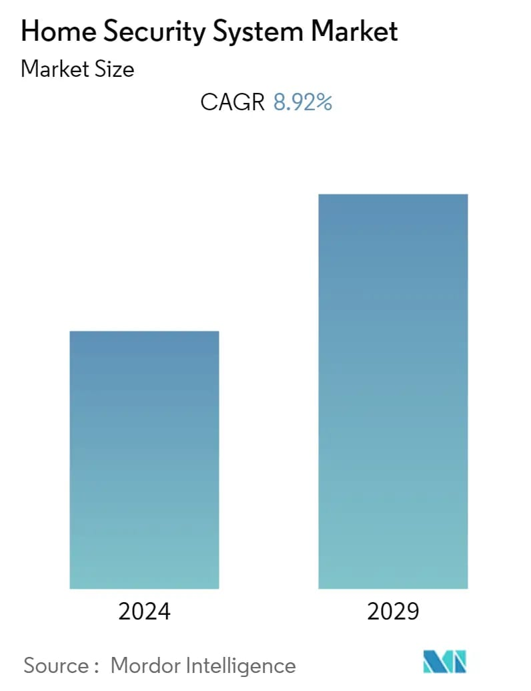
EXPLORATORY DATA ANALYSIS

Slide 17
MODULE DESCRIPTION
User Authentication Module:
- Ensures secure login and access control.
Surveillance Module:
- Uses AI-powered cameras for real-time monitoring.
Intrusion Detection Module:
- Integrates sensors (door/window) to monitor unauthorized entry.
Smart Door Lock Module:
- Provides access logs and real-time alerts on door status.

Slide 18
PROGRAM IMPLEMENTATION
# House Security System
password = "1234" # Set the password
# Ask the user to enter the password
user_input = input("Enter the security password: ")
if user_input == password:
print("Access granted. Welcome home!")
else:
print("Access denied. Security alert!")

Slide 19
OUTPUT
Enter the security password: 1234
Access granted. Welcome home!
Enter the security password: 0000
Access denied. Security alert!

Slide 20
CONCLUSION
The AI-based house security system is a transformative solution to modern security challenges. By leveraging technologies like facial recognition, motion detection, and real-time alerts, it addresses key issues such as false alarms and lack of real-time responses in traditional systems. The integration with smart home devices enhances usability, while advanced algorithms improve threat detection and privacy protection.

Slide 21
FUTURE SCOPE
The future scope of AI-based house security systems is vast, with advancements in machine learning enabling smarter threat detection and response. Enhanced facial recognition, voice authentication, and predictive analytics will provide proactive security measures.

Slide 22

ANY QUERIES?

