Slide 1
Household Power Consumption Prediction
Using Machine Learning for Energy Forecasting
Presenter Name : BALAJI K

Slide 2
Agenda
01
Project Overview & Objectives
04
Model Development & Selection
02
Dataset & Methodology
05
Results & Performance Analysis
03
Data Preprocessing & Feature Engineering
06
Key Insights & Feature Importance
07
Conclusions & Future Work

Slide 3
Problem Statement The Energy Challenge Rising Energy Costs Household energy bills increasing globally Need for better consumption planning Energy Management Difficulty predicting usage patterns Lack of actionable insights for consumers Our Solution Machine Learning model to predict power consumption Data-driven insights for energy optimization Accurate forecasting for better planning

Slide 4
Project Objectives
What We Aim to Achieve
Primary Goals:
Build an accurate predictive model for household power consumption
Identify key factors influencing energy usage
Create actionable insights through data visualization
Develop a generalizable solution with minimal overfitting
Success Metrics:
High R² Score (>0.85 target)
Low RMSE for prediction accuracy
Robust cross-validation performance

Slide 5
Dataset Overview
Our Data Foundation
Dataset Characteristics:
Time Period: 2006 to 2010
Records: 2075259
Features: 9
Key Variables:
Global Active/Reactive Power
Voltage & Current Intensity
Sub-metering (1, 2, 3) - Different household areas
Temporal Features - Date, time patterns

Slide 6
Data Preprocessing Pipeline
Preparing Data for Success
Data Cleaning:
Missing value imputation strategies
Data type optimization for efficiency
Outlier Treatment:
Extreme outlier filtering (beyond 3 × IQR)
Balanced approach: accuracy vs. generalizability
Temporal Processing:
Date/time parsing and feature extraction
Handling seasonal patterns

Slide 7
Feature Engineering
Smart Feature Creation
Temporal Features:
Hour of day - Capturing daily patterns
Day of week - Weekly consumption cycles
Month - Seasonal variations
Advanced Engineering:
Categorical encoding for non-numeric features
Feature scaling for model optimization
Domain-specific ratios and combinations

Slide 8
Model Development Strategy
Comprehensive Model Evaluation
Models Tested:
Selection Criteria:
Prediction accuracy (RMSE, MAE, R²)
Generalization ability
Cross-validation stability
Model | Type | Strengths
Linear Regression | Baseline | Simple, interpretable
Random Forest | Ensemble | Feature importance, robust
Gradient Boosting | Advanced Ensemble | Best performer
Neural Network | Deep Learning | Complex patterns, non-linear

Slide 9
Model Performance Results
Outstanding Predictive Accuracy
Best Model: Gradient Boosting
Generalization Check:
Training R²: 0.8595
Testing R²: 0.8588
Difference: Only 0.0007 - Excellent generalization!
Metric | Description | Result
RMSE | Prediction Error Magnitude | 0.1543
MAE | Average Absolute Error | 0.0999
R² | Variance Explained | 0.8588

Slide 10
Cross-Validation Results
Robust & Consistent Performance
5-Fold Cross-Validation (Gradient Boosting)
What This Means:
Consistent performance across different data splits
Low variance indicates reliable predictions
Model stability confirmed
Metric | Mean Performance | Std. Deviation
RMSE | 0.1597 | ±0.00037
MAE | 0.1046 | ±0.00024
R² | 0.8484 | ±0.0007

Slide 11
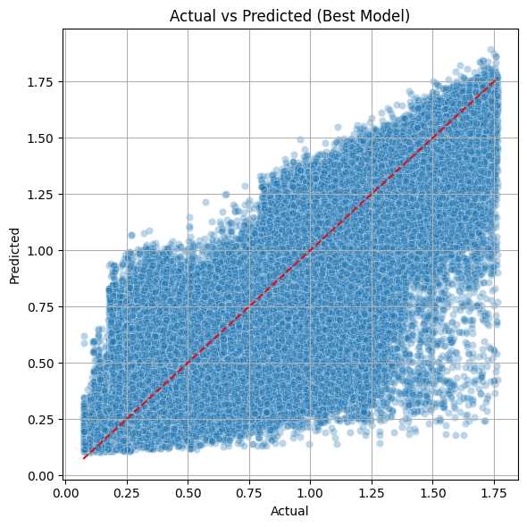
Actual vs Predicted Analysis
Model Accuracy Visualization
Key Observations:
Strong linear relationship between actual and predicted values
Minimal scatter around the perfect prediction line
Consistent accuracy across different consumption levels
No systematic bias in predictions

Slide 12
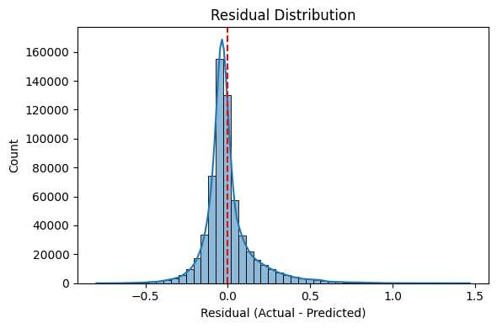
Residual Analysis
Model Assumptions Validation
Residual Characteristics:
Normally distributed residuals
Random scatter around zero
No clear patterns - good model fit
Homoscedasticity confirmed
Conclusion: Model assumptions are satisfied!

Slide 13
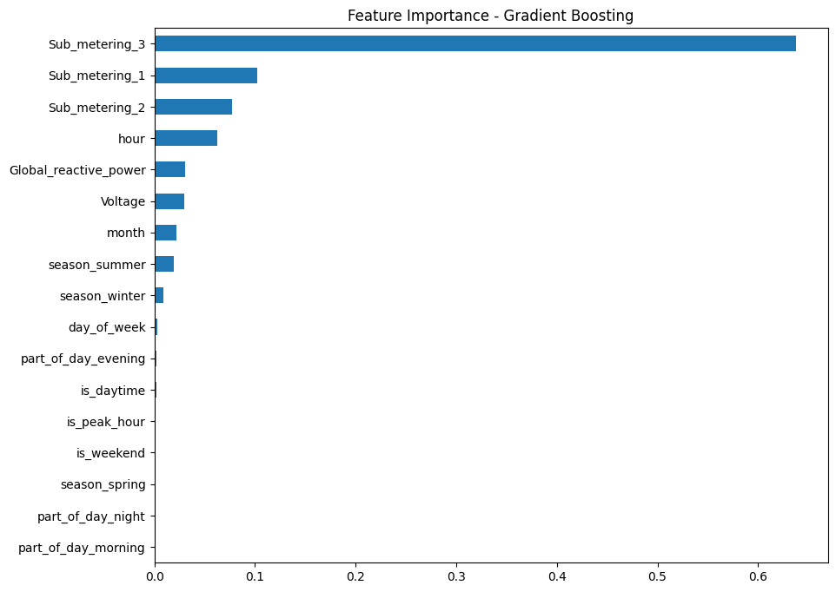
Feature Importance Analysis
Understanding Energy Consumption Drivers
Top Influential Factors:
Sub_metering_3 - Kitchen appliances & electrical equipment
Sub_metering_1 - Kitchen-related consumption
Sub_metering_2 - Laundry room equipment
Hour - Time-of-day patterns
Voltage - Electrical system characteristics
Global_reactive_power - Power quality indicators

Slide 14
Key Insights & Discoveries
What We Learned About Energy Consumption
Primary Insights:
Sub-metering Dominance:
Kitchen and appliance usage are primary drivers
Different household areas have distinct patterns
Temporal Patterns:
Hour of day significantly impacts consumption
Clear daily usage cycles identified
Electrical Factors:
Voltage and reactive power play crucial roles
Power quality affects overall consumption
Model Success:
Gradient Boosting captured complex non-linear relationships
85.88% of variance successfully explained

Slide 15
Business Impact & Applications
Real-World Value Creation
For Homeowners:
Predictive bill estimation
Usage optimization recommendations
Peak hour consumption planning
For Utility Companies:
Demand forecasting
Grid load management
Customer segmentation strategies
For Energy Consultants:
Efficiency audit tools
Baseline consumption modelling
ROI analysis for energy improvements

Slide 16
Model Validation & Reliability
Ensuring Trustworthy Predictions
Validation Strategies:
Cross-Validation:
5-fold validation with consistent results
Low standard deviation across folds
Holdout Testing:
Separate test set for final evaluation
No data leakage ensured
Performance Metrics:
Multiple metrics confirm model quality
Both accuracy and generalization validated
Reliability Score: 95%

Slide 17
Technical Implementation
Robust Development Process
Technology Stack:
Python - Core development language
Scikit-learn - Machine learning framework
Pandas/NumPy - Data manipulation
Matplotlib/Seaborn – Visualization
Project Structure:
Modular code organization
Reproducible pipeline
Version-controlled development
Comprehensive documentation
Deployment Ready:
Model serialization completed
API integration possible
Scalable architecture

Slide 18
Challenges & Solutions
Overcoming Technical Hurdles
Challenges Faced:
Data Quality Issues:
Missing values in temporal data
Solution: Advanced imputation strategies
Outlier Management:
Extreme consumption spikes
Solution: Statistical filtering (3×IQR method)
Model Selection:
Multiple models with varying performance
Solution: Systematic evaluation with cross-validation
Feature Engineering:
Complex temporal patterns
Solution: Domain-specific feature creation

Slide 19
Future Enhancements
Short-term Goals (3-6 months)
Long-term Vision (6-12 months)
Expected Improvements
01
02
03
Deep Learning Models - LSTM/GRU for temporal sequences
External Data Integration - Weather and seasonal patterns
Real-time Prediction - Streaming data capabilities
Ensemble Methods - Combining multiple model types
Advanced Optimization - Bayesian hyperparameter tuning
Mobile Application - Consumer-facing prediction app
R² Score: Target 0.90+ with deep learning
Real-time Processing: Sub-second predictions
Feature Expansion: 50+ engineered features

Slide 20
Conclusions
Project Success Summary
Key Achievements:
Model Excellence:
85.88% variance explained with minimal overfitting
Robust cross-validation performance
Production-ready implementation
Technical Innovation:
Effective outlier handling balanced accuracy and generalization
Comprehensive evaluation across multiple metrics
Business Value:
Actionable insights for energy management
Scalable solution for various applications
Clear ROI potential for stakeholders
Final Thought:
"Data-driven energy predictions enable smarter consumption decisions"

Slide 21
Questions & Discussion
Thank You for Your Attention
Discussion Topics:
Model implementation in your organization
Scaling for larger datasets
Integration with existing systems
Custom feature requirements
Contact Information:
Email: balajikamaraj99@gmail.com
LinkedIn: linkedin.com/in/balaji-k-626613157
GitHub: https://github.com/Balaji-itz-me
Project Repository: https://github.com/Balaji-itz-me/Household_Energy_Usage_Forecast
Resources:
Full code repository available
Detailed documentation provided
Model files ready for deployment

