Slide 1


INTRUSION DETECTION USING WIRELESS NETWORK IN MACHINE LEARNING
RVS TECHNICAL CAMPUS
COIMBATORE
DEPARTMENT OF COMPUTER SCIENCE AND ENGINEERING
GUIDED BY,
Mrs.Anitha BE.ME,
Assistant Proffesor,
Rvs Technical Campus.
PRESENTED BY,
Abdul Kareem N(712921104001)
Balaji V(712921104007)
Iswarya S(712921104017)
Sandhiya A(712921104046)

Slide 2
ABSTRACT
Hybrid Model Architecture: The system combines an autoencoder for feature extraction and dimensionality reduction with an attention-based LSTM to capture sequential patterns and detect anomalies effectively.
Dataset and Preprocessing: It uses the IoT-23 dataset, which includes network traffic from IoT devices, and applies preprocessing techniques such as cleaning, transformation, scaling, and SMOTE for class balancing.
Effective Anomaly Detection: The model demonstrates strong performance in identifying various types of malicious activities, showcasing robustness across multiple attack categories.
Real-Time Detection via Flask: The intrusion detection model is deployed using a Flask web framework, enabling lightweight and real-time network monitoring.
IoT Network Security Focus: The proposed IDS is specifically designed for the dynamic and resource-constrained environment of IoT networks, aiming to enhance cybersecurity in such contexts.

Slide 3
INTRODUCTION
The rapid adoption of Internet of Things (IoT) devices has significantly increased the risk of cyber threats, necessitating advanced intrusion detection systems (IDS) for network security. This paper presents a real-time IoT IDS utilizing a Hybrid Autoencoder-Attention LSTM model within a Flask framework to enhance detection efficiency.
The system is trained on the IoT-23 dataset, a comprehensive collection of network traffic data from smart home IoT devices.
To improve detection performance, the dataset undergoes preprocessing steps such as data cleaning, transformation, scaling, and Synthetic Minority Oversampling (SMOTE) to address class imbalances.
The proposed approach employs an autoencoder for feature extraction and dimensionality reduction, followed by an attention-enhanced LSTM to analyze sequential dependencies and detect anomalies effectively.

Slide 4
EXISTING SYSTEM
Traditional Intrusion Detection Systems (IDS) primarily rely on signature-based and anomaly-based detection methods. Signature-based IDS, such as Snort, use predefined attack signatures to detect known threats but struggle against zero-day attacks.
Anomaly-based IDS utilize statistical models and machine learning algorithms like Decision Trees, Support Vector Machines (SVM), and K-Means Clustering to identify unusual network behavior.
However, these systems face challenges in practical adoption due to poor explainability, high false positive rates, and limited adaptability to dynamic network environments.
AI/ML-based IDS solutions, while promising, often fail to gain enterprise acceptance due to issues such as usability, privacy concerns, and lack of compliance with security regulations. The complexity of these models also makes it difficult for administrators to interpret and act on detected threats effectively.

Slide 5
DISADVANATAGES
Poor explainability of detected threats.
High false positive rates persist.
Limited adaptability to network changes.
Usability concerns hinder practical adoption.
Privacy and compliance issues arise.
Complex models are hard to interpret.

Slide 6
PROPOSED SYSTEM
The proposed system introduces a real-time Intrusion Detection System (IDS) for wireless networks, utilizing a Hybrid Autoencoder-Attention LSTM model within a Flask framework.
The system employs an autoencoder for feature extraction and dimensionality reduction, followed by an attention-enhanced LSTM to effectively capture sequential patterns and detect anomalies in network traffic.
The IoT-23 dataset is used for training, with preprocessing techniques such as SMOTE, feature selection, and scaling applied to optimize model performance.
The experimental analysis highlights the efficiency of this hybrid approach in identifying multiple attack types while ensuring low-latency, real-time intrusion detection.
The proposed system enhances scalability and provides an effective security solution for IoT networks.

Slide 7
ADVANTAGES
Real-time intrusion detection enabled.
Enhanced anomaly detection accuracy.
Low-latency threat identification.
Improved scalability for IoT networks.
Effective feature extraction technique.
Better handling of imbalanced data.

Slide 8
LITERATURE SURVEY
S.NO | TITLE | AUTHOR/YEAR | DESCRIPTION
1 | CNN-BiLSTM: A Hybrid Deep Learning Approach for Network Intrusion Detection System in Software-Defined Networking With Hybrid Feature Selection | Rachid Ben Said/2023 | In this study, we created a hybrid Convolutional Neural Network (CNN) and bidirectional long short-term memory (BiLSTM) network to enhance network intrusion detection using binary and multiclass classification.
2 | Early Detection of Network Intrusions Using a GAN-Based One-Class Classifier | Taehoon Kim/2022 | The proposed method learns the patterns of packets that are unhelpful in order to classify network intrusions and benign sessions.
3 | Network Intrusion Detection Method Based on Hybrid Improved Residual Network Blocks and Bidirectional Gated Recurrent Units | Hongchen Yu/2023 | This paper proposes a hybrid network classifier consisting of improved residual network blocks and bidirectional gated recurrent units.

Slide 9
LITERATURE SURVEY
S.NO | TITLE | AUTHOR/YEAR | DESCRIPTION
4 | Wireless Network Intrusion Detection Based on Improved Convolutional Neural Network | Hongyu Yang/2019 | In order to enhance the security and improve the detection ability of malicious intrusion behavior in a wireless network, this paper proposes a wireless network intrusion detection method based on improved convolutional neural network (ICNN).
5 | Real-Time Intrusion Detection in Wireless Network: A Deep Learning-Based Intelligent Mechanism | Liqun Yang/2020 | In this paper, we exploit a CDBN (Conditional Deep Belief Network)-based intrusion detection mechanism to recognize the attack features and perform the wireless network intrusion detection in real time.

Slide 10
SOFTWARE REQUIREMENTS
Operating System : Windows 7 Or Later
Simulation Tool : Python -3.10, Flask
Documentation : Ms-Office
Front End : Html , Css, Js
Backend End : Python , Flask

Slide 11
HARDWARE REQUIREMENTS
RAM : 6 GB.
Processor : I5 and Above
Hard disk space : 2 GB (minimum) free space available.
Screen resolution : 1024 x 768 or higher.

Slide 12
SYSTEM ARCHITECTURE DIAGRAM
DATA SET COLLECTION
DATA PREPROCESSING
EDA
DECISION TREE
LSTM
MODEL IMPLEMENTATION
WEB API
INPUT PARAMETERS
RESULT

Slide 13
LIST OF MODULES
Data Collection Module – Collects IoT network traffic data from sources like the IoT-23 dataset, ensuring diverse attack scenarios are captured.
Data Preprocessing Module – Performs data cleaning, transformation, feature scaling, and applies SMOTE to balance class distribution and enhance detection reliability.
Feature Selection Module – Identifies the most relevant features, improving model efficiency while reducing computational overhead.
Model Training Module -The autoencoder extracts essential network features and reduces dimensionality. The attention-enhanced LSTM captures sequential dependencies in network traffic, improving anomaly detection.
Intrusion Detection Module – Applies the trained deep learning model to real-time network traffic, identifying potential security threats.

Slide 14
MODULE EXPLANATION
1. Data Collection Module This module gathers IoT network traffic data from sources like the IoT-23 dataset. It ensures that the data covers a wide range of normal and attack scenarios. The collected data forms the foundation for training and evaluating the intrusion detection system.
2. Data Preprocessing Module This module handles data cleaning by removing noise and irrelevant entries. It transforms data into a suitable format, scales features for uniformity, and uses SMOTE to balance class distributions. Proper preprocessing improves model performance and reliability.
3. Feature Selection Module This module identifies and selects the most important features from the dataset. It reduces redundant data, lowers computational costs, and helps the model focus on the most impactful indicators of network behavior. This leads to faster and more accurate detection.

Slide 15
MODULE EXPLANATION
4. Model Training Module In this module, an autoencoder learns essential network features and reduces data dimensionality. An attention-enhanced LSTM is then trained to capture sequential patterns in network traffic. Together, they strengthen the model's ability to detect anomalies effectively.
5. Intrusion Detection Module This module applies the trained deep learning model to live or incoming IoT network traffic. It monitors the traffic in real-time and flags suspicious or abnormal activities, helping to quickly identify and respond to potential security threats.

Slide 16
WORK FLOW DIAGRAM
start
Dataset
TEST
Preprocessing
TRAIN
EDA model
Result
END

Slide 17
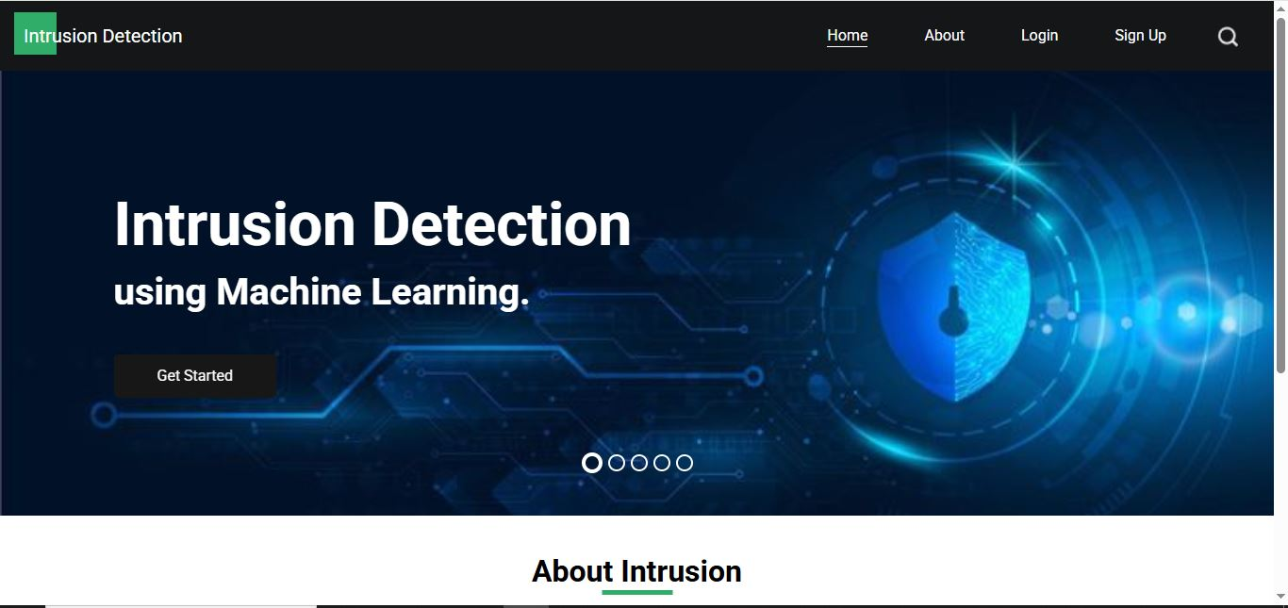
OUTPUT SCREENSHOTS HOME PAGE

Slide 18
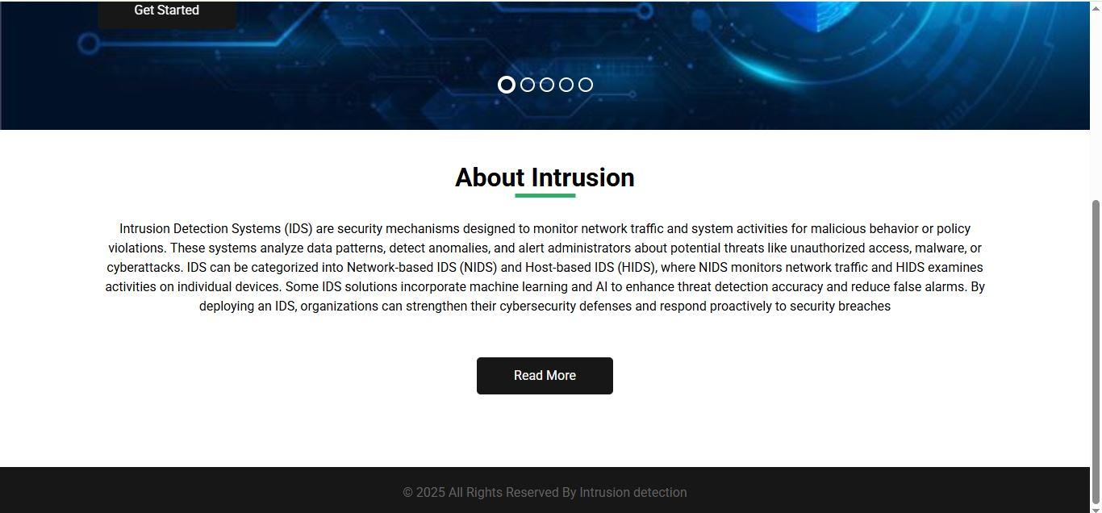
HOME PAGE

Slide 19
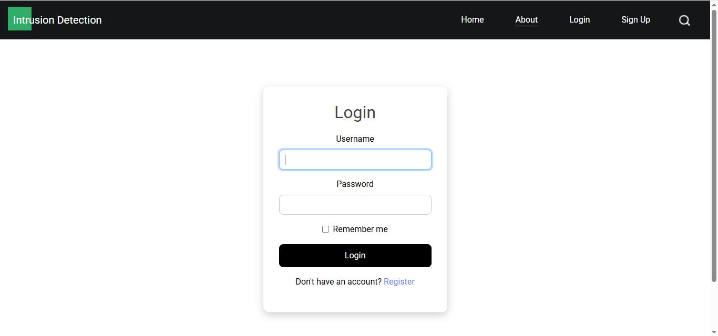
LOGIN PAGE

Slide 20
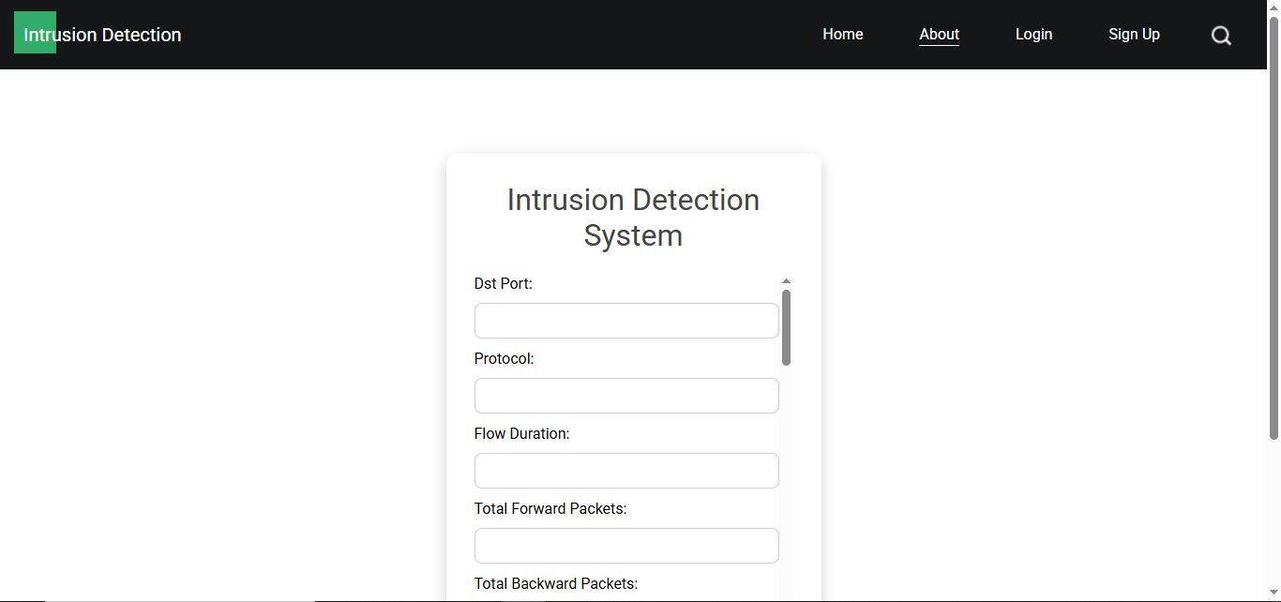
PREDICTION PAGE

Slide 21
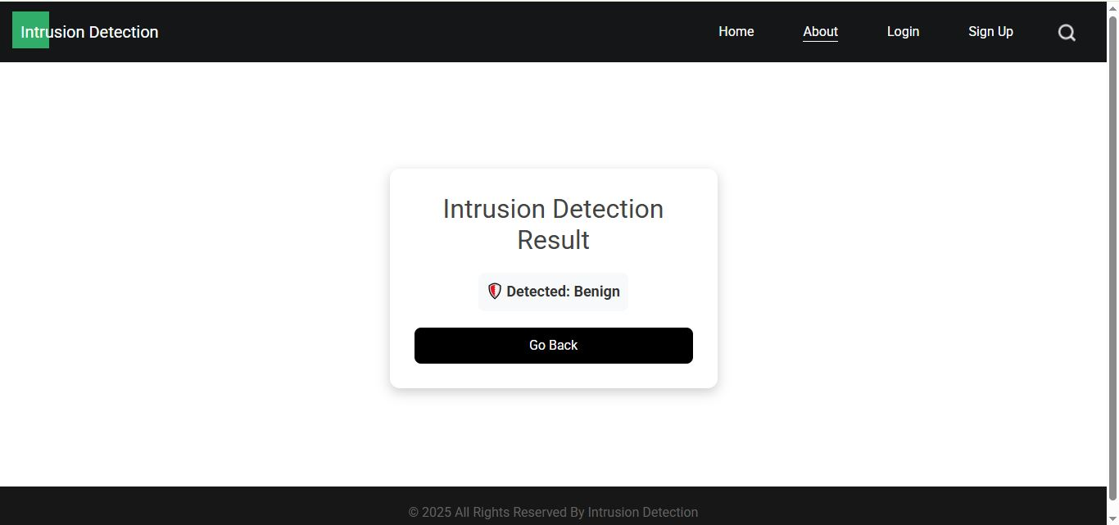
RESULT PAGE

Slide 22
RESULT AND EVALUATION
The evaluation of the proposed Intrusion Detection System demonstrates its strong performance in detecting a wide range of malicious activities in wireless IoT networks. By integrating a Hybrid Autoencoder-Attention LSTM model, the system effectively extracts significant features from high-dimensional network traffic and models temporal dependencies to identify intrusions with high accuracy. The use of the IoT-23 dataset, after undergoing robust preprocessing—such as SMOTE for class imbalance, feature selection, and scaling—contributed to enhanced model generalization and detection rates. Experimental results reveal that the hybrid model achieves superior precision, recall, and F1-score when compared to traditional machine learning and standalone deep learning approaches, particularly in handling diverse and imbalanced attack categories. Furthermore, the Flask-based deployment ensures the system is lightweight and responsive, enabling real-time anomaly detection with minimal latency. Overall, the system proves to be a scalable and efficient security solution, capable of adapting to the dynamic and heterogeneous nature of IoT network environments.

Slide 23
CONCLUSION
In conclusion, the proposed real-time Intrusion Detection System utilizing a Hybrid Autoencoder-Attention LSTM model demonstrates a highly effective approach for securing wireless IoT networks. By combining feature extraction and dimensionality reduction with advanced sequential learning and attention mechanisms, the system achieves high accuracy in detecting a variety of intrusion types. The use of the IoT-23 dataset, along with comprehensive preprocessing techniques, ensures robustness and adaptability to real-world network traffic. Deployed through a Flask framework, the system offers lightweight, low-latency performance, making it a practical and scalable solution for real-time IoT network security.

Slide 24
FUTURE ENHANCEMENT
In the future, the system can be expanded by integrating federated learning, allowing multiple IoT devices to collaboratively train intrusion detection models without sharing raw data. This would enhance data privacy while improving the detection capabilities across different network environments. Additionally, incorporating adaptive learning techniques will help the model evolve over time, automatically adjusting to emerging threats and minimizing the need for manual updates.
Furthermore, the project can be enhanced by deploying lightweight versions of the model optimized for resource-constrained IoT devices, ensuring real-time intrusion detection with minimal latency. Integrating blockchain technology for secure data sharing and alert management across IoT ecosystems could further strengthen trust and system robustness. Advanced visualization tools can also be added to provide administrators with intuitive dashboards for real-time monitoring and rapid response.

Slide 25
REFERENCE
IoT-23 Dataset – "A labeled dataset with malicious and benign IoT network traffic." Stratosphere Laboratory, Czech Technical University, 2020.
Chawla, N. V., et al. – "SMOTE: Synthetic Minority Over-sampling Technique." Journal of Artificial Intelligence Research, 2002.
Hochreiter, S., and Schmidhuber, J. – "Long Short-Term Memory." Neural Computation, vol. 9, no. 8, 1997, pp. 1735–1780.
Vaswani, A., et al. – "Attention Is All You Need." Advances in Neural Information Processing Systems (NeurIPS), 2017.
Saxe, J., and Berlin, K. – "Deep Neural Network Based Malware Detection Using Two-Dimensional Binary Program Features." 2015 10th International Conference on Malicious and Unwanted Software (MALWARE).

