Slide 1
Kubernetes

Slide 2
Kubernetes
What is Kubernetes?
Cluster Architecture :-
Kubernetes Architecture
ETCD for Beginners
ETCD in Kubernetes
Kube- API Server
Controller Managers
Kube Scheduler
Kubelet
Kube Proxy

Slide 3
Kubernetes
Dockerized applications like java or angular are running as containers in server,but docker containers doesn’t not have feature to monitor ,manage and scale those containers running in the server, If docker containers crashed or stopped. In these cases docker containers doesn’t scale up another instances or containers for application up and running. Kubernetes is a tool or software package used to orchestrate the docker containers and make sure containers are always up and running and maninting the state of the containers.If your application docker container is down,kubernetes automatically scale up another docker container.We can segregate the applications using groups and namespaces in kubernetes.it enables us very easy to use containers orchestration. Google introduced Kubernetes and made it Open source. In Kubernetes,we have different components to achieve different functionalities.

Slide 4
Kubernetes
We are using analogy of ships to understand the architecture of Kubernetes.The Purpose of Kubernetes is to host your applications in the form of containers in an automated fashion.We can easily deploy many instances of your application as required and enabled easily communication between different services within your application. Example :- We have 2 kinds of ships available
Cargo Ships- Actual work of carrying containers across the sea. 2) Control Ships - For Monitoring and Managing the Cargo Ships.
Kubernetes Cluster consists of set of NODES which can be Physical Or Virtual OR On Premises OR on CLOUD that host the applications in the form of Containers. This is the example for Cargo Ships.

Slide 5
Kubernetes
Worker Nodes in the cluster :- This is nothing but ships that load containers . It host Applications as Containers. It is nothing but slave node.it has Docker runtime engine.
Master Node :- It Manage,Plan,Schedule and Monitor nodes of all worker nodes. It has 1) ETCD Cluster 2)
Kube Scheduler 3) Node Controllers(Controller Manager) 4) Replication Controller 5) Kube API Server.
ETCD Cluster :- It contains information about the ships and containers like when the container loaded into the ship and unloaded into the ships etc in the form of Key Value Pairs.
Kube Scheduler :- It identifies the right nodes to place respective container based on resource availability and worker nodes capacity and based on any other policies or constraints.
Node-Controllers :- It responsible for onboarding new nodes to the cluster and finds when nodes become unavailable and destroy the nodes.
Replication Controller :- it responsible to find out whether the desired containers are running in all the time and based on that it replicates the containers.
Kube-apiserver :- it responsible to orchestrate all the operations within the cluster. It exposes API which is used by external users to perform management operations in the cluster as wells as various controllers to monitor the state of the cluster to make necessary changes as required and worker nodes to communicate within the server.

Slide 6
Kubernetes
Kubelet :- it is an agent like captain in the cargo ships which runs on each nodes in a cluster. It listens instructions from kube-api server and deploys,destroys the containers in the node as required.
Kubelet is main component,without kubelet ,worker node cannot communicate anything to Cluster using Kubectl.
Kube-api server periodically fetches the status reports from Kubelet to monitor the states of nodes and containers.
It is nothing but HUB and all API’s are present in this kube api server.
User make a request from outside using Kube-api server, it comes to Kubelet of worker node Via Kube Proxy.
Kube Proxy :- Its for communication to pass some instructions between different containers of worker nodes
Kube Proxy service runs on worker nodes.
Worker Nodes has 1) Kubelet 2) Kube Proxy
LINK :- https://www.youtube.com/watch?v=8C_SCDbUJTg

Slide 7
Kubernetes Setup
Kubernetes Setup :- MiniKube Installation :- Take Ubuntu 2X Large Server which has 4 CPU and 16GB RAM in AWS Cloud.
What is Minikube :- It creates one node cluster.
Kubectl :- It is used as CLI to communicate between Cluster and Worker nodes . We need to install this package in Ubuntu. Normally Kubectl must be installed in Slave Nodes or Worker Nodes.
What is Kubernetes PODS ?
Pods is nothing but one or more containers running in Kubernetes. It is a resource or object to run containers.
Install 1.15 in Linux or Ubuntu :- https://v1-15.docs.kubernetes.io/docs/tasks/tools/install-kubectl/
curl -LO https://storage.googleapis.com/kubernetes-release/release/`curl -s https://storage.googleapis.com/kubernetes-release/release/stable.txt`/bin/linux/amd64/kubectl
curl -LO https://storage.googleapis.com/kubernetes-release/release/v1.15.11/bin/linux/amd64/kubectl
Make the kubectl binary executable.
chmod +x ./kubectl

Slide 8
Kubernetes Setup
Move the binary in to your PATH.
sudo mv ./kubectl /usr/local/bin/kubectl
Test to ensure the version you installed is up-to-date:
kubectl version
Installation of Minikube :- https://kubernetes.io/docs/tasks/tools/install-minikube/
curl -Lo minikube https://storage.googleapis.com/minikube/releases/latest/minikube-linux-amd64 \
&& chmod +x minikube
sudo mkdir -p /usr/local/bin/
sudo install minikube /usr/local/bin/
Confirm Installation
minikube status
If your cluster is running, the output from minikube status should be similar to:
host: Running
kubelet: Running
apiserver: Running
kubeconfig: Configured

Slide 9
Kubernetes Setup
Move the binary in to your PATH.
Install Virtual Box
Command :- sudo apt install virtualbox
Start minkube with driver virtualbox
minikube start --driver=virtualbox
Virtualbox takes 2 CPU’s
minikube start --driver=<driver_name> We used Docker as Driver
Install below packages to work Docker as Driver to minkube
If minikube does not support virtualbox than delete minikube command :- minikube delete
To run minikube with driver docker run below commands
sudo usermod -aG docker $USER && newgrp docker
minikube start --driver=docker
Check minikube status command :- minikube status
Get the lists of clusters and which server our kubectl is currently on
Command :- kubectl config get-contexts
TO switch between different clusters
kubectl config use-context my-cluster-name→ cluster name

Slide 10
Kubernetes Setup
How Kubectl Works ?
Kubectl runs through config file
Command to see kubectl view cmnd :- kubectl config view
Kubectl config file present in .kube folder
CMD to get kubernetes pods cmd :- kubectl get pods -A
ex:- ubuntu@ip-172-31-19-55:~$ kubectl get pods -A
NAMESPACE NAME READY STATUS RESTARTS AG E
kube-system coredns-66bff467f8-hcx9g 1/1 Running 0 5m 41s
kube-system coredns-66bff467f8-jtjpn 1/1 Running 0 5m 41s
kube-system etcd-minikube 1/1 Running 0 5m 46s
kube-system kube-apiserver-minikube 1/1 Running 0 5m

Slide 11
Kubernetes Setup
What is Stateful Set in Kubernetes ?
CMD to get kubectl namespaces cmd :- kubectl get namespaces
ex:- ubuntu@ip-172-31-19-55:~$ kubectl get namespaces
NAME STATUS AGE
default Active 7m39s
kube-node-lease Active 7m40s
kube-public Active 7m40s
kube-system Active 7m40s
We use miniKube for Local Development
Kubernates Cheatsheat MUST READ
https://kubernetes.io/docs/reference/kubectl/cheatsheet/

Slide 12
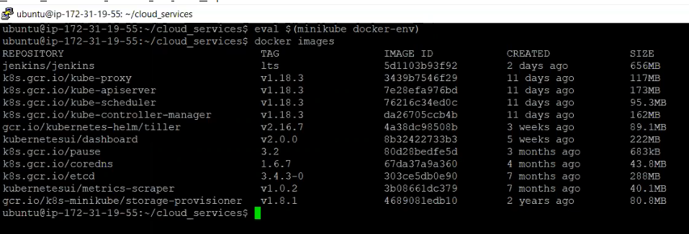
Deploy Spring Boot using minikube Kubernetes
To Deploy Springboot application in Ubuntu using minikube kubernetes, Copy springboot jar into ubuntu and its docker file to create docker image.
Assuming in Ubuntu server ,docker already installed . To Available kubernetes related docker images to view.
Need to enter this command which helps to show kubernetes related docker images.
Command :- eval $(minikube docker-env)
Now enter command :- docker images it will lists the kubernetes docker images as well.

Slide 13
Deploy Spring Boot using minikube Kubernetes
We are in directory :- /home/ubuntu/cloud_services it has targert folder which has java jar file.
And Dockerfie to create docker image of jar which is in target folder.
Command to create docker image cmd :- docker build -t springboot-k8s:1.0 .
Above commands creates docker image
Now we have to create deployment object in kubernetes. Deployment object is responsible for running the set of pods.
Command to create deployment object :- kubectl run deploymentname --image=dockerimagename --port=anyport
--image-pull-policy=Never or ifNotPresent
Command :- kubectl run springboot-k8s --image=springboot-k8s:1.0 --port=8080 --image-pull-policy=Never

Slide 14


Deploy Spring Boot using minikube Kubernetes
Check the deployment object is created or not.
Command :- kubectl get deployments
Now we have to create service object .Service Objects gives network access to these set of pods.
Command to create service object nothing but expose deployment object to type NodePort
Command :- kubectl expose deployment springboot-k8s --type=NodePort
Check the service Object is created or not command :- kubectl get services

Slide 15

Deploy Spring Boot using minikube Kubernetes
Check the deployment object is created or not.
Now you would see one pod is created. To create pod ,we must finish deployment and service expose should be done. Deployment nothing but attaching docker image for depoyment and service object we are exposing that deployment object to one TCP Port.
To see the pods run the following command :- kubectl get pods
You should see one pod is up and running.
Here pods is nothing but collection of containers, we can have multiple pod records if i deploy another java docker image.
Command to check the minikube ip command :- minikube ip

Slide 16
Deploy Spring Boot using minikube Kubernetes
Curl command to check the java application rest service response
Check the kubernetes pods with IP address shown as
To Create replicas for the given pods
Command :- kubectl scale --replicas=size deployment/deploymentname
Command :- kubectl scale --replicas=3 deployment/springboot-k8s

Slide 17
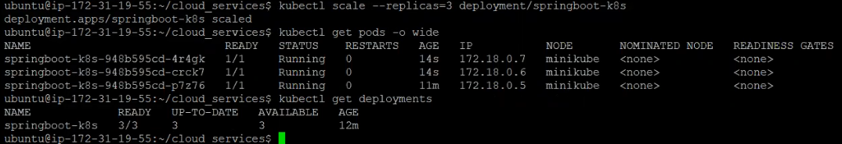
Deploy Spring Boot using minikube Kubernetes
Now you can check pods using the command :- kubectl get pods -o wide . Now you can see 3 pods are up and running.
Here 3 Instances are up and running for springboot jar using kubernetes.
Command to check replicas available for deployments syntax :- kubectl get rs
Check minikube dashboard syntax :- minikube dashboard

Slide 18
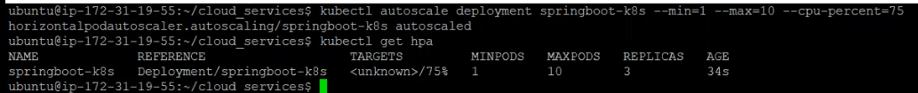
Deploy Spring Boot using minikube Kubernetes
Autoscale the deployment using below command for our application
Syntax :- kubectl autoscale deployment deploymentname --min=1 --max=10 --cpu-percent=75
Syntax :- kubectl autoscale deployment springboot-k8s --min=1 --max=10 --cpu-percent=75
Autoscaling is done.
Command to check horizontalpodautoscalar syntax :- kubectl get hpa
Update Or Deploy Springboot latest docker image into kubernetes
Create docker image with new version syntax :- docker build -t springboot-k8s:2.0 .

Slide 19
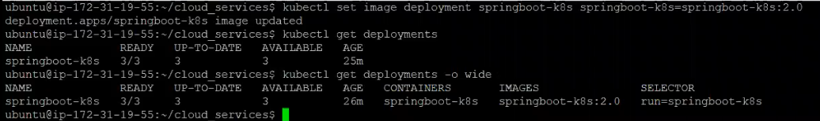
Deploy Spring Boot using minikube Kubernetes
Update docker image command :- kubectl set image deployment deploymentname containername=imagename:tag
command :- kubectl set image deployment springboot-k8s springboot-k8s=springboot-k8s:2.0
Check the kubectl deployment configuration file command :- kubectl describe deployments
We can see all deployment information.
Another Approach to deploy application in Kubernetes using YAML files. We need to write deployment and service yaml files for deployment and service objects.
Commands to run those YAML files and deploy application in Kubernetes.
First delete existing deployment command is :- kubectl delete deployment deploymentname
Syntax :- kubectl delete deployment springboot-k8s

Slide 20
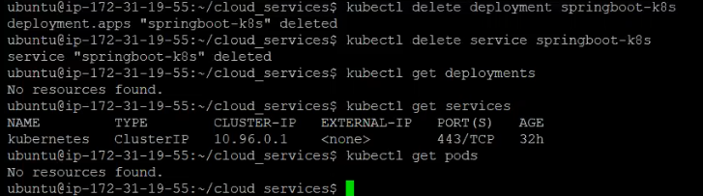
Deploy Spring Boot using minikube Kubernetes
Delete service object command :- kubectl delete service servicename
Syntax :- kubectl delete service springboot-k8s
Now run deployment yaml file command :- kubectl apply -f deployment.yml
Check for deployments :- kubectl get deployments → you can see deployment record
Run service yaml file command :- kubectl apply -f service.yml

Slide 21
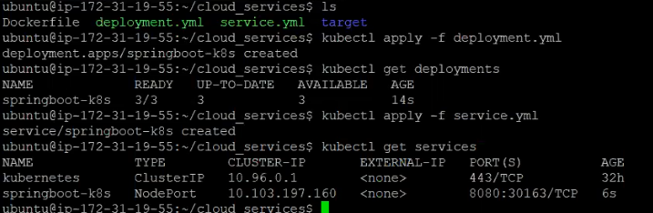
Deploy Spring Boot using minikube Kubernetes

Slide 22
Deploy Spring Boot using minikube Kubernetes
Namespaces :- create namespaces :- kubectl create namespace namespacename syntax :- kubectl create namespace counterapp
Create Deployment and Service Objects using created namespace
Syntax :- kubectl apply -f deployment.yml --namespace=counterapp
Kubectl apply -f service.yml --namespace=counterapp
Command to get all namespaces syntax :- kubectl get namespace
To see resources in default namespace syntax :- kubectl get pods
To see resources in created namespace counterapp
Syntax :- kubectl get pods --namespace=counterapp
Syntax :- kubectl get deployments --namespace=counterapp
Syntax :- kubectl get services --namespace=counterapp
Reference Link for namespaces :- https://youtu.be/K3jNo4z5Jx8

Slide 23
Kubernetes
Thank You
Parasuram Yerramsetty

