Slide 1
Docker

Slide 2
Steps
Open Source Container
Docker Container is an executable environment with code and files.
A Docker file contains individual commands called layers which are used to create an image.
EC2 Container Registry(ECS ECR) is managed docker registry service.
It supports private Docker Repositories

Slide 3
Steps
https://docs.docker.com/install/linux/docker-ce/centos/
https://hub.docker.com/

Slide 4
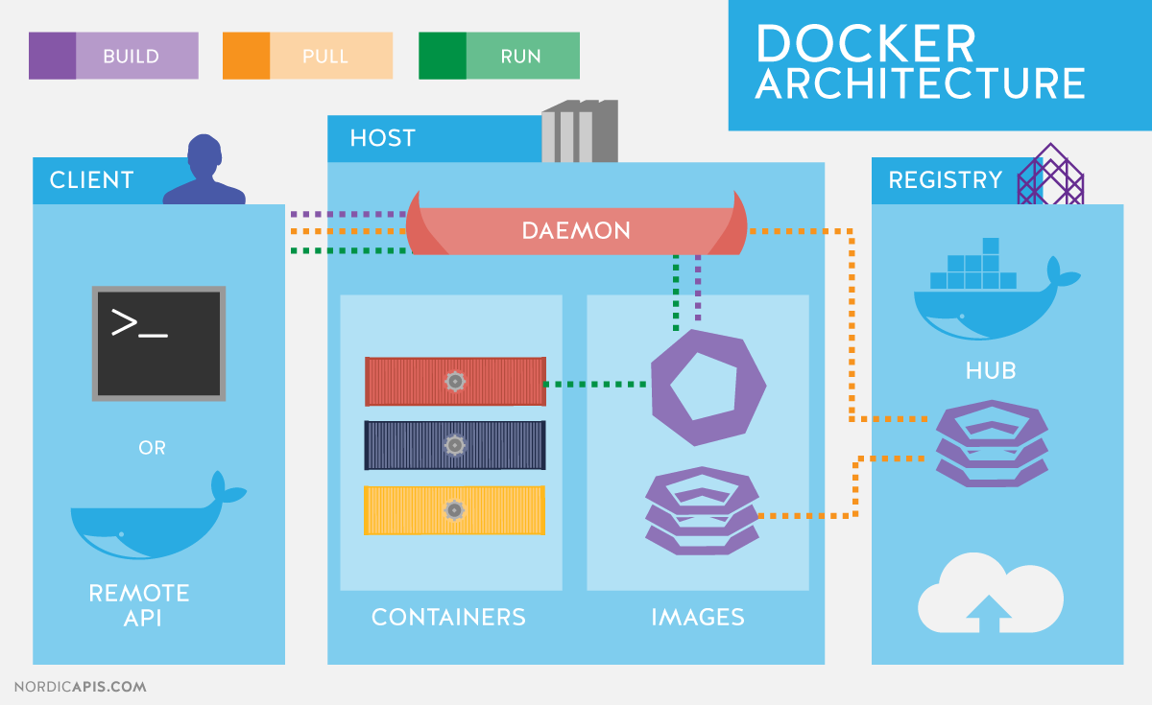
Steps

Slide 5
Install Docker on Centos
sudo yum check-update
sudo yum install -y yum-utils device-mapper-persistent-data lvm2
sudo yum-config-manager --add-repo https://download.docker.com/linux/centos/docker-ce.repo
sudo yum install docker
sudo systemctl start docker
sudo systemctl enable docker
sudo systemctl status docker0

Slide 6
Deploying angular app using docker
Create a docker file in the angular application
Include the following commands in the docker file:
FROM node:10.16.3
RUN mkdir /usr/src/app
WORKDIR /usr/src/app
RUN npm install -g @angular/cli@8.3.21
COPY . /usr/src/app
CMD ng serve --host 0.0.0.0 --port 4200

Slide 7
Steps
sudo docker build -t distillery .
docker run -it -v ${PWD}:/usr/src/app -p 4200:4200 -h 3.22.254.157 distillery
docker image ls
docker image rm -f 9fa754db8e3a
docker container rm e79c7a806063

Slide 8
Steps
Error response from daemon: You cannot remove a running container e79c7a8060631c118c03299d0efca359586c9eb4a8069332738d19a07529c16a. Stop the container before attempting removal or use -f
[root@ip-10-0-1-118 distillery-web-app]# docker container stop e79c7a806063

Slide 9
Steps

Slide 10
Steps

