Slide 1

WEB BASED GAMES WITH TWO PLAYERS
(Dots-And-Boxes)
Project Supervisor : Dr.R.M.Gomathi M.Tech.,P.hD.
Name of the Student : Balaji Manchi
Register Number : 39120015

Slide 2
Presentation Outiline
Course Certificate
Introduction
Objectives
System Architecture/Ideation Map
System Requirements
Module Implementation
Project Screenshots
Results And Discussions
Conclusion & Future work
References

Slide 3
Introduction
It is a well-known game as Dots-And-Boxes.
Which we all played in our Child-hood using paper and pen.
In a brief, we will take a grid(rows*columns).
We can design our grid however we want using how many rows and columns we want each accordingly.
And we will create two colors for two players to have unique representation.
And the game starts now…

Slide 4
Objectives
This game is designed for a good synergy and time-pass for friends.
The game is concluded when all the edges have been marked.
The result screen then displays the winner and the number of boxes marked by each player.

Slide 5
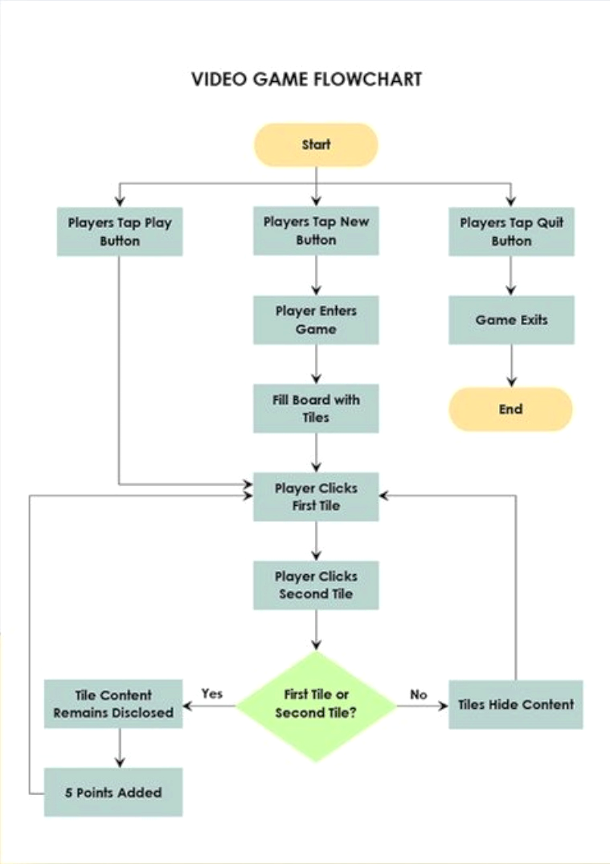
System Architecture

Slide 6
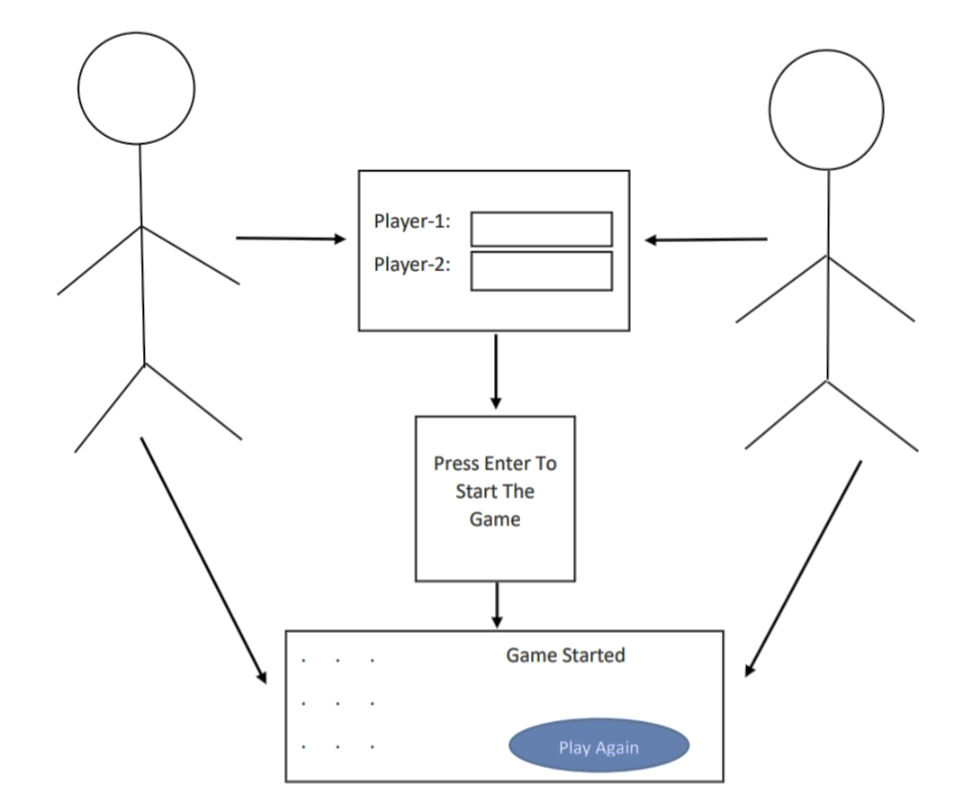
Ideation Map

Slide 7
Technologies Used
HTML
CSS
JavaScript
GitHub

Slide 8
Hardware And Software Requirements
4gb RAM,Operating System,Windows 10,
Intel i3,10 Generation, Visual Studio Code(optional)

Slide 9
Module Implementation
Game starts by clicking start the game by the user.
First player-1 have to select a line in which he is going to make a box.
Player-2 gets chance after Player-1.

Slide 10
Module Implementation
Whenever player-1 marks an edge around a box, the value of the array associated with that box is decremented by 1 and when it is marked by player 2 it is incremented by 1.
Whenever any element of this array reaches a value of -4(or 4), this indicates that player-1 (player-2) has successfully created the box.

Slide 11
Controls
Specify the size of the game.
Player-1 starts the game.
Click on edges to mark them.
If a box is made, it gets shaded with the player assigned color.
When all the edges are marked, the result is displayed on the result screen.
Click on play again to play again

Slide 12
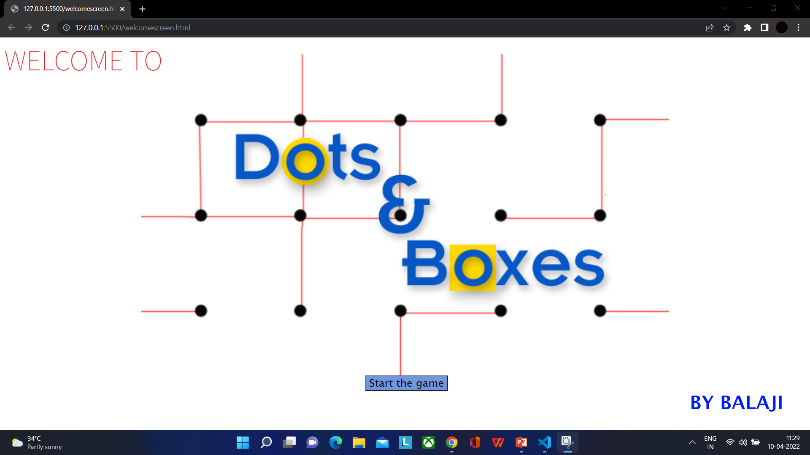
Project Screenshots
Welcome Screen GUI

Slide 13
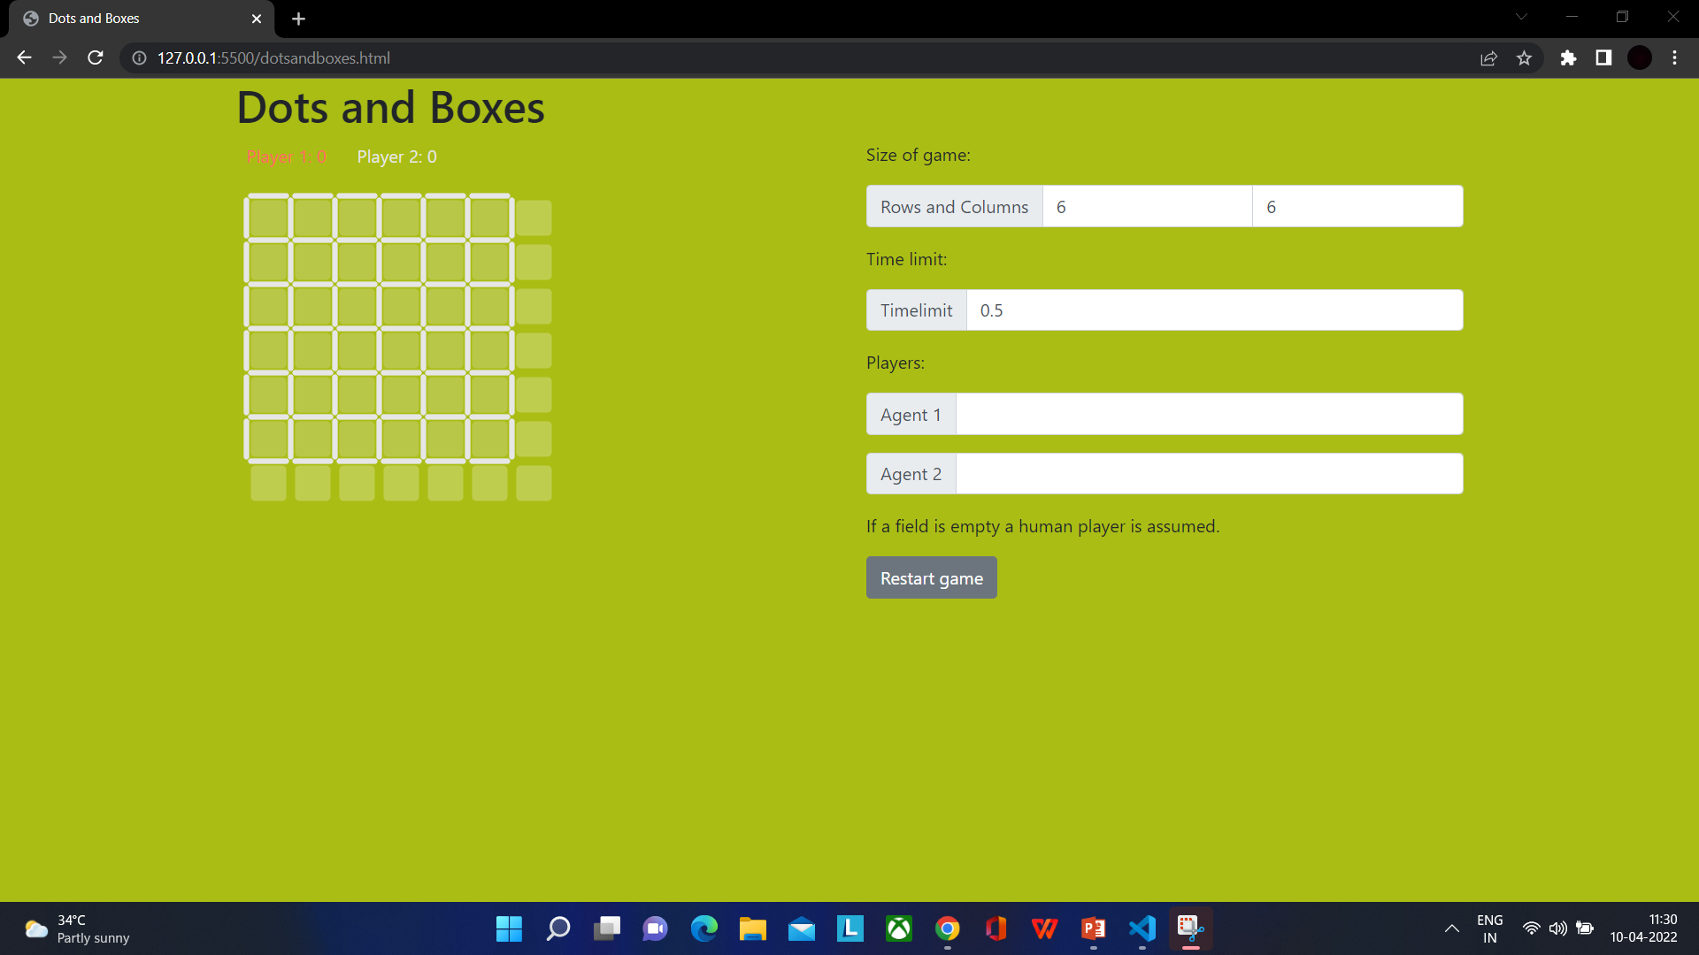
Result And Discussions
Finally the game has been designed and the result screen has been displayed

Slide 14
Conclusion
In the project two clients comes together to connect and plays the game.
The project can be taken a set forward by adding more than two players or by setting a difficulty level.(My View).

Slide 15
References
HTML5 W3C Recommendation 28 October 2014 (@ http://www.w3.org/TR/html5).
W3School HTML/CSS Tutorials, References and Examples @ http://www.w3schools.com/.
https://developer.mozilla.org/en-US/docs/Web/JavaScript
https://github.com/Balaji8403/dots-and-boxes

