Slide 1
Identifying suitable location to start a restaurant

Slide 2
Business Problem:
.The location is an essential factor to consider while discussing how to start a restaurant business, as it can determine the success of your restaurant. While choosing your restaurant’s location, it is a good idea to identify your competitor in that area and gauge their progress and understand their business model. The restaurant should be located in a place that is easily visible as well as accesssible.
The size of the location is an essential factor to be considered during the restaurant site selection process.
. The size of the restaurant does not just imply the dining space.
. The site should be big enough to accommodate all the kitchen equipment

Slide 3
Data acquisition and cleaning
This https://en.Wikipedia.Org/wiki/category:neighbourhoods_in_hyderabad,_india is a list of neighbourhoods in hyderabad, with 200 neighbourhoods. I have used web scraping techniques to extract the data from the wikipedia page, with the help of python requests and beautifulsoup .
Foursquare API will provide many categories of the venue data, and we are particularly interested in the restaurant category in order to help us solve the business problem.

Slide 4
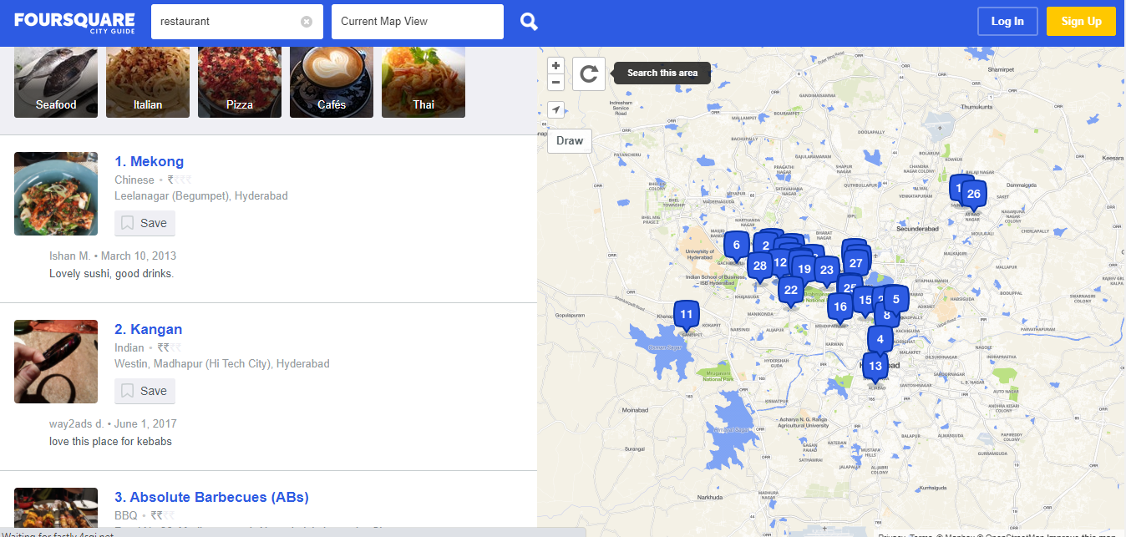
Using FOURSQUARE

Slide 5
Methodology
The foursquare API allows application developers to interact with the foursquare platform. The API itself is a restful set of addresses to which you can send requests, so there’s really nothing to download onto your server.
Perform scraping using python requests and beautiful soup packages to extract the list of neighbourhoods data.
We need to get the geographical coordinates in the form of latitude and longitude in order to be able to use foursquare api. To do so, we will use the geocoder package that will allow us to convert the address into geographical coordinates in the form of latitude and longitude.
We have obtained the latitude and longitude coordinates for all the places, so we need to merge the coordinates into the original data frame.

Slide 6
Conclusions
A good number of restaurants are concentrated in the central area of hyderabad city. Cluster 0 has a very low number of restaurants. This represents a great opportunity and high potential areas to open new restaurants, as there is very little to no competition from existing restaurants . meanwhile, restaurants in cluster 2 are likely suffering from intense competition because of oversupply and a high concentration of restaurants. Therefore, this project recommends property developers to capitalize on these findings to open new restaurants in neighbourhoods in cluster 0 with little to no competition. Property developers with unique selling propositions to stand out from the competition can also open new restaurants in neighbourhoods in cluster 1 with moderate competition. Lastly, property developers are advised to avoid neighbourhoods in cluster 2 which already have a high concentration of restaurants and suffering from intense competition.

Slide 7
Thank u

