Slide 1
Data engineering on Azure Databricks - workshop
Anagha Khanolkar | Ryan Murphy Azure Cloud Solution Architects – Data and AI

Slide 2
About the lab

Slide 3
Learn how to…
Provision Azure resources – blob storage, Azure SQL DB, Databricks
Learn how to copy a public dataset into Azure
Learn how to build a data engineering pipeline in Azure Databricks
Learn how to automate a report jobset that integrates reports generated in Databricks into an RDBMS

Slide 4


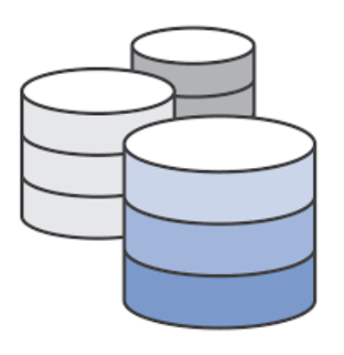
The datasets
NYC taxi data
Transactional data
Reference data
Yellow taxi trips (675 million) | 2009 - 2017
Green taxi trips (59 million) | 2013 - 2017 CSV Schema varies between taxi types
Schema varies across years
~30GB raw
Trip months
Payment type
Rate code
Taxi zone
Trip type
Vendor

Slide 5


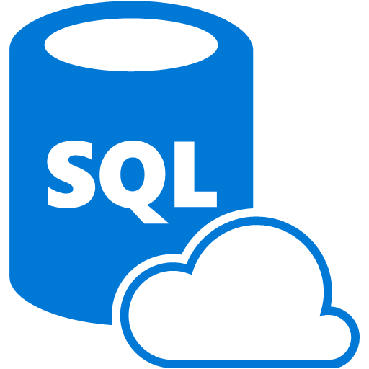
The Azure services
Utilities: Azure Cloud Shell – for provisioning storage and copying data
Azure SQL Database Query Explorer – cloud IDE for Azure SQL DB

Slide 6
The lab modules
Data copy
Data load
Transform
Create materialized views
Run reports & visualize
Batch job automation
Copy datasets using Azure cloud shell into your storage account
Read CSV from blob storage, save raw data as partitioned parquet
Apply data transformations to homogenize schemas across taxi type over years
Homogenize and merge curated yellow and green taxi data into a single table
Run some reports Create some charts
Create and schedule and automated
Databricks batch job, write to RDBMS

Slide 7
Data copy
With Azure Cloud Shell - Bash

Slide 8

Data load TODOs
Launch cloud shell
Create a resource group in US East 2
Create a storage account
Create blob storage containers
Copy data for the workshop (details in doc)
Upload a subset of the workshop data into staging directory
Instructions: https://aka.ms/DEW-Setup
Copying the entire dataset (30 GB) look 2 hours USE2-USE2 For the lab- we will use a subset

Slide 9
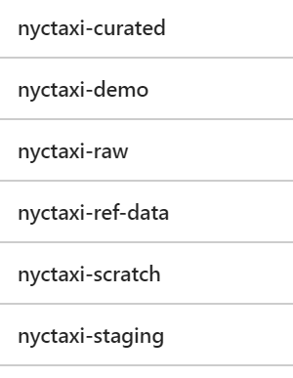
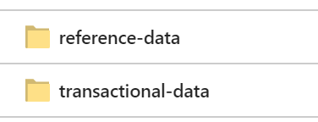
By now…
You should have the following set up in your subscription:
Resource Group
Storage account
Containers
Datasets

Slide 10
Azure services
Provisioning, configuration

Slide 11
Provisioning TODOs
Provision Azure SQL Database in the resource group (100 DTU)
Create tables in the Azure SQL Database – for batch job history & reports
Provision Azure Databricks workspace in the resource group
Launch workspace
Instructions: https://aka.ms/DEW-Setup

Slide 12

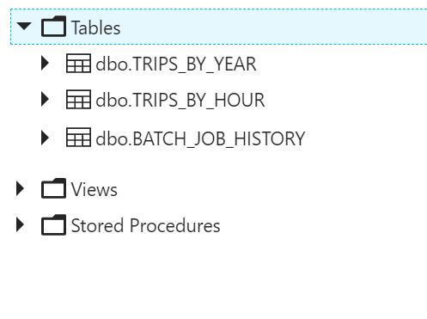
By now…
You should have the following set up in your subscription:
Resource Group
Storage account
Containers
Workspace
Tables
Datasets

Slide 13
Azure Databricks
Provisioning, configuration

Slide 14
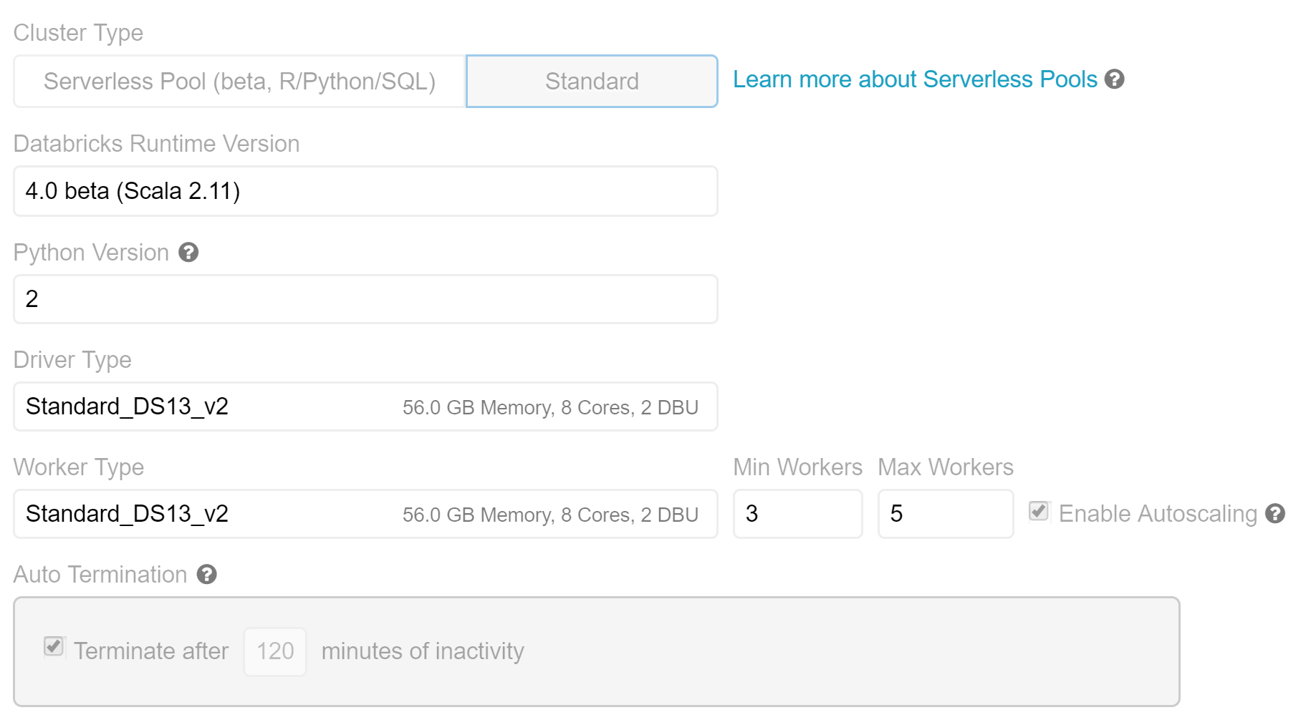
Provision cluster Azure Databricks – setup
Initialize workspace and create a cluster with the following specifications:
In the Spark config section, enter your storage account credentials-
spark.hadoop.fs.azure.account.key.<storageaAccount>.blob.core.windows.net <key>

Slide 15
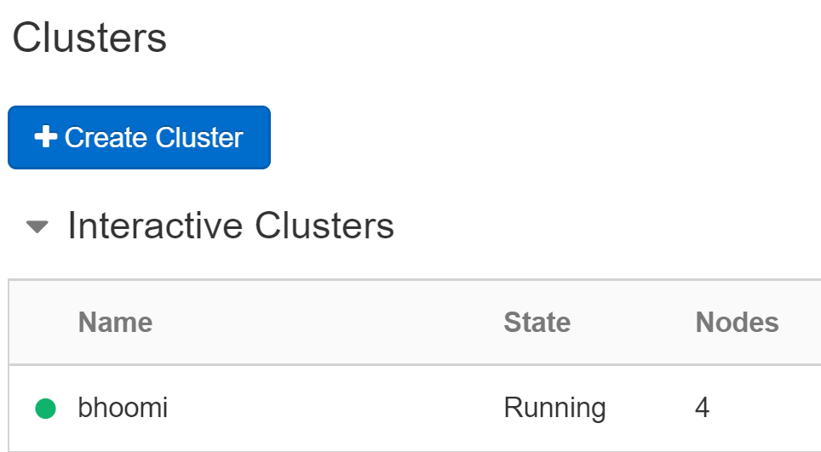
By now…
You should have the following set up in your subscription:
Resource Group
Storage account
Containers
Workspace & cluster
Tables
Datasets

Slide 16
Azure Databricks
Import workshop notebooks

Slide 17
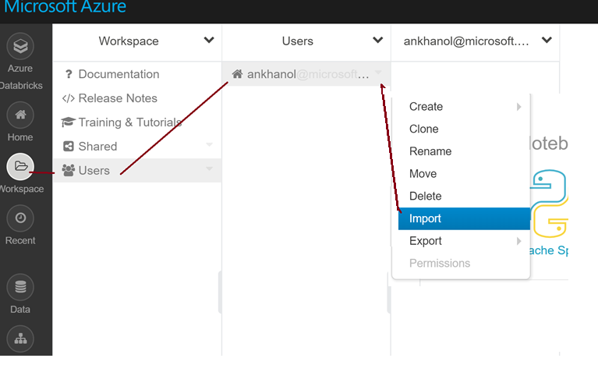
Import workshop notebooks

Slide 18
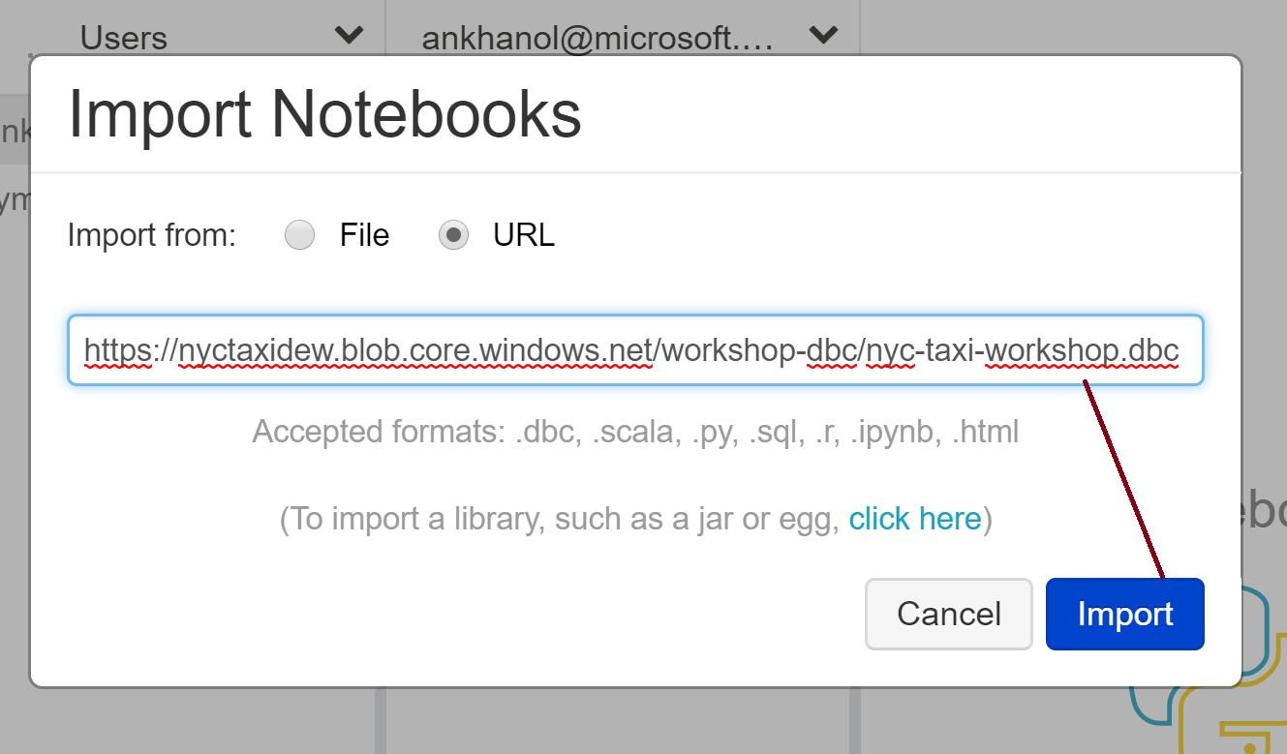
https://nyctaxidew.blob.core.windows.net/workshop-dbc/nyc-taxi-workshop.dbc

Slide 19
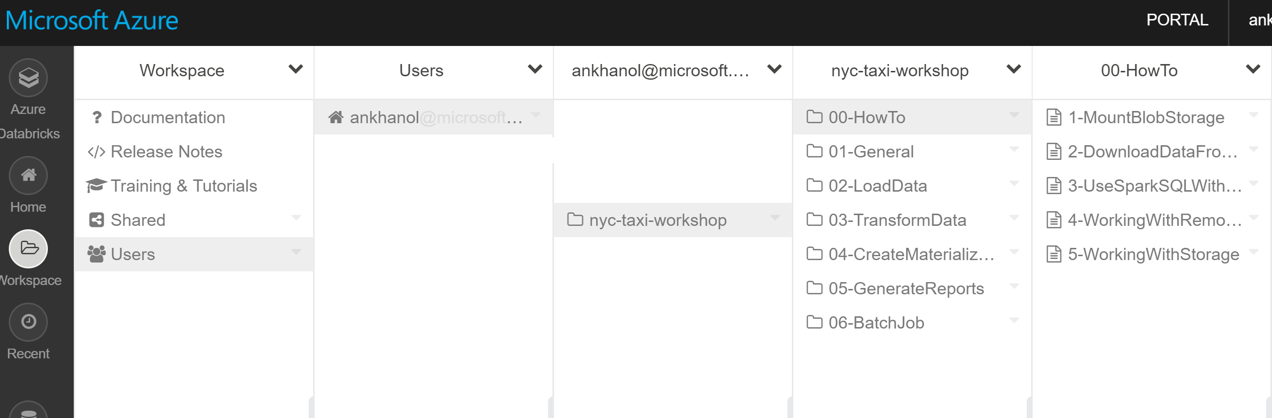

Slide 20
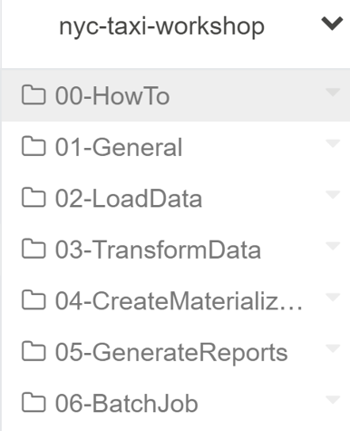
You are done with setup!
You should have the following set up in your subscription:
Resource Group
Storage account
Containers
Workspace, cluster, notebooks
Tables
Datasets

Slide 21
Password for demo database
The password for the RDBMS demodbserver is: d@t@br1ck$

Slide 22
Azure Databricks
Preview of what’s you’ll be creating

Slide 23
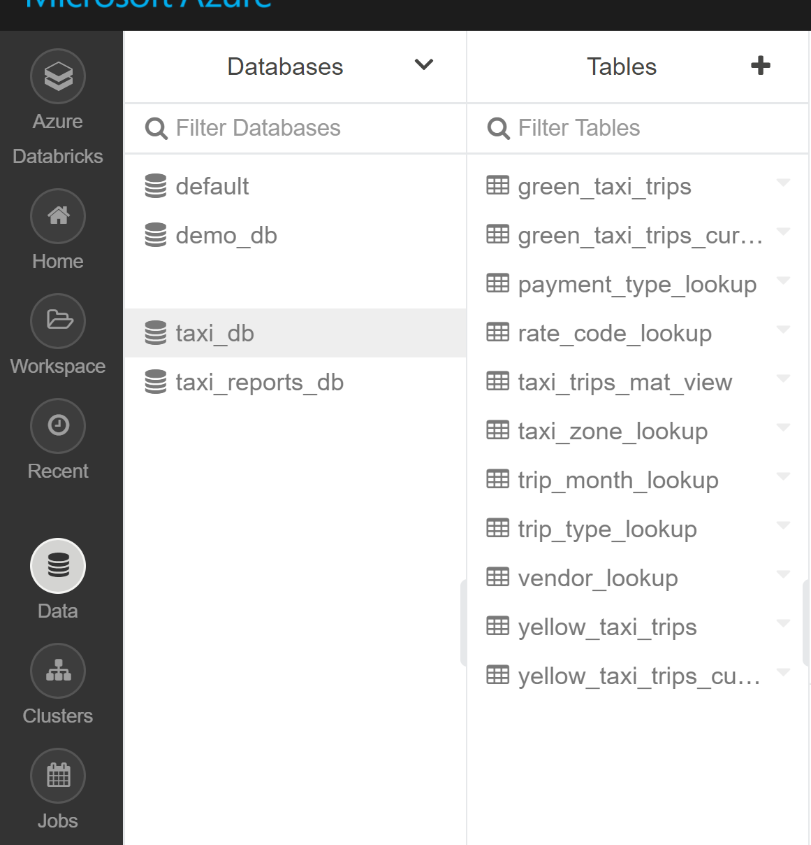
Query-able Hive tables

Slide 24
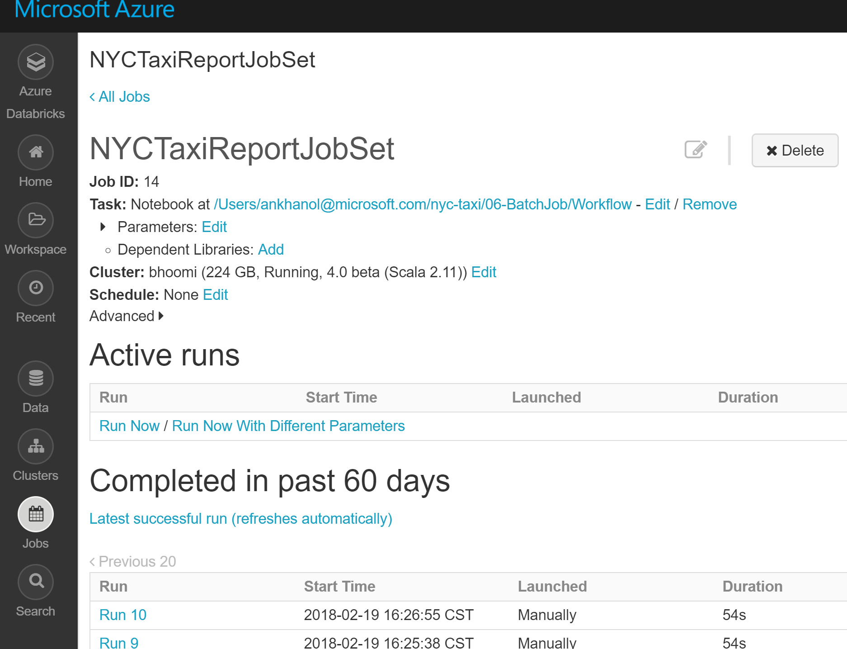
On-demand/scheduled batch jobset

Slide 25
Hands on lab - Module 1
HOW TO work with Hive, with DBFS, with remote databases

Slide 26
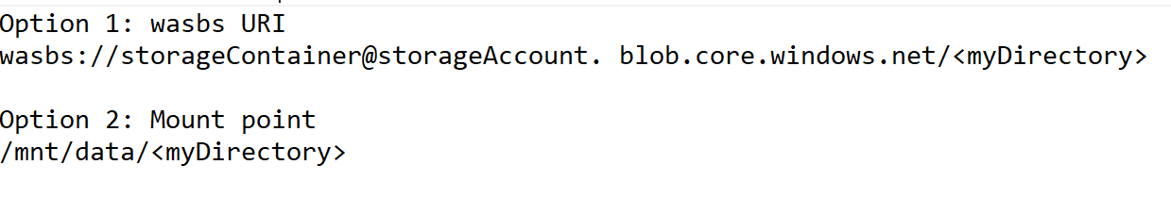
1.1. Mount blob storage Why?
What’s easier?
Mounting blob storage is an option with Azure Databricks 3.5 and above, and a general best practice. It simplifies and secures accessing storage

Slide 27
1.1. Mount blob storage How to
Lets review the notebook – nyc-taxi-workshop/00-HowTo/00-MountBlobStorage.scala
In this notebook – we will mount a storage container, and access it using the mountpoint. We will also learn to refresh mountpoints and to unmount.

Slide 28
1.2. Downloading the original Yellow Taxi data How to
This is informational only
Lets review the notebook – nyc-taxi-workshop/00-HowTo/2-DownloadDataFromInternet.scala

Slide 29
1.3. Working with Hive & SparkSQL How to
Lets review the notebook – nyc-taxi-workshop/00-HowTo/3-UseSparkSQLWithHive.scala
In this notebook – we will create a text file locally (bash), load it to DBFS, create a hive table on it, and run queries using SQL

Slide 30
1.4. Working with remote databases/JDBC How to
Lets review the notebook – nyc-taxi-workshop/00-HowTo/4-WorkingWithRemoteDatabases.scala
In this notebook – we will query a remote Azure SQL database like it were a table created in Azure Databricks

Slide 31
1.5. Working with storage How to
Lets review the notebook – nyc-taxi-workshop/00-HowTo/5-WorkingWithStorage.scala
In this notebook, we will work with DBFS file system commands

Slide 32
Recap of module
We learned how to -
Mount blob storage
Work with Hive and SparkSQL
Work with a remote SQL database
Work with Databricks File System (DBFS)

Slide 33
Hands on lab - Module 2 General setup Mount blob storage
Create database
Common functions

Slide 34
2.1. Mount blob storage Workshop - setup
Lets review this notebook- nyc-taxi-workshop/01-General/1-MountBlobStorage.scala
In this notebook, we create a function to mount blob storage and call it to mount several containers

Slide 35
2.2. Create database objects Workshop - setup
Lets review this notebook- nyc-taxi-workshop/01-General/2-CreateDatabaseObjects.scala
In this notebook, - (1) We create a database taxi_db (2) We create a JDBC Hive table against the Azure SQL database table you set up during provisioning – batch_job_history

Slide 36
2.3. Define common functions Focus - reusability
Lets review this notebook- nyc-taxi-workshop/01-General/3-CommonFunctions.scala
In this notebook, - We create a set of commonly used functions in a notebook for future use in the workshop

Slide 37
Recap of module
We completed-
Mounting blob storage
Creating a Hive database
Creating a Hive table definition for a remote Azure SQL database
Creating a set of commonly used functions in a notebook for future use in the workshop

Slide 38
Hands on lab - Module 3
Load dataset

Slide 39
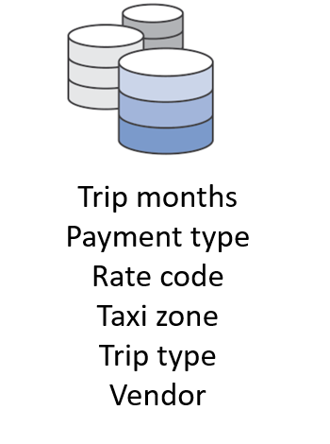
3.1. Load reference data
Lets review this notebook- nyc-taxi-workshop/02-LoadData/1-LoadReferenceData.scala
In this notebook, - (1) We load all the reference datasets – read from stagingDir, save as parquet to refDataDir (2) Create Hive tables on top of them (3) Compute statistics

Slide 40
3.2. Load transactional data – Yellow Taxi
Lets review this notebook- nyc-taxi-workshop/02-LoadData/2-LoadData-YellowTaxi.scala
In this notebook, - (1) We load yellow taxi data over several years– read from stagingDir, save as parquet to refDataDir (2) Create Hive tables on top of them (3) Compute statistics
To note: the schema of the dataset differs over years. We homogenize the schema in this notebook

Slide 41
3.3. Load transactional data – Green Taxi
Lets review this notebook- nyc-taxi-workshop/02-LoadData/3-LoadData-GreenTaxi.scala
In this notebook, - (1) We load green taxi data over several years– read from stagingDir, save as parquet to refDataDir (2) Create Hive tables on top of them (3) Compute statistics
To note: the schema of the dataset differs over years. We homogenize the schema in this notebook

Slide 42
Recap of module
We completed-
Loading reference data and saving as parquet, with hive tables & stats
Loading yellow taxi and green taxi data, saving as parquet, with hive tables & stats

Slide 43
Hands on lab - Module 4
Transform data

Slide 44

4.1. Transform yellow taxi data
Lets review this notebook- nyc-taxi-workshop/03-TransformData/1-TransformData-YellowTaxi.scala
In this notebook, - (1) We execute the notebook with common functions (2) Denormalize - join yellow taxi with all reference datasets and persist to DBFS (3) Define Hive table for the transformed dataset (curated), create partitions (year, month) (4) Compute statistics
+ reference data
+ temporal attributes
taxi_db.yellow_taxi_trips
taxi_db.yellow_taxi_trips_curated

Slide 45
4.2. Transform green taxi data
Lets review this notebook- nyc-taxi-workshop/03-TransformData/2-TransformData-GreenTaxi.scala
In this notebook, - (1) We execute the notebook with common functions (2) Denormalize - join yellow taxi with all reference datasets and persist to DBFS (3) Define Hive table for the transformed dataset (curated), create partitions (year, month) (4) Compute statistics
+ reference data
+ temporal attributes
taxi_db.yellow_taxi_trips
taxi_db.yellow_taxi_trips_curated

Slide 46
Recap of module
We completed-
Denormalizing yellow and green trip taxi data – joining with reference data, and saving as parquet, and ran hive tables & stats

Slide 47
Hands on lab - Module 5
Create materialized view

Slide 48
5.1. Create materialized view
Lets review this notebook- nyc-taxi-workshop/04-CreateMaterializedView/1-CreateMaterializedViews.scala
In this notebook, - (1) We execute the notebook with common functions (2) We add columns to yellow taxi data to match green taxi data (3) Do a union all on yellow and green taxi curated datasets and persist to DBFS (4) Define Hive table for the transformed dataset (curated), create partitions (taxi type, year, month) (5) Compute statistics
+ few extra fields +
taxi_db.yellow_taxi_trips_curated
taxi_db.green_taxi_trips_curated
taxi_db.taxi_trips_mat_view

Slide 49
Hands on lab - Module 6
Generate a report with visualization

Slide 50
6.1. Generate report
Lets review this notebook- nyc-taxi-workshop/05-GenerateReports/Report-1.scala
In this notebook, we will run several reports and visualize- 1. Trip count by taxi type
2. Revenue including tips by taxi type
3. Revenue share by taxi type
4. Trip count trend between 2013 and 2016
5. Trip count trend by month, by taxi type, for 2016
6. Average trip distance by taxi type

Slide 51
6.1. Generate report
7. Average trip amount by taxi type
8. Trips with no tip, by taxi type
9. Trips with no charge, by taxi type
10. Trips by payment type
11. Trip trend by pickup hour for yellow taxi in 2016
12. Top 3 yellow taxi pickup-dropoff zones for 2016

Slide 52
Hands on lab - Module 7
Batch job automation

Slide 53
7.1. Global vars and functions
Lets review the notebook- nyc-taxi-workshop/06-BatchJob/GlobalVarsAndMethods.scala
In this notebook-
(1) We define JDBC credentials (2) We create a function to generate a batch_ID by querying the batch_job_history table in Azure SQL database

Slide 54
7.2. Report 1
Lets review the notebook- nyc-taxi-workshop/06-BatchJob/Report-1.scala
In this notebook-
(1) We create a dataframe – a simple report – trips by year (2) Persist the data to Azure SQL database table trips_by_year

Slide 55
7.3. Report 2
Lets review the notebook- nyc-taxi-workshop/06-BatchJob/Report-2.scala
In this notebook-
(1) We create a dataframe – a simple report – trips by hour (2) Persist the data to Azure SQL database table trips_by_hour

Slide 56
7.4. Workflow
Lets review the notebook- nyc-taxi-workshop/06-BatchJob/Workflow.scala
This is a notebook workflow spec and in this we –
(1) Execute the GlobalVarsAndFunctions notebook (2) We generate batch ID by calling a method from #1
(3) We insert start time into batch_job_history, execute notebook Report-1, then insert completion time into the RDBMS table

Slide 57
7.4. Workflow
(4) If #3 completed successfully, we repeat #3 for Report-2
(5) If #4 completed successfully, we exit with a pass status
(6) We create a batch job in which we call workflow.scala and do multiple ad-hoc executions

Slide 58
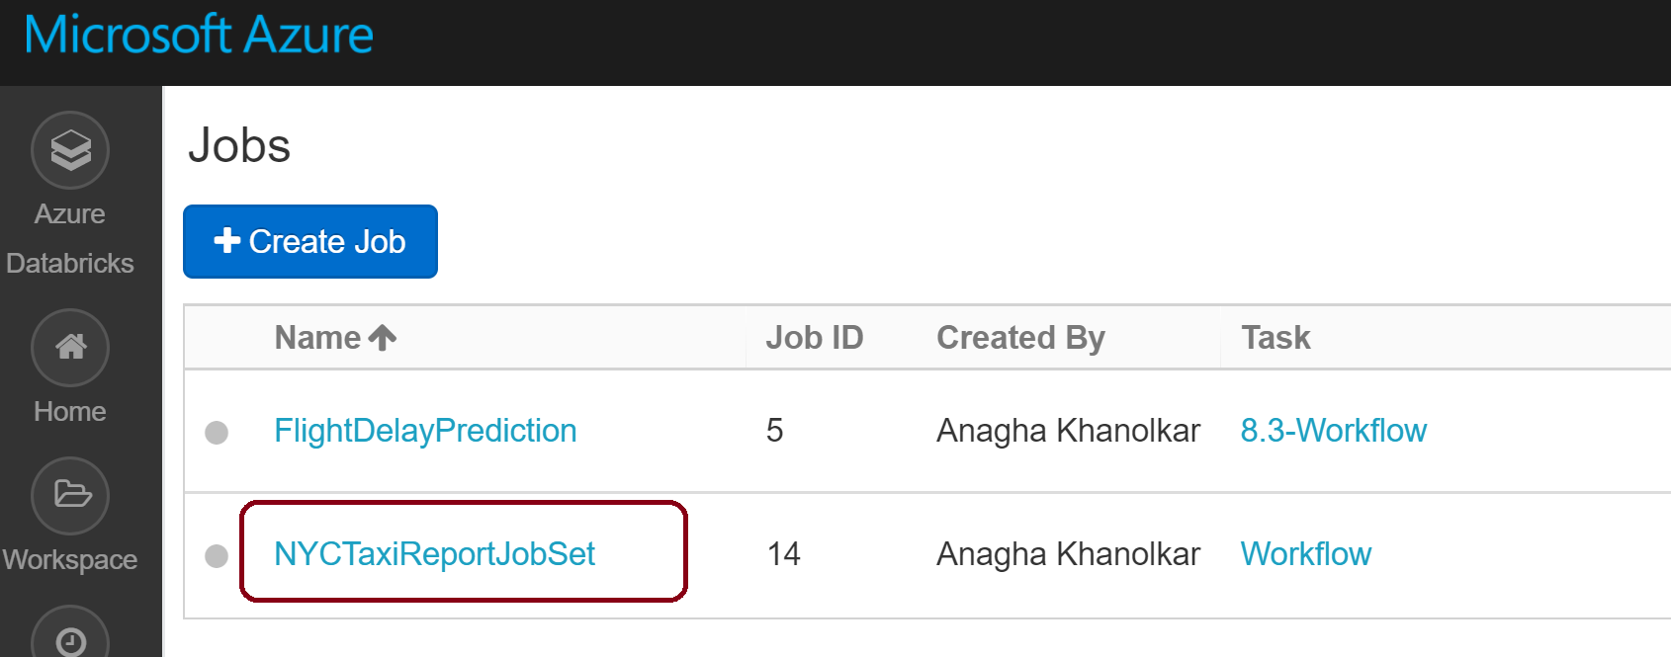

Slide 59
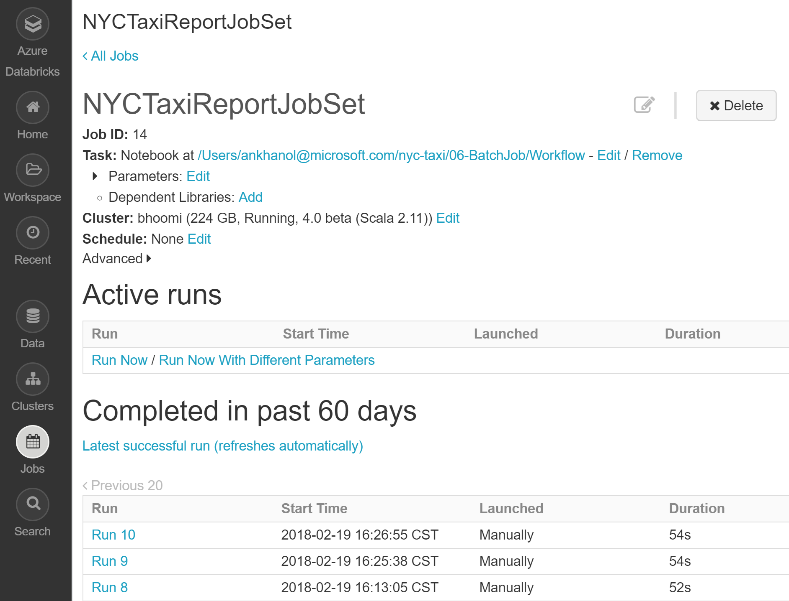

Slide 60
Wrap up

Slide 61
Machine Learning Workshop - preview
Lecture/discussion: Data science process Data science lexicon – level set
Lab:
Use case: Flight delay prediction Technologies/Services: (1) Azure Machine Learning (AML) Studio – we will learn how to predict flight delays using AML – ingest, cleanse, dedupe, train, test, operational model, batch score (2) Spark ML – we will repeat the exact same experiment in Spark ML – dataframe API for a more scalable solution We will discuss how we can operationalize a Spark model trained in Databricks on the Azure ML platform

Slide 62
Q & A
Terminate your cluster
Any questions? Note: you will use the same cluster next week for the machine learning on Databricks workshop

