Slide 1


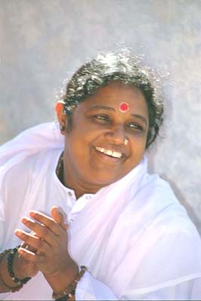
presents
K/B ollywood Dhinchak
(A Charitable Fundraiser for Mata Amritanandamayi Center)
Come, rock to the lilting tunes of all-time favorite Bollywood and Tamil Film Songs!
Complimentary Dinner will be served by Amma Vegetarian Kitchen, Vienna, VA
Venue:
Shady Grove Conference Center :
University of Maryland Shady Grove Campus
Rockville, MD 20850
Date:
Saturday, May 13th 2006
Time:
Dinner: 6:00 PM – 6:45 PM
Concert: 7:00 PM – 9:00 PM
Tickets:
$20.00 (Adults)
$10.00 (Children 13 & Under)
(Checks payable to M.A. Center)
Vocals:
Jaishree Sankaran, Rohini Ravada
Saikumar Natarajan, Rama Rao Mysore
Chandu Ketkar
For Tickets Please Contact:
Maragatham Ramaswamy (703) 971-7328
Lakshmi Mukundan (703) 793-1045
Sridevi Suku Nair (703) 442-9356
Kavita Rajan (703) 597-2471
Request Tickets via Email:
sramaswamy@cox.net or jaishree_sankaran@cox.net
Mata Amritanandamayi Center
Benefit
Om Amriteswaryai Namaha
"The beauty and charm of selfless love and service should not die away from the face of the earth. The world should know that a life of dedication is possible, that a life inspired by love and service to humanity is possible.”
M. A. Center is a California nonprofit corporation, tax exempt under section 501 (c) (3) of the Internal Revenue Code. Donations to M. A. Center are tax-deductible to the full extent permitted by law.

