Slide 1



2026 International Conference on Data Science, Agents, and Artificial Intelligence (ICDSAAI 2026)
26th–28th March 2026
Chennai Institute of Technology, Chennai
Paper ID &Title : A215 & Real-Time Currency Identification for Visually Impaired Users Using a Lightweight YOLOv5-Based Object Detection System
Author(s) : Nethi Sathwik, Talasila Balaji, M. Chandralekha
Presenter
Author : Talasila Balaji
Affiliation : Department of Computer Science and Engineering Amrita School of Computing
Amrita Vishwa Vidyapeetham
Chennai, India

Slide 2
Introduction
Background
Identifying currency is essential in everyday financial transactions.
Visually impaired individuals face difficulty recognizing currency denominations independently.
Problem Statement
Existing methods require external assistance or specialized hardware.
Traditional techniques are often inaccurate or limited.
Motivation
Develop an automated system that enables visually impaired users to recognize currency independently.
Significance
Improves accessibility and independence for visually impaired individuals.

Slide 3
Literature Review
Existing Approaches
Image processing based currency recognition systems
CNN-based classification models
Mobile-based assistive applications
Limitations
High computational cost
Many methods work only with static images
Some systems require additional hardware
Research Gap
Lack of lightweight real-time detection systems suitable for edge devices.

Slide 4
Research Objectives
Research Objectives
• Develop a real-time currency identification system to assist visually impaired users in recognizing Indian currency notes.
• Implement a lightweight object detection model (YOLOv5 Nano) suitable for real-time operation on resource-constrained devices.
• Accurately detect and classify different Indian currency denominations from live camera input.
• Provide audio feedback to inform users about the detected currency denomination.
• Evaluate the system using performance metrics such as Precision, Recall, mAP, F1-score, and inference time.
Hypothesis
• A lightweight deep learning model such as YOLOv5 Nano can achieve high accuracy and low inference latency, making it suitable for real-time assistive currency recognition systems.

Slide 5
Methodology
Dataset Description
Indian currency dataset collected from Kaggle.
Contains 11 classes of currency notes (old and new denominations).
Images were manually annotated with bounding boxes for object detection.
Dataset split into 80% training and 20% validation.
Proposed Approach
Implemented a YOLOv5-based real-time object detection system.
Compared three models: YOLOv5 Nano, YOLOv5 Small, and YOLOv5 Medium.
YOLOv5 Nano was selected due to its lightweight architecture and faster inference suitable for edge devices.
System detects currency notes from live camera input and identifies the denomination.

Slide 6
Methodology
Tools, Technologies, and Algorithms
Programming Language: Python
Deep Learning Framework: PyTorch
Object Detection Model: YOLOv5(Nano, Small, Medium)
Image Processing: OpenCV
Annotation Tool: LabelImg
Audio Feedback: Text-to-Speech module

Slide 7
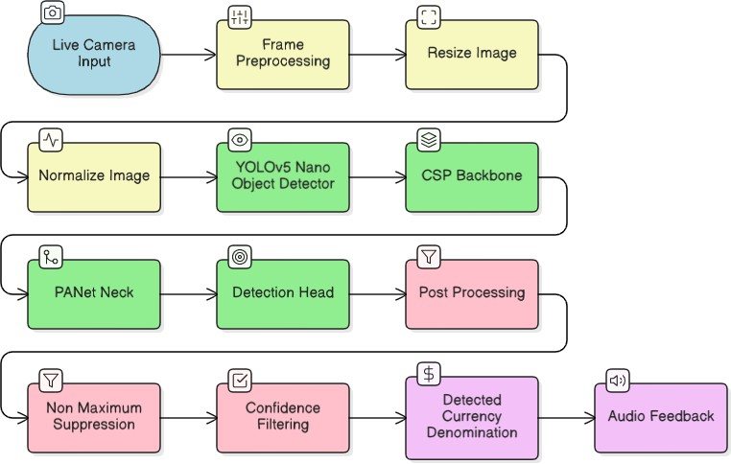
Implementation Details
Work Flow

Slide 8
Implementation Details
Experimental Setup and Configuration
Programming Language: Python
Deep Learning Framework: PyTorch
Object Detection Model: YOLOv5 Nano, YOLOv5 Small, YOLOv5 Medium.
Image Resolution: 640 × 640 pixels
Training Method: Transfer learning using pretrained YOLOv5 weights
Dataset Split: 80% training and 20% validation
Evaluation Metrics: Precision, Recall, mAP, F1-score, and Inference Time

Slide 9
Results and Discussion
Key Findings
• The YOLOv5 Nano model achieved high detection performance for identifying Indian currency notes.
• The system achieved mAP@0.5 of 0.995, indicating highly accurate object detection.
• Precision and Recall values of 0.87 show balanced detection performance.
• The model achieved real-time inference with only 15 ms latency, making it suitable for edge devices.

Slide 10
Results and Discussion
Comparison with Existing Models
• Three YOLOv5 variants were evaluated: YOLOv5 Nano, YOLOv5 Small, and YOLOv5 Medium.
• Larger models slightly improved accuracy but required higher computational resources.
• YOLOv5 Nano provided the best trade-off between speed and accuracy for real-time applications.
Metric | YOLOv5n | YOLOv5s | YOLOv5m
Precision | 0.87 | 0.90 | 0.92
Recall | 0.87 | 0.89 | 0.91
mAP@0.5 | 0.995 | 0.997 | 0.998
mAP@0.5:0.95 | 0.78 | 0.80 | 0.82
F1-Score | 0.87 | 0.89 | 0.91
Inference Time in (ms) | 15 | 28 | 45
Model Size (MB) | 7 | 14 | 42

Slide 11
Results and Discussion
Insights from the Results
• The model successfully detected currency notes under different lighting conditions and backgrounds.
• Precision–Recall curves and confusion matrix show strong classification performance across denominations.
• Integration of object detection with audio feedback improves accessibility for visually impaired users.

Slide 12
Conclusion & Future Work
Summary of Contributions
Developed a real-time Indian currency identification system using a lightweight YOLOv5 Nano object detection model.
The system accurately detects and classifies different currency denominations from live camera input.
Achieved high detection performance with mAP@0.5 of 0.995 while maintaining low inference latency (15 ms).
Integrated audio feedback to assist visually impaired users in recognizing currency independently.

Slide 13
Conclusion & Future Work
Limitations
The system was trained on a limited dataset of Indian currency images.
Detection performance may be affected by severely damaged, folded, or highly worn currency notes.
The system currently supports only Indian currency denominations.
Future Research Directions
Expand the dataset with more currency images and additional denominations.
Extend the system to support multiple international currencies.
Deploy the system on mobile devices or embedded platforms for real-world usage.
Integrate multilingual text-to-speech support for better accessibility.

Slide 14
References
[1] S. A. Shreya, M. A. I. Siddique, and S. Tasnim, “Real-time currency detection and voice feedback for visually impaired individuals,”arXiv preprint, 2025.
[2] U. Kadam et al., “Currency detection for visually impaired people using edge devices,” in Proc. Int. Conf. on Modeling, Simulation & Intelligent Computing (MoSICom), Dubai, UAE, 2023, pp. 498–503.
DOI: https://doi.org/10.1109/MoSICom59118.2023.10458734
[3] N. Rathore et al.,“Indian currency recognition for visually impaired individuals,” in Proc. 14th Int. Conf.on Computing, Communication and Networking Technologies(ICCCNT), Delhi, India, 2023, pp.1–7.
[4] R. Gupta, A. Gupta, A. Chauhan, G. Bisht, and V. Tripathi, “Currency detection application for visually impaired using CNN,”in Proc. IEEE Int. Conf. on Computer Vision and Machine Intelligence(CVMI),2023,pp. 1–7.
DOI: https://doi.org/10.1109/CVMI59935.2023.10464729
[5] V. Agustin et al., “Money identifier: An android-based application for visually impaired people using object detection,” International Journal of Advanced Trends in Computer Science and Engineering, vol. 11, no. 3, pp. 108–116, 2022.
DOI: https://doi.org/10.30534/ijatcse/2022/061132022

Slide 15
Acknowledgments
We sincerely acknowledge Dr. M. Chandralekha for her guidance and valuable suggestions throughout this work.
We express our gratitude to Amrita Vishwa Vidyapeetham, Department of Computer Science and Engineering, for providing the necessary support and resources.
We appreciate the organizers of ICDSAAI 2026 for providing the platform to present our work.

Slide 16
Q&A
Thank you!

