Slide 1

Problem Statement
Emergency healthcare systems face critical challenges during urgent situations: hospitals often struggle to allocate limited resources such as ICU beds, ventilators, medical staff, and ambulances efficiently, while traffic congestion and delayed coordination further increase patient risk. Traditional systems react slowly, often selecting hospitals based only on proximity, without considering resource availability or patient severity.
There is a need for a smart, real-time system that can:
Quickly identify the most suitable hospitals within a user’s vicinity.
Optimize ambulance routing considering traffic, road conditions, and signal management.
Collect patient vitals during transit to prepare hospitals ahead of arrival.
Efficiently allocate hospital resources—ICU beds, staff, and medical equipment—based on patient priority and hospital capacity.

Slide 2


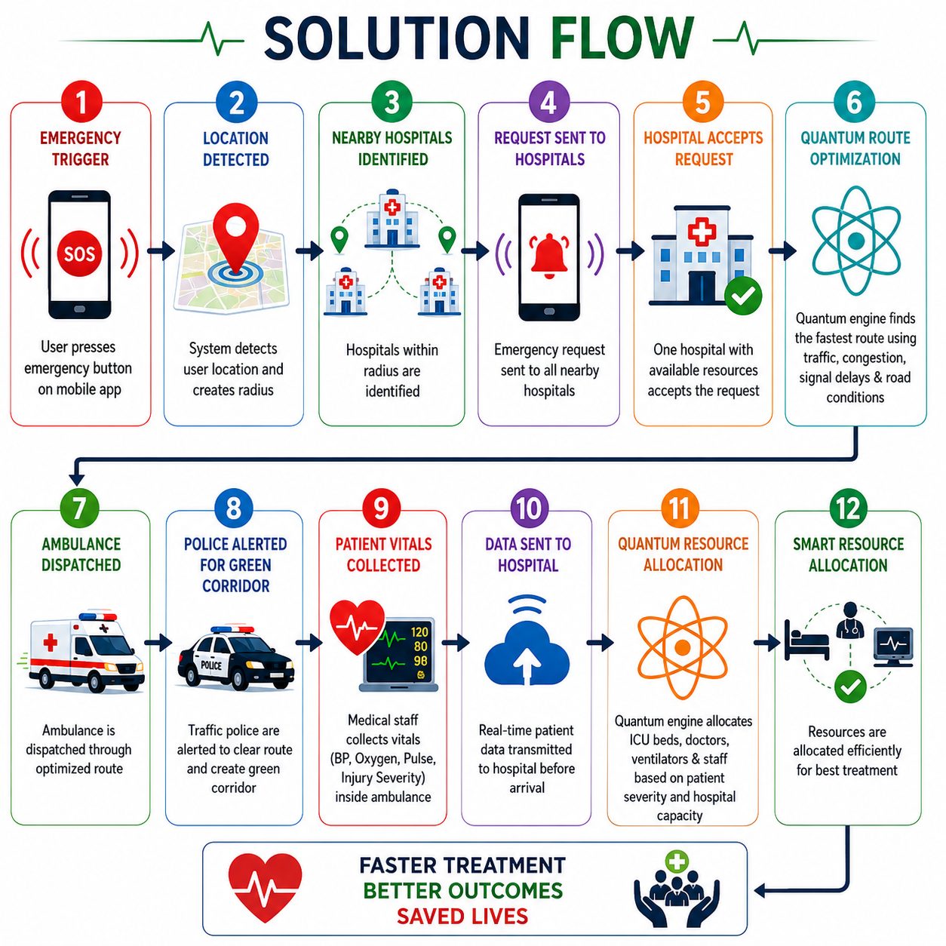
Solution
Our project is a Quantum-Assisted Smart Emergency Response and Hospital Resource Optimization System designed to improve emergency healthcare coordination and resource allocation during critical situations.

Slide 3

Features
Quantum-based route optimization analyzes traffic and congestion to generate the fastest ambulance route during emergencies.
Real-time hospital resource monitoring tracks ICU beds, doctors, ventilators, and emergency equipment availability.
Quantum-assisted resource allocation intelligently assigns medical resources based on patient severity and hospital capacity.
Live patient vitals transmission enables hospitals to prepare treatment before the patient arrives.
Traffic clearance coordination alerts police units to create green corridors for faster ambulance movement.
Dynamic emergency coordination connects hospitals, ambulances, police, and healthcare workers into one platform.

Slide 4
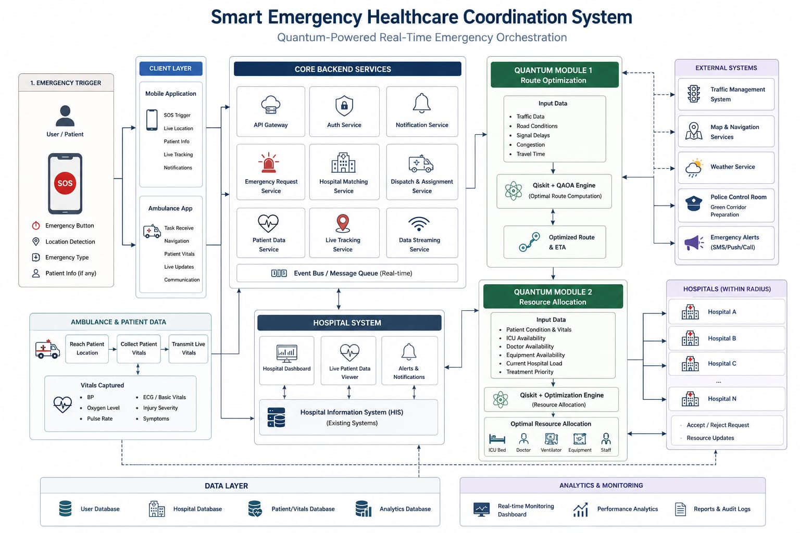
Flow Chart

Slide 5


Tech Stack
React.js is used to build an interactive and responsive frontend dashboard for emergency monitoring and coordination.
Python with Flask/FastAPI is used to handle backend processing, emergency workflows, and API integration.
Qiskit with QAOA is used for quantum-based route optimization and intelligent hospital resource allocation.
Google Maps API / Mapbox is used for live ambulance tracking, radius detection, and route visualization.
Twilio API is used for emergency calling, hospital notifications, and communication services.
Recharts and Three.js are used for real-time analytics, dashboard visualization, and quantum optimization display.

Slide 6

Impact
HOW DOES YOUR
IDEA CREATE VALUE?
“Where Quantum Intelligence Meets Emergency Healthcare to Save Lives in Real Time”
Our system creates a faster, smarter, and more efficient emergency healthcare ecosystem by improving coordination between patients, hospitals, ambulances, police, and healthcare workers. By using quantum-assisted optimization, the platform reduces ambulance response time, minimizes delays caused by traffic congestion, and enables intelligent allocation of ICU beds, doctors, ventilators, and emergency medical resources. Real-time patient vitals transmission allows hospitals to prepare treatment before patient arrival, improving emergency readiness and patient survival chances. The system also helps reduce hospital overload, optimize resource utilization, and support better healthcare accessibility during critical situations, directly contributing to SDG 3 – Good Health & Well-being.

Slide 7



Thank You
Athernex
So Much

