Slide 1
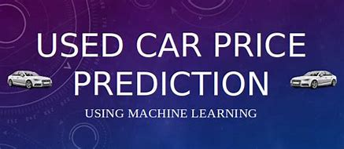

Slide 2
Introduction:
The manufacturer sets the price of new cars in the industry, with the government incurring some additional costs in the form of taxes. Due to rising new cars prices, used car sales are on the rise worldwide. However, because of the affordability of used cars , people tend more purchasing the used cars.
When purchasing and selling, its critical to understand true market value of a car. A used car price prediction system is needed to accurately estimate the cars worthiness based on features
Several method and algorithms may be required in the prediction of a used cars true market worth.

Slide 3
Model and research question
Research Questions:
To predict the price of used cars on given features.
Which manufacturer has highest resale value?
Which transmission (Automatic/Manual) have higher value in market?
Which engine fuel car are most costly?
Which colour cars are more preferred and have high value?

Slide 4
Solution:
The models that used are :
LINEAR REGRESSION
RANDOM FOREST REGRESSOR
XGBOOST REGRESSOR

Slide 5
Models are run using Python Jupyter Notebook .
Dropped the irrelevant column and Null values in dataset.
There were many categorical column in data, so we have done the one hot encoding to all object data type columns.
After running the base model , the parameters are analysed using random search method and best parameters are selected.
The performance of random search model as increased slightly than base model. MSE, Mean Absolute Error as decreased and R^2 has increased when compared to base model.

Slide 6
Data collection and cleaning:
For accurate and real time analysis, data is prepared from scratch.
Data is scrapped from Kaggle website
Data cleaning process
Duplicates
Null values
Data types
Kaggle website for data
Scrap the data
Analysis data
Extract features
Store .CSV file
Import data
Data cleaning

Slide 7
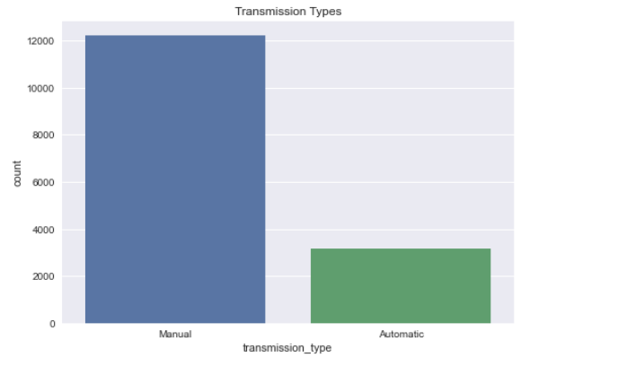
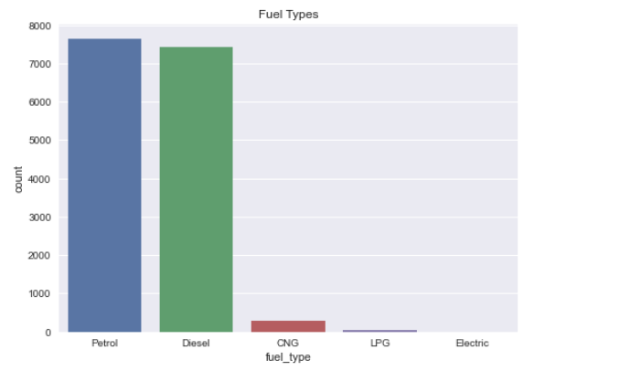
EXPLORATORY ANALYSIS FINDINGS
TRANSMISSION TYPE
FUEL TYPE

Slide 8
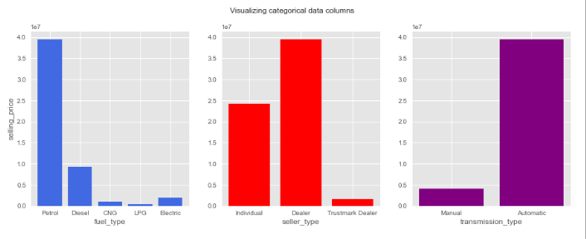
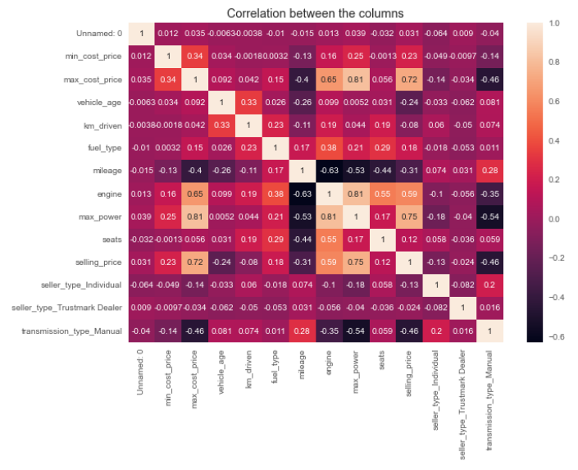
FUEL TYPE VS TRANSMISSION TPE VS SELLING PRICE
CORRELATION BETWEEN COLUMN

Slide 9
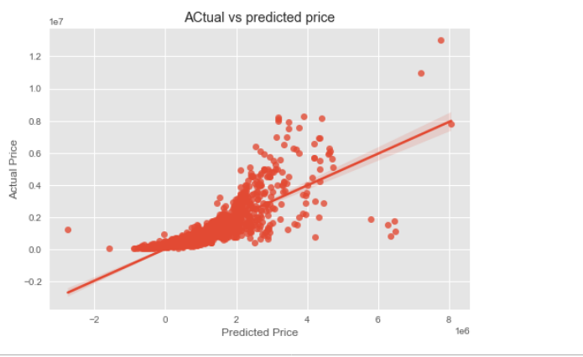
PREDICTED PRICE S VS OLD/TRUE PRICES
The plot shows a high positive relationship between the old prices and newly predicted prices

Slide 10

Linear regression model
This model we processed the data using standard scaler we got accuracy .Which shows that most of data is linear.

Slide 11

DECISION TREE
Using decision tree model we got good train score

Slide 12

Xg boost model
This model good for both train and test data the root mean squared error is less than other models.

Slide 13
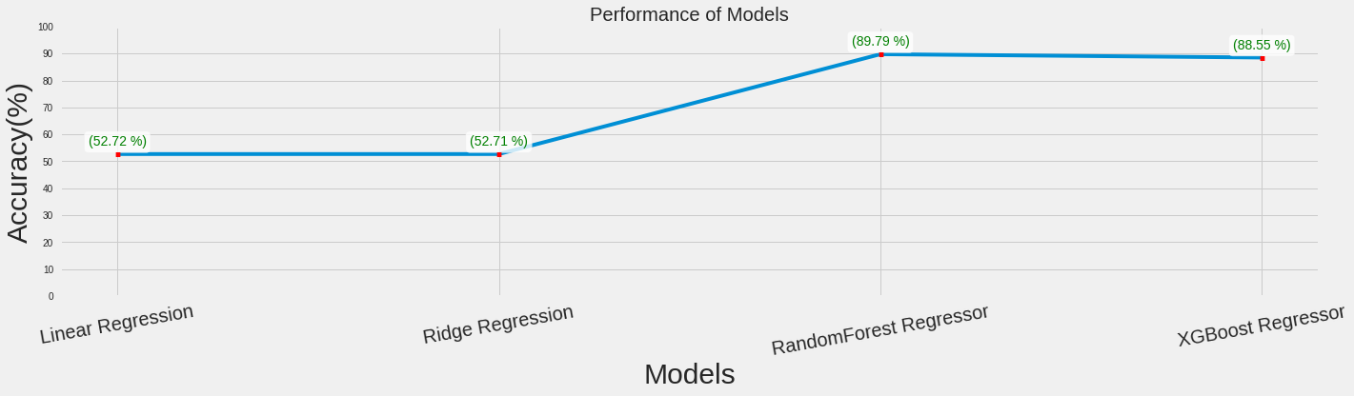
RESULT
Random forest and XG boost model have better performance compare to Other algorithms

